Slide 1
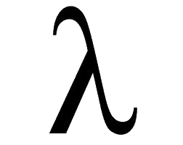
Thinking Functionally with C# The Power Of Tiny Abstractions version 0.0.5 K. Scott Allen scott@OdeToCode.comf

Slide 2
First Question
Why C#?

Slide 3
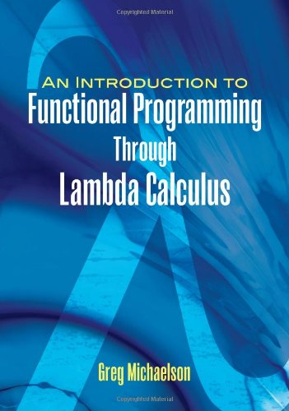
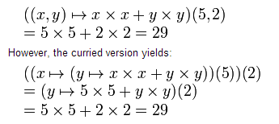
Not Using This Approach

Slide 4
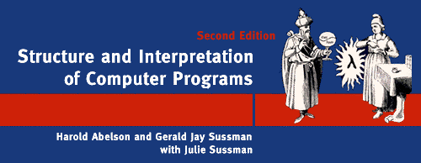
http://mitpress.mit.edu/sicp/

Slide 5
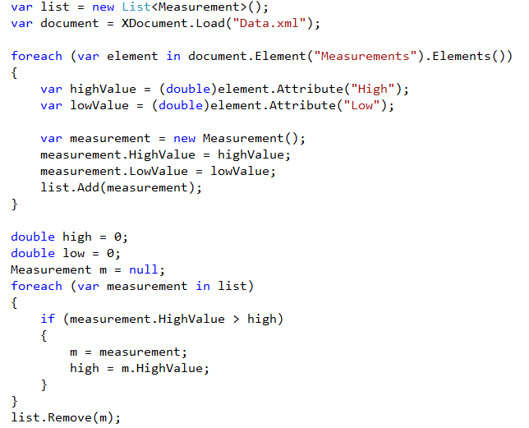


Slide 6
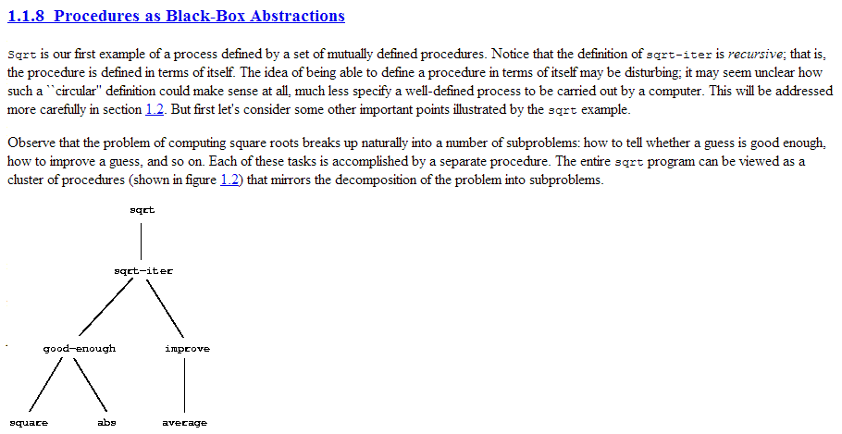


Slide 7


Thinking Functionally
Function as a first class abstraction
Name
Clear Output
Encapsulation
Clear Inputs

Slide 8
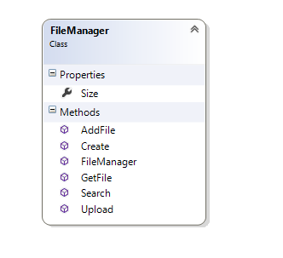

Versus Class Abstractions

Slide 9
Just Creating Objects Can Be Hard
Task t1 = new Task(/* ... */ );
Task t2 = Task.Run(/* ... */ );
Task t3 = Task.Factory.StartNew(/* ... */ );
Task t4 = Task.FromResult(/* ... */ );

Slide 10
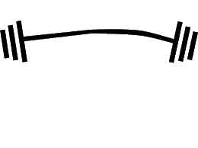
Using Abstractions
Functions
Objects
Services
Smaller
Bigger
Easy!
Easy!

Slide 11
Thinking Functionally
Assign functions to variables
Pass functions as parameters
Return functions from other functions
Func<int, int, int> square = x => x * x;
Func<int, int> add = (x,y) => x+y;
Action<int> write = x => Console.Write(x);
Predicate<int> isOdd = x => x % 2 == 1;

Slide 12
What Makes A Good Function?
… it is crucial that each procedure accomplishes an identifiable task that can be used …

Slide 13
Good Functions
Single responsibility principle
Easier composition
Deciding versus doing
var numbers = new[] {1, 2, 3, 6, 7, 8, 10};
var odd = numbers.Where(n => n % 2 == 1);
Knows how to filter
Knows what to filter

Slide 14
Functional Advantages
Small, reusable abstractions
Lazy
Immutability => parallelism
Reusable
private static IEnumerable<T> Filter<T>(this IEnumerable<T> things,
Predicate<T> predicate)
{
foreach (var thing in things)
{
if (predicate(thing)) yield return number;
}
}
Lazy
var numbers = new[] {1.0, 2, 3, 6, 7, 8, 10};
var evenNumbers = numbers.AsParallel().Filter(n => n%2 == 0);
Parallel

Slide 15
Functions As Data
public bool IsValidMovie(Movie movie)
{
if(string.IsNullOrEmpty(movie.Title))
{
return false;
}
if(movie.Length > 300 || movie.Length < 60)
{
return false;
}
if(movie.ReleaseDate.Value.Year < 1920)
{
return false;
}
return true;
}

Slide 16
Functions as Parameters
Abstract away what should happen around method invocation
Caching, retries, logging, timing
static void WithRetry(this Action action)
{
int retryCount = 0;
bool succesful = false;
do
{
try
{
action();
succesful = true;
}
catch (NetworkException e)
{
retryCount++;
}
} while (retryCount < 3 && !succesful);
}
Action fetchMovies = () =>
{
// ... call web serivce
};
fetchMovies.WithRetry();

Slide 17
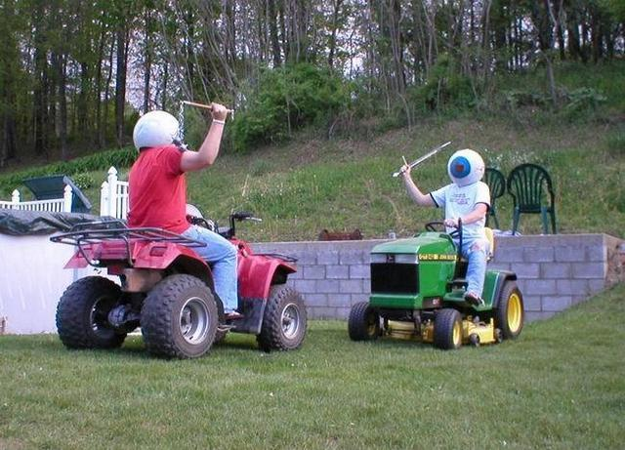
Is This Normal

Slide 18

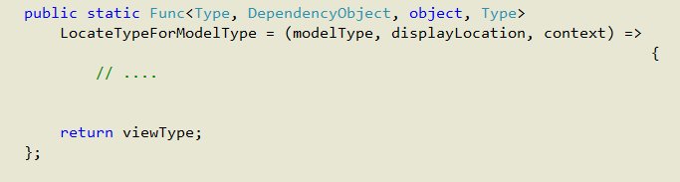
Func Is The New Interface

Slide 19


Returning Functions
Can add clarity and readability

Slide 20
Return functions
Pass functions, return functions, make new functions
public Action<User, User> MakeAuthCheckFunction(Action<User> action)
{
return (currentUser, userToActOn) =>
{
if (currentUser == userToActOn || currentUser.IsAdmin)
{
action(userToActOn);
}
else
{
// .. throw
}
};
}
if (currentUser == userToDelete || currentUser.IsAdmin)
{
Delete(userToDelete);
}
else
{
// ...
}
if (currentUser == userToActivate || currentUser.IsAdmin)
{
Activate(userToActivate);
}
else
{
// ...
}
Action<User, User> safeDelete = MakeAuthCheckFunction(Delete);
Action<User, User> safeActivate = MakeAuthCheckFunction(Activate);
safeDelete(currentUser, userToDelete);

Slide 21
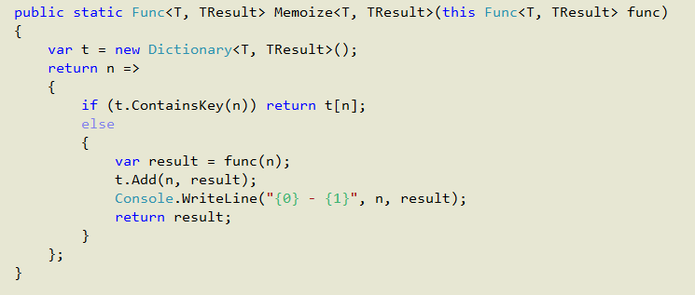
Memoize

Slide 22
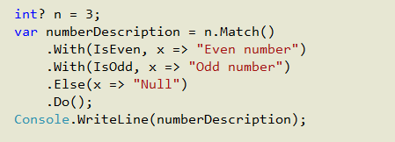
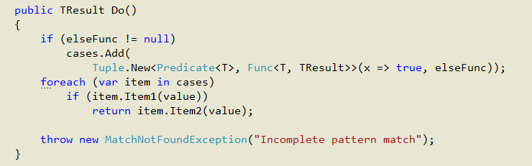
Pattern Matching
http://archive.msdn.microsoft.com/FunctionalCSharp

Slide 23
Beyond Queries…

Slide 24
Summary
Functions are abstractions, too!
Focused, reusable
Extension methods for better APIs
Add a function anywhere
Functional thinking can lead to elegant solutions

