Slide 1
HTTP and the Web API
Building interoperable and scalable services

Slide 2

Traditional Web Services
SOAP

Slide 3



HTTP Web Services
HTTP

Slide 4
WebAPI Framework
Extensible framework for building and consuming HTTP services
Works with or without ASP.NET
Embraces HTTP
Enables REST

Slide 5
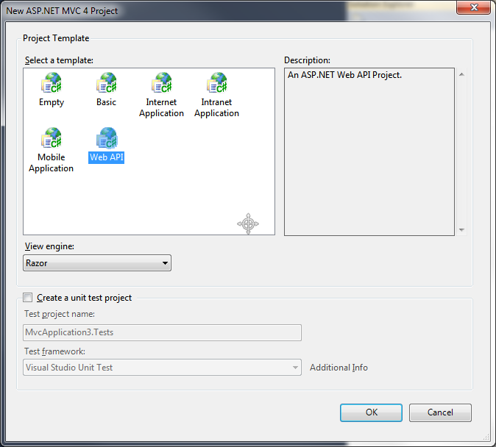
Getting Started
Create a WebAPI project
Create an ASP.NET project
Create any project!
install-package Microsoft.AspNet.WebApi.SelfHost

Slide 6
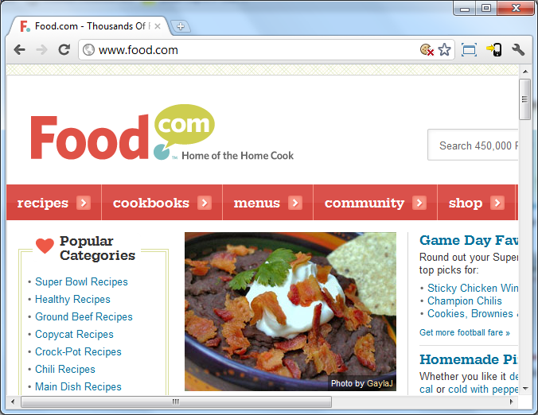
What’s So Great About HTTP?
1. Resources identified by URIs

Slide 7
Resource Representation
MIME Types
Type/SubType | Description
text/html | HTML
text/xml | XML
image/png | PNG image
application/json | JSON
application/atom+xml | ATOM
video/mp4 | MP4 Video
text/plain | Plain text

Slide 8
What’s So Great About HTTP?
2. Messages
GET /odetocode.jpg HTTP/1.1
Host: odetocode.com
HTTP/1.1 200 OK
Cache-Control: private
Content-Type: text/html charset=utf-8
Content-Length:17151
<html>
…
</html>
GET /odetocode.jpg HTTP/1.1
Host: odetocode.com
Accept-Language: fr-FR
Date: Fri, 9 Aug 2002 21:12 GMT

Slide 9
Status Codes
Code | Meaning
100-199 | Informational
200-299 | Success
300-399 | Redirection
400-499 | Client error
500-599 | Server error

Slide 10
HTTP Request Methods
Method | Description | Safe | Idempotent
GET | Retrieve a resource | Yes | Yes
HEAD | Metainformation only | Yes | Yes
POST | Create a resource | No | No
PUT | Update a resource | No | Yes
DELETE | Remove a resource | No | Yes
OPTIONS | Determine requirements | Yes | Yes

Slide 11


What’s So Great About HTTP?
3. The Stack
Application
HTTP
Application
Transport
TCP
Transport
Network
IP
Network
Data Link
Ethernet
Data Link
Media

Slide 12



What’s So Great About HTTP?
4. Intermediaries
Reverse proxies
Forward proxies
Caching
Logging
Compression
Internet
Forward Proxy
Internet
Reverse Proxy

Slide 13
What’s So Great About HTTP?
5. The abstraction
Ruby
C#

Slide 14
WebAPI Embraces HTTP
Uses content negotiation
Routes based on HTTP methods
API to work with headers and status codes

Slide 15
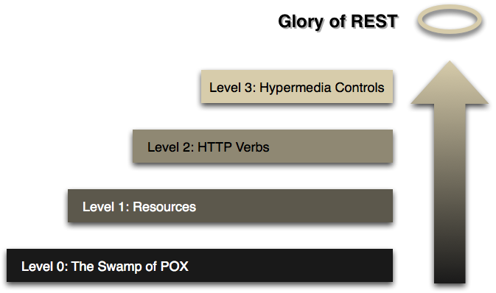
REST
Representational State Transfer
An architectural style, not a protocol
URIs
Uniform interfaces
Links
Resource representations
Stateless (HATEOAS)
http://martinfowler.com/articles/richardsonMaturityModel.html

Slide 16
WebAPI versus WCF
WCF abstracts away HTTP
WCF supports SOAP and WS-*
WSDL versus HATEOAS

Slide 17
Summary
WebAPI embraces HTTP
Scalable, interoperable, flexible
Includes client and self hosting capabilities

