Slide 1
WebAPI Hosting
Hosting HTTP Anywhere & Everywhere

Slide 2
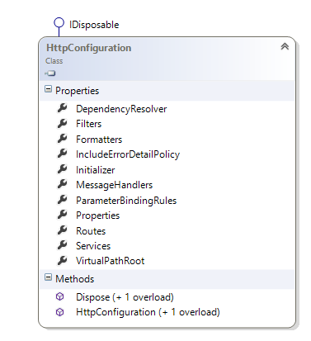
HttpConfiguration
Configuration for all environments
In ASP.NET, access via GlobalConfiguration.Configuration
For self hosting, create your own

Slide 3
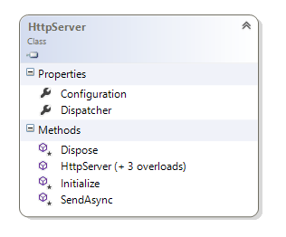
Self Hosting
NuGet – Microsoft.AspNet.WebApi.SelfHost
Create an HttpServer in any process
Typically HttpSelfHostServer
Console, Windows service, WPF
OpenAsync starts the server
Create an HttpConfiguration object
Typically HttpSelfHostConfiguration

Slide 4
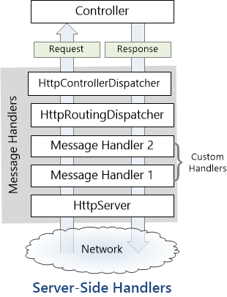
HttpMessageHandler
Lynchpin of the WebAPI (both client and server)
HttpServer is an HttpMessageHandler
Controller dispatcher is an HttpMessageHandler
HttpClient uses an HttpMessageHandler
http://www.asp.net/web-api/overview/working-with-http/http-message-handlers

Slide 5
Handling Requests
Use your own HttpMessageHandler
Use a built-in HttpMessageHandler
HttpControllerDispatcher (requires route definitions)

Slide 6
ASP.NET Hosting
HttpServer and HttpConfiguration created internally
HttpConfiguration.Global exposes configuration

Slide 7
Security
ASP.NET provides forms (cookie) based security
IIS provides SSL and client certificates
IIS provides basic and Windows authentication

Slide 8
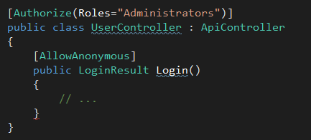
Attributes
AllowAnonymousAttribute
Explicit anonymous access to controller or action
AuthorizeAttribute
Restrict controller or action to specific users or roles
Allows call through or returns a 401 status code

Slide 9
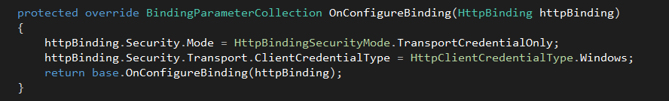
Self Hosting Security
Subclass HttpSelfHostConfiguration
Override OnConfigureBinding
Requires System.ServiceModel

Slide 10
Summary
HttpServer and HttpMessageHandlers are the key to hosting
Not much “out of the box” for security

