Slide 1
The WebAPI Client
A new client for old standards

Slide 2
The New HttpClient
HttpWebRequest (.NET 1.0)
WebClient (.NET 2.0)
HttpClient (WebAPI / .NET 4.0)
Available via NuGet

Slide 3
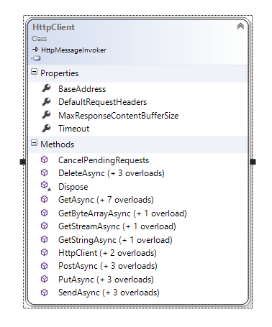
HttpClient Benefits
Embraces HTTP!
Same programming model as server
HttpRequestMessage
HttpResponseMessage
100% async

Slide 4
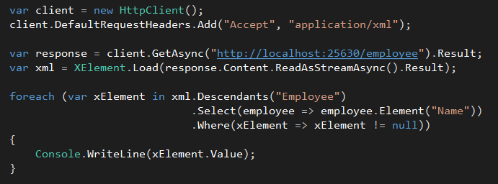
Using HttpClient
Blocking example with XML

Slide 5

EnsureSuccessStatusCode
Throws if the response is not in the 200-299 range
Can also check IsSuccessStatusCode

Slide 6
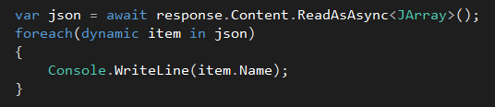
Working with JSON
JSON.NET included as part of client NuGet package

Slide 7
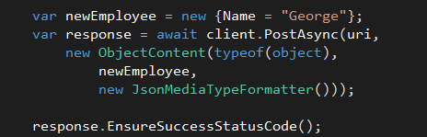
HttpContent
Derived types send data to server
ByteArrayContent
MultipartContent
MultipartFormDataContent
StreamContent
StringContent
ObjectContent / ObjectContent<T>

Slide 8

Client Headers
DefaultRequestHeaders define headers for every request
HttpContent defined per-request headers
No User-Agent header by default

Slide 9
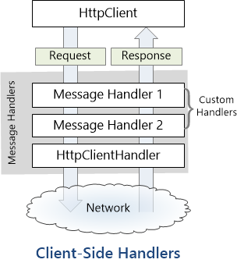
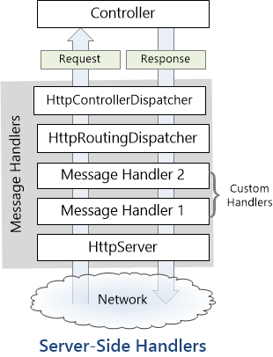
HttpMessageHandlers Redux
http://www.asp.net/web-api/overview/web-api-clients/httpclient-message-handlers
http://www.asp.net/web-api/overview/working-with-http/http-message-handlers

Slide 10
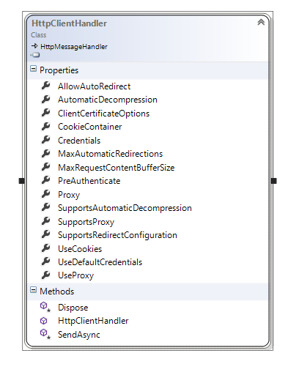
HttpClientHandler
Message processor for HttpClient
Common to derive from DelegatingHandler

Slide 11
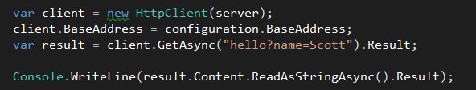
WebAPI Stack With No HTTP
Pass HttpServer to HttpClient
Useful for unit testing, in-memory message passing

Slide 12
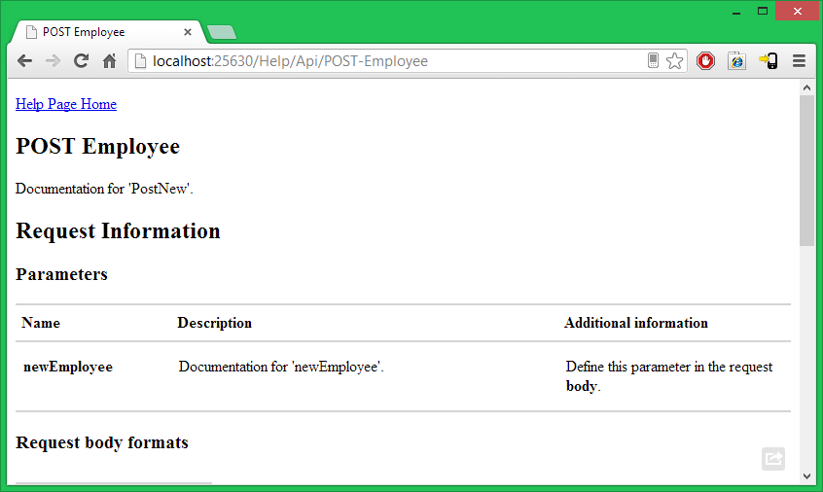
Help!
NuGet package Microsoft.AspNet.WebApi.HelpPage
Requires ASP.NET MVC

Slide 13
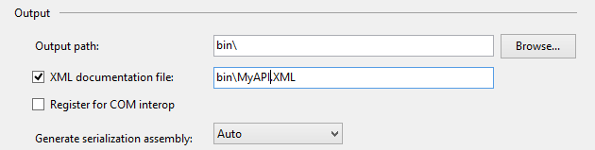

Help! XmlDocumentation
Can augment help pages with XML documentation

Slide 14
Summary
HttpClient embraces HTTP
Extensible
Async all the way down

