Slide 1
WebAPI Extensibility
Layers and

Slide 2
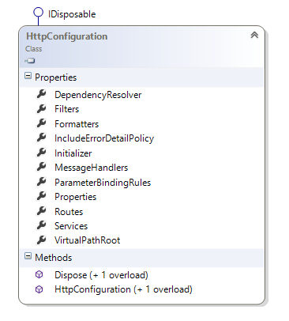
HttpConfiguration
Extensibility done mostly through configuration

Slide 3
IncludeErrorDetailPolicy
Local
LocalOnly
Always
Default
In ASP.NET, use customErrors

Slide 4
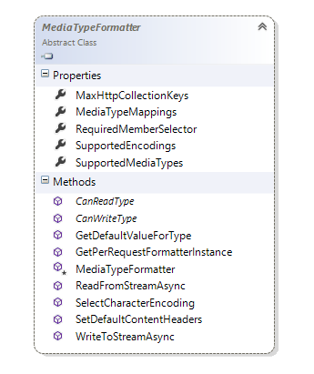
Formatters
Derive from MediaTypeFormatter
Serialization and deserialization
Matched by Content-Type

Slide 5
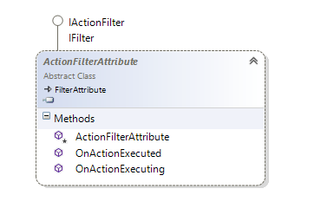
Filters
Similar to MVC filters
Operate in the controller and model binding space

Slide 6
Message Handlers
Everything is based on HttpMessageHandler
Plug your own message handler into the stack
Typically use DelegatingHandler

Slide 7
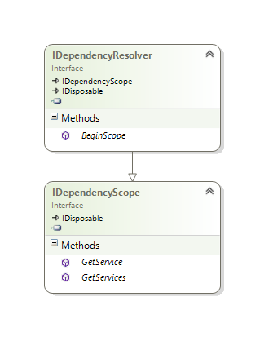
DependencyResolver
Used as a service locator by the runtime

Slide 8
WebAPI Services
IHttpControllerSelector
IHttpControllerTypeSelector
IAssembliesResolver
IHttpControllerActivator
IHttpActionSelector
IHttpActionInvoker
IContentNegotiator

Slide 9
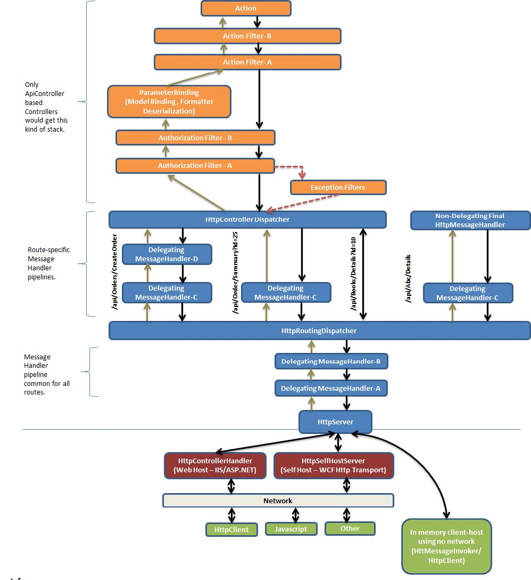
The Pipeline
http://blogs.msdn.com/b/kiranchalla/archive/2012/05/06/asp-net-mvc4-web-api-stack-diagram-currently-in-development.aspx

Slide 10
Summary
Formatters
Message handlers
Filters
Dependency resolver

