Slide 1
LINQ – Beyond Queries
LINQ for Better Business Logic

Slide 2
Repurposing LINQ Features
Extension methods
For better APIs
Expression trees
For static reflection
Funcs and Actions
For functional, declarative programming
Demos
Functional validation
Increasingly complex validations
Building a LINQ powered rules engine

Slide 3
Example Scenario
Scheduling tasks for periodic execution
public class ScheduledTask {
public ScheduledTask(ITask task,
TimeSpan interval,
TimeSpan expiration) {
Task = task;
Interval = interval;
Expiration = expiration;
}
public ITask Task { get; protected set; }
public TimeSpan Interval { get; protected set; }
public TimeSpan Expiration { get; protected set; }
...
}
?
var task = new ScheduledTask(
new AccountSynchronizationTask(),
new TimeSpan(0, 0, 2, 0),
new TimeSpan(2, 0, 0, 0));

Slide 4
Goals
Readability
Easier to maintain
Essence over ceremony
Remove language clutter
var task = new ScheduledTask(
new AccountSynchronizationTask(),
new TimeSpan(0, 0, 2, 0),
new TimeSpan(2, 0, 0, 0));

Slide 5
Named parameters
Only a small step forward
Particularly useful when combined with optional parameters
Gives reader a clue when using constants
var task = new ScheduledTask(
Tasks.AccountSynchronization,
runEvery: new TimeSpan(0, 0, 2, 0),
expiresIn: new TimeSpan(2, 0, 0, 0));

Slide 6
Extension Methods
Extend types!
Even sealed types, generic types, and interfaces
public static class StringExtensions
{
public static int ToInt32(this string value)
{
return Int32.Parse(value);
}
}
int value = "32".ToInt32();

Slide 7
Fluent APIs
A readable API
Often uses method chaining
var then = 2.Minutes().Ago();
public static TimeSpan Minutes(this int value)
{
return new TimeSpan(0, 0, value, 0, 0);
}
public static DateTime Ago(this TimeSpan value)
{
return DateTime.Now - value;
}

Slide 8
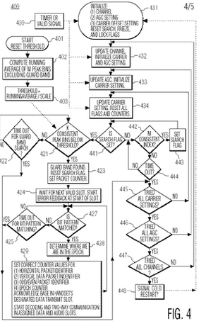
Validation Example
Dealing with requirements in the form of complex flowcharts
Model them with procedural if/else code?
public bool IsValid(Movie movie)
{
if(string.IsNullOrEmpty(movie.Title))
{
return false;
}
if(movie.Length < 60 || movie.Length > 400)
{
return false;
}
if(movie.ReleaseDate.Value.Year < 1903)
{
return false;
}
return true;
}

Slide 9
Functional Validation
Using lambda expressions for a declarative approach
Keep the code in a data structure for passive evaluation
public bool IsValid(Movie movie)
{
Func<Movie, bool>[] rules =
{
m => string.IsNullOrEmpty(m.Title),
m => m.Length < 60 || m.Length > 400,
m => m.ReleaseDate.Value.Year < 1903
};
return rules.All(rule => rule(movie) == false);
}

Slide 10
A More Complex Scenario
Instead of validation, we’ll perform a rules evaluation
Required to compute more than just a binary result
Should scale up to manage hundreds of rules
Should be able to complete evaluation even with incomplete data
Required to provide information about what properties are inspected

Slide 11
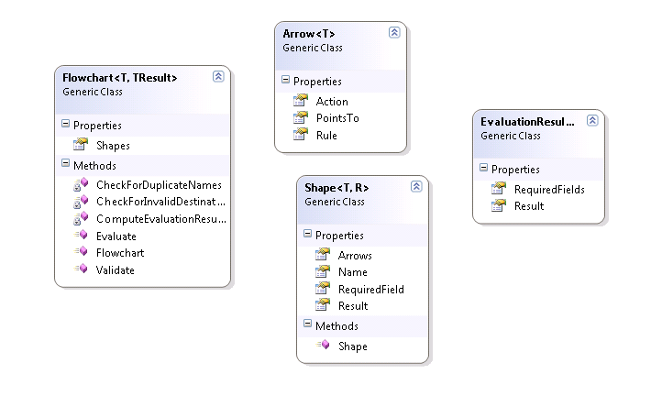
Domain Model
Models the business flowcharts
Shape, arrows, rules, results
Shape
Rule
Rule
Shape
Shape

Slide 12
Creating the Flowchart
Tedious!
var chart = new MovieFlowchart();
chart.Shapes.Add(
new Shape<Movie, MovieResult>()
{
Name = "CheckTitle",
Arrows =
{
new Arrow<Movie>
{
PointsTo = "CheckLength",
Rule = m => !String.IsNullOrEmpty(m.Title)
}
},
RequiredField = new PropertySpecifier<Movie>(m=>m.Title)
}
// ... and so on
);

Slide 13
Building the Fluent API / Internal DSL
Heavy use of extension methods
public static Flowchart<T, R> AddShape<T, R>(
this Flowchart<T, R> chart, string shapeName)
{
var shape = new Shape<T, R> { Name = shapeName };
chart.Shapes.Add(shape);
return chart;
}
public static Flowchart<T, R> YieldsResult<T, R>(
this Flowchart<T, R> chart, R result)
{
chart.LastShape().Result = result;
return chart;
}
chart.AddShape("CheckTitle")
.Requires(m => m.Title)
.WithArrowPointingTo("CheckLength").AndRule(TitleNotNullOrEmpty)
.AddShape("CheckLength")
.Requires(m => m.Length)
.WithArrowPointingTo("BadMovie").AndRule(LengthIsTooLong)
.WithArrowPointingTo("GoodMovie").AndRule(LengthIsJustRight)
.WithArrowPointingTo("CheckReleaseDate").AndRule(LengthExists)
.AddShape("CheckReleaseDate")
.Requires(m => m.ReleaseDate)
.WithArrowPointingTo("BadMovie").AndRule(TooOld)
.WithArrowPointingTo("GoodMovie").AndRule(HasReleaseDate)
.AddShape("BadMovie").YieldsResult(MovieResult.BadMovie)
.AddShape("GoodMovie").YieldsResult(MovieResult.GoodMovie);

Slide 14
Taking Advantage of Expression<T>
Expression<T> can yield rich meta-data about a piece of code
“Static” reflection
public PropertySpecifier(Expression<Func<T, object>> expression)
{
if(expression.Body is MemberExpression)
{
var me = expression.Body as MemberExpression;
_propertyName = me.Member.Name;
}
else if(expression.Body is UnaryExpression)
{
var ue = expression.Body as UnaryExpression;
var me = ue.Operand as MemberExpression;
_propertyName = me.Member.Name;
}
}

Slide 15
Summary
LINQ features – more than just data access
Extension methods provide a shim for alternate APIs
Use lambdas and Func<> for expressive, functional programming
Leverage Expression<T> for metadata about code

