Slide 1

Services & Dependency Injection
provide(service)

Slide 2
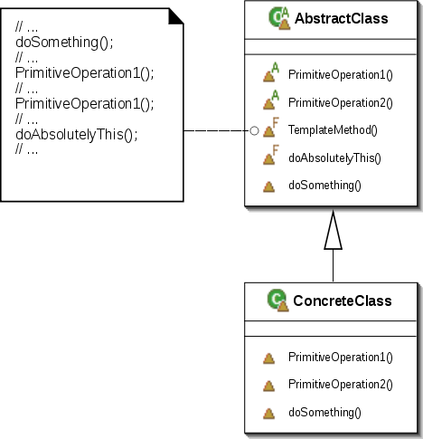
Inversion of Control
Increase modularity and extensibility
Factory pattern
Template method pattern
Strategy pattern
Service locator pattern
Dependency injection*
"Template Method UML" by Giacomo Ritucci

Slide 3
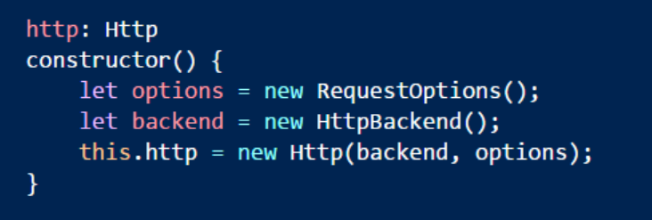
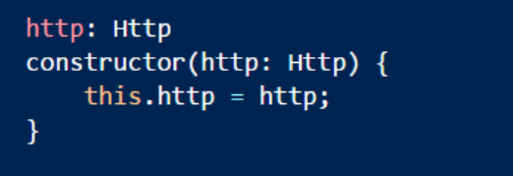
Dependency Injection
Object asks for dependencies instead of creating them

Slide 4
DI and IoC
Dependency injection enabled by IoC container
Container knows how to build and assemble objects
Container knows how to analyze dependencies
Container
Http
RequestOptions
Component
HttpBackend

Slide 5
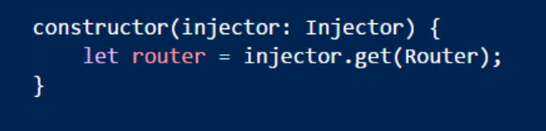
The Angular Injector
The injector is available after bootstrapping
Many core services come pre-configured
Need to register custom services

Slide 6
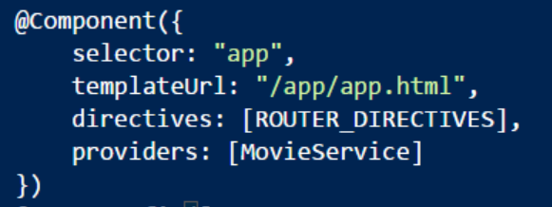
Providers
The injector requires a provider for every service
Can use built-in providers that rely on class definitions
Providers registered at the component level
Components can register unique providers for children
Injector uses provider only once
Single instance

Slide 7
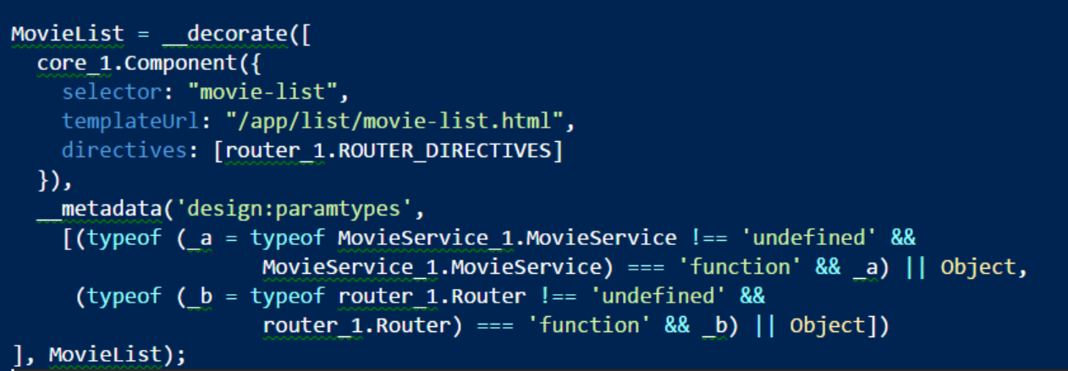
Metadata
Injector relies on metadata to analyze dependencies

Slide 8
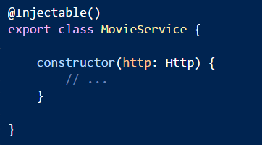
Decorators
Only decorators can add the metadata required for injection
@Component
@Injectable
Any other decorator you might need on a service

Slide 9
Providers Revisited
Different techniques for registering providers
useClass
useFactory
useValue

Slide 10

Factories
Take control of the service creation
Can specify dependencies with the “deps” property

Slide 11
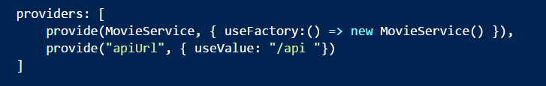
Values
Useful for configuration values
Paths
Magic numbers
Also can register existing instance of a service

Slide 12
Hierarchy
Injectors follow the component hierarchy
Providers create new instances for current and child components
Child injectors search up the tree
App
LogService
MovieList
MovieService
Detail
Review
Comment

Slide 13
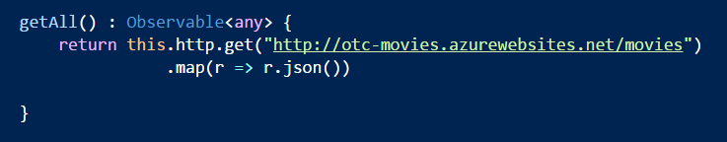

Http
Makes HTTP requests
get, put, post, delete
Returns an Observable from RxJs

Slide 14
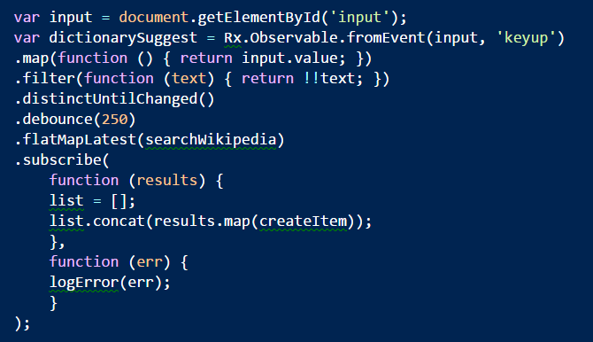

RxJs
Compose events and async data into queryable sequences
Many operators available operators
http://reactivex.io/documentation/operators.html

Slide 15
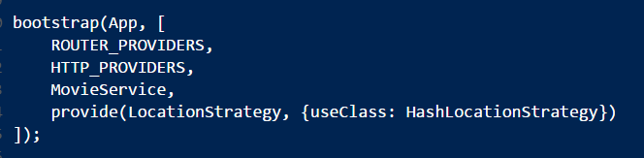
Remember To Provide HTTP
Can do this at the root level
Sets up XHRBackend

Slide 16
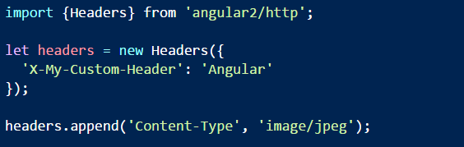
Working with Headers
Instantiate the Headers class

Slide 17
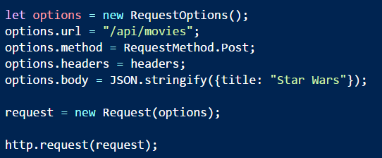
Low Level Work
Use Request and Request options

Slide 18
Summary
Injector -> Provider -> Service
App
LogService
MovieList
MovieService
Detail
Review
Comment

