Slide 1

An Introduction To Angular 2

Slide 2

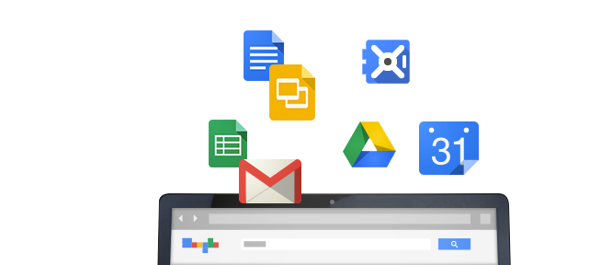
History
Started in 2009 @ Google
Built from experience with large web applications

Slide 3
Concepts and Goals
Separation
of
Concerns
Testability
Extensibility
Forward
Looking

Slide 4


Tools & Languages

Slide 5
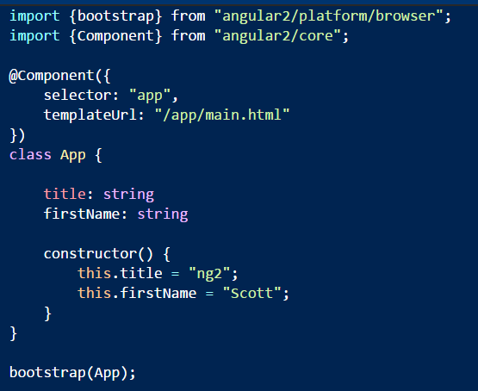
Components
Components define a custom HTML element
Data + behavior + template

Slide 6
Getting Started : Packages
angular 2 – the framework
typescript – the language
systemjs - the module loader
npm init –y
npm install angular2 typescript rxjs
systemjs reflect-metadata --save

Slide 7
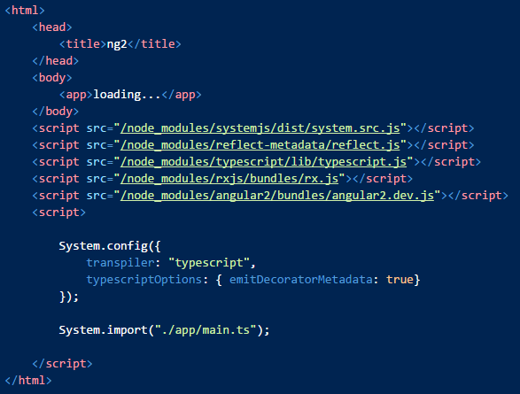
Getting Started: Shell Page

Slide 8
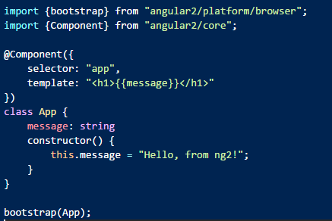
Getting Started: First Script

Slide 9

Other Starting Points
Yeoman generators
generator-angular2
generator-angular2-gulp-webpack
Seed projects
angular2-seed (npm)
ng2-play (github:pkozlowski-opensource)
angular-starter (github:eladrk)

Slide 10
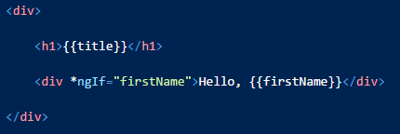
Directives
Directives extend HTML
Add behavior or change the appearance of the DOM
Angular compiles markup to process directives
You can build your own directives
In fact, this is encouraged

Slide 11
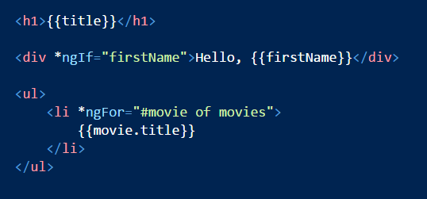
Templates
Responsible for presenting the model
Using directives and {{ interpolation }}

Slide 12
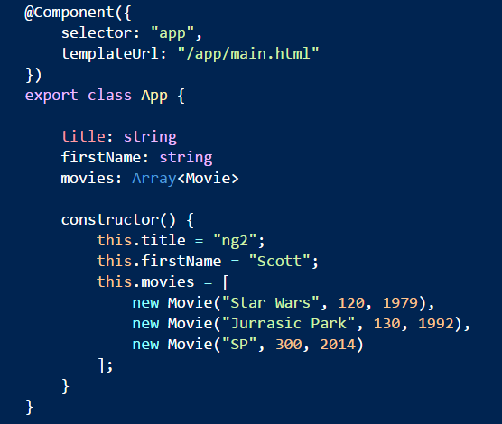
Models
Plain Old JavaScript (2015)
Component fields exposed for binding

Slide 13
Essence
<template>
Components
No direct DOM manipulation
Templates
No serious model manipulation
properties
events
@Component

Slide 14
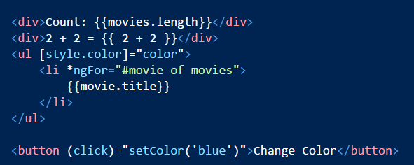
Template Syntax
Display text using {{expressions}}
Set properties using [expressions]
Handle events using (expressions)
[] () deal with properties, not attributes
Expressions limit side effects and global scope

Slide 15
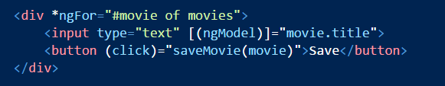
Inputs
Two way data binding and change notification

Slide 16
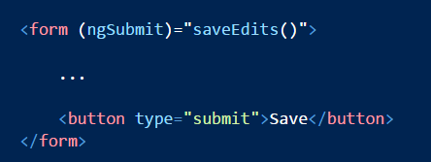
Forms
Support for validation and dirty flags
Use ngModel in combination with:
ngSubmit
ngControl
ngForm

Slide 17
Angular versus Unobtrusive JavaScript
Everyone is using JavaScript
Angular behaves the same across browsers
Expressions not evaluated in global scope

Slide 18
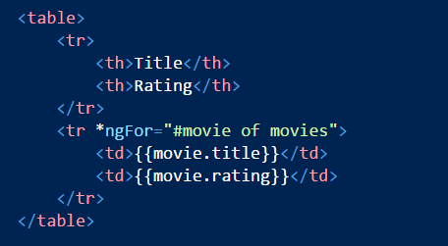
Lists and Tables
Use ngFor
Semantics similar to the new for-of loop in ES2015
Works with any iterable
Updates the screen if collection changes

Slide 19
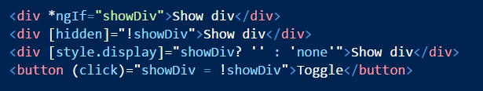
Hiding and Showing
Several approaches
Use *ngIf
Bind to the hidden property
Bind to the style.display property

Slide 20

Styles
Use the ngClass directive
Adds class names for truthy values

Slide 21
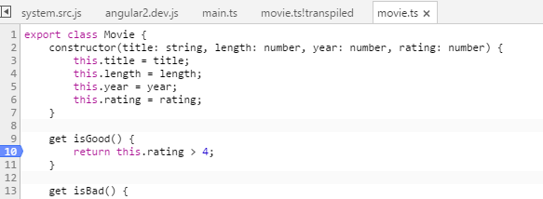
Debugging
Source maps let you step through TypeScript

Slide 22
Summary
Angular2 is an application framework
Similar to an MVVM design
Extensible, modular, testable

