Slide 1

The Dragons in JavaScript K. Scott Allen @OdeToCode
Notes:
Hi everyone, my name is Scott, and this talk is about the new dragons of JavaScript. This is not a negative talk where I bash JavaScript features. Instead, I’m trying to express my feelings as I’ve worked with the new language features for over a year now.

Slide 2

Notes:
… were drawn on the unexplored and uncharted areas of a map. When you truly embrace the es2015 features of JavaScript you’ll often

Slide 3
Arrow
Functions
Notes:
So to get started, and give you a feel for what this talk is all about, let’s start with a simple topic. Arrow functions. How hard can they be, right? They look just like lambda expressions in C# and many of us have been using and abusing those for years.

Slide 4
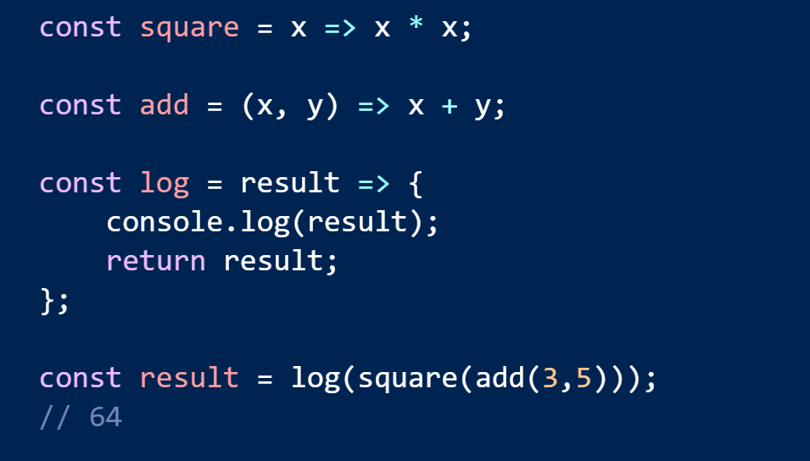
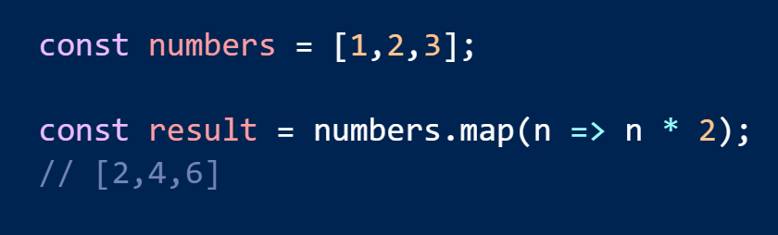
Arrow Syntax

Slide 5
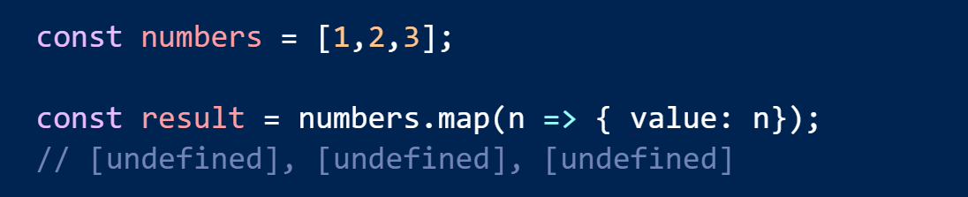
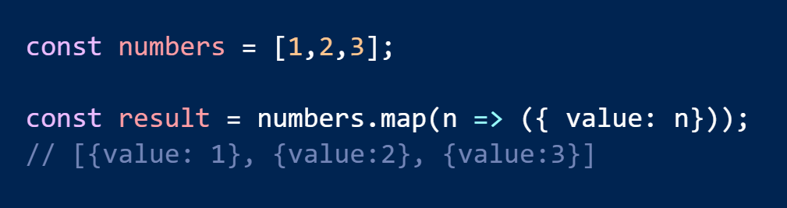
Return An Object Literal

Slide 6
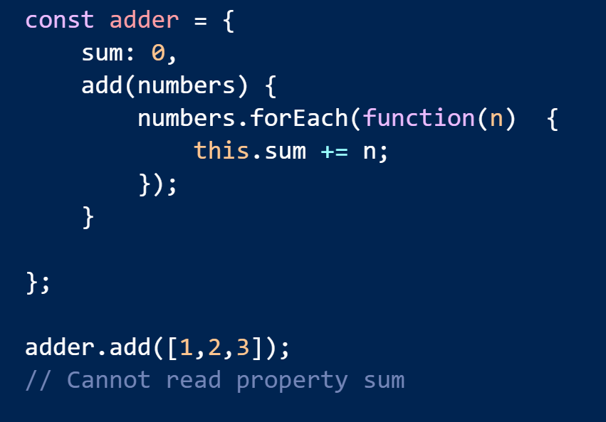
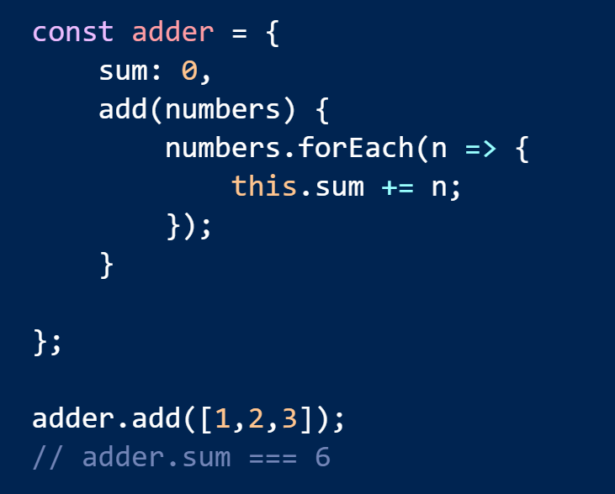
Lexical this Reference

Slide 7
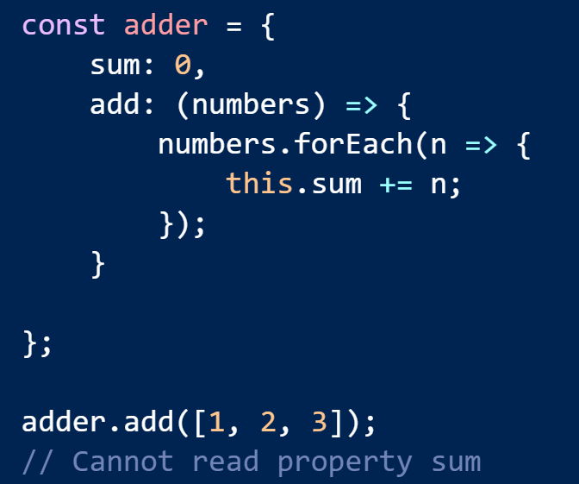
Careful With Literals

Slide 8
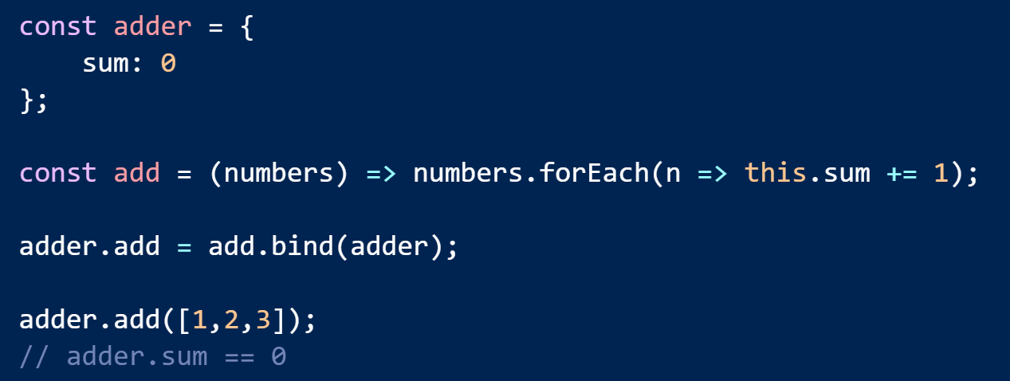
Cannot re-bind with bind, apply, or call

Slide 9
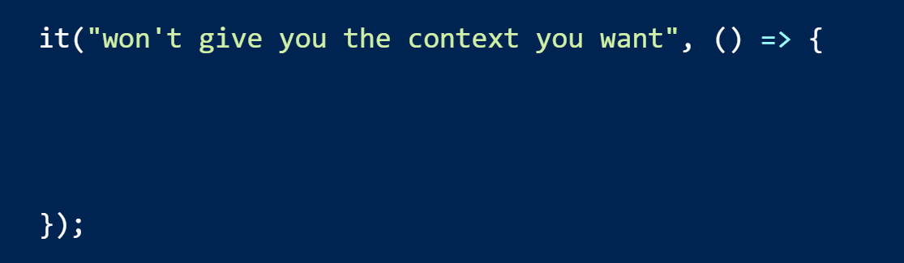
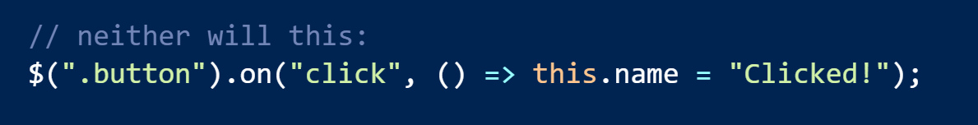
Careful with Legacy Libraries

Slide 10
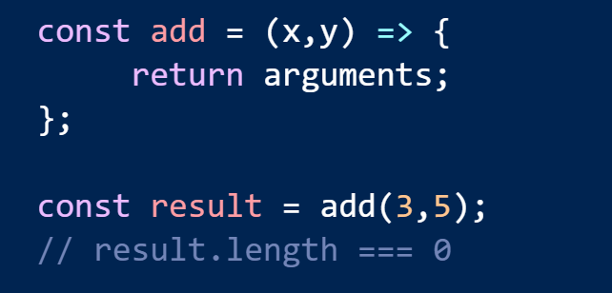
Also, no implicit arguments

Slide 11
Arrow
Functions
Template
Literals
Notes:
So to get started, and give you a feel for what this talk is all about, let’s start with a simple topic. Arrow functions. How hard can they be, right? They look just like lambda expressions in C# and many of us have been using and abusing those for years.

Slide 12
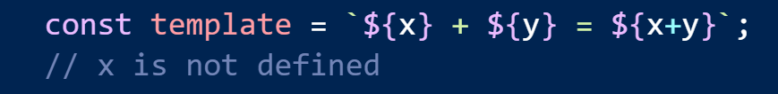
They Aren’t Reusable …

Slide 13
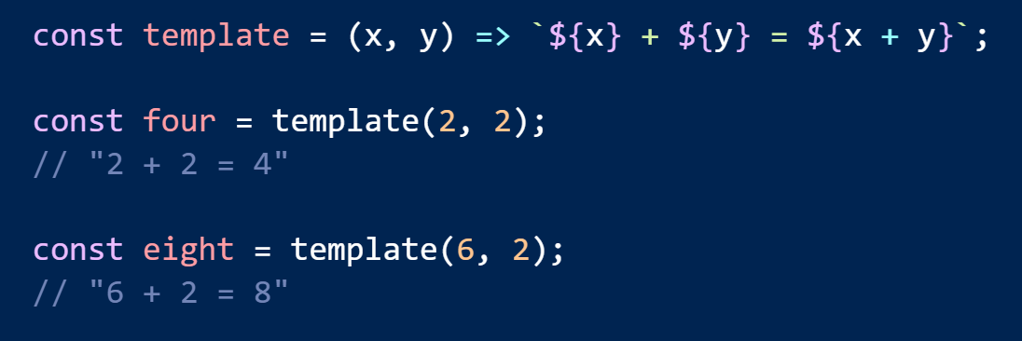
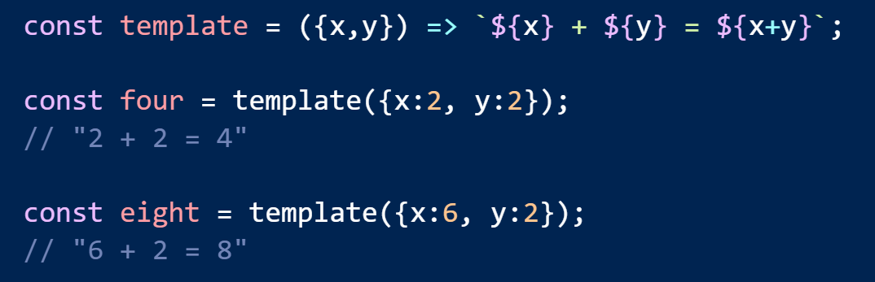
… Unless You Wrap Them

Slide 14
Arrow
Functions
Template
Literals
Crazy Syntax
Notes:
So to get started, and give you a feel for what this talk is all about, let’s start with a simple topic. Arrow functions. How hard can they be, right? They look just like lambda expressions in C# and many of us have been using and abusing those for years.

Slide 15
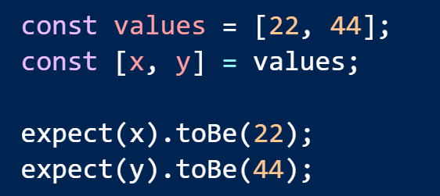
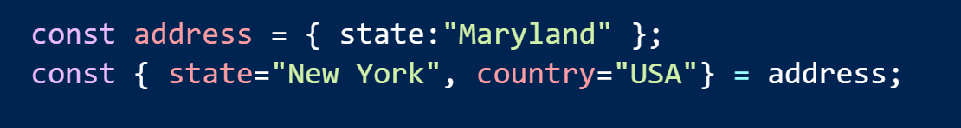
Destructuring

Slide 16
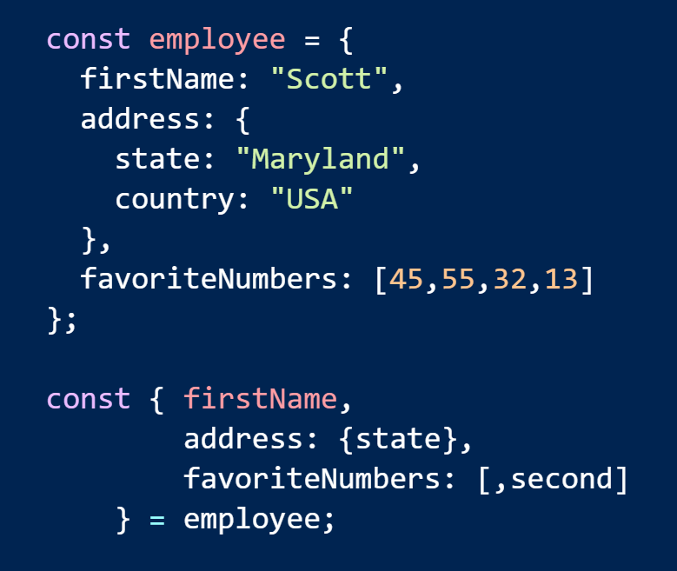
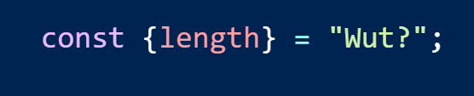
Readable?

Slide 17
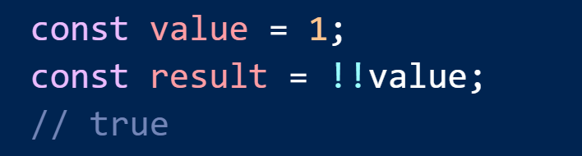
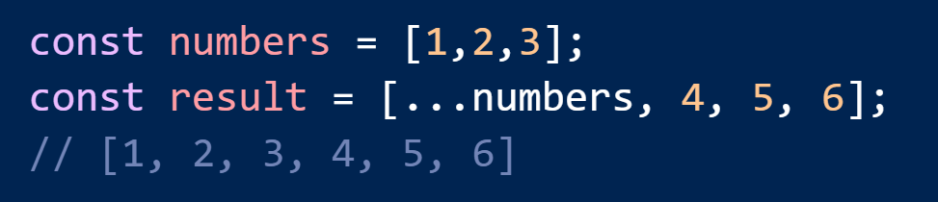
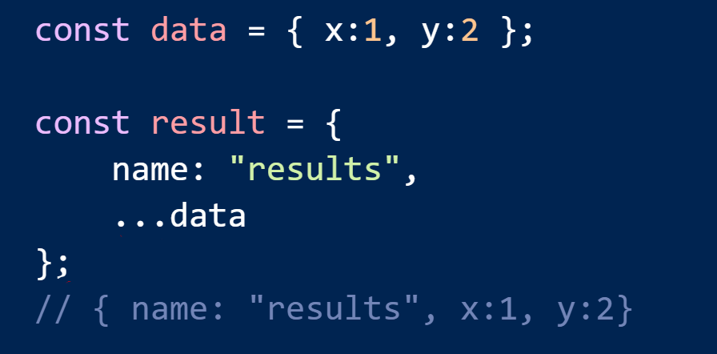
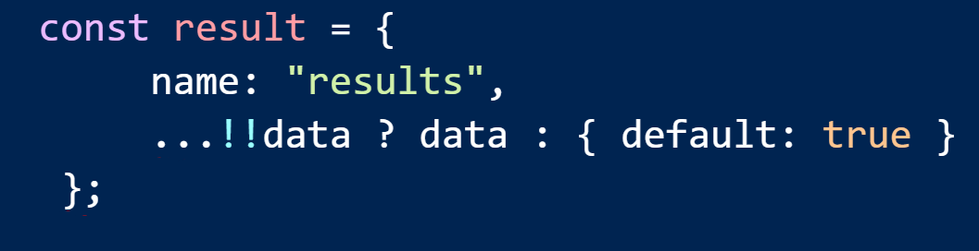
Crazy Operators

Slide 18
const
let
Arrow
Functions
Template
Literals
Crazy Syntax
Notes:
So to get started, and give you a feel for what this talk is all about, let’s start with a simple topic. Arrow functions. How hard can they be, right? They look just like lambda expressions in C# and many of us have been using and abusing those for years.

Slide 19
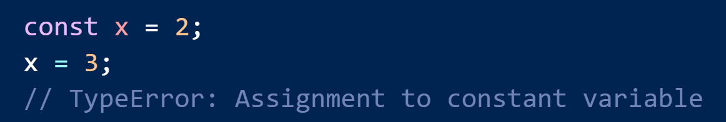
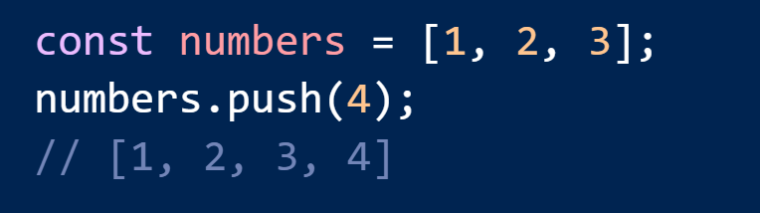
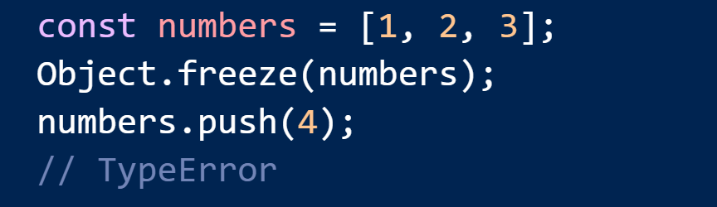
const means no more assignments

Slide 20
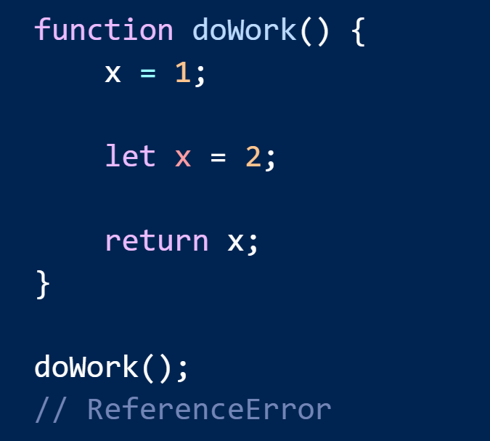
The TDZ

Slide 21
Collections
const
let
Arrow
Functions
Template
Literals
Crazy Syntax
Notes:
So to get started, and give you a feel for what this talk is all about, let’s start with a simple topic. Arrow functions. How hard can they be, right? They look just like lambda expressions in C# and many of us have been using and abusing those for years.

Slide 22
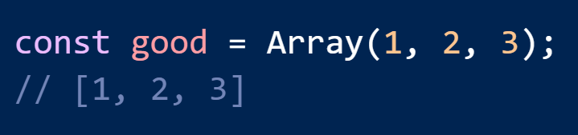
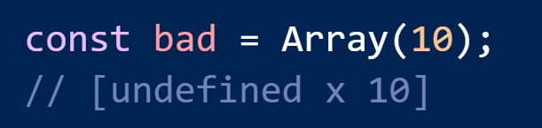
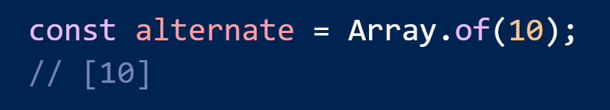
Creating Arrays

Slide 23

When the gods wish to punish us
they answer our prayers.
Oscar Wilde

Slide 24
Modules

