Slide 1

Hello, Aurelia

Slide 2


Aurelia An Introduction For Anyone Who Has Never Seen The Framework
Scott Allen
http://OdeToCode.com
Tweet this talk
#DEVintersectionEU
@OdeToCode

Slide 3




Thank You Sponsors!

Slide 4



Slide 5

Next Gen
Written with ES 2015 & 2016
Integration with future standards

Slide 6
JavaScript Framework
Aurelia Framework
Application Code
Polyfills

Slide 7




Mobile Desktop and Web

Slide 8
Simple conventions
ViewModel
View
+

Slide 9


Getting Started
Install Node
Install a Git CLI
Getting Started

Slide 10

Install JSPM
More than a package manager
Also includes a runtime
System API polyfill
ES6 module loader
Runtime configuration

Slide 11
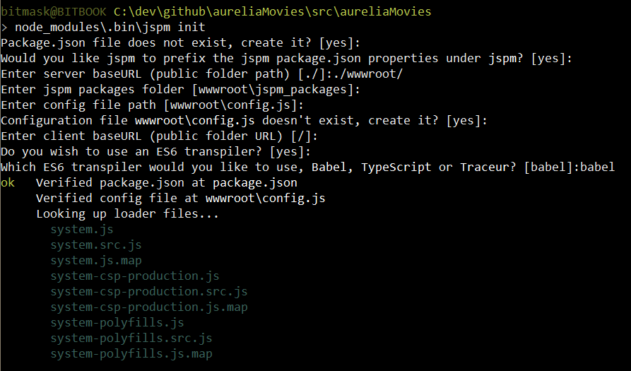
jspm init

Slide 12
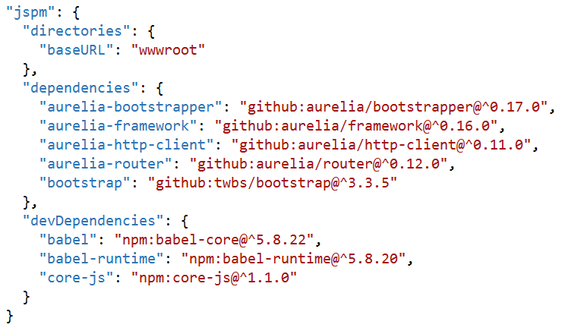
jspm install
Dependencies manages in package.json
You’ll probably want
aurelia-framework
aurelia-bootstrapper
aurelia-router
aurelia-http-client

Slide 13
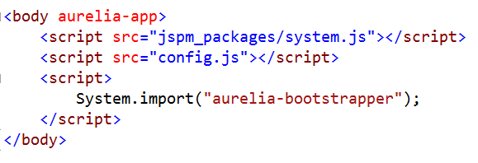
Bootstrap an App
Bring in
SystemJS
Runtime module configuration
Aurelia bootstrapper

Slide 14
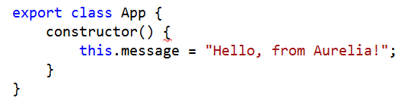
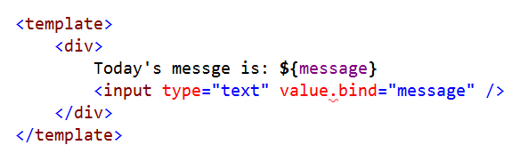
Aurelia Conventions
app.js
+
app.html

Slide 15
What’s Happening?
System loads aurelia-bootstrapper
(with help of config.js)
Aurelia asks System for app module
Module loader imports and transpiles app.js
(with help of Babel, Tracuer, or TypeScript)
Aurelia framework binds app VM to V

Slide 16
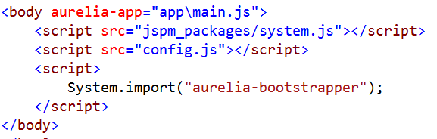
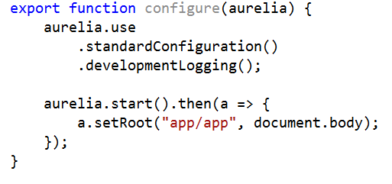
Taking Control
Specify a configure module for aurelia

Slide 17
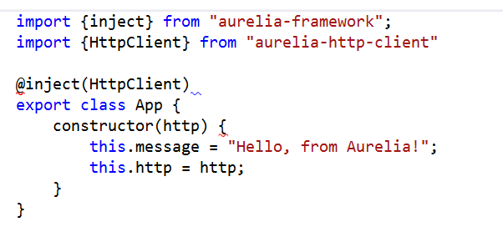
Dependency Injection
Container configured during startup
Can inject using decorators

Slide 18
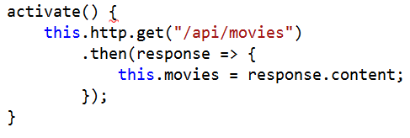
Working with Http Client
Like everything else, HttpClient not required
Supports basic GET, POST, PUT, DELETE with application/json

Slide 19
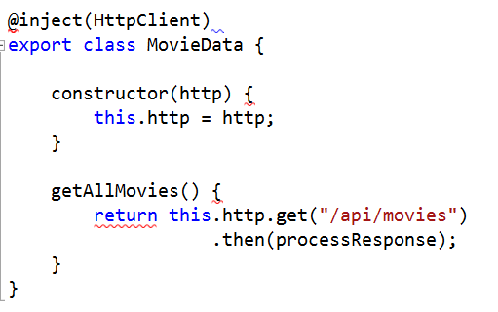
Creating “Services”
Write plain JavaScript and export
Import or inject where needed

Slide 20
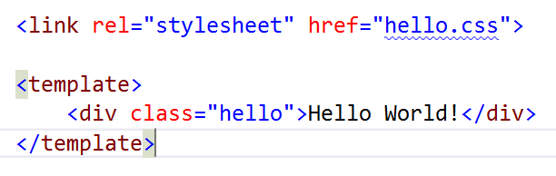
Templating
Uses HTML Import technology

Slide 21


Data Binding
Use .bind anywhere for sensible binding
Also can use .one-way, .two-way, and .one-time

Slide 22
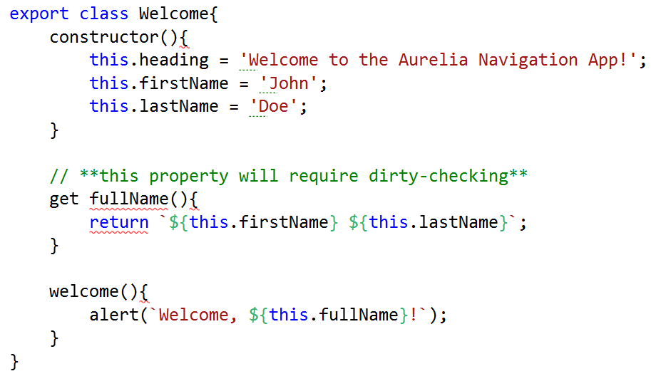
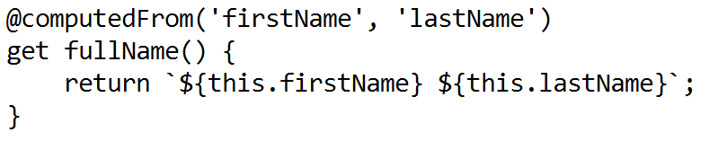
Adaptive Binding
ObserverLocator for data binding
DOM elements (SelectValueObserver, CheckedObserver)
Object.observe, Object.defineProperty

Slide 23
Delegate and Trigger

Slide 24
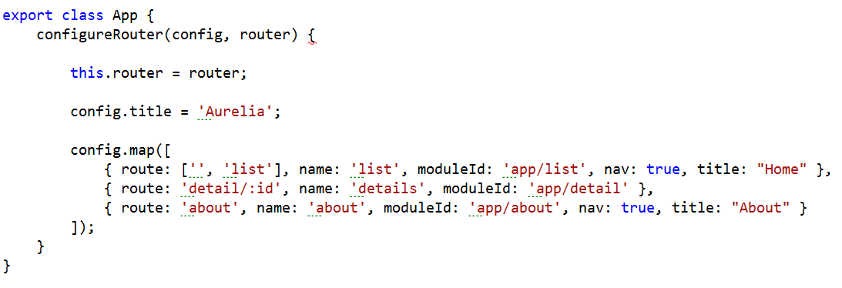
Routing
Router and router-view work together
Routing information is bindable

Slide 25
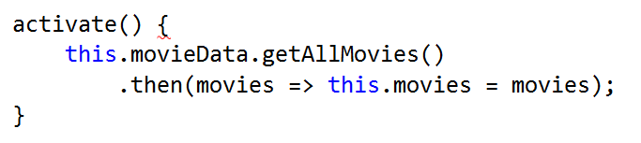
Screen Activation
Use activation lifecycle to control navigation
canActivate
activate
canDeactivate
Deactivate
Return promises to have the router wait…

Slide 26
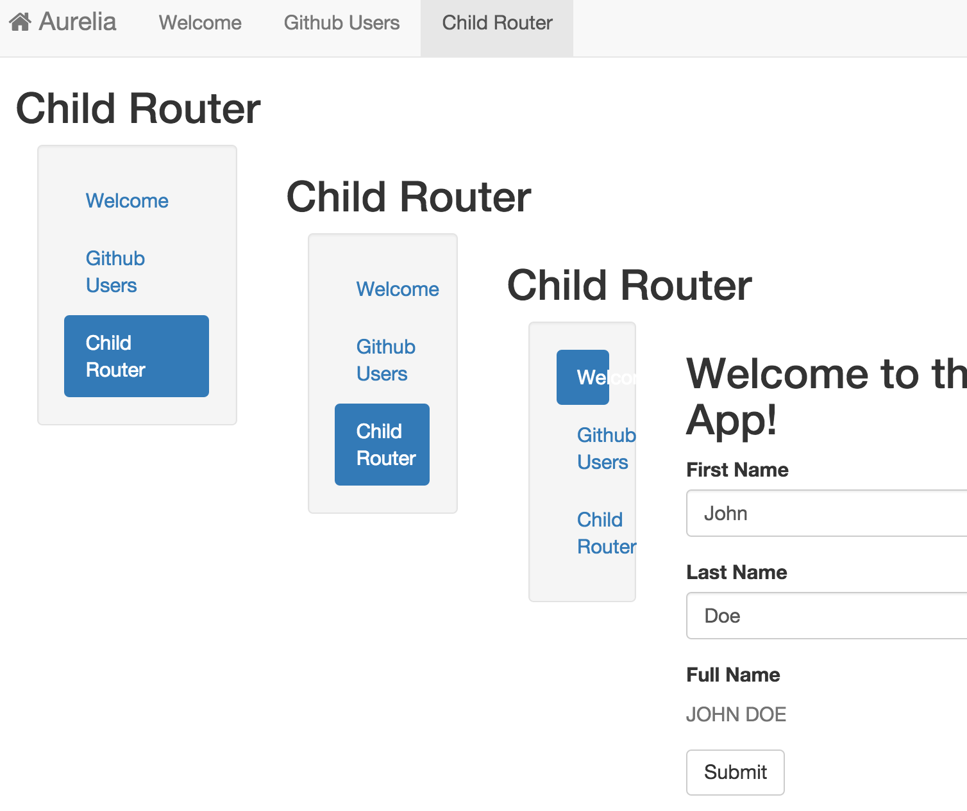
Child Routers
Independent route configuration
Navigate relative to parent

Slide 27
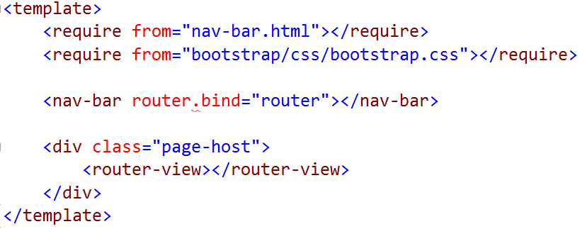
Custom Elements
Follow the View <-> View Model conventions

Slide 28
Next
Aurelia – the beta almost ready!
http://aurelia.io
https://gitter.im/Aurelia/Discuss

Slide 29
Connect with me
@OdeToCode
scott@OdeToCode.com
My Connect
On the page for this session, you’ll find
Ask a question to the speaker(s)
Slides
Resources
Feedback form

