Slide 1
The Entity Framework

Slide 2
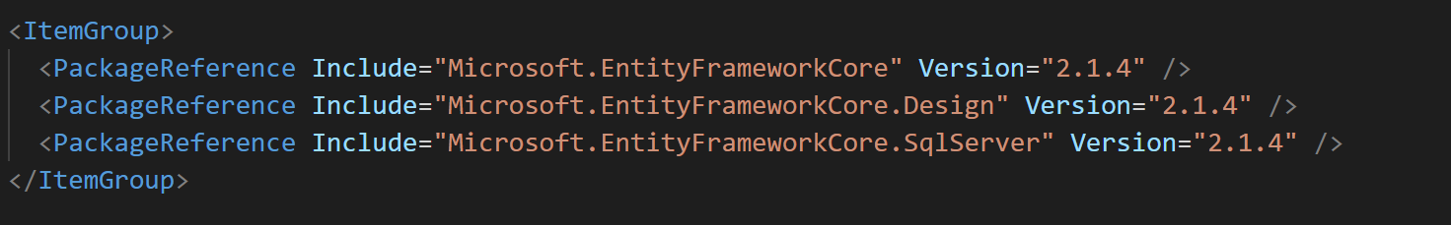
Dataase Providers in NuGet
SQL Server
SQLite
In-memory
PostgreSQL
MySQL
CosmosDB

Slide 3
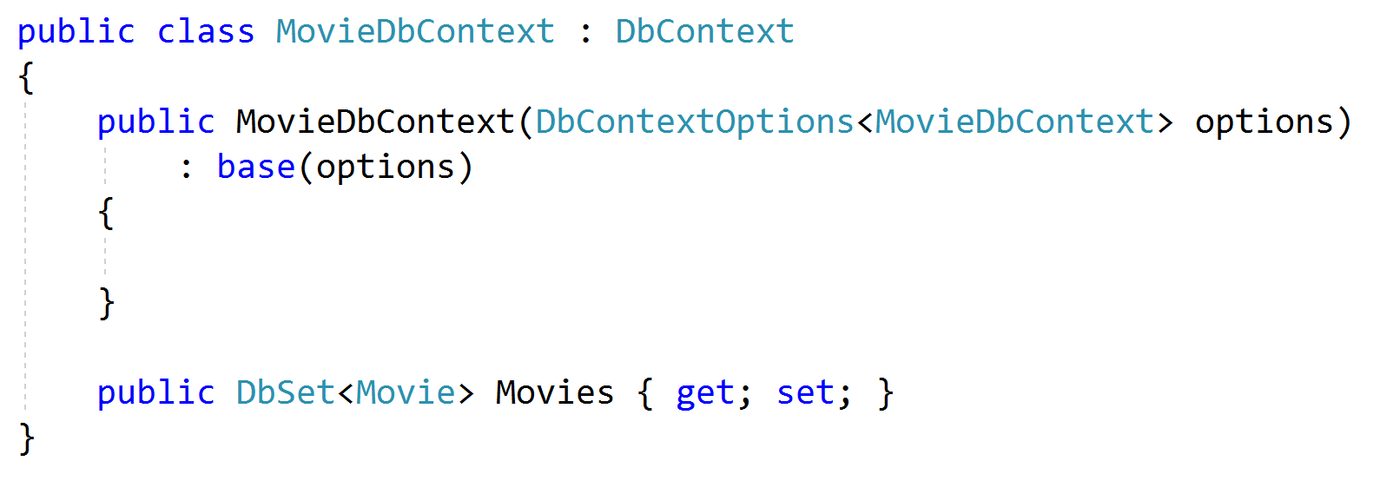
DbSet
The gateway to the database
Instance represents a unit of work

Slide 4
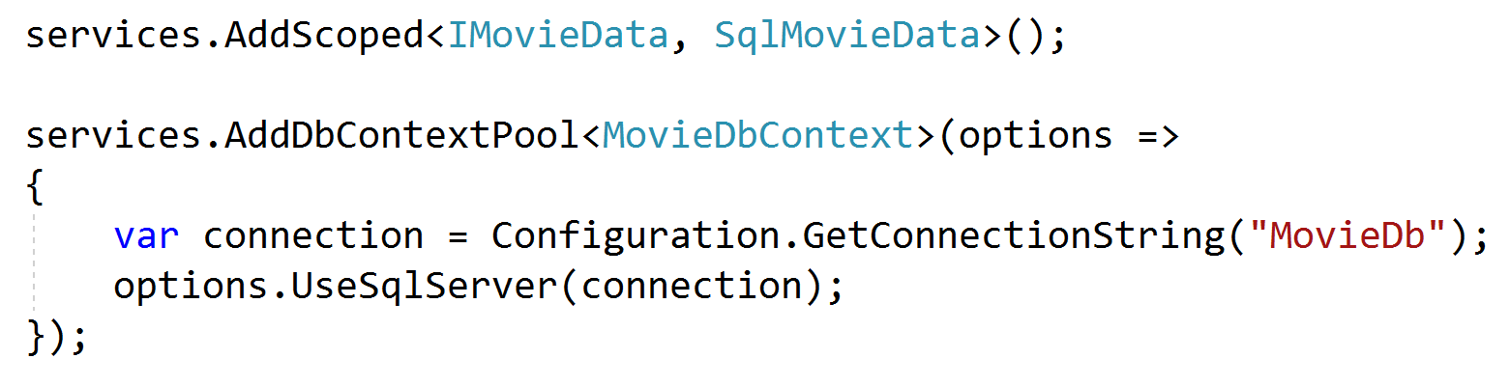
DBContext is a Service
Configure for injection

Slide 5
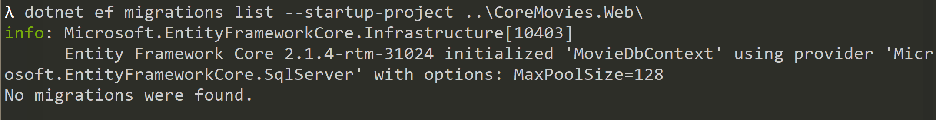
dotnet ef
Global tool installed with the SDK
Manage DbContext
Manage migrations
Manage databases
Scaffold (reverse engineer)

Slide 6
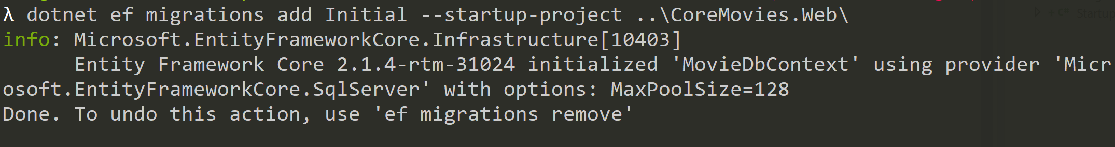
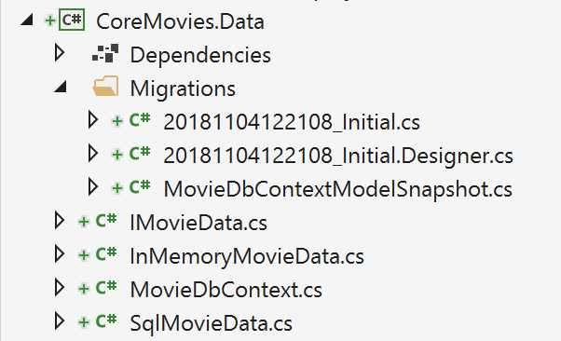
Add a Migration
dotnet ef migrations add <name>

Slide 7
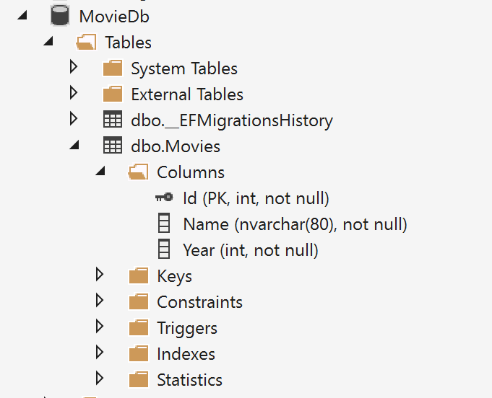
Apply Migrations
dotnet ef database update

Slide 8
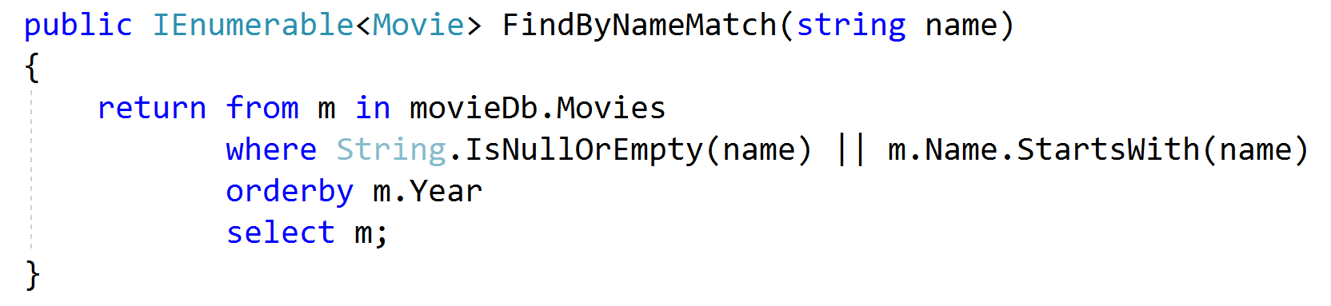
Using LINQ: Lazy versus Eager
Lazy is IQueryable or IEnumerable
Only executes if needed
Eager is using ToList
Fails fast

Slide 9
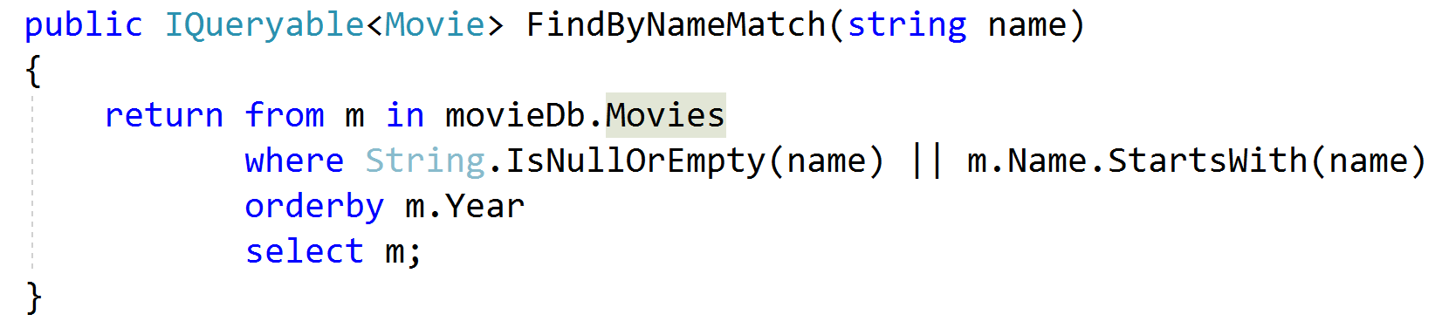
Using LINQ: Composable versus Sealed
IQueryable is composable
Allows callers to modify query
IEnumerable is in-memory
Callers cannot modify query sent to DB

Slide 10
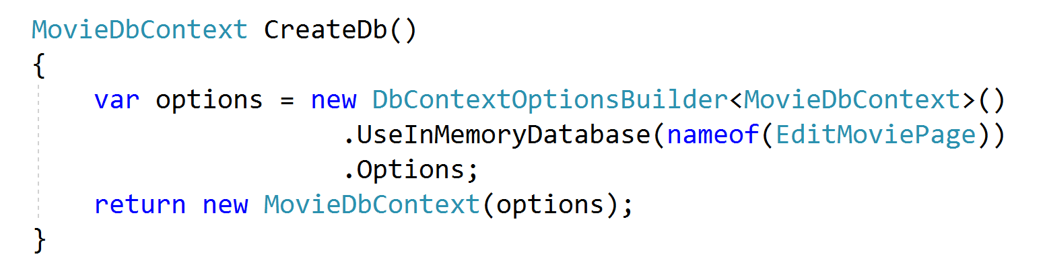
In-Memory
Great for testing!

Slide 11
Summary

