Slide 1
The Evolution of JavaScript (and the features of ES2015) K. Scott Allen

Slide 2
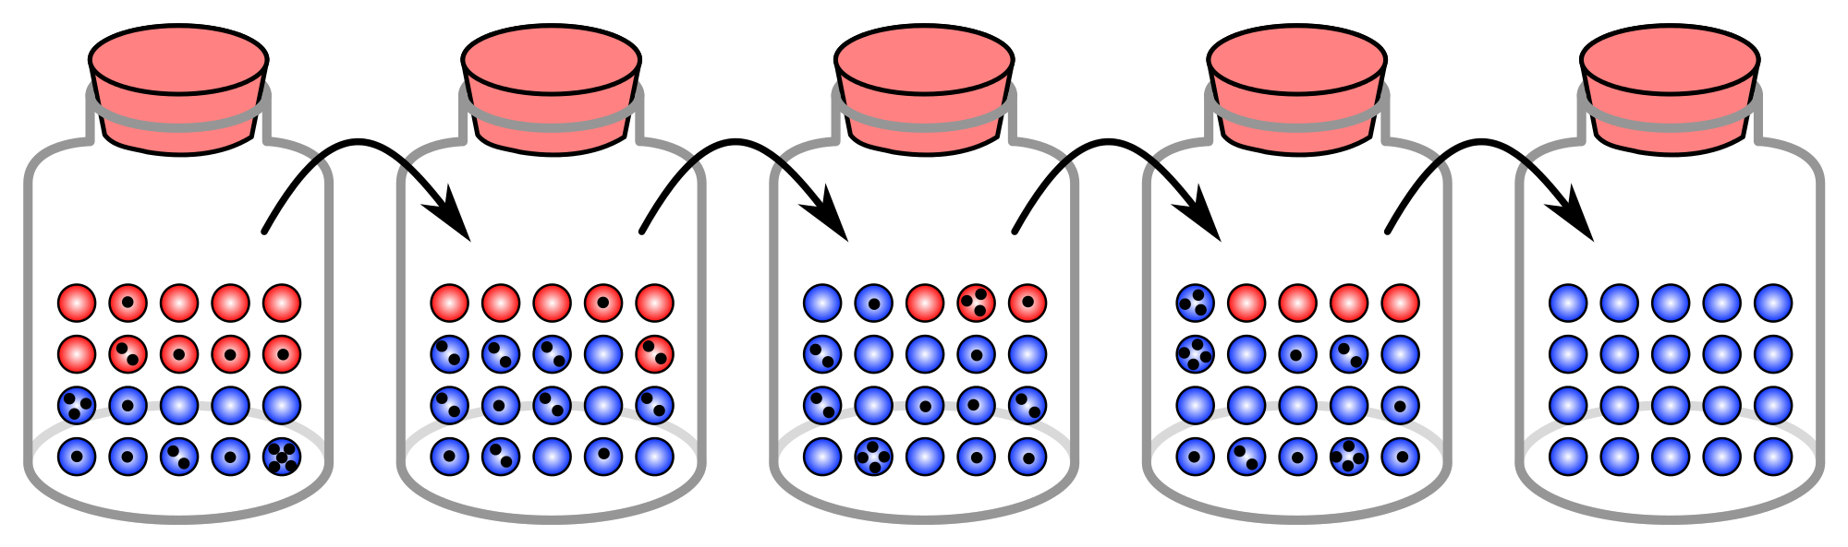

Slide 3
1993
1.0
1999
3.0
2015
6.0
1998
2.0
2009
5.0

Slide 4
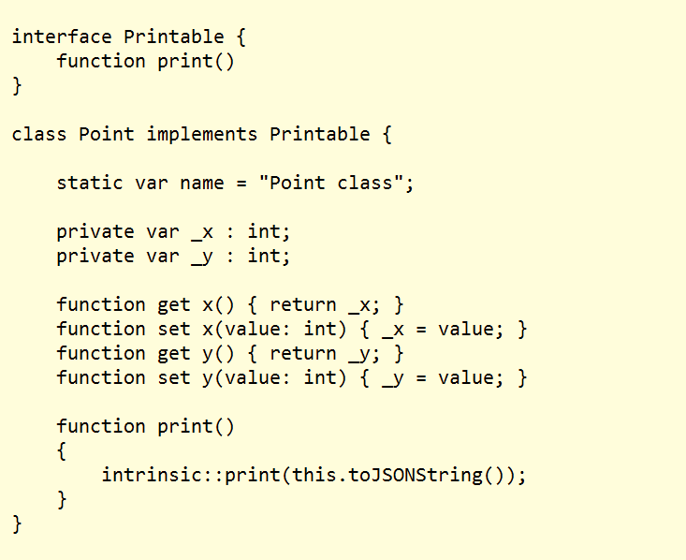
2007

Slide 5
Why The Excitement?
First substantial addition to JavaScript since inception
1993
1.0
1999
3.0
2015
6.0
1998
2.0
2009
5.0

Slide 7
The Old New JavaScript
Apologies to Raymond Chen
Lisp
C#
JavaScript
Python
Ruby

Slide 8
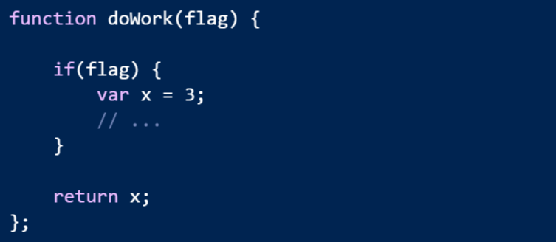
Problem
JavaScript has no block scope

Slide 9
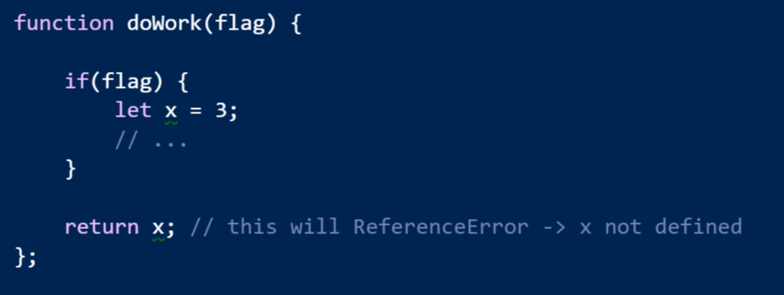
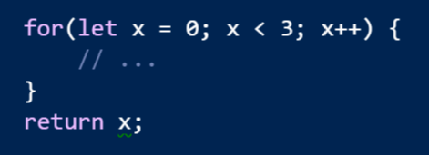
Solution: let

Slide 10

Problem
All variables are mutable
=4

Slide 11
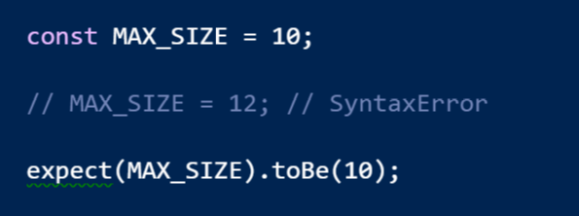
Solution: const

Slide 12
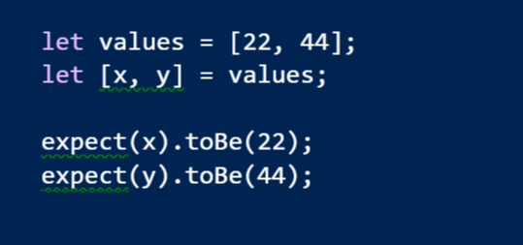
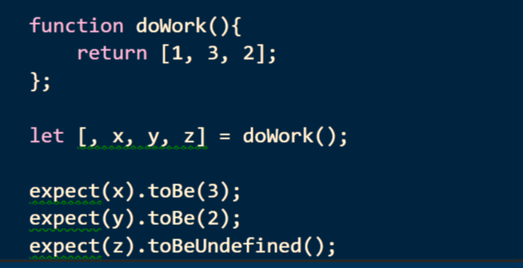
Destructuring
The opposite of constructing is destructing

Slide 13
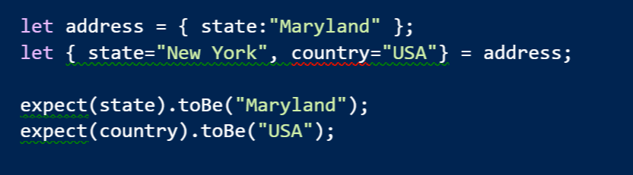
Destructuring Objects

Slide 14
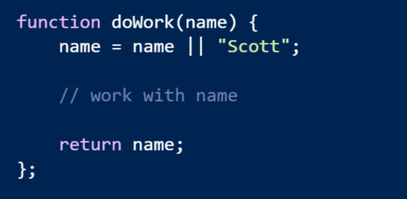
Problem: Default Values
Default are buried in the function code

Slide 15
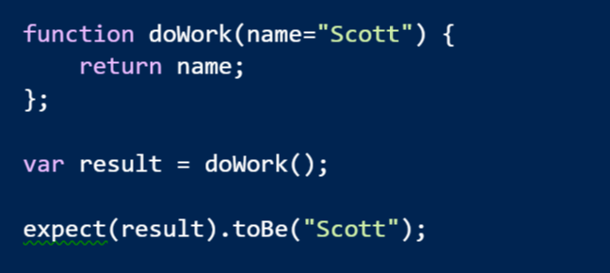
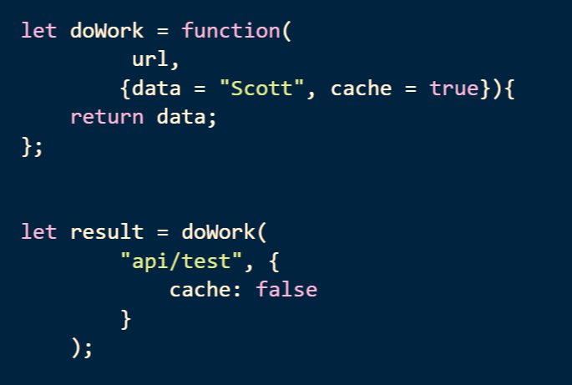
Solution: Default Parameter Values

Slide 16
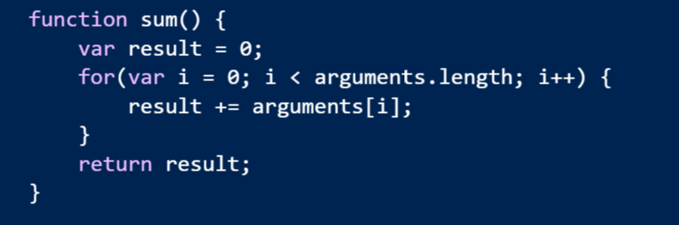
Problem: Variable Number of Arguments
Syntax is not obvious to the consumer

Slide 17
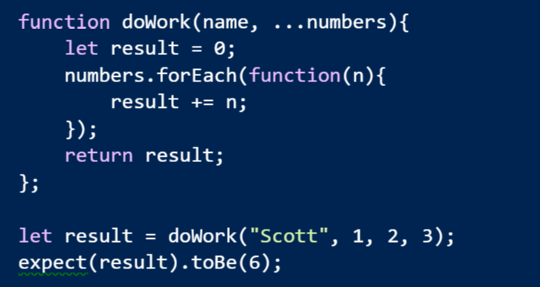
Solution: Rest Parameters
Let the last parameter take the rest of the arguments

Slide 18
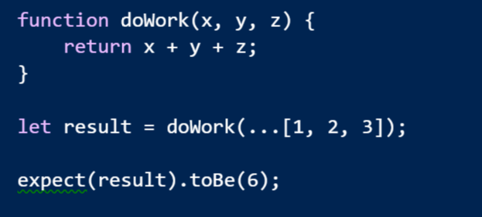
Spread Operator
Spread an array across the parameters

Slide 19
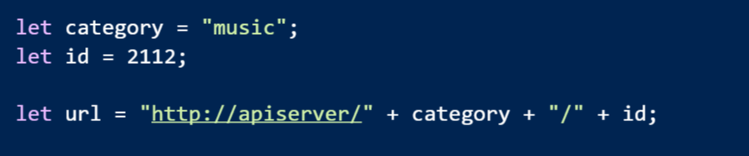
Problem: String Concatenation Is Unpleasant

Slide 20
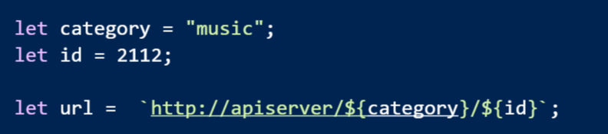
Solution: String Templates

Slide 21
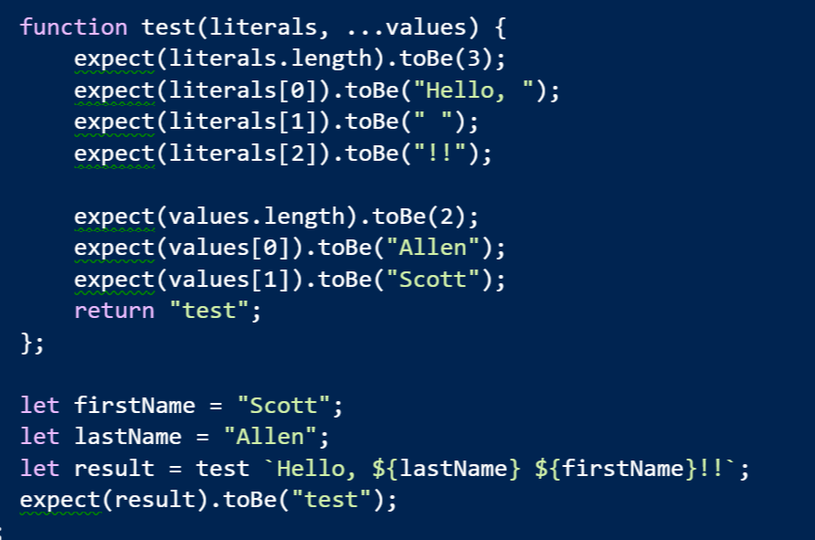
Even Better: Tagged Templates

Slide 22
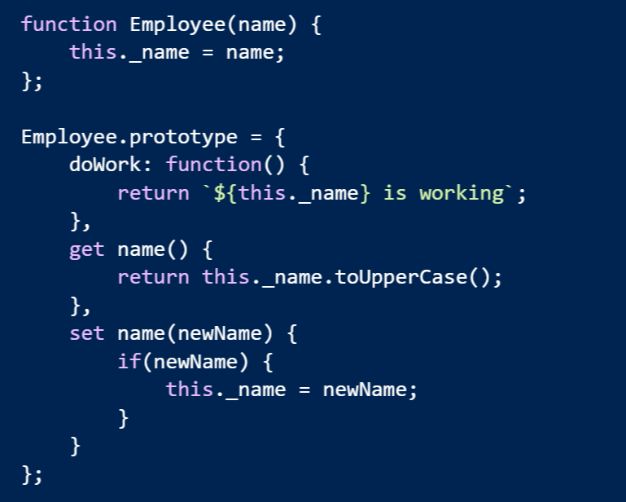
Problem: Simulating OOP

Slide 23
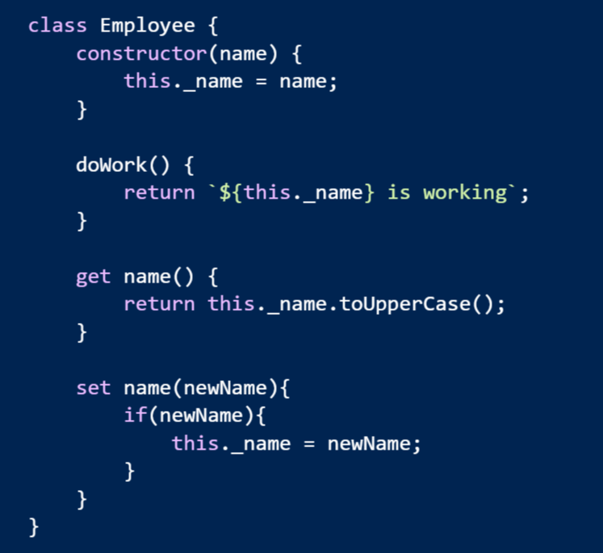
Solution: class Keyword

Slide 24
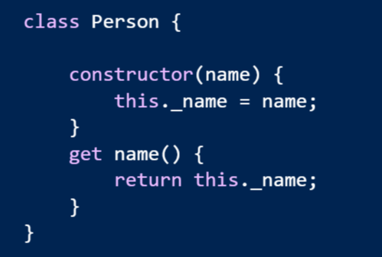
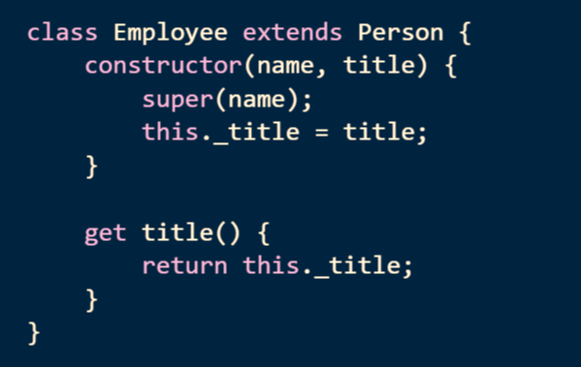
Inheritance

Slide 25
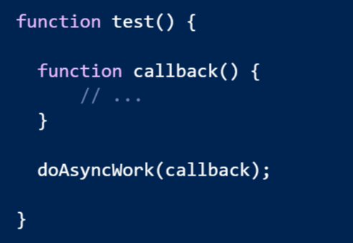
Problem: function is an 8 character word

Slide 26
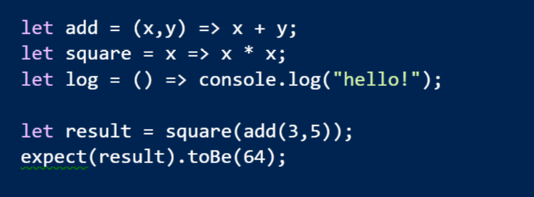
Arrow Functions
Expressive syntax
Familiar to C# developers

Slide 27
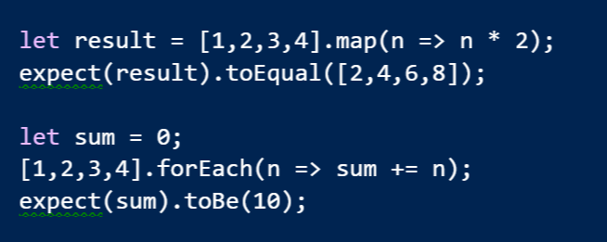
LINQish Arrows

Slide 28
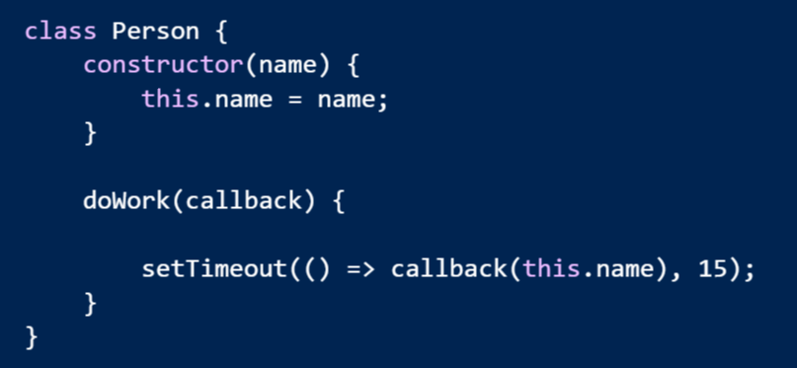
Arrow Functions Lexically Bind this

Slide 29
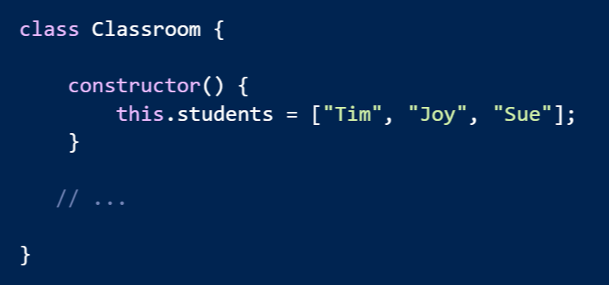
Problem: Encapsulating Collections

Slide 30
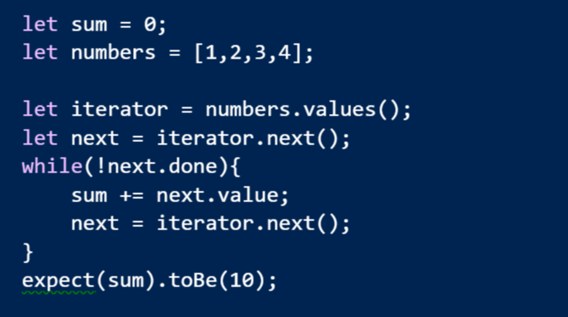
Solution: Iterators and Iterables

Slide 31
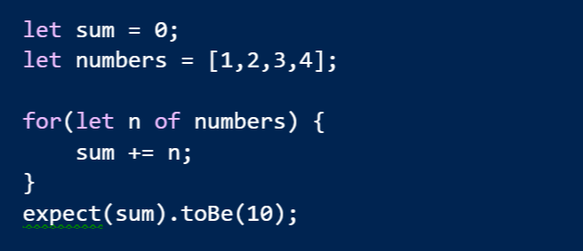
for of

Slide 32
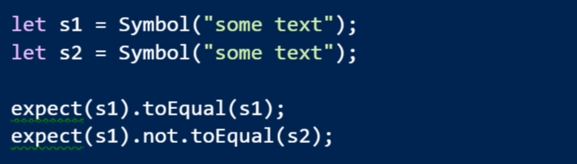
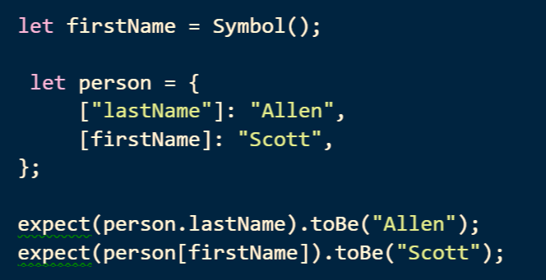
Symbol
A new type where every value is unique and immutable
Can use a symbol as a key into an object

Slide 33
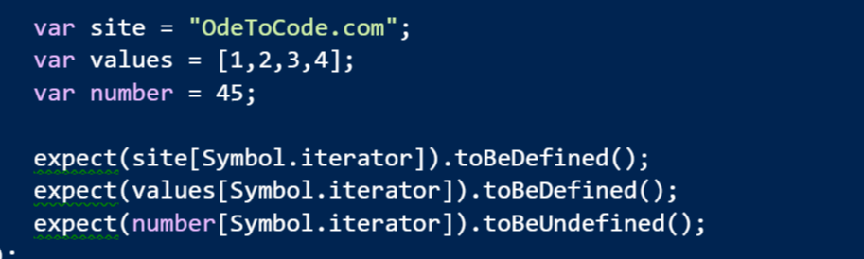
Symbol.iterator
A magic method that makes an object iterable

Slide 34
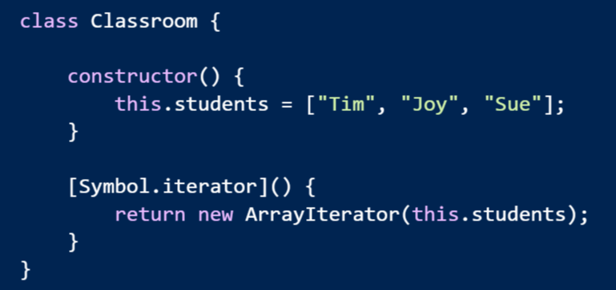
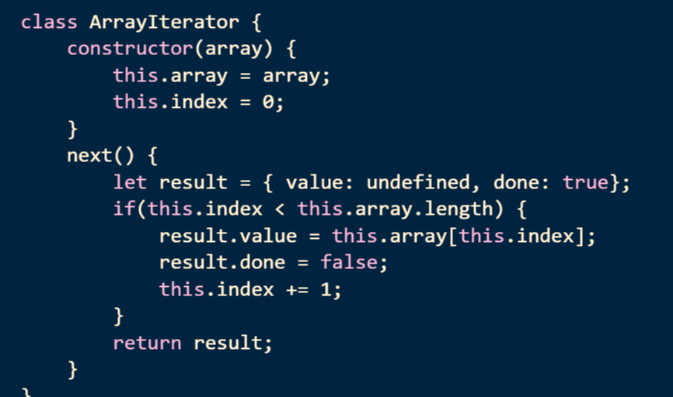
Make Your Own Iterable

Slide 35
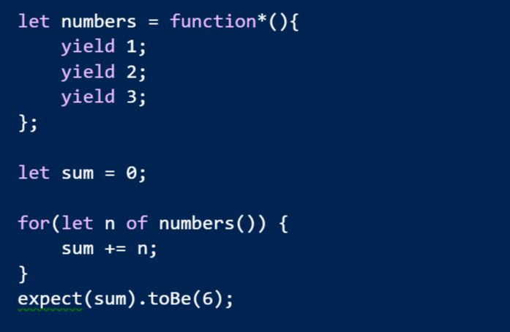
Generators

Slide 36
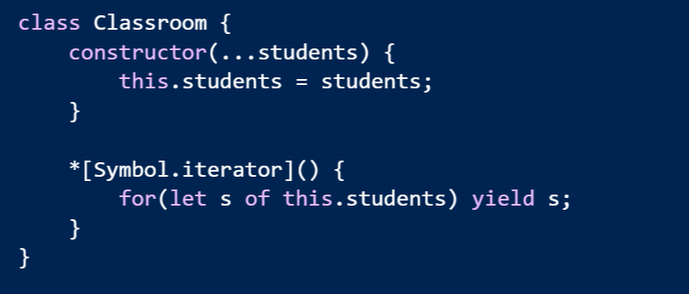
Easy To Make Iterables

Slide 37
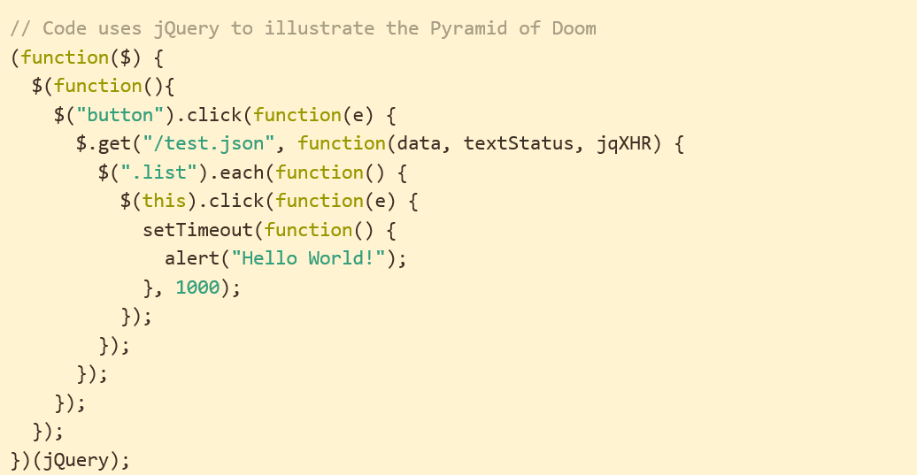
Problem: Async Code
http://tritarget.org/blog/2012/11/28/the-pyramid-of-doom-a-javascript-style-trap/

Slide 38
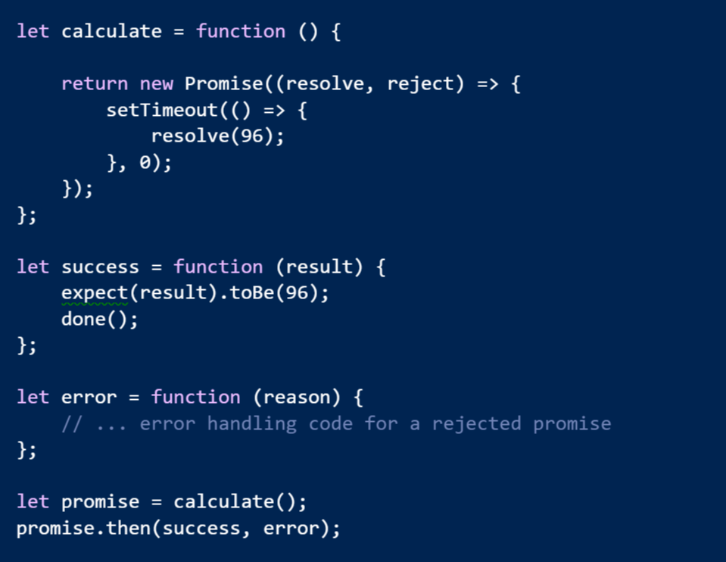
Solution: Promises

Slide 39
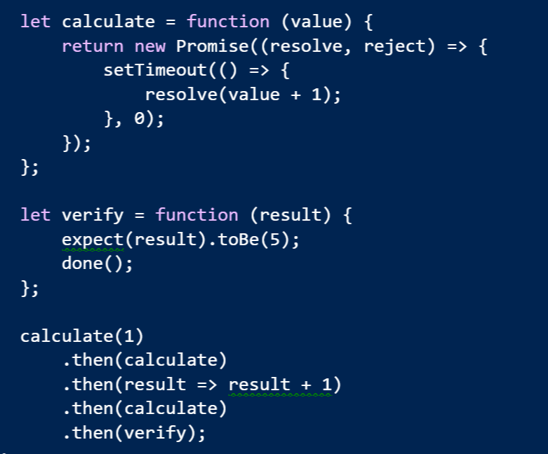
Promises Chain

Slide 40
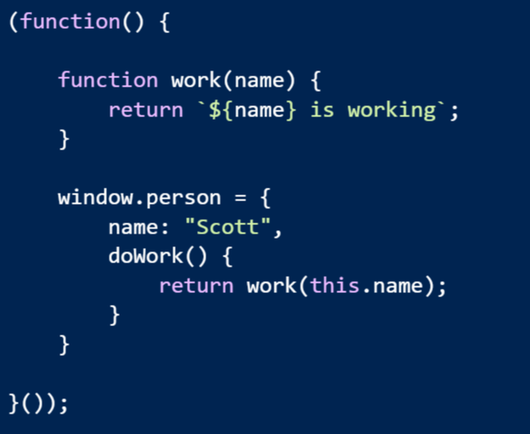
Problem: Modularity & Scope

Slide 41
Problem: Modularity & Scope
Possible solutions
Common JS
Asynchronous Module Definitions
IFFE and Globals
Think about how current libraries are designed
jQuery -> $
Angular -> angular
Lodash -> _

Slide 42
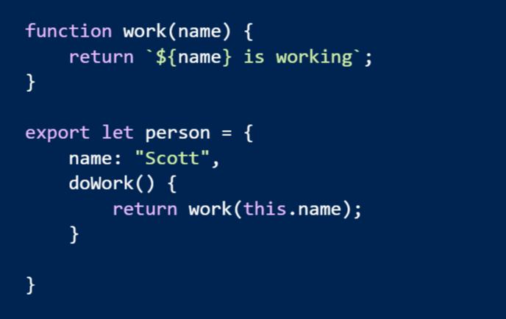
Solution: Real Modules!
Think “module” not “file”

Slide 43
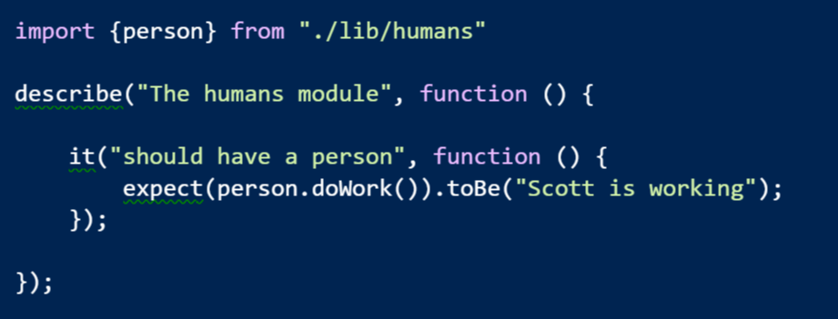
Imports

Slide 44
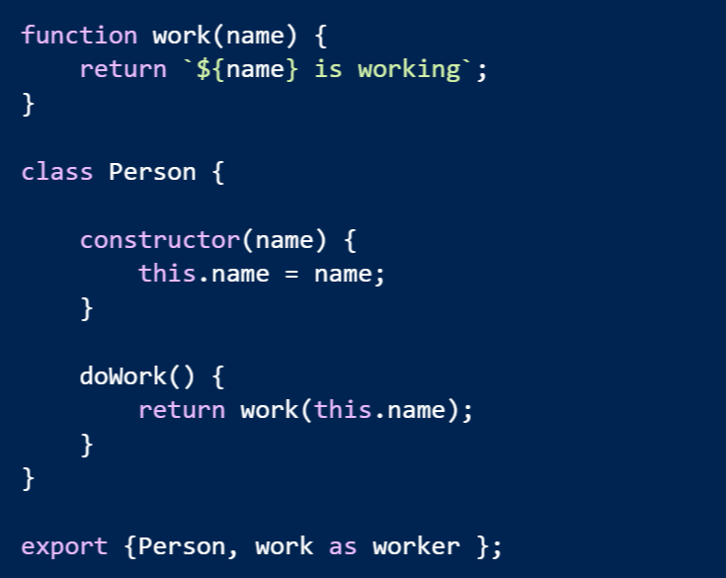
Multiple Exports

Slide 45
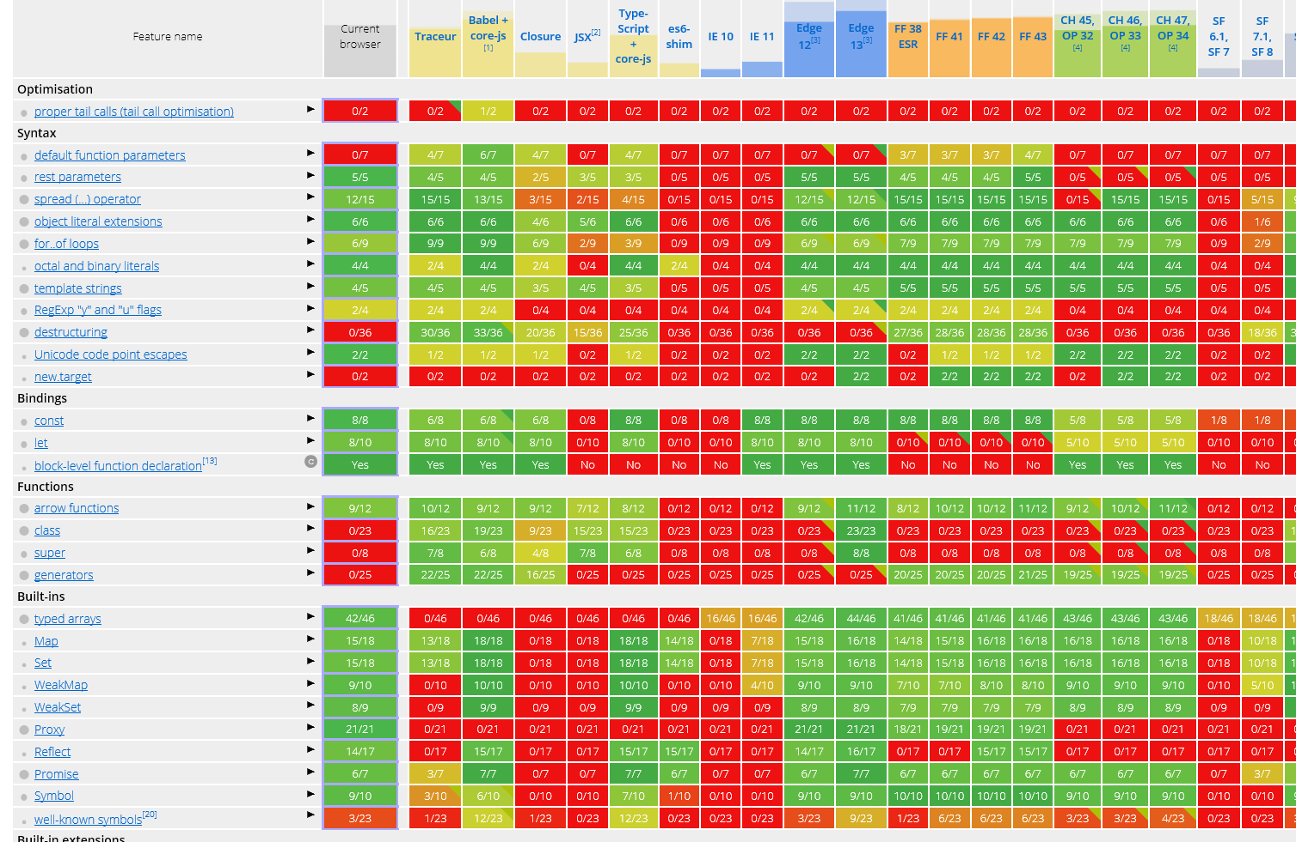
Making It Work
https://kangax.github.io/compat-table/es6/

Slide 46
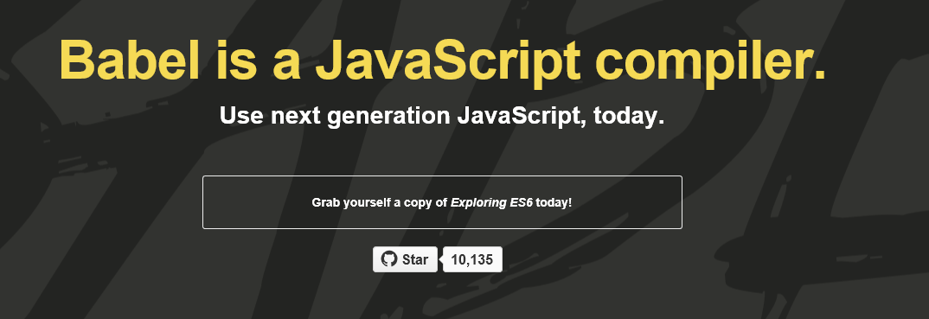
Build Your JavaScript
https://babeljs.io/
Use with Grunt, Gulp, WebPack, JSPM
Many others
Or . . . directly in a browser

Slide 47
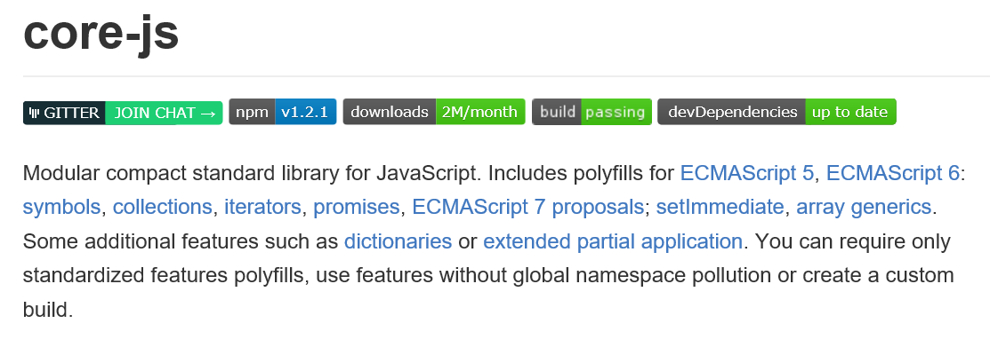
Polyfill Your Browser
Almost automatic with many bundling tools

Slide 48
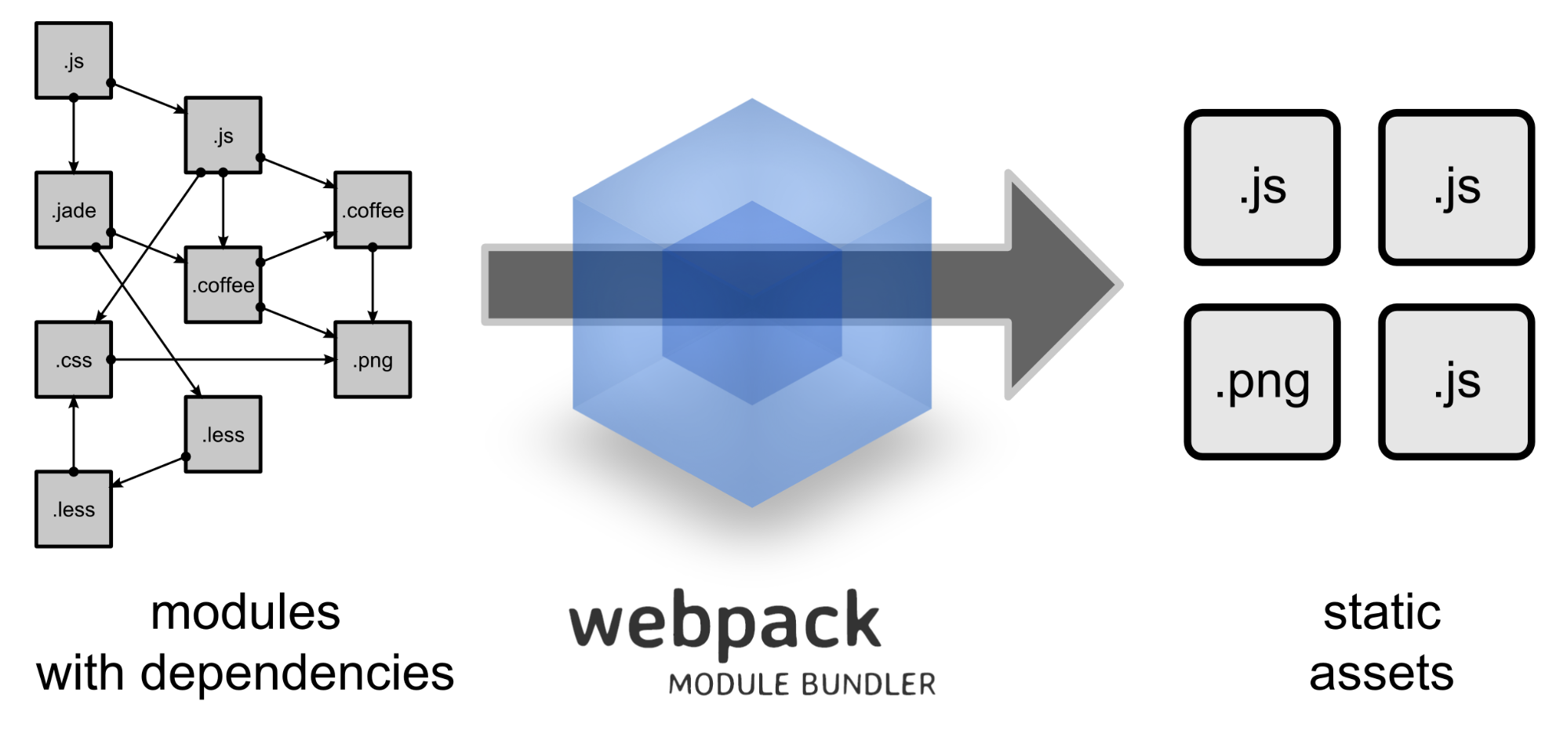
Build Your Modules
http://webpack.github.io/
Bundle them, too

Slide 49
In Conclusion …
Thanks for listening!
scott@OdeToCode.com

