Slide 1
Services & Dependencies
DI for .NET Core

Slide 2
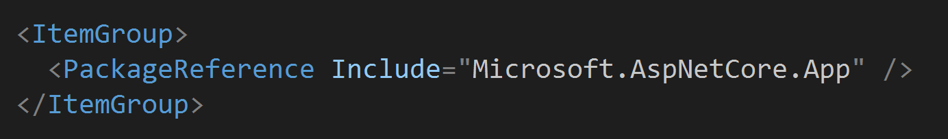
Package Dependencies
Live in csproj
Only top level packages required

Slide 3
Meta Packages
Microsoft.AspNetCore.App is a meta packages
Brings in all features of ASP.NET and EF
Version is implicit for this meta package

Slide 4
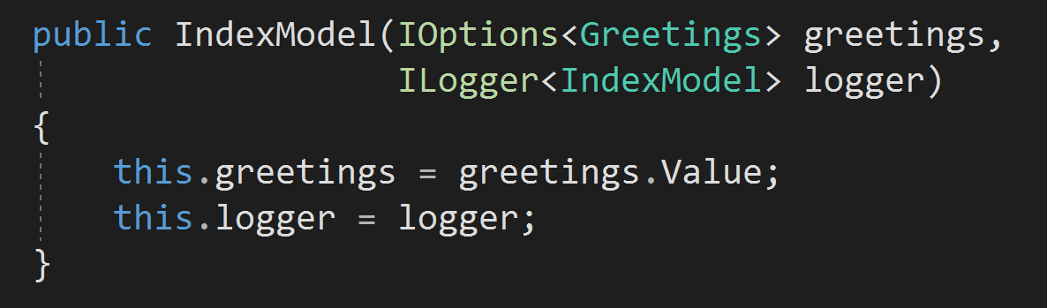
Service Dependencies
Avoid using new
Objects needed to do work accepted as constructor parameters

Slide 5
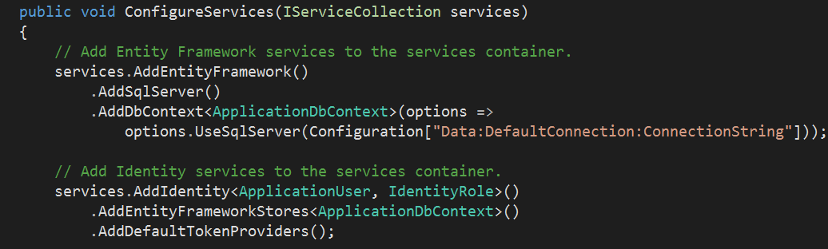
Dependency Injection
Single, simple container out of the box
Container can build an object graph

Slide 6
IServiceProvider
Abstraction for system-wide container
Implementation supports lifestyles:
Instance
Transient
Singleton
Scoped

Slide 7
Built-In Services
Core Services
IHostingEnvironment
IConfiguration
ILoggerFactory
Assembly loading, compilation, and more
Framework Services
Model binding
Routing
Authentication and authorization
Sessions
Caching
And more …

Slide 8
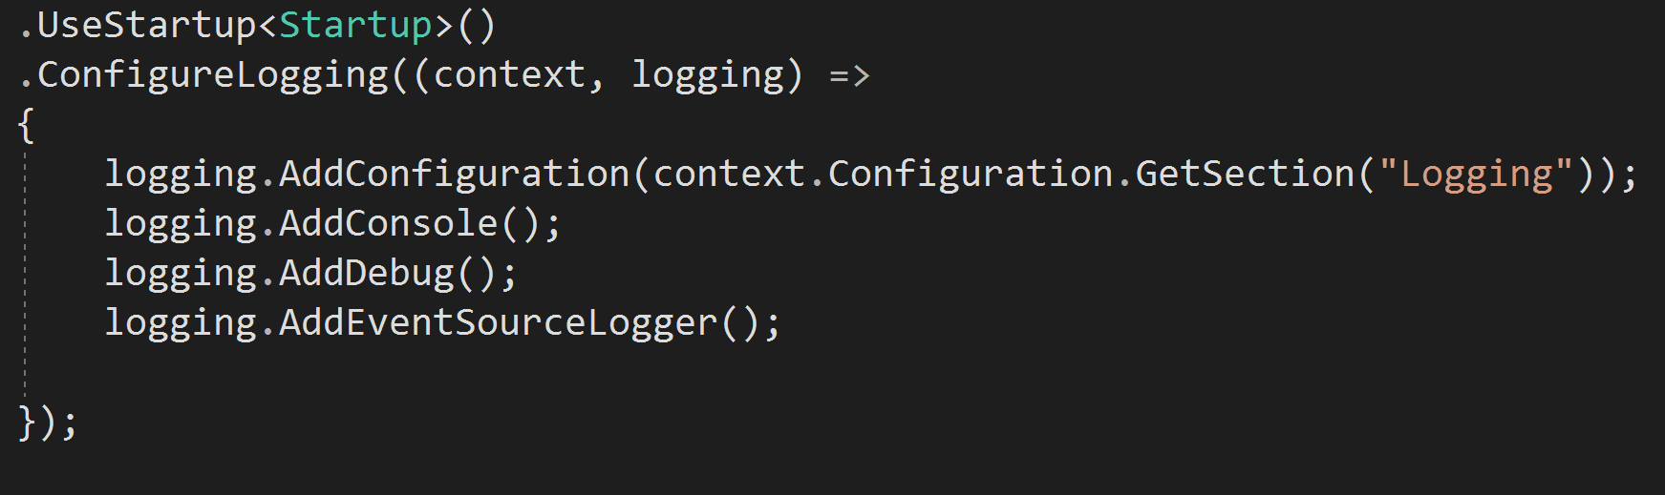
Logging
Provider model allows for variety of logging solutions
Built-in logging from Microsoft.Extensions.Logging

Slide 9
ILogger API
Log levels
Trace
Debug
Information
Warning
Error
Critical

Slide 10
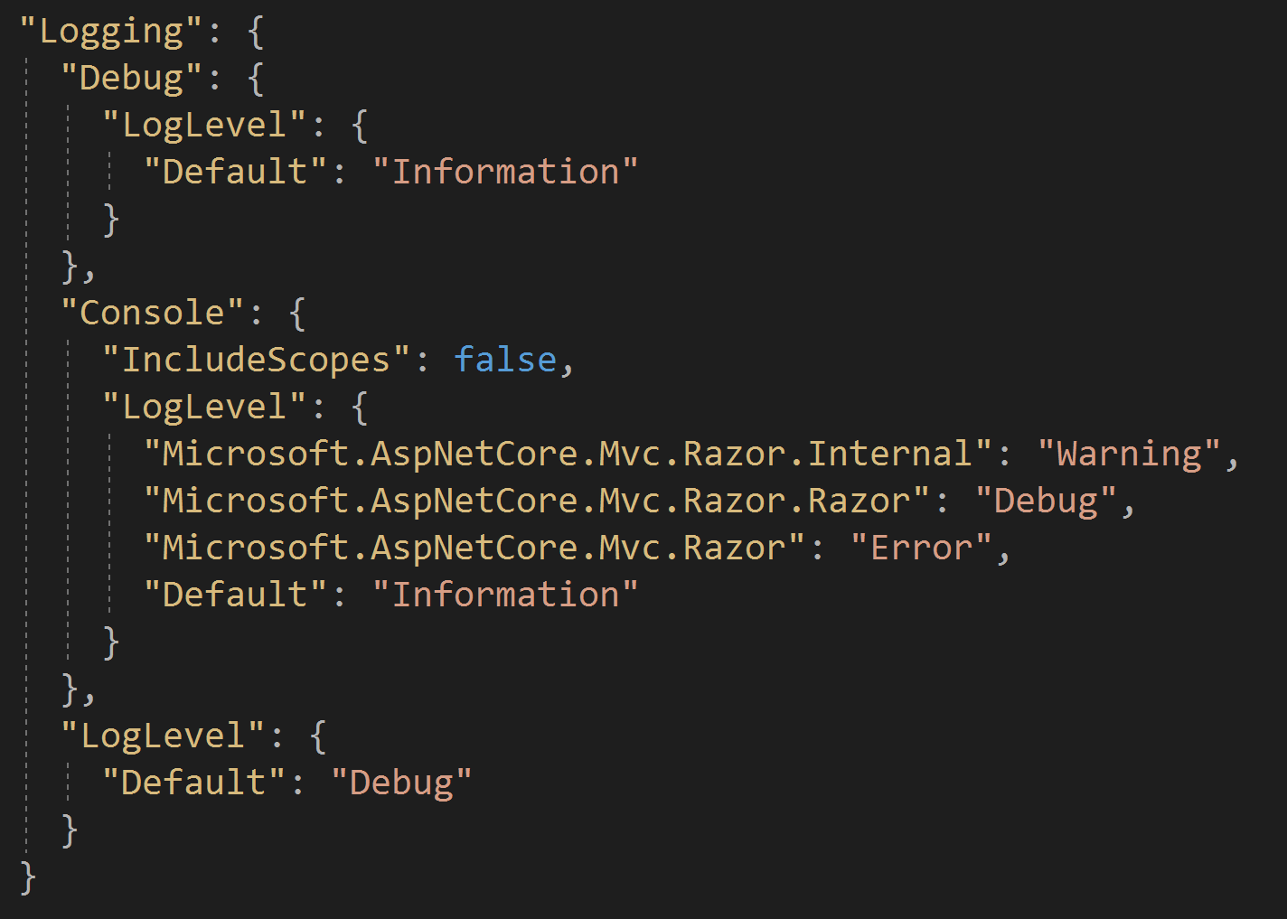
Filter Logs

Slide 11
Summary
Configuration and DI work together
Many options for flexibility and extensibility

