Slide 1

TypeScript and ECMAScript

Slide 2
Why The Excitement?
First substantial addition to JavaScript since inception
1993
1.0
1999
3.0
2015
6.0
1998
2.0
2009
5.0

Slide 3
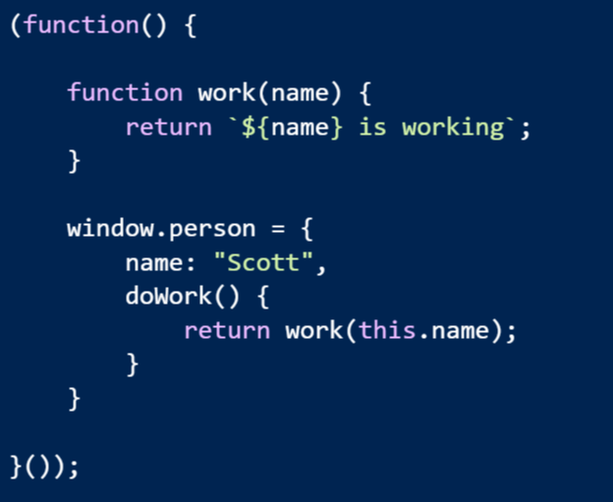
Problem: Modularity & Scope

Slide 4
Problem: Modularity & Scope
Possible solutions
Common JS
Asynchronous Module Definitions
IFFE and Globals
Think about how current libraries from 2014 are designed
jQuery -> $
Angular -> angular
Lodash -> _

Slide 5
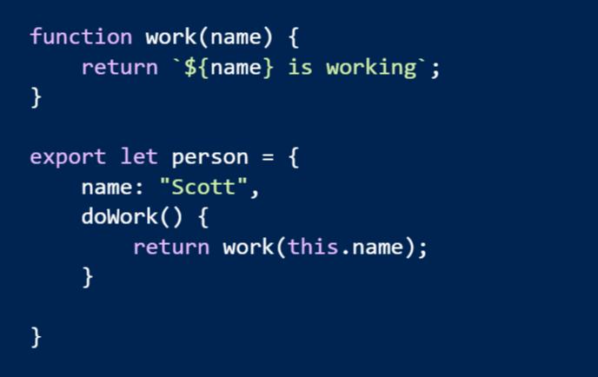
Solution: Real Modules!
Think “module” not “file”

Slide 6
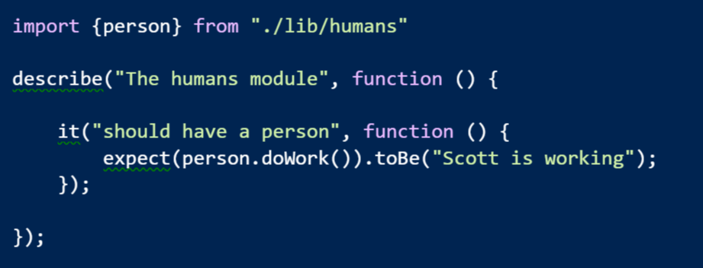
Imports

Slide 7
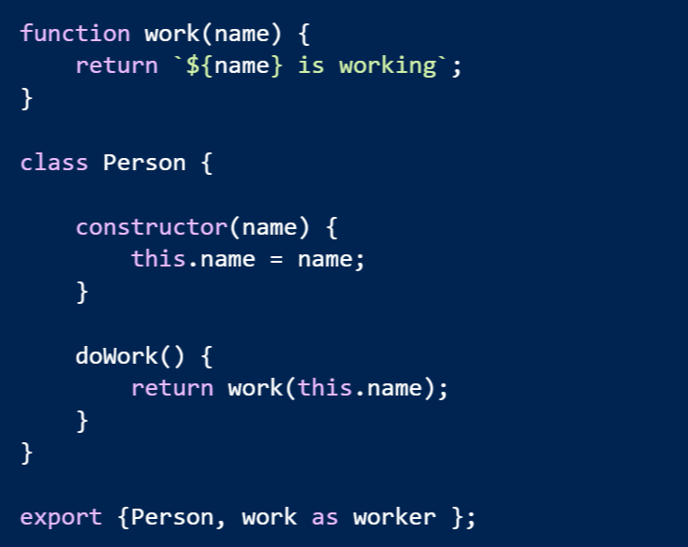
Multiple Exports

Slide 8
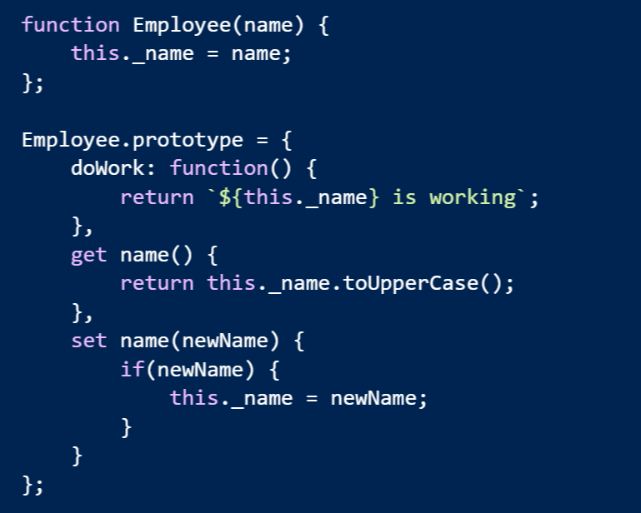
Problem: Simulating OOP

Slide 9
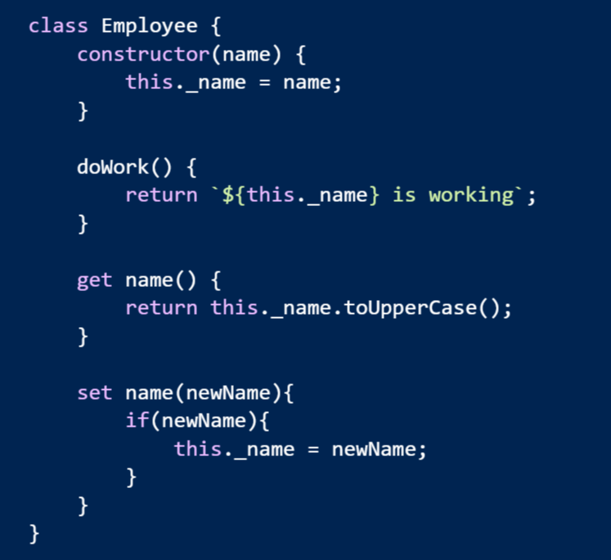
Solution: class Keyword

Slide 10
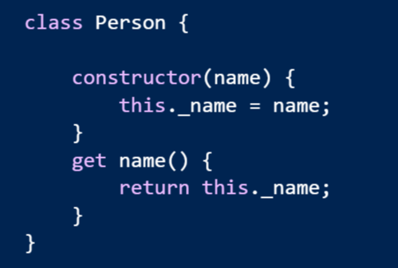
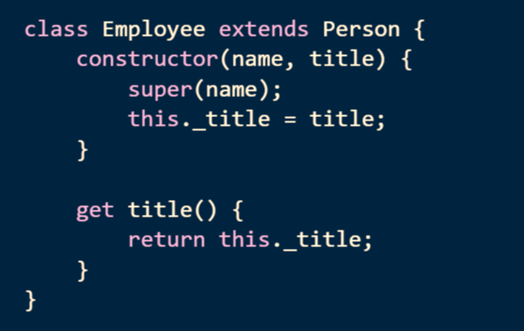
Inheritance

Slide 11
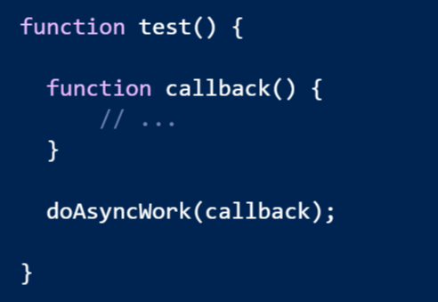
Problem: function is an 8 character word

Slide 12
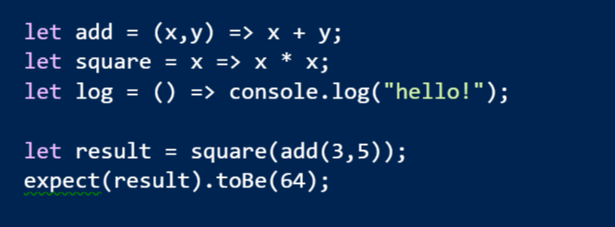
Arrow Functions
Expressive syntax
Familiar to C# developers

Slide 13
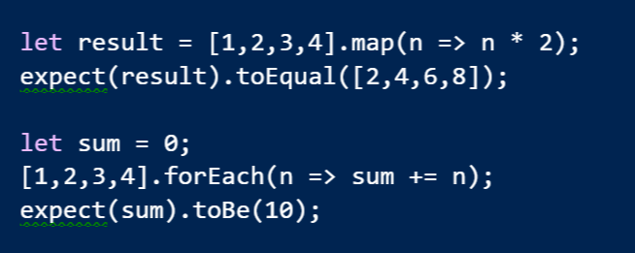
LINQish Arrows

Slide 14
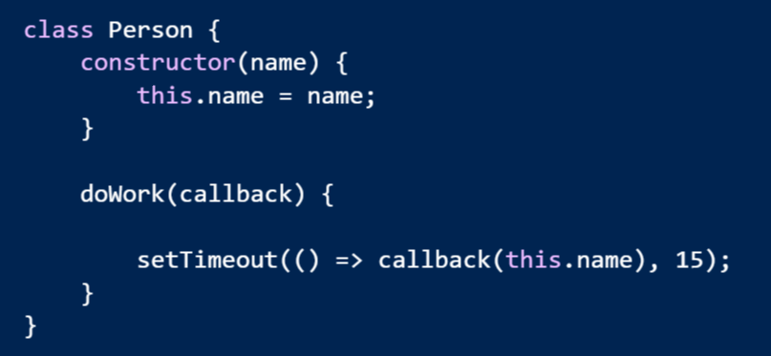
Arrow Functions Lexically Bind this

Slide 15
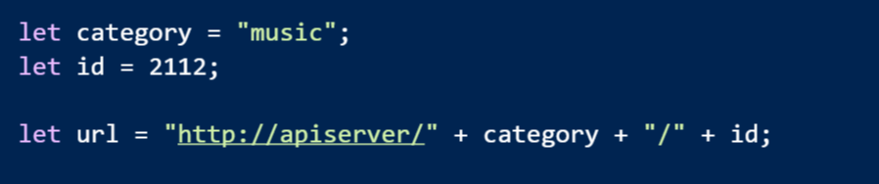
Problem: String Concatenation Is Unpleasant

Slide 16
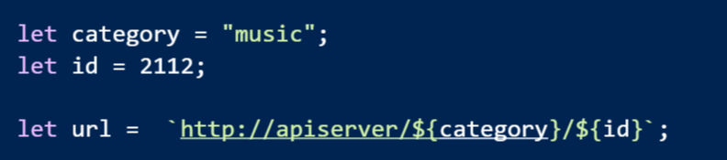
Solution: String Templates

Slide 17
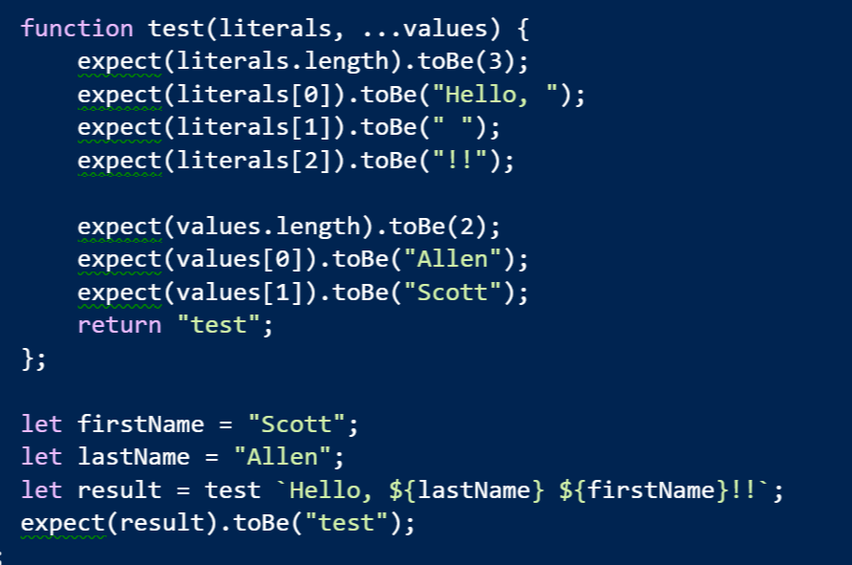
Even Better: Tagged Templates

Slide 18
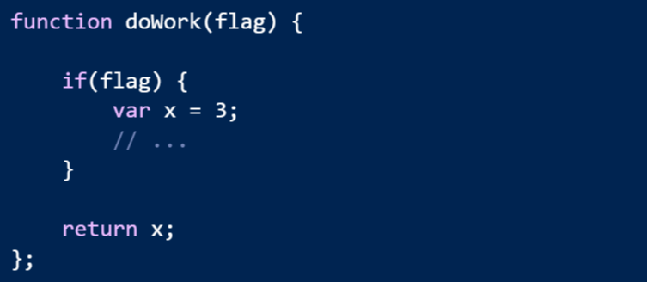
Problem
JavaScript has no block scope

Slide 19
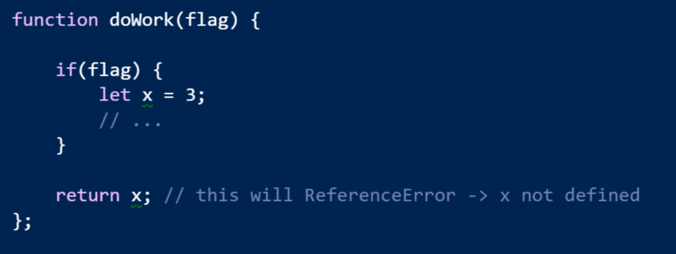
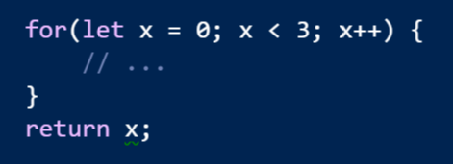
Solution: let

Slide 20
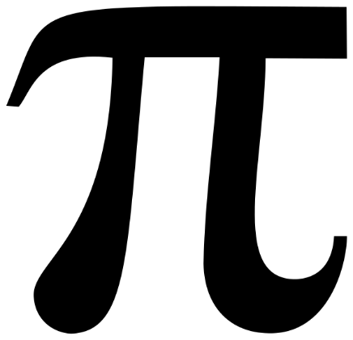
Problem
All variables are mutable
=4

Slide 21
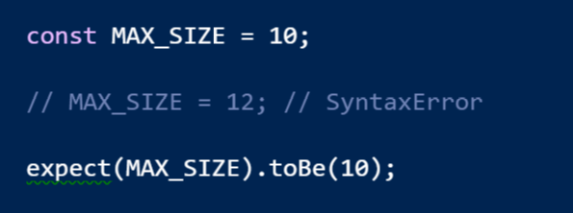
Solution: const

Slide 22
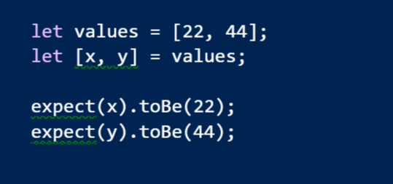
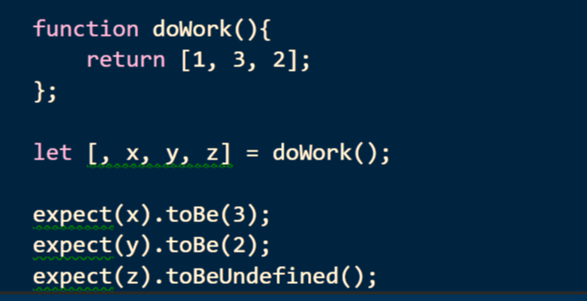
Destructuring
The opposite of constructing is destructing

Slide 23
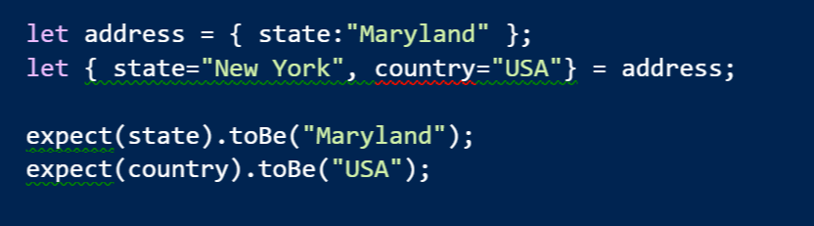
Destructuring Objects

Slide 24
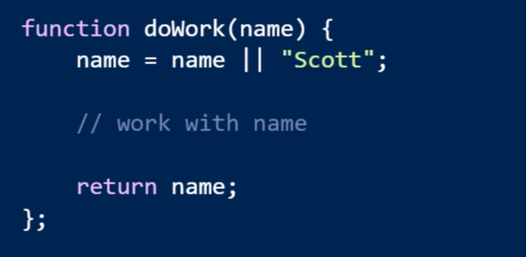
Problem: Default Values
Default are buried in the function code

Slide 25
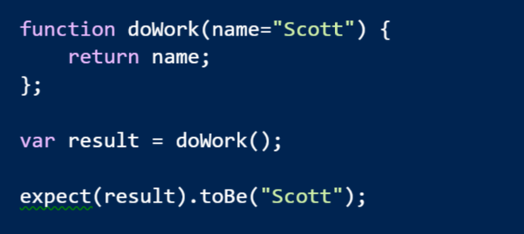
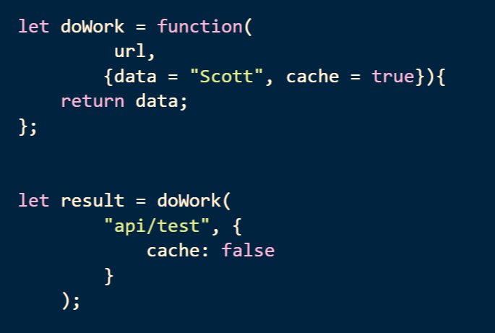
Solution: Default Parameter Values

Slide 26
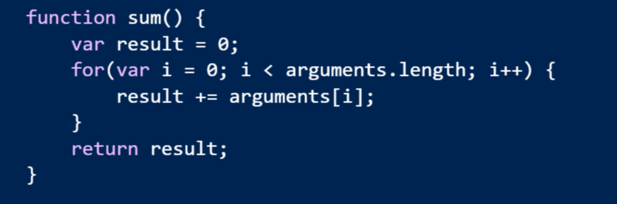
Problem: Variable Number of Arguments
Syntax is not obvious to the consumer

Slide 27
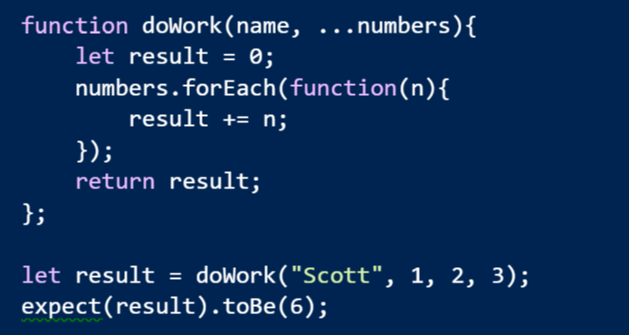
Solution: Rest Parameters
Let the last parameter take the rest of the arguments

Slide 28
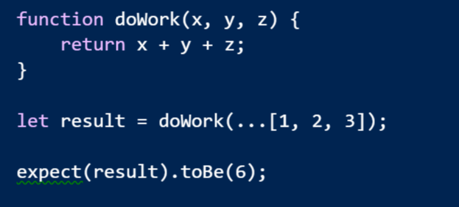
Spread Operator
Spread an array across the parameters

Slide 29
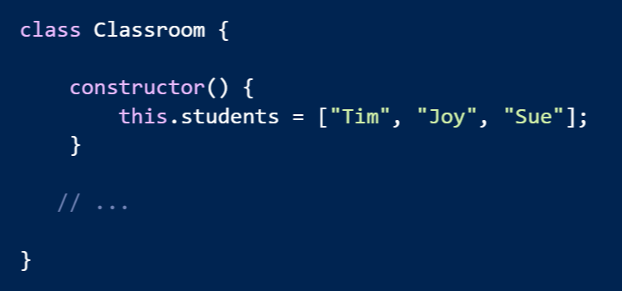
Problem: Encapsulating Collections

Slide 30
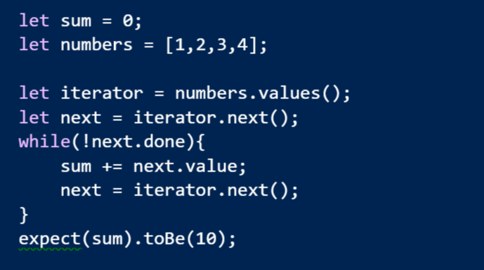
Solution: Iterators and Iterables

Slide 31
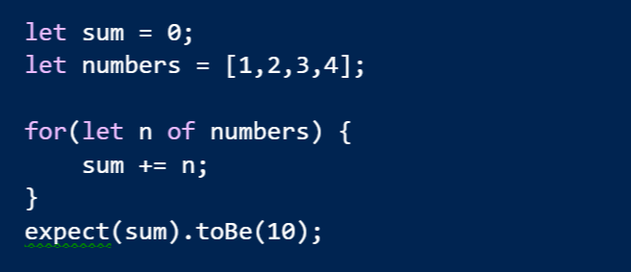
for of

Slide 32
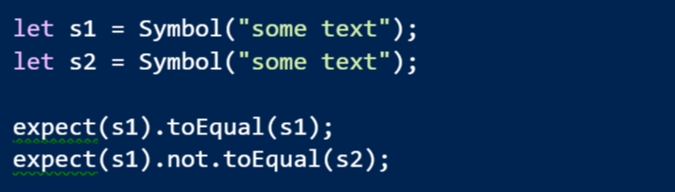
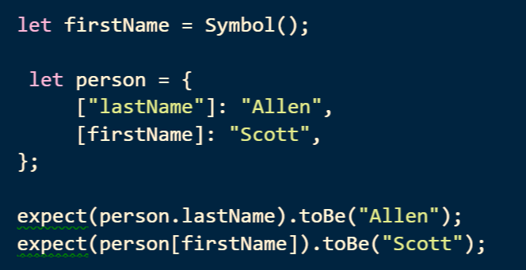
Symbol
A new type where every value is unique and immutable
Can use a symbol as a key into an object

Slide 33
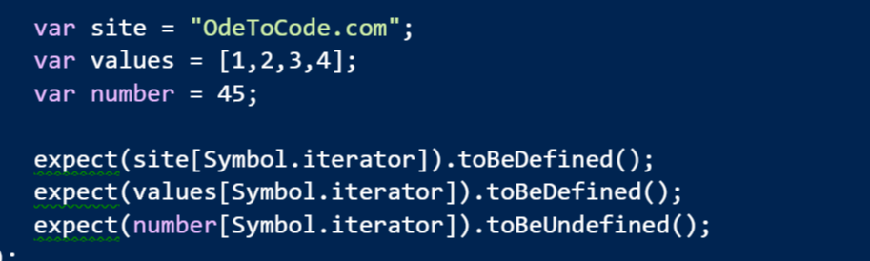
Symbol.iterator
A magic method that makes an object iterable

Slide 34
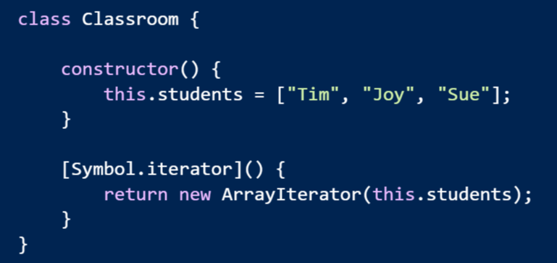
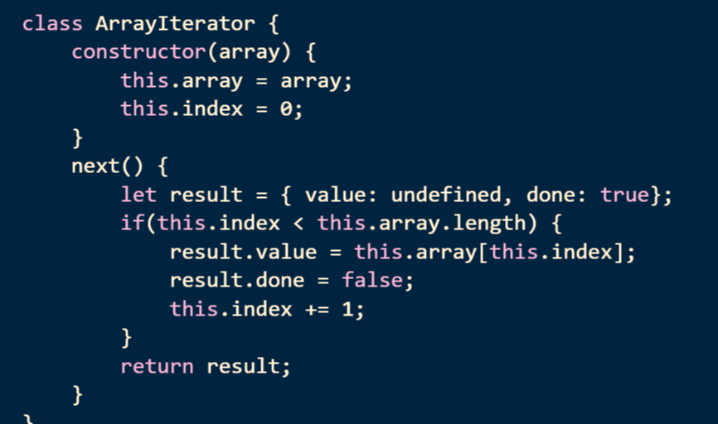
Make Your Own Iterable

Slide 35
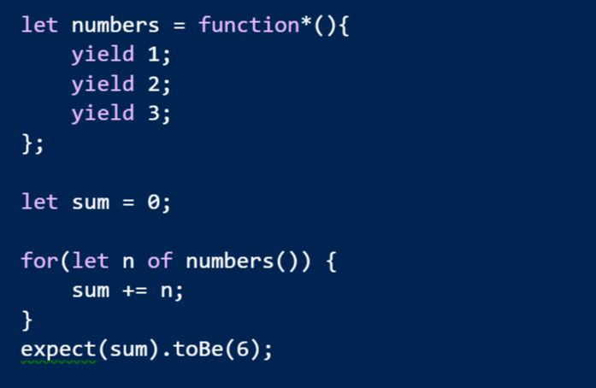
Generators

Slide 36
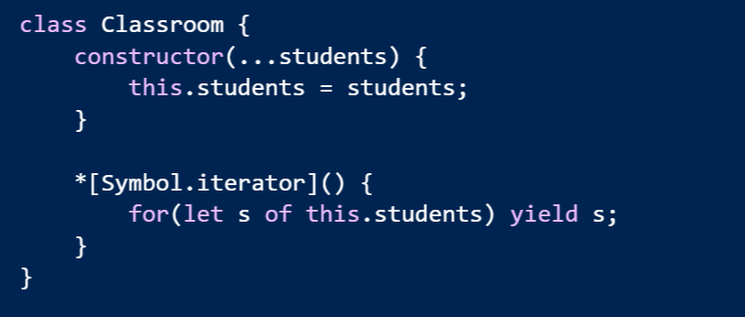
Easy To Make Iterables

Slide 37
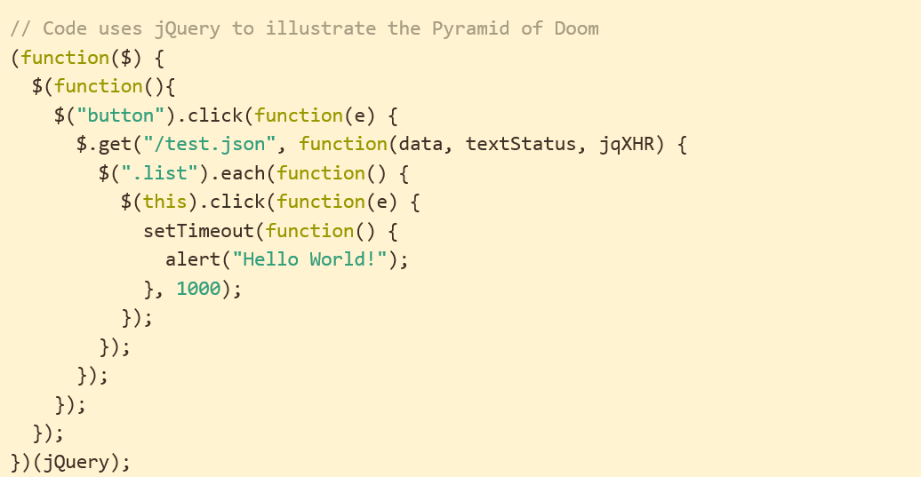
Problem: Async Code
http://tritarget.org/blog/2012/11/28/the-pyramid-of-doom-a-javascript-style-trap/

Slide 38
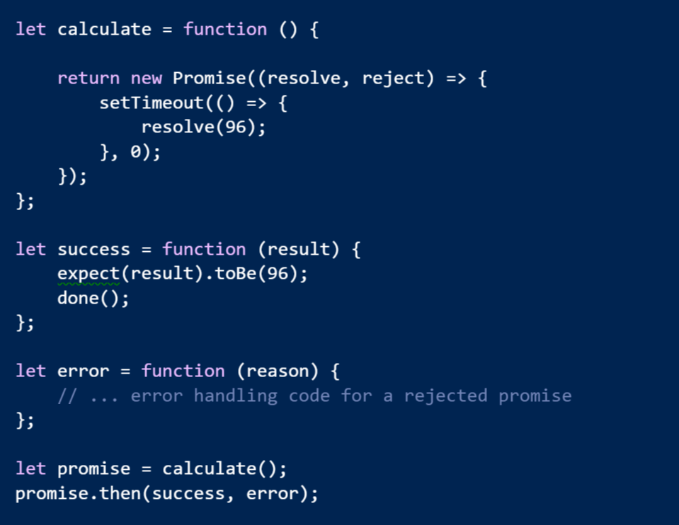
Solution: Promises

Slide 39
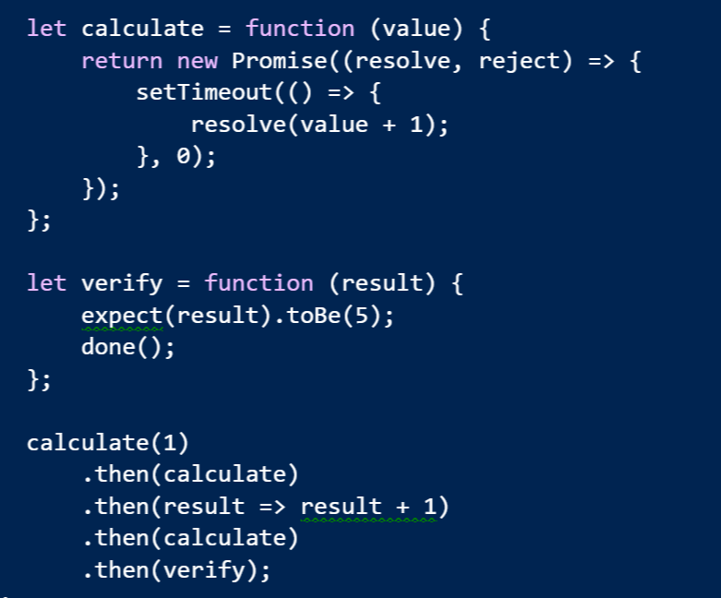
Promises Chain

Slide 40
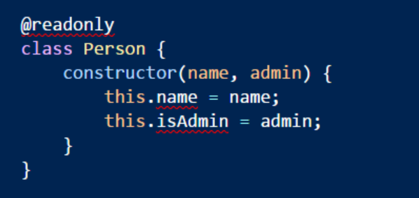
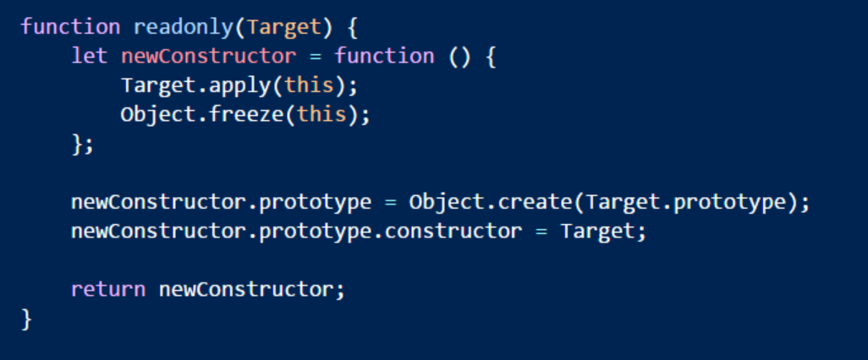
Decorators
@ symbol followed by a function
Function can modify
A class
A property
A method
A parameter

Slide 41

TypeScript
Designed by Microsoft
Anders Heilsberg
Open Source
https://github.com/Microsoft/TypeScript
Superset of JavaScript
Adds optional types and interfaces

Slide 42
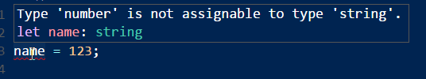

Type Annotations
Declare the intended type of a variable
Default is “any”
boolean, number, string, Array, enum, void

Slide 43
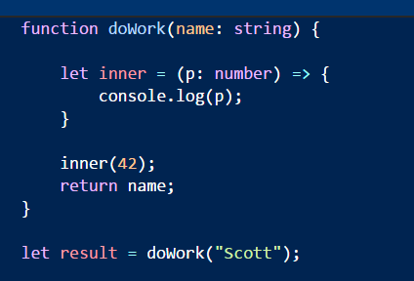
Types and Functions
Parameters can be typed
Return value can also be typed
Often can be inferred

Slide 44
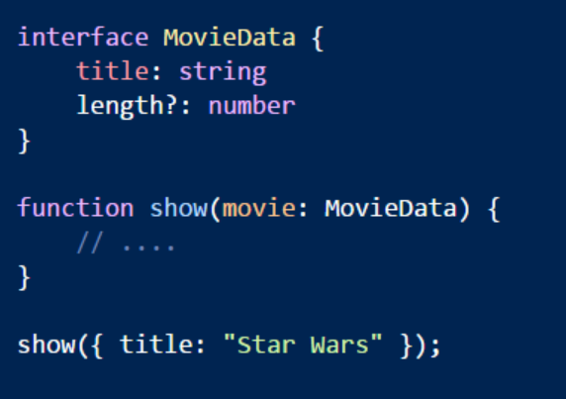
Interfaces
Focus on the shape
Allows for duck typing
Can use optional properties
Can also describe functions

Slide 45
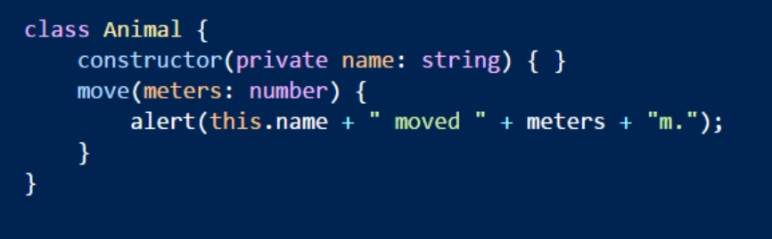
Public and Private
Public is the default
Compiler enforces private keyword

Slide 46
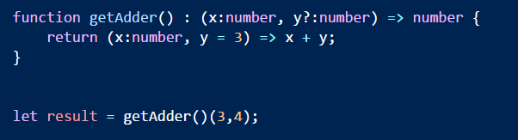
Functions
Can have return types, optional and default parameters

Slide 47
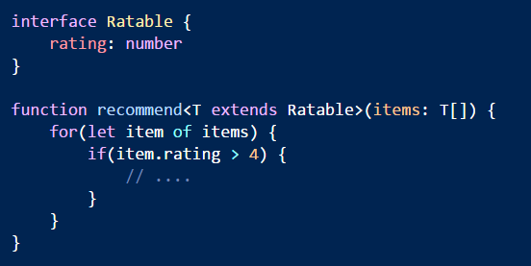
Generics
Use generic types to parameterize a function or class
Generic constraints can make type programmable

Slide 48

Declaration Files
.d.ts files provide type metadata for 3rd parties

Slide 49
Summary
ES2015 is a new language
Classes, arrow functions, generators, and more
TypeScript adds optional type annotations
Types are structural
Type annotations useful for tooling and compile time checks

