Slide 1
Code First Entity Framework
From C# to the Database

Slide 2
Overview
The DbContext
Conventions
The API
Fetching data

Slide 3
Getting Started
public class Movie
{
public int Id { get; set; }
public string Title { get; set; }
}
public class MovieDb: DbContext
{
public DbSet<Movie> Movies { get; set; }
}

Slide 4
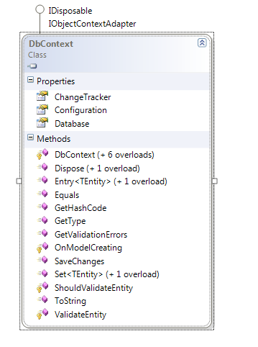
DbContext

Slide 5
Construction & Connecting
Convention
Config entry
Explicit
EDMX is optional
public class MovieDb: DbContext
{
public MovieDb() :base("movie_sql_db")
{
}
public DbSet<Movie> Movies { get; set; }
}

Slide 6
Initialization & Seeding
EF knows if the model changes …
Database.SetInitializer(
new DropCreateDatabaseIfModelChanges<MovieDb>());
public class MovieDbInitializtion
: DropCreateDatabaseAlways<MovieDb>
{
protected override void Seed(MovieDb context)
{
new Movie() {Title = "Pulp Fiction "};
new Movie() {Title = "The Matrix"};
base.Seed(context);
}
}

Slide 7
Migrations
Enable-Migrations
Automatic migrations
Code based migrations
public class Settings : DbMigrationContext<MovieDb>
{
public Settings()
{
AutomaticMigrationsEnabled = false;
SetCodeGenerator<CSharpMigrationCodeGenerator>();
AddSqlGenerator<SqlConnection, SqlServerMigrationSqlGenerator>();
}
}

Slide 8
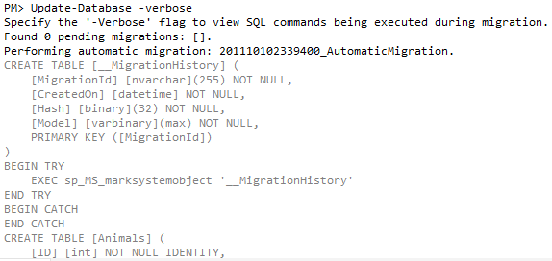
Update-Database
Can perform an automatic migration

Slide 9
Mapping
Fluent API
Data Annotations
Key
Concurrency
Timestamp
DatabaseGenerated
protected override void OnModelCreating(DbModelBuilder modelBuilder)
{
modelBuilder.Entity<Movie>()
.HasKey(m => m.Pkey)
.ToTable("tbl_movies");
base.OnModelCreating(modelBuilder);
}

Slide 10
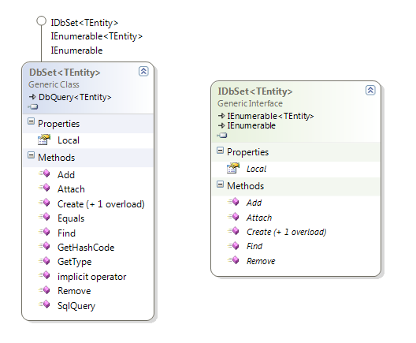
DbSets
Use DbSet<T>
Use IDbSet<T>
Can be read-only

Slide 11
Retrieving Entities
Use LINQ queries
Use Find (with a primary key)
Will use cached entities
var db = new MovieDb();
var movie = db.Movies.Single(m => m.Id == 1);
var db = new MovieDb();
var movie = db.Movies.Find(1);

Slide 12
Entity States
Added
Deleted
Detached
Modified
Unchanged
Movie newMovie = new Movie() {Title = "Star Wars"};
DbEntityEntry<Movie> entry = db.Entry(newMovie);
EntityState state = entry.State;

Slide 13
Proxies
EF will generate dynamic proxies by default
var movie = db.Movies.Create();
movie.Title = "Cars";
db.SaveChanges();
var movie = db.Movies.Single(m => m.Id == 3);
var type = ObjectContext.GetObjectType(movie.GetType());

Slide 14
Attaching
Attached entities in an Unchanged state
db.Movies.Attach(movie); // movie is unchanged
// apply changes here, or if movie is already edited:
db.Entry(movie).State = EntityState.Modified;
db.SaveChanges();

Slide 15
Property Values
Several ways to access values in an entity
var entry = db.Entry(movie);
var isModified = entry.Property(m => m.Title).IsModified;
if(isModified)
{
var curentTitle = entry.Property(m => m.Title).CurrentValue;
var originalTitle = entry.Property(m => m.Title).OriginalValue;
}
var values = entry.GetDatabaseValues();
foreach (var name in values.PropertyNames
{
Console.WriteLine(values[name]);
}

Slide 16
Loading
Use Include to eager load
Always loads all related entities
Lazy loading
Achieved through proxies and virtual properties
var db = new MovieDb();
var query = db.Movies.Include(m => m.Reviews)
.Where(m => m.Id == 3);

Slide 17
Explicit and Filtered Loads
if(!db.Entry(movie).Collection(m => m.Reviews).IsLoaded)
{
db.Entry(movie).Collection(m => m.Reviews).Load();
}
db.Entry(movie).Collection(m => m.Reviews)
.Query()
.Where(r => r.Username == "Scott")
.Load();

Slide 18
Local Data
Local property contains entities tracked by DbContext
It is an ObservableCollection
var db = new MovieDb();
db.Movies.Local.CollectionChanged += (s, e) =>
{
foreach(var newItem in e.NewItems)
{
Console.WriteLine(db.Entry(newItem).State);
}
};

Slide 19
Optimistic Concurrency
try
{
db.SaveChanges();
}
catch(DbUpdateConcurrencyException ex)
{
// ...
}

Slide 20
Working with SQL
var movies = db.Movies
.SqlQuery("SELECT * FROM movies WHERE Title LIKE {0}",
"Star%")
.ToList();
var movies =
db.Movies
.SqlQuery("SELECT * FROM movies WHERE Title LIKE @title",
new SqlParameter("@title", "Star%"))
.ToList();
var count = db.Database.SqlQuery<int>(
"SELECT COUNT(*) FROM movies");
int rows = db.Database.ExecuteSqlCommand("DELETE FROM movies");

Slide 21
Summary
EF Code First
Easy API
Conventions

