Slide 1
C# : Classes and Objects
new World();

Slide 2
Overview
Classes versus Objects
Constructors
Inheritance
Access modifiers
Abstract classes
Static classes
Sealed classes
Partial classes

Slide 3
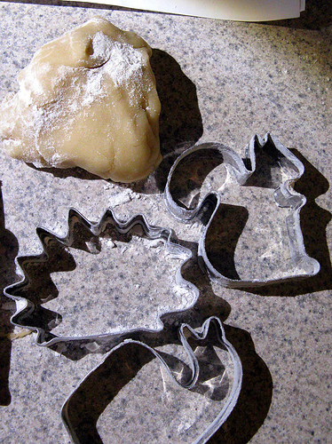
Classes are to Objects as …
Classes define types
State
Behavior
Access
Objects are instances of a type
You can create multiple instances
Each instance holds different state
Each instance has same behavior

Slide 4
Constructors
Special methods to create objects
Set default values
Multiple constructors allowed
Overloaded methods must take different arguments
class Employee
{
public Employee()
{
Name = "<empty>";
Salaried = false;
}
// ...

Slide 5
Reference Types
Classes create reference types
Object is stored on the “heap”
Variables reference the object instance
Heap
Employee worker = new Employee();
worker.Name = "Tim";
Employee
Employee
Name=“Tim”
Employee

Slide 6
Object Oriented Programming
C# is an OO language
Inheritance
Encapsulation
Polymorphism

Slide 7
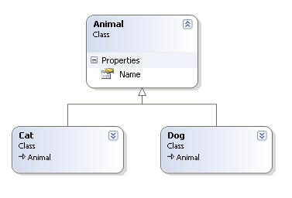
Inheritance
Create classes to extend other classes
Classes inherit from System.Object by default
Gain all the state and behavior of the base class
class Animal
{
public string Name { get; set; }
}
class Dog : Animal
{
}
class Cat : Animal
{
}

Slide 8
Access Modifiers
Keywords to declare the accessibility of a type or member
Keyword | Applicable To | Meaning
public | Class, Member | No restrictions
protected | Member | Access limited to the class and derived classes
internal | Class, Member | Access limited to the current assembly
protected internal | Member | Access limited to current assembly and derived types
private | Member | Access limited to the class

Slide 9
Abstract
The abstract keyword
Can apply to a class
Can also apply to members (methods, properties, indexers, events)
Abstract class cannot be instantiated
Abstract class is designed as a base class
Must implement abstract members to make a concrete class
public abstract class Animal
{
public abstract void PerformTrick();
}
public class Dog : Animal
{
public override void PerformTrick()
{
// roll over
}
}

Slide 10
Virtual
The virtual keyword creates a virtual member
Can override the member in a derived class
Members are non-virtual by default
Virtual members dispatch on runtime type
public class Animal
{
public virtual void PerformTrick()
{
// animal trick
}
}
public class Dog : Animal
{
public override void PerformTrick()
{
// perform dog trick
// and then animal trick
base.PerformTrick();
}
}

Slide 11
Static
Static members are members of the type
Cannot invoke the member through an object instance
Static classes can have only static members
Cannot instantiate a static class
public double Circumference
{
get { return Diameter * Math.PI; }
}
public double Diameter
{
get; set;
}

Slide 12
Sealed
Sealed classes cannot be inherited
Prevent extensibility or misuse
Some framework classes sealed for performance and security implications
public class MyString : System.String
{ // error!
}

Slide 13
Partial classes
Partial classes frequently generated by VS designer
Partial class definitions can span multiple files
But only in the same project
Partial method definitions are extensibility points
Optimized away if no implementation provided
public partial class Animal
{
public string Name { get; set; }
partial void OnNameChanged();
}
public partial class Animal
{
partial void OnNameChanged()
{
// ....
}
}

Slide 14
Summary
C# gives you everything you need for OOP
Encapsulation
Inheritance
Polymorphism
Additional features for performance, convenience, extensibility
Static classes
Sealed classes
Partial classes

