Slide 1
C# : Types & Assemblies
Interfacing with C#

Slide 2
Overview
Value types and reference types
Enumerations
Structs
Interfaces
Arrays
Assemblies
Assembly references

Slide 3
Reference Types
Variables store a reference to an object
Multiple variables can point to the same object
Single variable can point to multiple objects over it’s lifetime
Objects allocated on the heap by new operator
Employee
e1
e2
Employee
e3

Slide 4
Value Types
Variables hold the value
No pointers or references
No object allocated on the heap – lightweight
Should be immutable
Many built-in primitives are value types
Int32, DateTime, Double
y
Int32
x
Int32

Slide 5
Creating Value Types
struct definitions create value types
Cannot inherit from a struct (implicitly sealed)
Rule of thumb: should be less than 16 bytes
public struct Complex
{
public int Real;
public int Imaginary;
}

Slide 6
Method Parameters
Parameters pass “by value”
Reference types pass a copy of the reference
Value types pass a copy of the value
Changes to value don’t propagate to caller
Parameter keywords
ref and out keywords allow pass “by reference”
ref parameters requires initialized variable
public bool Work(ref string text, out int age)
{
return Int32.TryParse(text, out age);
}

Slide 7
The Magical String Type
Strings are reference types
But behave like value types
Immutable
Checking for equality performs a string comparison
string s1 = "Vitamin";
string s2 = "Vitamin";
bool result = s1 == s2;
result = s1.Equals(s2, StringComparison.InvariantCultureIgnoreCase);

Slide 8
Boxing & Unboxing
Boxing converts a value type to an object
Copies value into allocated memory on the heap
Can lead to performance and memory consumption problems
Unboxing converts an object to a value type
public static void Main()
{
int i = 42;
object o = i; // box
DoWork(i); // box
}
private static void DoWork(object value)
{
int i = (int) value;
}
i (42)
int 42
o
int 42
value
i (42)

Slide 9
Enumerations
An enum creates a value type
A set of named constants
Underlying data type is int by default
public enum PayrollType
{
Contractor = 1,
Salaried,
Executive,
Hourly
}
if(e.Role == PayrollType.Hourly)
{
// ...
}

Slide 10
What Makes a Value Type & Reference Type?
Value Type
struct
enum
Reference Type
class
interface
delegate
array

Slide 11
Interfaces
An interface defines a group of related methods, properties, and events.
No implementation defined in interface (very abstract)
All members are public
Classes and structs can inherit from an interface and provide an implementation
Classes and structs can inherit from multiple interfaces
interface IMessageLogger
{
void LogMessage(string message);
}
class FileSystemLogger : IMessageLogger
{
public void LogMessage(string message)
{
// ....
}
}

Slide 12
Arrays
Simple data structure for managing a collection of variables
Everything inside has the same type
Always 0 indexed
Always derive from abstract base type Array
Single-dimensional, multi-dimensional, and jagged
const int numberOfBowlers = 4;
int[] scores = new int[numberOfBowlers];
int totalScore = 0;
foreach(int score in scores)
{
totalScore += score;
}
double averageScore = (double)totalScore / scores.Length;

Slide 13
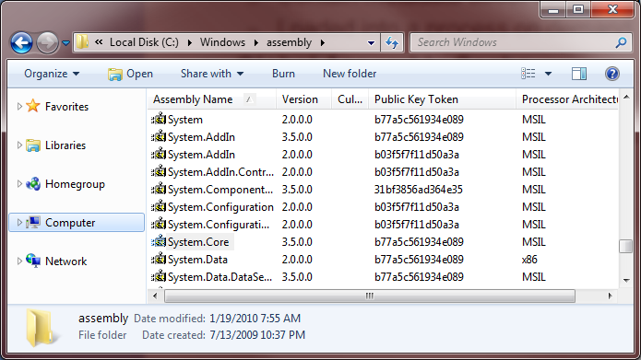
Assemblies
Fundamental building blocks
Implemented as .exe or .dll files
Contain metadata about version and all types inside
Global Assembly Cache
A central location to store assemblies for a machine
Assembly in the GAC requires a strong name

Slide 14
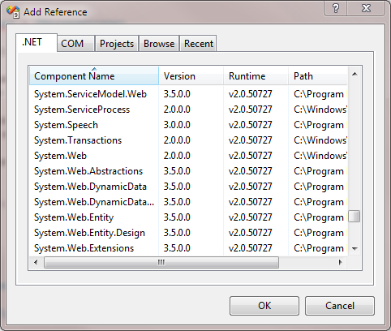
References
Must load assembly into a process before using types inside
Easy approach – reference the assembly in Visual Studio
Assemblies loaded on demand at runtime

Slide 15
Summary
Every type is a value type or reference type
Use struct to create a value type
Use class to create a reference type
Arrays and strings are reference types
Strings behave like a value type

