Slide 1
C# and the CLR
Best Friends Forever

Slide 2
Overview
JIT compilation and garbage collection
Threads
Reflection and metadata
Processor architecture
Interoperability

Slide 3
C# - From Source To CPU
if (age <= 2)
ServeMilk();
else if (age < 21)
ServeSoda();
else
{
ServeDrink();
}
if (age <= 2)
ServeMilk();
else if (age < 21)
ServeSoda();
else
{
ServeDrink();
}
if (age <= 2)
ServeMilk();
else if (age < 21)
ServeSoda();
else
{
ServeDrink();
}
C# Compiler
NGEN
Assembly
(MSIL)
JIT

Slide 4
Garbage Collection
Garbage collector cleans up unused memory
Visits global variables and local variables to determine what is in use
String
employee
Employee

Slide 5
Threads
System.Threading
Low level API for starting, stopping, and joining threads
System.Threading.Tasks
High level API for concurrent and asynchronous programming
string[] urls = {"http://pluralsight.com",
"http://microsoft.com",
"http://odetocode.com" };
Parallel.ForEach(urls, url => {
var client = new WebClient();
var result = client.DownloadString(url);
// ...
});

Slide 6
Reflection
CLR provides an API for self-examination
System.Type is the starting point for reflection
Type type = o.GetType();
PropertyInfo[] properties = type.GetProperties();
foreach (var propertyInfo in properties)
{
Console.WriteLine(propertyInfo.Name);
}

Slide 7
Custom metadata
[AttributeUsage(AttributeTargets.Property)]
public class DangerZoneAttribute : Attribute
{
public DangerZoneAttribute(int min, int max)
{
Minimum = min;
Maximum = max;
}
public int Minimum { get; set; }
public int Maximum { get; set; }
}
[DangerZone(12,18)]
public int Age { get; set; }

Slide 8
Invoking Methods and Properties
Type type = o.GetType();
PropertyInfo info = type.GetProperty("Length");
int length = (int) info.GetValue(o, null);
Type type = o.GetType();
MethodInfo info = type.GetMethod("Compute");
int result = (int) info.Invoke(o, new object[] {2, 5});
dynamic someObject = o;
int length = someObject.Length;
int result = someObject.Compute(2,5);
C# 4.0

Slide 9
Creating Objects
Activator class provides static methods to instantiate types
var assembly = Assembly.LoadFrom("plugin.dll");
foreach(var type in assembly.GetTypes())
{
if(type.GetInterface("ILogger") != null)
{
var logger = Activator.CreateInstance(type);
}
}

Slide 10
Creating Code
MethodInfo methodInfo = typeof (Console).GetMethod("WriteLine",
new Type[] {typeof (string)});
DynamicMethod method = new DynamicMethod(
"HelloWorld", typeof(void), new Type[]{},
GetType(), false);
ILGenerator il = method.GetILGenerator();
il.Emit(OpCodes.Ldstr, "Hello, world");
il.Emit(OpCodes.Call, methodInfo);
il.Emit(OpCodes.Ret);
Action action = (Action)method.CreateDelegate(typeof (Action));
action();

Slide 11
C# on the Metal
x86
32 bit
process
AnyCPU
64 bit
process
x64

Slide 12
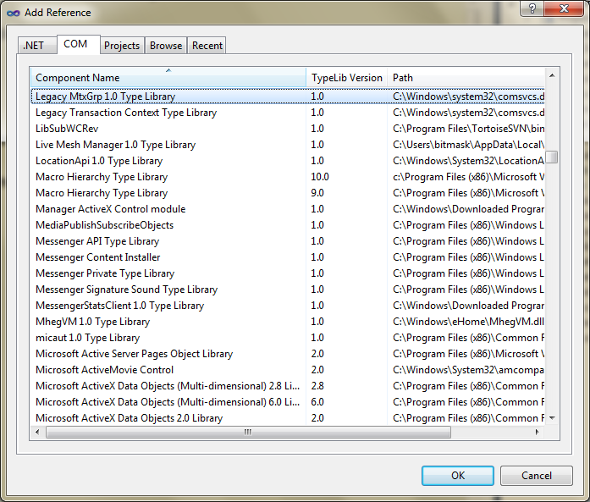
COM Interop
C# can consume COM components
C# code can package itself as a COM component
[Guid("EAA4976A-45C3-4BC5-BC0B-E474F4C3C83F")]
public interface MyComInterface
{
}

Slide 13
Pinvoke Interop
Platform Invoke
Can call into Windows APIs and unmanaged code
public static class NativeStuff
{
public static void Beep()
{
if (!MessageBeep(0))
{
Int32 err = Marshal.GetLastWin32Error();
throw new Win32Exception(err);
}
}
[DllImport("User32.dll")]
static extern Boolean MessageBeep(UInt32 beepType);
}

Slide 14
Summary
C# - tightly integrated with the CLR
Can still interop with COM
Can still interop with native code
Metadata drives many features
Garbage collection
Reflection

