Slide 1
Controllers

Slide 2
Overview
MVC Controllers
Controller Factories
Actions
Action Filters
Action Results

Slide 3
Controllers Are Key
Controller
HTTP Request
Model
View

Slide 4
Routes & Controllers
Home
Controller
http://localhost/home/index/
Model
View
routes.MapRoute(
"Default", // Route name
"{controller}/{action}/{id}", // URL with parameters
new { controller = "Home",
action = "Index",
id = ""
} // Parameter defaults

Slide 5
MVC Request Processing
MvcRouteHandler
Routing engine is agnostic
MvcHandler
Creates controller
Executes controller
Disposes controller
IController
Lowest level abstraction
http://localhost/home/index/
UrlRoutingModule
MvcRouteHandler
IControllerFactory
MvcHandler
IController

Slide 6
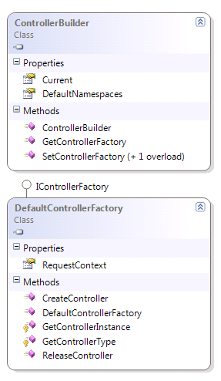
DefaultControllerFactory
Finds controllers
Looks in all referenced assemblies
Looks in all namespaces
Type name ends with “Controller”
Type implements IController
Instantiates controllers
Controller must have a default constructor
public class EmployeeController : IController
{
public EmployeeController(ILogger logger)
{
_logger = logger;
}
// ...

Slide 7
Controller Factory Extensibility
Can set factory during startup
Can also implement custom IDependencyResolver
protected void Application_Start() {
InitializeContainer();
RegisterRoutes(RouteTable.Routes);
}
private void InitializeContainer() {
StructureMapConfiguration
.ForRequestedType<ILogger>()
.TheDefaultIsConcreteType<SqlServerLogger>();
ControllerBuilder.Current.SetControllerFactory(
new StructureMapControllerFactory());
}

Slide 8
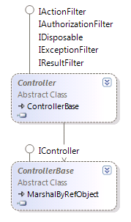
Controller Execution
IController
Execute method invoked by MvcHandler
Writes to the response stream
ControllerBase
Introduces ViewData and ControllerContext
Controller
Default base class in MVC
Introduces Actions
Includes helper methods for rendering content

Slide 9
Actions
http://localhost/home/index/
Actions are the ultimate request destination
Public controller methods
Non-static
No return value restrictions
UrlRoutingModule
MvcRouteHandler
IControllerFactory
MvcHandler
Controller Derived
Object
IActionInvoker

Slide 10
Action Selector Filters
Specified as attributes
ActionName
Overrides default of action name == method name
Method name is no longer a valid action
AcceptVerbs attribute
Restricts invocation to specified verbs
[ActionName("Modify")]
[AcceptVerbs(HttpVerbs.Post)]
public ActionResult Edit(Department department)
{
// ...
}

Slide 11
Action Parameters
Actions can take a variety of parameters
Primitive parameters (int, bool, string)
Map from route data
Map from form data
Map from query string
If parameter is not found a null reference is passed
Complex parameters
Framework uses model binder to map properties
Public properties of object mapped to data sources listed above
You can define custom model binders

Slide 12
Filter Attributes
Name | Description
OutputCache | Cache the output of a controller
ValidateInput | Turn off request validation and allow dangerous input
Authorize | Restrict an action to authorized users or roles
ValidateAntiForgeryToken | Helps prevent cross site request forgeries
HandleError | Can specify a view to render in the event of an unhandled exception

Slide 13
Custom Action Filters
Derive from ActionFilterAttribute base class
public class LogAttribute : ActionFilterAttribute
{
public override void OnActionExecuting(ActionExecutingContext filterContext)
{ /* */ }
public override void OnActionExecuted(ActionExecutedContext filterContext)
{ /* */ }
public override void OnResultExecuting(ResultExecutingContext filterContext)
{ /* */ }
public override void OnResultExecuted(ResultExecutedContext filterContext)
{ /* */ }
}
[Log]
[HandleError]
public class DepartmentController : Controller
{
// ...
}

Slide 14
Results
Actions typically return an ActionResult
Name | Framework Behavior | Producing Method
ContentResult | Returns a string literal | Content
EmptyResult | No response
FileContentResult / FilePathResult / FileStreamResult | Return the contents of a file | File
HttpUnauthorizedResult | Returns an HTTP 403 status
JavaScriptResult | Returns a script to execute | JavaScript
JsonResult | Returns data in JSON format | Json
RedirectResult | Redirects the client to a new URL. | Redirect
RedirectToRouteResult | Redirect to another action, or another controller’s action | RedirectToRoute / RedirectToAction
ViewResult PartialViewResult | Response is the responsibility of a view engine | View / PartialView

Slide 15
Asynchronous Controllers
When to use?
Actions are waiting for network or other I/O operation
Parallelism more valuable than simplicity
How to use?
Derive from AsyncController
Two methods for each action (ActionAsync and ActionCompleted)
Replace blocking I/O calls with async versions
Use AsyncManager to coordinate with MVC runtime

Slide 16
Sync -> Async
public ActionResult Index()
{
var client = new NewsServiceClient();
var news = client.GetNews();
return View(news);
}
public void IndexAsync()
{
var client = new NewsServiceClient();
AsyncManager.OutstandingOperations.Increment();
client.GetNewsCompleted += (s, e) => {
AsyncManager.Parameters["news"] = e.Result;
AsyncManager.OutstandingOperations.Decrement();
};
client.GetNewsAsync();
}
public ActionResult IndexCompleted(object news)
{
return View(news);
}

Slide 17
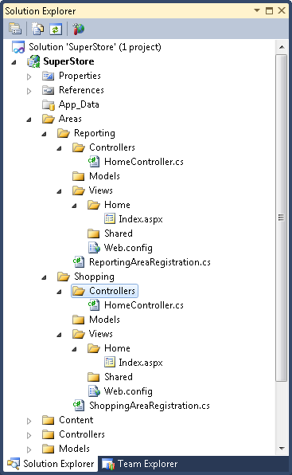
Areas
Break large applications into pieces
Each area has self-contained routes, controllers, and views

Slide 18
Area Registration
public class ShoppingAreaRegistration : AreaRegistration
{
public override string AreaName
{
get { return "Shopping"; }
}
public override void RegisterArea(AreaRegistrationContext context)
{
context.MapRoute(
"Shopping_default",
"Shopping/{controller}/{action}/{id}",
new { action = "Index", id = UrlParameter.Optional }
);
}
}
protected void Application_Start()
{
AreaRegistration.RegisterAllAreas();
RegisterRoutes(RouteTable.Routes);
}

Slide 19
Area Linking
Links inside current area
<%: Html.ActionLink("Home", "Index", "Home")%>
<%: Html.ActionLink("Shopping", "Index", "Home",
new { area="Shopping"}, null)%>
Links to external area

Slide 20
Summary
Controllers are the lynchpins
IController defines an Execute method
Controller class defines a rich execution model
Controller built by a factory
Actions invoked by name
Extensible set of action selectors and action filters
Variety of ActionResults

