Slide 1
Views

Slide 2
Overview
Conventions
Layout
HTML Helpers
Partial Views
Preventing XSS and CSRF

Slide 3
HTTP Refresher
Clients request information with an HTTP GET
Retrieve HTML
Query string can parameterize the request
Should not modify state on the server
Clients send information with an HTTP POST
“Controls” are input elements inside a form element
Values of input elements submitted by browser as name-value pairs
Safe to modify state
<form name="login" method="POST" >
<input type=hidden name=origin value="p" />
<input name="sign_on" type="submit" />
<select name="AccountDrop">
<option>...</option>
</select>
</form>

Slide 4
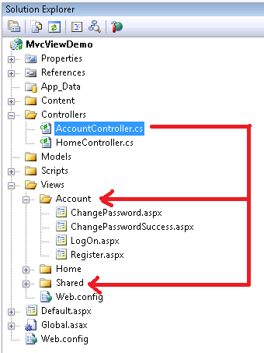
View Conventions
Every controller has a default view directory
Default view is the name of the action
ViewResult can override the default view name
Shared views for all controllers
ASP.NET will look here after the default
// extension not required ...
return View("Error");

Slide 5
Razor Templates
Template
Data
Generated
Output
+
=

Slide 6
Goals
Easy to use / easy to learn
No ties to ASP.NET runtime
Smart!
<% foreach (var item in Model) { %> <tr> <td> <%: Html.ActionLink("Edit", "Edit", new { id=item.ID }) %> | <%: Html.ActionLink("Details", "Details", new { id=item.ID }) %> | <%: Html.ActionLink("Delete", "Delete", new { id=item.ID }) %> </td> <td> <%: item.Title %> </td> <td> <%: String.Format("{0:g}", item.ReleaseDate) %> </td> </tr> <% } %>
@foreach (var item in Model) { <tr> <td> @Html.ActionLink("Edit", "Edit", new { id=item.ID }) | @Html.ActionLink("Details", "Details", new { id=item.ID }) | @Html.ActionLink("Delete", "Delete", new { id=item.ID }) </td> <td> @item.Title </td> <td> @String.Format("{0:g}", item.ReleaseDate) </td> </tr> }

Slide 7
Intermingling
C#
HTML
<ul> @foreach (var movie in Model) { <li> <a href="/home/details/@movie.ID">@movie.Title</a> </li> } </ul>
Email: scott-allen@pluralsight.com Twitter: @@OdeToCode

Slide 8
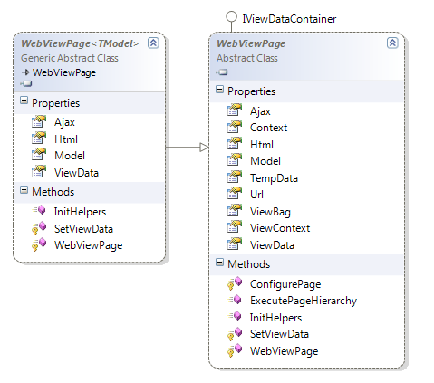
Razor Views and View Data
Model type is dynamic
ViewBag is dynamic
Strongly type with @model

Slide 9
Layout with Razor
Layout views are “master pages” for razor
Use inherited methods to specify content areas
RenderBody
RenderSection
<!DOCTYPE html> <html> <head> <title>@ViewBag.Title</title> <script src="@Url.Content("~/Scripts/jquery-1.4.4.min.js")"
type="text/javascript"></script> </head> <body> @RenderBody() </body> </html>

Slide 10
_ViewStart
Code inside _ViewStart.cshtml executes before every view renders
Hierarchical (subfolders override parent)
@{ Layout = "~/Views/Shared/_Layout.cshtml"; }

Slide 11
Razor Configuration
Razor uses a dedicated configuration section
<system.web.webPages.razor> <host factoryType=“MvcWebRazorHostFactory, System.Web.Mvc" /> <pages pageBaseType="System.Web.Mvc.WebViewPage"> <namespaces> <add namespace="System.Web.Mvc" /> <add namespace="System.Web.Mvc.Ajax" /> <add namespace="System.Web.Mvc.Html" /> <add namespace="System.Web.Routing" /> </namespaces> </pages> </system.web.webPages.razor>

Slide 12
HTML Helpers
Html is a property of the ViewPage base class
Create inputs
Create links
Create forms
@using (Html.BeginForm()) { @Html.ValidationSummary(true) <div class="editor-label"> @Html.LabelFor(model => model.FirstName) </div> <div class="editor-field"> @Html.EditorFor(model => model.FirstName) @Html.ValidationMessageFor(model => model.FirstName) </div>

Slide 13
Custom Helpers
Write extension methods for the HtmlHelper class
Return string or override ToString method
TagBuilder manages closing tags and attributes
Add namespace in web.config
The place for complicated view logic
public static TagBuilder Image(this HtmlHelper helper,
string imageUrl, string alt)
{
TagBuilder imageTag = new TagBuilder("img");
imageTag.MergeAttribute("src", imageUrl);
imageTag.MergeAttribute("alt", alt);
return imageTag;
}

Slide 14
ViewData / ViewBag
A loose dictionary of model data
ViewData and ViewBag are synonomous
Model type is dynamic by default
@ViewData["Message"] @ViewBag.Message @Model.Anything

Slide 15
Partials
Partial views render portions of a page
Reuse pieces of a view
Html helpers – Partial and Action
Razor partial views are still .cshtml files
@foreach (var item in Model) { @Html.Partial("_movieRecord", item) }
@model Movie <tr> <td> @Html.ActionLink("Edit", "Edit", new { id = this.Model.ID }) | @Html.ActionLink("Details", "Details", new { id = Model.ID }) </td> <td> @Model.Title </td> </tr>

Slide 16
Html.Action vs Html.Partial
Partial
Use partials to reuse markup
Action
Think "sub-request"
Can let controller build sub-model, select partial view
@Html.RenderPartial("movieDetail", Model.Movie)
@Html.RenderAction("show", "weather", new { postalCode="21740" }

Slide 17
Templated Helpers
Builds UI based on metadata
@Html.Display("JoinedOn")
@Html.DisplayFor(m => m.JoinedOn)
@Html.DisplayForModel()
@Html.Editor("JoinedOn")
@Html.EditorFor(model => model.JoinedOn)
@Html.EditorForModel()

Slide 18
Data Annotations
Gives additional metadata for templates
public class UserEditModel { [ScaffoldColumn(false)] public int ID { get; set; } [DisplayFormat(NullDisplayText="No name")] public string Name { get; set; } [DisplayName("Joined")] [DisplayFormat(DataFormatString="{0:d}")] public DateTime JoinedOn { get; set; } }

Slide 19
Display / Edit Annotations
Attribute | Description
DisplayColumn | Specify the property of a model class for simple text display.
HiddenInput | Render value in a hidden input (when editing).
UIHint | Specify the name of the template to use for rendering.
DataType | Common templates (email, password, URL, currency)
ReadOnly | Specify a read-only property (for model binding).
DisplayFormat | Format strings and null display text
ScaffoldColumn | Turn off display and edit capabilities
DisplayName | Friendly name for labels
Required | Specify required properties (for model binding).

Slide 20
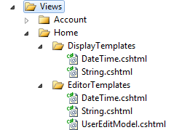
Custom Templates
DisplayTemplates
EditorTemplates
Template selected based on type
@ViewData.TemplateInfo.FormattedModelValue

Slide 21
MVCContrib
Collection of useful features for MVC development
Paging
Route debugging
Strongly typed HTML helpers
Menu and Grid builders
Test helpers
Available with NuGet
Add Package Reference

Slide 22
Custom T4 Templates
Text Template Transformation Toolkit
Code generation tool
Built into Visual Studio
Customize “Add Controller” and “Add View” code generation
Copy templates into project
Remove custom build step
T4MVC
Generates strongly typed assessors for content, controllers, and actions

Slide 23


Security
Html.Encode
Helps to avoid XSS attacks
Not encoding user input makes you particularly vulnerable
Html.AntiForgeryToken
Helps to avoids CSRF attacks
Requires a ValidateAntiForgeryToken attribute on controller action
Valid only for POST operators
EVIL.com
GET evil.aspx
<form action=“http://you.com/editprofile.aspx”>
…
YOU.com
POST editprofile.aspx

Slide 24
Using Anti-Forgery Tokens
For authenticated POST operations
Adds hidden input to <form> using HtmlHelper
Cryptographically strong random number
Client must support cookies
Controller action requires token validation attribute
@using (Html.BeginForm()) {
@Html.AntiForgeryToken()
[ValidateAntiForgeryToken]
[AcceptVerbs(HttpVerbs.Post)]
public ActionResult Edit(int id, FormCollection collection)
{
…
}

Slide 25
Alternate View Engines
Spark
http://sparkviewengine.com/
NHaml
https://github.com/NHaml/NHaml
Brail
http://www.castleproject.org/monorail/documentation/v1rc2/viewengines/brail/index.html
NVelocity
http://nvelocity.sourceforge.net/
Write your own

Slide 26
Summary
Views in MVC are “close to the metal”
Can still use Web Forms view engine
HTML Helpers can build HTML
Views follow a convention
Partials can encapsulate common markup

