Slide 1
Configuration & Deployment
Putting MVC Into Production

Slide 2
Overview
Configuration files for .NET
Location
Precedence
ASP.NET MVC and IIS
Applications and App Pools
IIS Configuration
Web Deployment Projects

Slide 3
Configuration Files
XML files control environmental settings
Authentication & Authorization
Compilation
Connections
Cryptography
Custom errors
Page settings
Trace and Debug settings
Web services
Configuration is extensible

Slide 4
Accessing Settings
Use the ConfigurationManager from System.Configuration
Includes shortcuts to AppSettings and ConnectionStrings
Can also use manager class to open config files for editing and update
var server = ConfigurationManager.AppSettings["FileServerName"];
var modulesSection =
ConfigurationManager.GetSection("system.web/httpModules")
as HttpModulesSection;
var installedModules = modulesSection.Modules.Count;

Slide 5
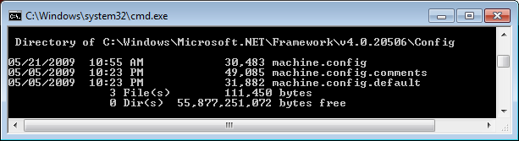
Machine Configuration
Machine.config is located in the runtime’s Config directory
Note: .NET 3.5 uses the .NET 2.0 Config directory
.comments file documents available settings
.default file contains the runtime’s default settings

Slide 6
Machine Level Web.config
Controls settings for all ASP.NET applications on a computer
Same location as machine.config
Also contains .default and .comment files
Includes
Default assemblies, namespaces, providers, security settings
<system.web>
<authorization>
<allow users="*" />
</authorization>
<!-- ... -->

Slide 7
Hierarchical Configuration
Each application inherits settings from higher level config files
Machine config
Machine web.config
Parent’s web.config
Your web.config
Settings computed once and cached
ASP.NET monitors files for changes
Lower level settings can override higher level settings
Locking down settings
Use the allowOverride attribute

Slide 8
Configuring Locations
Location element allows location-specific settings
Can also drop web.config into any sub-directory
Some settings only available at root of web site
<location path="/MySecrets" >
<system.web>
<authorization>
<deny users="*"/>
</authorization>
</system.web>
</location>

Slide 9
Custom Errors
HandleError attribute renders Error view
Custom errors must be on
Error view passed a HandleErrorInfo model
[HandleError]
public class MovieController : Controller
{
// ...
}

Slide 10
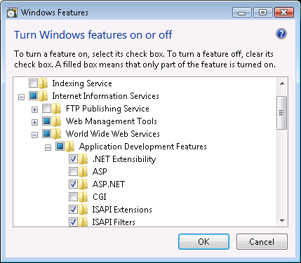
Hosting ASP.NET MVC
Building MVC projects produces a .dll
Needs a host process to execute
WebDev.Webserver.exe (Cassini) is a development host
Default for Visual Studio 2008
Rejects remote requests
Runs with your identity
Internet Information Services is a production web server
Available on both server and personal version of Windows
Scalable
Includes management and diagnostic tools
“Off by default”.
Can host various frameworks & protocols

Slide 11
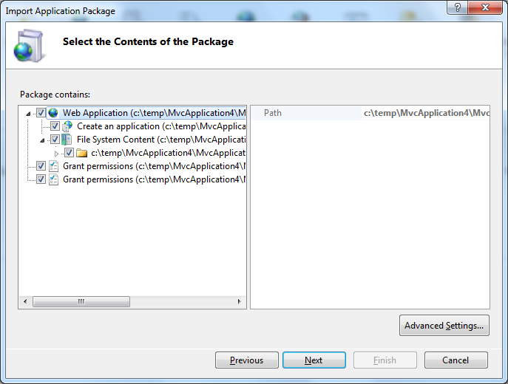
Web Deploy
Package, archive, and deploy web applications
Content
Databases
Registry, GAC, ACLs
Web server migration and synchronization
Command line and GUI tools

Slide 12
Internet Information Services
IIS uses application pools to host web applications
Each app pool has a dedicated worker process (w3wp.exe)
Runs with the NETWORK SERVICE account by default
Each app pool maintains CPU, memory, and recycle settings
App Pool #1
App Pool #2
App Pool #3
w3wp.exe
w3wp.exe
w3wp.exe
Your Web
App
Web
App
Web
App
Web
App
Web
App

Slide 13
Web.config and IIS 7+
System.web versus System.webserver
IIS 7 introduced an integrated pipeline
HTTP modules and handlers now configured under the webserver section
“Classic” pipeline supports legacy code and system.web section
Webserver settings
Compression
Default documents
Directory browsing
Logging
and more …

Slide 14
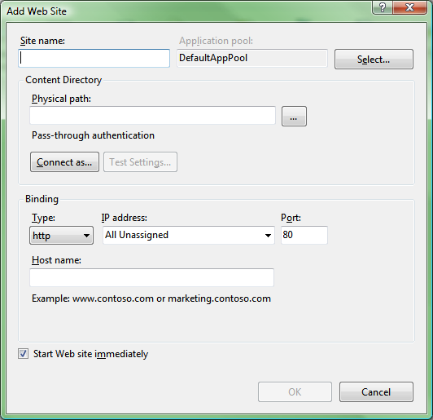
Sites, Applications, & VDirs
A web site contains one or more applications
Defines binding protocol and information
Logging and throttle settings apply to a site
Application contains one or more virtual directories
Path becomes part of a web site’s URL
Assigned to an application pool
Virtual directory points to a physical path
Can exist anywhere in a web site
Can point to an arbitrary physical path
http://www.pluralsight.com/main
/screencasts/screencast.aspx
?id=iis-aspnetdev

Slide 15
Summary
Configuration files for .NET
Location
Precedence
ASP.NET MVC and IIS
Applications and App Pools
IIS Configuration
Web Deployment Projects

