Slide 1
ASP.NET Infrastructure
Core Runtime Features

Slide 2
Overview
Caching
Internationalization and localization
Diagnostics
Membership & Security
State Management

Slide 3
Output Caching
OutputCache action filter
Use as attribute on action or controller
Specify Duration and VaryByParam
Configurable with cache profiles
Don’t use OuputCache directive on views!
Can use on Child Actions (RenderAction)
public class CachedController : Controller
{
[OutputCache(Duration=60, VaryByParam="none")]
public ActionResult Index()
{
return View();
}
}

Slide 4
Output Cache Settings
VaryByParam
Vary by “none” to always cache the same content
Vary by “*” to cache for every permutation of all parameters
Vary by “name” to cache for every value of name parameter
Location
Cache on server, client, client and server
VaryByHeader
Vary on an HTTP header, like Accept-Language
VaryByCustom
Implement custom static method in global.asax
SqlDependency
Cache until data in a SQL Server table changes

Slide 5
Cache Profiles
Avoids repetition in cache attributes
Easy to change during performance profiling
[OutputCache(CacheProfile="Aggresive", VaryByParam="firstName")]
public ActionResult Index(string firstName)
{
// ...
return View();
}
<caching>
<outputCacheSettings>
<outputCacheProfiles>
<add name="Aggresive" duration="300" />
<add name="Mild" duration="10"/>
</outputCacheProfiles>
</outputCacheSettings>
</caching>

Slide 6
Data Caching
ASP.NET Cache API
Cache object associated with HttpContext
Also accessed via HttpRuntime.Cache (better for unit tests)
Absolute and sliding expirations
Cache dependencies on file system and SQL Server data
List<Movie> topMovies = null;
if (HttpContext.Cache[TopMovieKey] == null)
{
topMovies = (from m in ctx.Movies
orderby m.Reviews.Average(r => r.Rating) descending
select m).Take(10).ToList();
HttpContext.Cache.Insert(TopMovieKey,
topMovies,
null,
Cache.NoAbsoluteExpiration,
TimeSpan.FromMinutes(10));
}

Slide 7
Localization & Culture
Thread.CurrentCulture property impacts formatting
Example: DateTime.Now.ToString()
Thread.CurrentUICulture impacts resource loading
ASP.NET can set cultures according to HTTP headers
Accept-language header
Use <globalization> section in web.config
<system.web>
<globalization culture="auto" uiCulture ="auto"/>
…
<system.web />

Slide 8
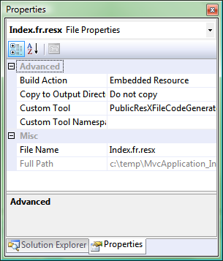
Resources
Resx files can store localized text and binary assets.
Strings.resx will store default resources
Strings.es.resx will store resource for Spanish culture
Resource manager will load appropriate file
Visual Studio generates strongly-typed class
Use “PublicResXFileCodeGenerator” as tool outside of App_GlobalResources
Set Build Action to “Embedded Resource”
Don’t use App_GlobalResouces from a controller if you want to unit test
<%= Html.Encode(Resources.Strings.Greeting) %>

Slide 9
Diagnostics
Traditional ASP.NET trace feature is geared for Web Forms
Traces page lifecycle events only
Logging options
ASP.NET Health Monitoring
log4net (http://logging.apache.org/log4net/index.html)
elmah (http://code.google.com/p/elmah/)
P&P Application Logging Block
<healthMonitoring enabled="true">
<rules>
<add name="All Events" eventName="All Events“
provider="SqlWebEventProvider"/>
</rules>
</healthMonitoring>

Slide 10
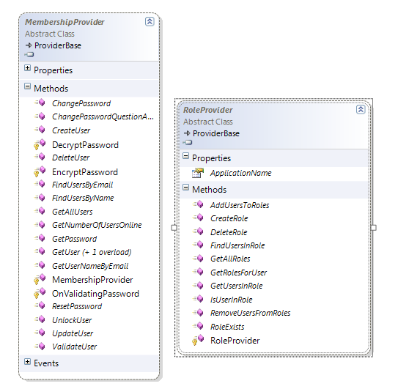
Security
Membership provider
Authenticates users
SQL provider for forms authentication
Active Directory provider for integrated authentication
Role provider
Authorizes users
SQL provider stores roles in SQL Server
AD provider uses roles in Active Directory

Slide 11
State Management
ASP.NET State Management
Session & Application
Cookies
Cache
ASP.NET MVC State Management
Model State
TempData

Slide 12
Summary
Build on the ASP.NET Platform
Caching
Diagnostics
Resource localization
Security
State Management

