Slide 1
Cloud Patterns and Architecture
Architecture in the Cloud

Slide 2









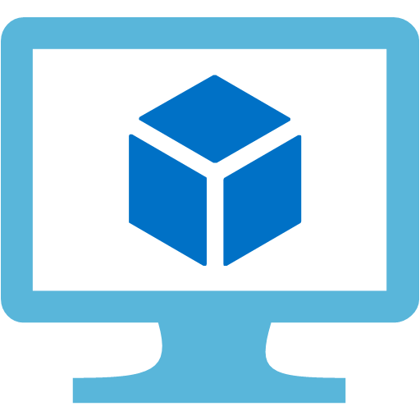



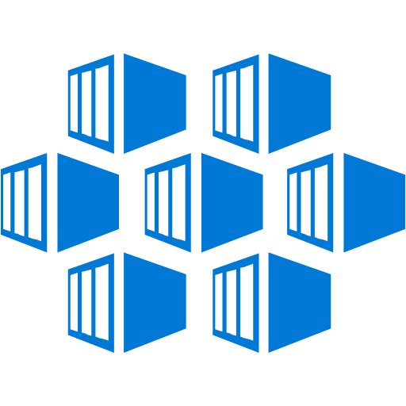



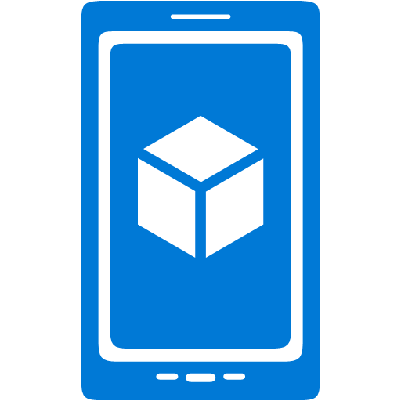











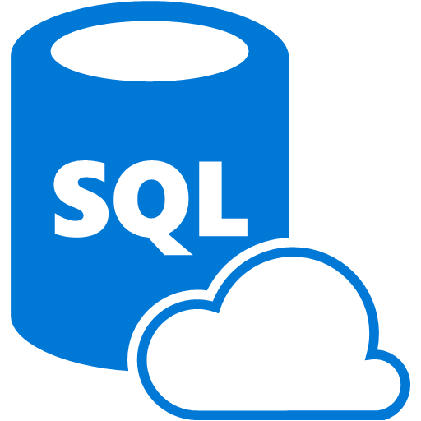










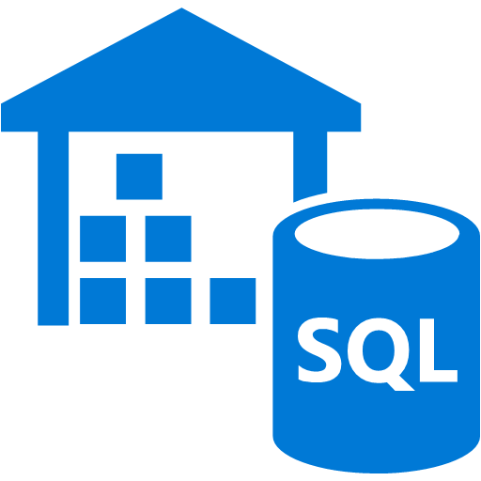






Security & Management
Portal
Multi-Factor Authentication
Key Vault
VM Image Gallery
& VM Depot
Active
Directory
Store/Marketplace
Automation
Infrastructure
Services
Platform Services
Security & Management
Compute
App Service
Analytics & loT
Compute
Cloud
Services
Windows
Web Apps
HDInsight
Portal
Service Fabric
Active
Directory
Linux
API Apps
Machine Learning
Containers
Batch
API
Management
Data Factory
Multi-Factor Authentication
Storage
Integration
Event Hubs
Automation
Mobile Apps
BLOB Storage
Storage
Queues
Key Vault
Logic Apps
Stream Analytics
Azure Files
Biztalk
Services
Notification
Hubs
Mobile
Engagement
Store/Marketplace
Premium Storage
Hybrid
Connections
VM Image Gallery
& VM Depot
Networking
Data
Virtual Network
Service Bus
Developer Services
SQL Database
Load Balancer
Media & CDN
Visual Studio
Redis Cache
DNS
Media Services
Azure SDK
DocumentDB
Express Route
Content Delivery
Network (CDN)
SQL Data
Warehouse
Team Project
Traffic Manager
Application
Insights
Search
VPN Gateway
Application Gateway
Tables

Slide 3
Security & Management
Portal
Multi-Factor Authentication
Key Vault
VM Image Gallery
& VM Depot
Active
Directory
Store/Marketplace
Automation
Infrastructure
Services
Platform Services
Security & Management
Compute
App Service
Analytics & loT
Compute
Cloud
Services
Web Apps
Windows
HDInsight
Portal
Active
Directory
Linux
Service Fabric
API Apps
Machine Learning
Containers
Batch
API
Management
Data Factory
Multi-Factor Authentication
Storage
Integration
Event Hubs
Automation
Mobile Apps
BLOB Storage
Storage
Queues
Key Vault
Logic Apps
Stream Analytics
Azure Files
Biztalk
Services
Notification
Hubs
Mobile
Engagement
Store/Marketplace
Premium Storage
Hybrid
Connections
VM Image Gallery
& VM Depot
Networking
Data
Virtual Network
Service Bus
Developer Services
SQL Database
Load Balancer
Media & CDN
Visual Studio
Redis Cache
DNS
Azure SDK
Media Services
DocumentDB
Express Route
Content Delivery
Network (CDN)
SQL Data
Warehouse
Team Project
Traffic Manager
Application
Insights
Search
VPN Gateway
Application Gateway
Tables

Slide 4




App Service
Resource
Group
Blob Storage
Customers
Azure SQL
Deployment Slots
Staging
Production
QA
App Service Plan

Slide 5
App Service
Resource
Group
Blob Storage
Customers
Asp.NET
Identity
Azure SQL
Deployment Slots
Staging
Production
QA
App Service Plan

Slide 6







App Service
Resource
Group
Blob Storage
Customers
Asp.NET
Identity
Azure SQL
Deployment Slots
Staging
Production
QA
App Service Plan

Slide 7
App Service
Resource
Group
Blob Storage
Customers
Azure SQL
Deployment Slots
Staging
Production
QA
App Service Plan
Azure
Active
Directory

Slide 8



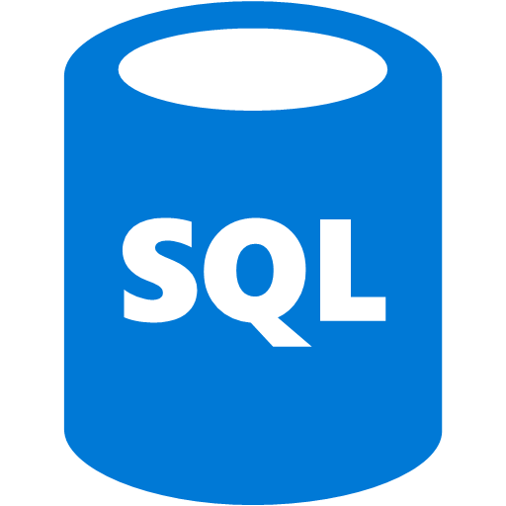
App Service
Functions
WebJobs
Redis
Key Vault
Customers
Storage Account
DocumentDB
App
Insights
Blob
Queue
Table
Azure
Active
Directory
Azure SQL
Search
CDN

Slide 9
Traffic
Manager
App Service
Queue
DocumentDB
Azure SQL
Customers
Geo replication
App Service
Queue
DocumentDB
Azure SQL

Slide 10

App Service
Customers
API Manager
VM Hosted Service
Functions
Identity Sources

Slide 11



App Service
Azure SQL
Customers
Notification Hubs
HockeyApp
Visual Studio Team Services

Slide 12
Customers
Load Balancer
Service Fabric

Slide 13






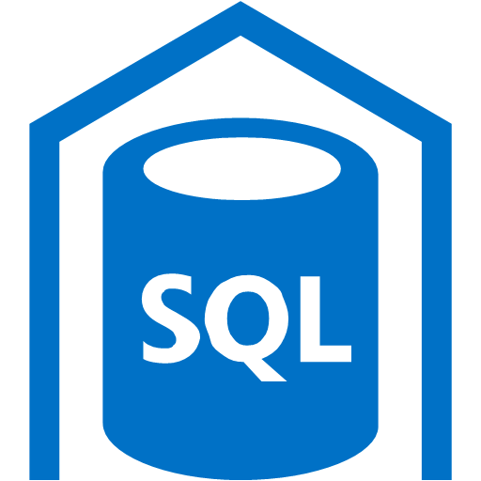



App Service
Data Lake
HDInsight
Stream
Analytics
Event Hub
SQL Data
Warehouse
Machine Learning
IoT Hub

Slide 14


Virtual Network
Web
Business
Load Balancer
Customers
Availability
Set
Availability
Set
Management
Data
VPN Gateway
Jump Box

Slide 15
Security & Management
Portal
Multi-Factor Authentication
Key Vault
VM Image Gallery
& VM Depot
Active
Directory
Store/Marketplace
Automation
Infrastructure
Services
Platform Services
Security & Management
Compute
App Service
Analytics & loT
Compute
Cloud
Services
Windows
Web Apps
HDInsight
Portal
Service Fabric
Active
Directory
Linux
API Apps
Machine Learning
Containers
Batch
API
Management
Data Factory
Multi-Factor Authentication
Storage
Integration
Event Hubs
Automation
Mobile Apps
BLOB Storage
Storage
Queues
Key Vault
Logic Apps
Stream Analytics
Azure Files
Biztalk
Services
Notification
Hubs
Mobile
Engagement
Store/Marketplace
Premium Storage
Hybrid
Connections
VM Image Gallery
& VM Depot
Networking
Data
Virtual Network
Service Bus
Developer Services
SQL Database
Load Balancer
Media & CDN
Visual Studio
Redis Cache
DNS
Media Services
Azure SDK
DocumentDB
Express Route
Content Delivery
Network (CDN)
SQL Data
Warehouse
Team Project
Traffic Manager
Application
Insights
Search
VPN Gateway
Application Gateway
Tables

