Slide 1
Monitoring & Scaling Web Applications and APIs

Slide 2
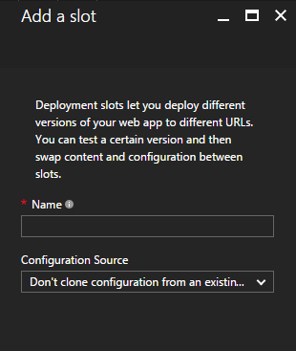

Notes:
When you deploy an application, you can setup deployment slots (first icon)
Add a slot to the app service (middle icon)
Right-hand side shows we could have 3 slots
Last animation of curved arrow to talk about how easy it is to swap slots

Slide 3
Notes:
When you deploy an application, you can setup deployment slots (first icon)
Add a slot to the app service (middle icon)
Right-hand side shows we could have 3 slots
Last animation of curved arrow to talk about how easy it is to swap slots

Slide 4
QA
Staging
Production
Notes:
When you deploy an application, you can setup deployment slots (first icon)
Add a slot to the app service (middle icon)
Right-hand side shows we could have 3 slots
Last animation of curved arrow to talk about how easy it is to swap slots

Slide 5
QA
Staging
Production
Notes:
When you deploy an application, you can setup deployment slots (first icon)
Add a slot to the app service (middle icon)
Right-hand side shows we could have 3 slots
Last animation of curved arrow to talk about how easy it is to swap slots

Slide 6
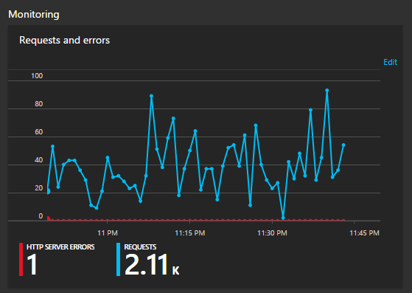
Monitoring
Notes:
For a 30 second into to monitoring

Slide 7
Monitoring
Notes:
For a 30 second into to monitoring

Slide 8
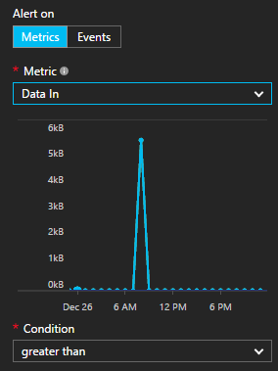

Email Alerts
Notes:
Need a visual to talk for 30 seconds about setting up alerts that can deliver email to me if something is going loopy

Slide 9
Email Alerts
Notes:
Need a visual to talk for 30 seconds about setting up alerts that can deliver email to me if something is going loopy

Slide 10
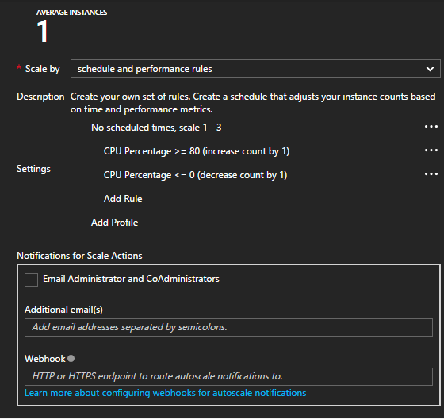
Scaling
Notes:
30 seconds of visual to talk about scaling in Azure. Can scale up an instance or down an instance when thresholds are exceeded

Slide 11
Scaling
Notes:
30 seconds of visual to talk about scaling in Azure. Can scale up an instance or down an instance when thresholds are exceeded

Slide 12
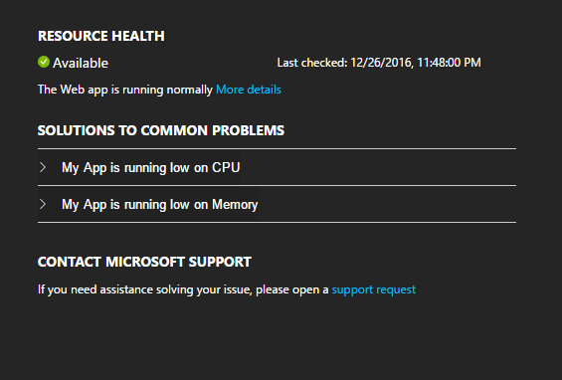
Debugging
Tools
Notes:
30 second visual to talk about troubleshotting, remote debugging, tools we can use to find out what is going on!

Slide 13
Debugging
Tools
Notes:
30 second visual to talk about troubleshotting, remote debugging, tools we can use to find out what is going on!

