Slide 1
Using Cloud Databases

Slide 2
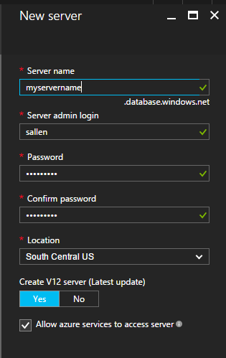
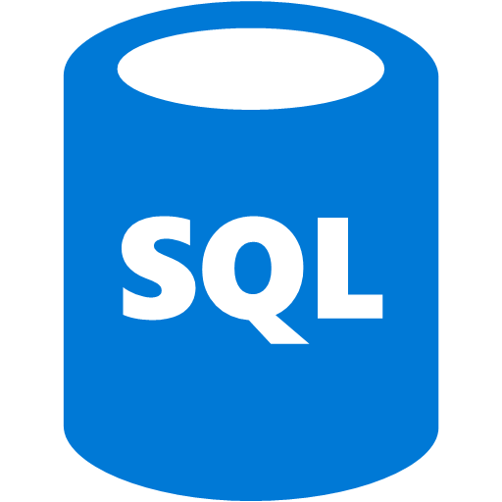

Server
Azure SQL Database
DocumentDB Database
Notes:
Two topics in this module – Azure SQL Databases and DocumentDB databases

Slide 3
Server
Notes:
Need to get across the point that a single Azure server can be a container for multiple databases instances

Slide 4
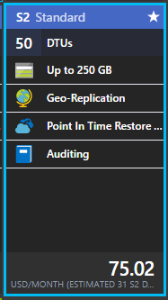
5
10
20
4000
Notes:
Explaining “data transfer units” – a measure of how much relative power you need from a database, ranges from 5 to 4000

Slide 5
50

Slide 6
50
2500

Slide 7
50
2500
4000

Slide 8
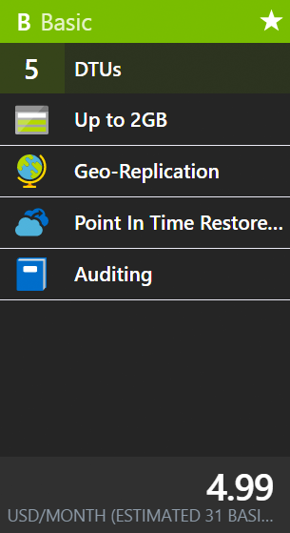
5

Slide 9
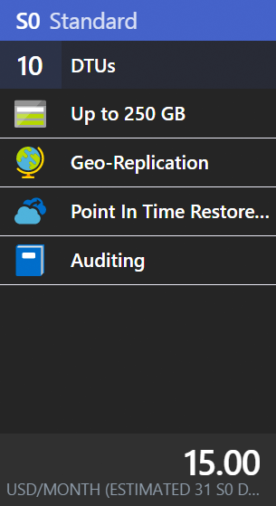
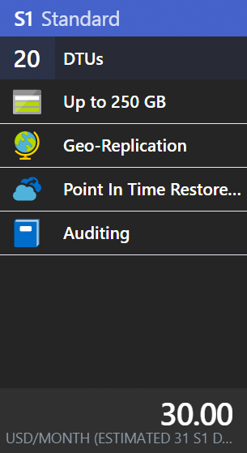
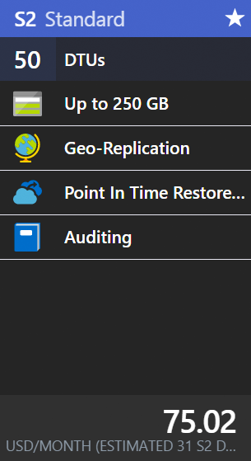
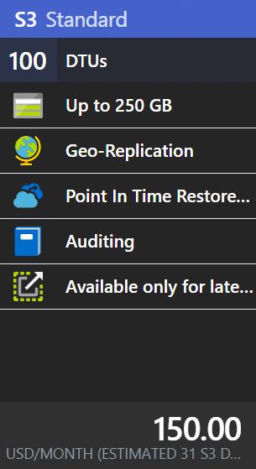
10-100

Slide 10
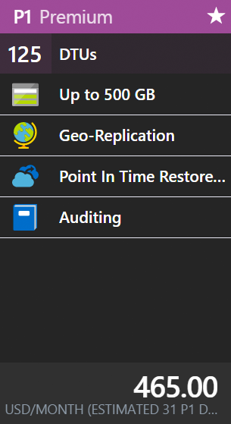
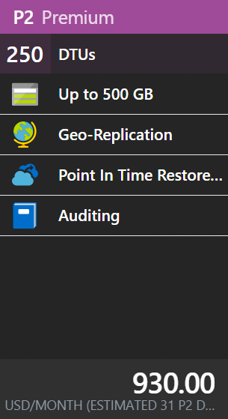
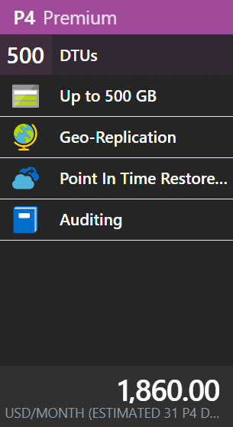
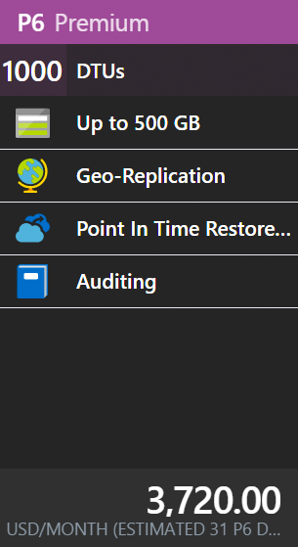
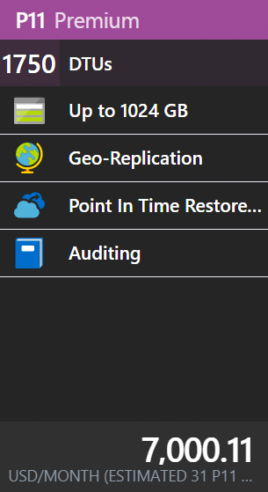
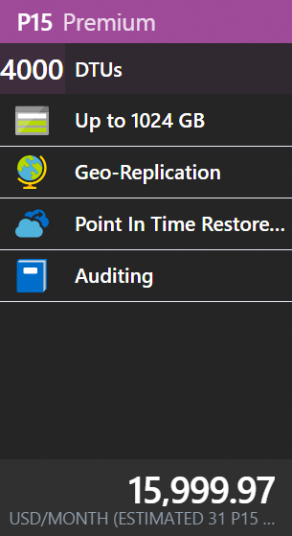
125 - 4000

Slide 11
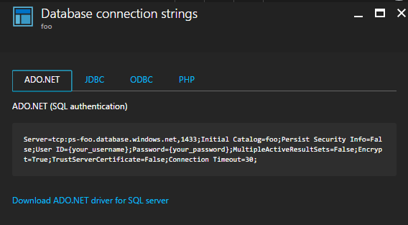
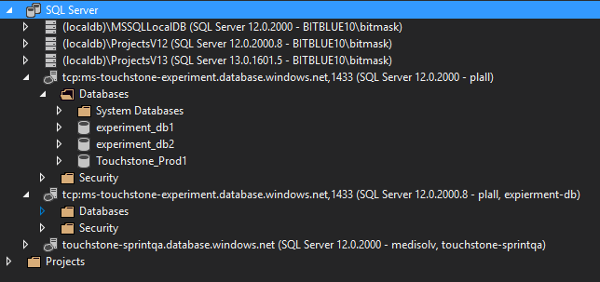
Notes:
With SQL Azure, you can connect using ADO.NET, etc. Any regular SQL Server tools will give you access to the database.

Slide 12
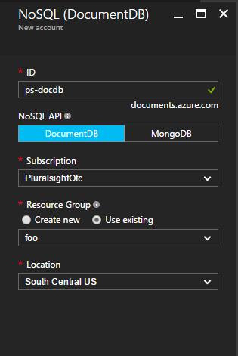
Notes:
Turning attention to DocumentDB

Slide 13
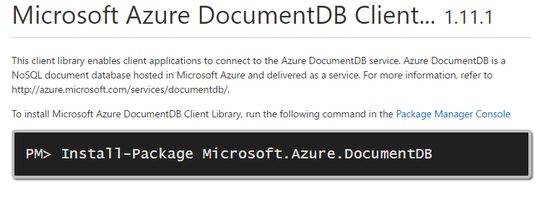
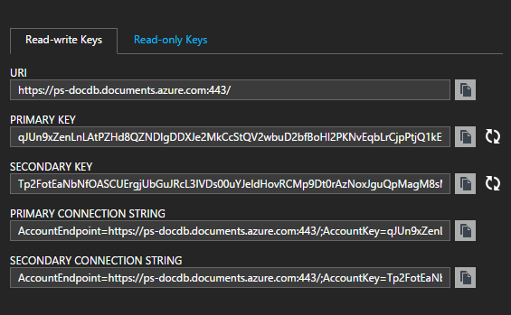
Notes:
To get started, install a nuget package. We’ll need to use the DocDB connection strings to make a connection.

Slide 14
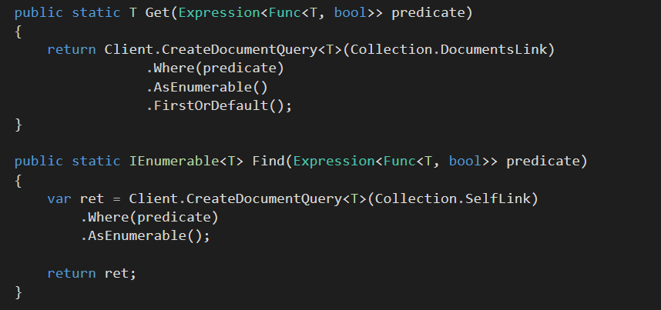
Notes:
Gonna be writing some code against DocumentDB, will talk about the scenario for a few seconds.

Slide 15
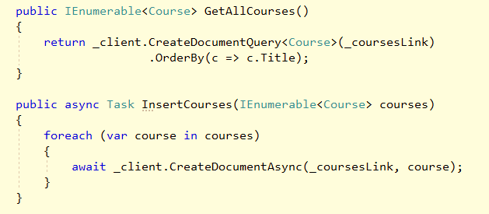
Notes:
Will add some code or finished application screen shots here

