Slide 1
Cloud Storage

Slide 2




Blob Storage
Table Storage
Queue Storage
File Storage
Notes:
Types of Azure Storage. Want to highlight blob storage as that is primarily what we will focus on.

Slide 3
Blob Storage
Table Storage
Queue Storage
File Storage
Notes:
Types of Azure Storage. Want to highlight blob storage as that is primarily what we will focus on.

Slide 4
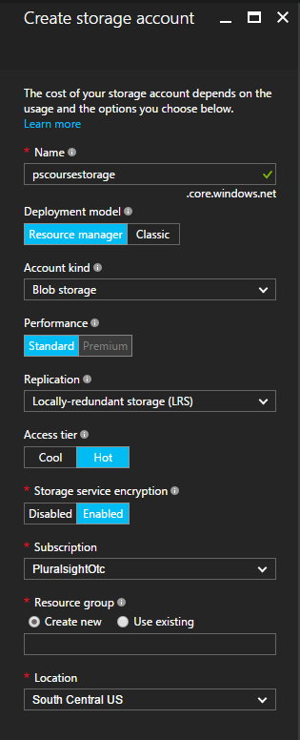
Account
Blobs
Containers
0001.tiff
scans
0002.tiff
0003.tiff
app01.xml
applicants
app02.xml
app03.xml
Notes:
First we create a storage account. Inside an account you can have multiple containers. Inside a container you can have multiple blobs.

Slide 5

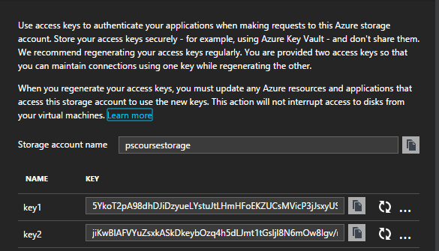
Access Keys
Notes:
To connect to storage, we need to use one of the ACCESS KEYS

Slide 6

Access Keys
Notes:
To connect to storage, we need to use one of the ACCESS KEYS

Slide 7
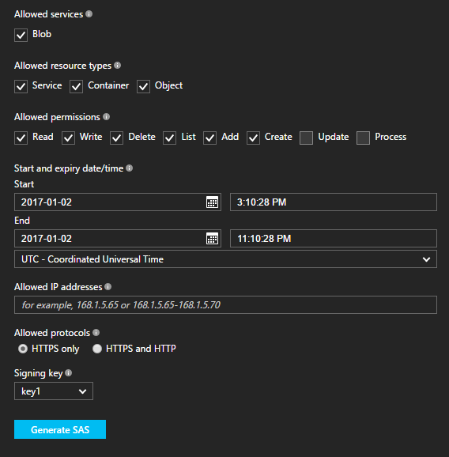

Shared Access Signatures
Notes:
SHARED ACCOUNT SIGNATURES allow us to delegate some rights to staorge

Slide 8

Shared Access Signatures
Notes:
SHARED ACCOUNT SIGNATURES allow us to delegate some rights to staorge

Slide 9
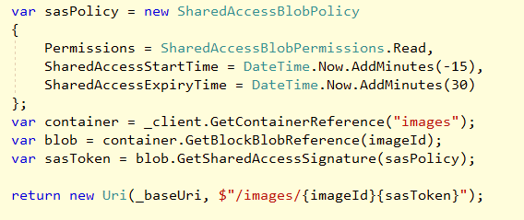
Notes:
Insert screen shot of some finished code…

