Slide 1

ASP.NET Core A New Vision For Your Enterprise K. Scott Allen @OdeToCode
Notes:
Hi everyone, my name is Scott, and this talk is about the new dragons of JavaScript. This is not a negative talk where I bash JavaScript features. Instead, I’m trying to express my feelings as I’ve worked with the new language features for over a year now.

Slide 2
Risks
Rewards

Slide 3
.NET Core
Hosting
Middleware
Security
Data Access
ASP.NET Core

Slide 4


.NET Framework
.NET Core
ASP.NET Core
ASP.NET Core
WinForms
WebForms
WCF
WPF

Slide 5
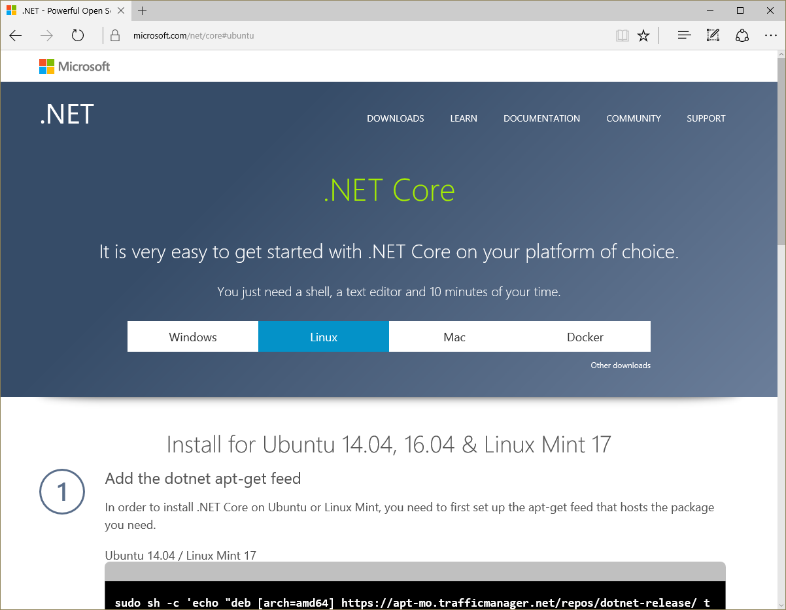

Slide 6
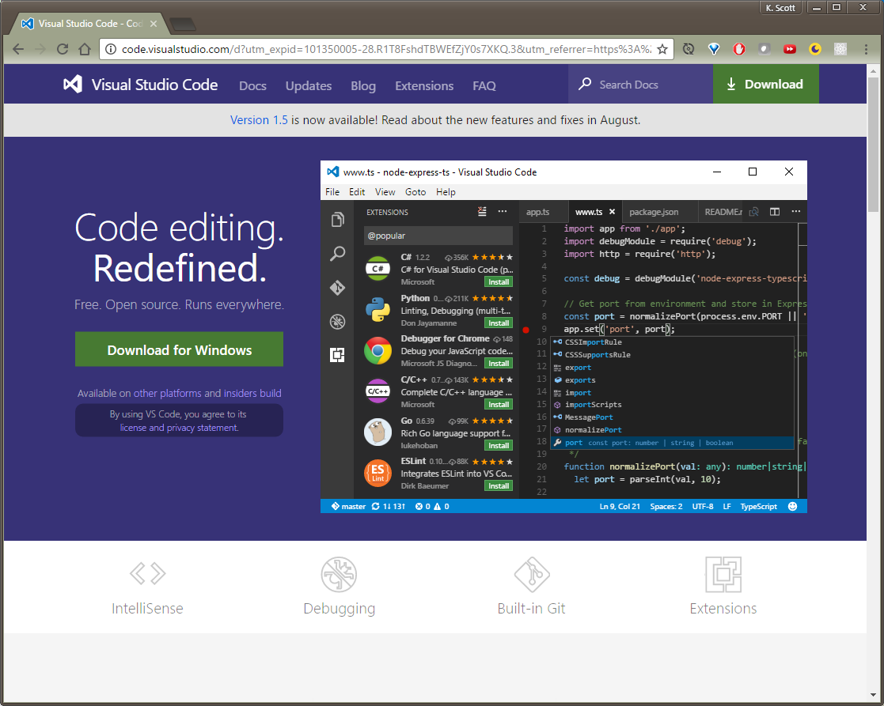


Slide 7
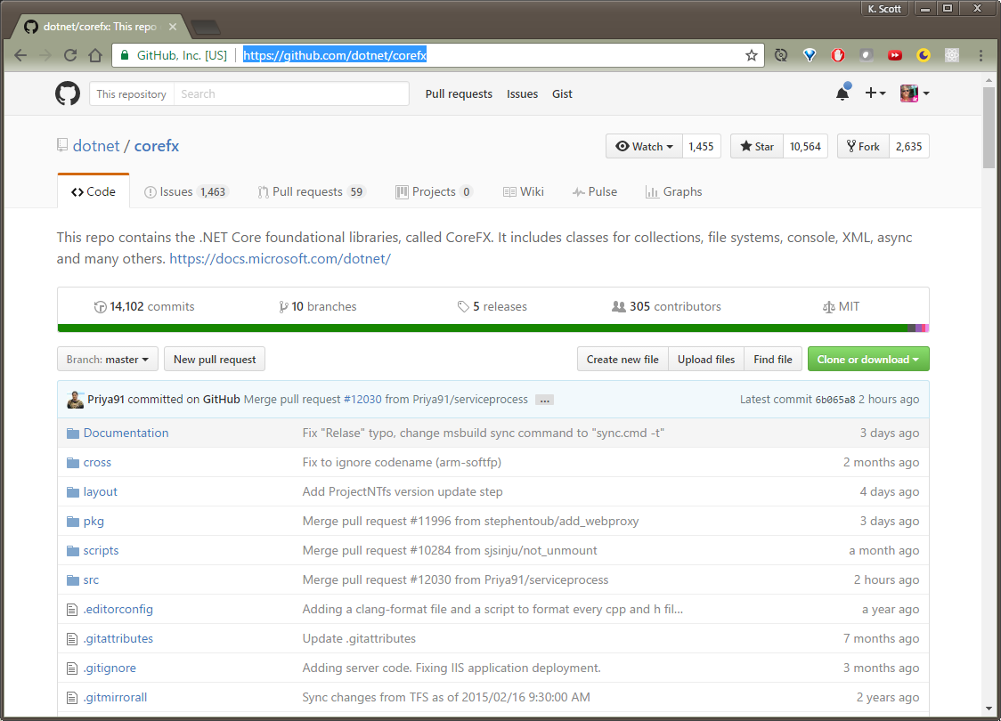

Slide 8
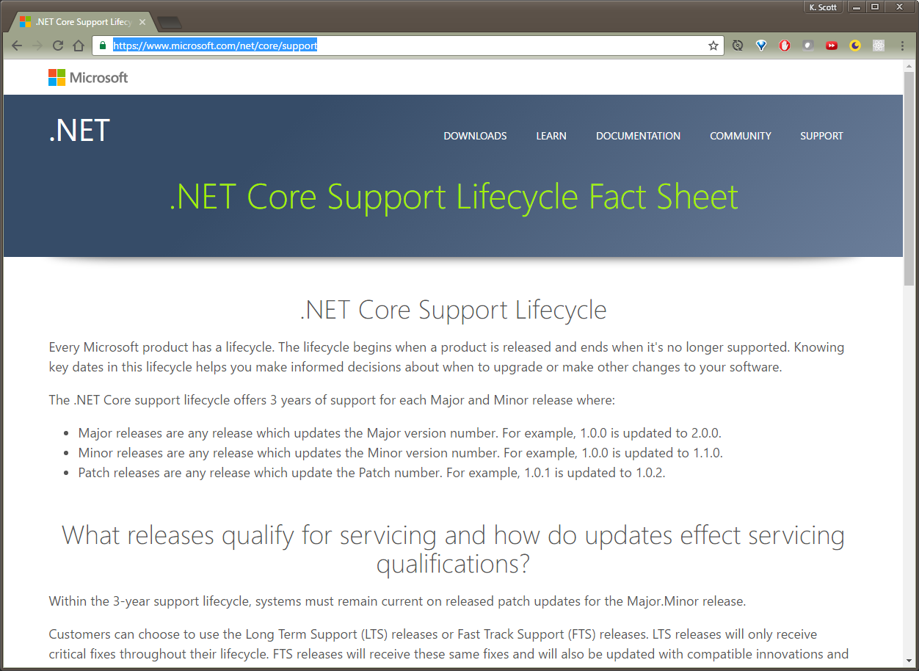

Slide 9
