Slide 1
ECMAScript 2015 (the language formerly known as ECMAScript 6)

Slide 2
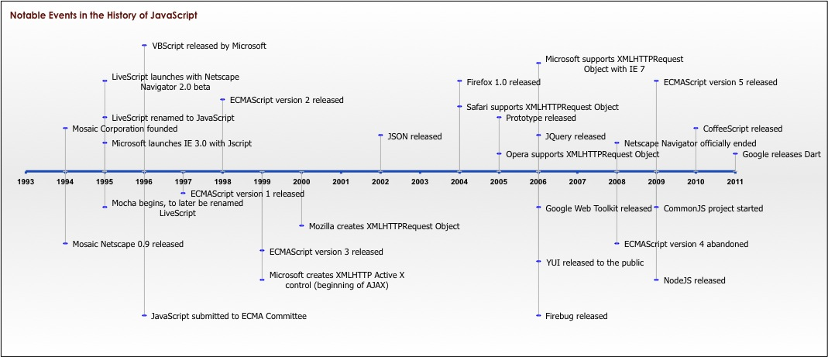
Why?
First substantial addition to JavaScript since inception

Slide 3
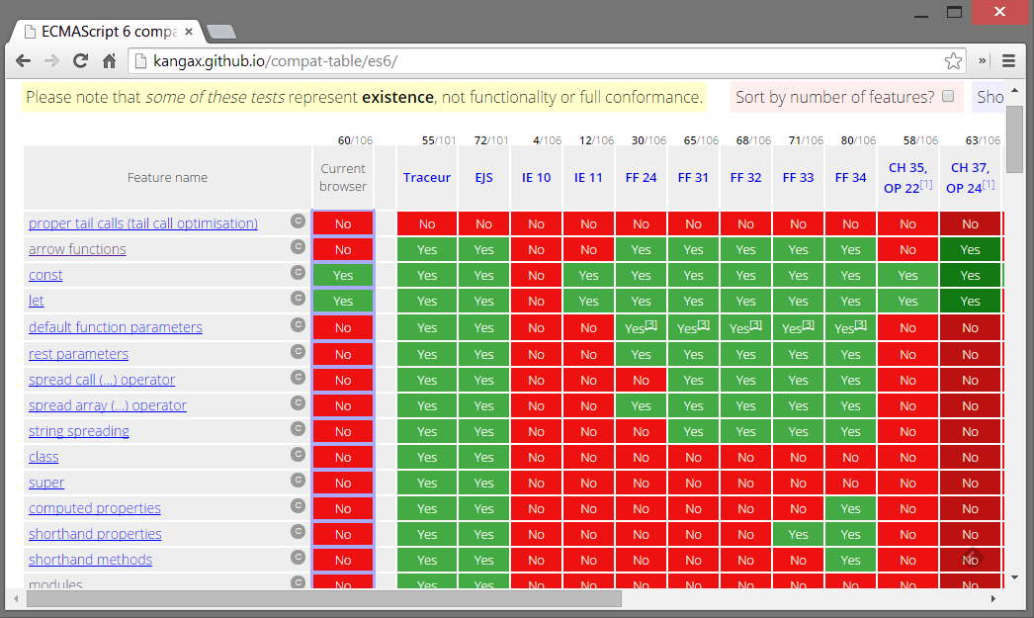
When?

Slide 4
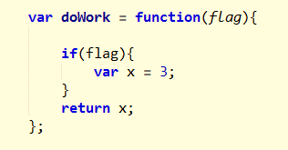
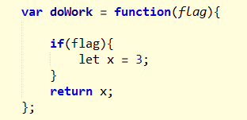
let

Slide 5
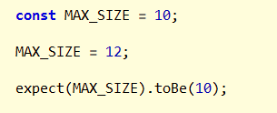
const

Slide 6
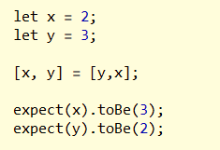
Destructuring

Slide 7
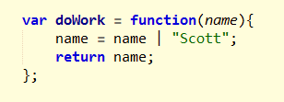

Default Parameter Values

Slide 8
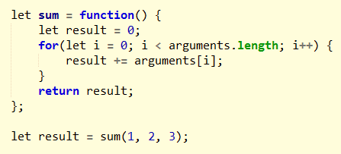
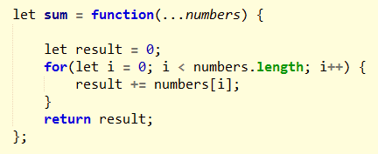
Rest Parameters

Slide 9
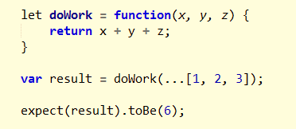
Spread Operator

Slide 10


Template Literals

Slide 11
Why Classes?
Object
Class Definition
Object
Object

Slide 12
Why Classes?
Employee Object
Employee
Employee Object
Employee Object

Slide 13
Why Classes?
Employee Object
“Scott”
Employee
getName
doWork
Employee Object
“Alex”
Employee Object
“Chris”

Slide 14
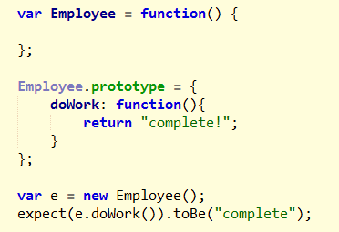
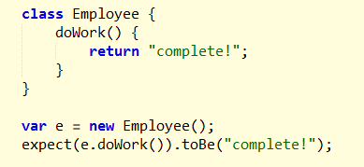
Class versus Prototype

Slide 15
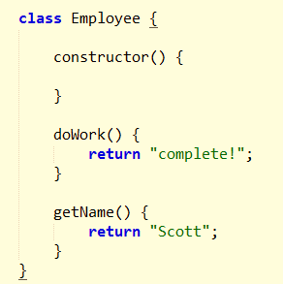
constructor

Slide 16
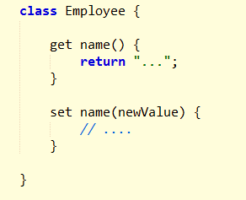
Getters and Setters

Slide 17
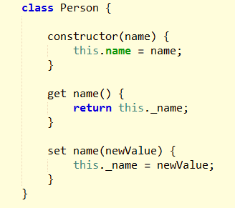

Inheritance

Slide 18
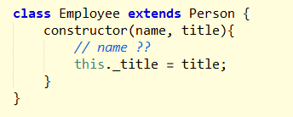
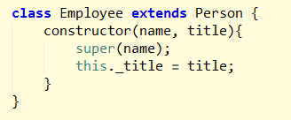
super

Slide 19
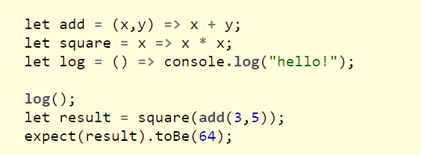

Arrow Functions

Slide 20
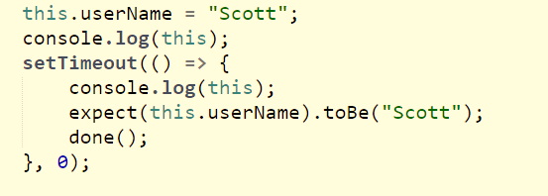
Arrows and this

Slide 21
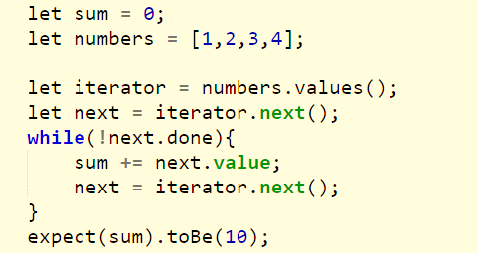
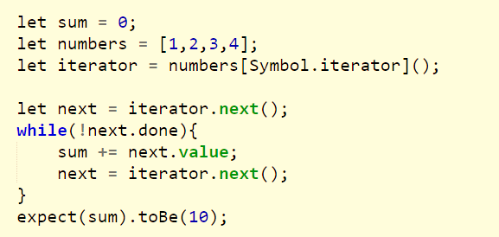
Iterables and Iterators

Slide 22
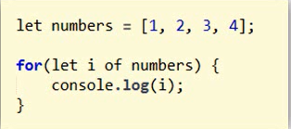
for of

Slide 23
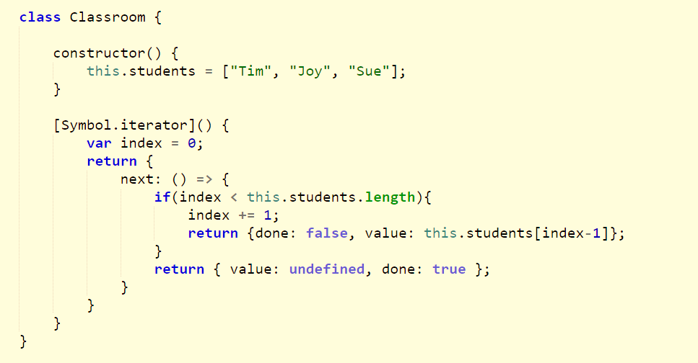
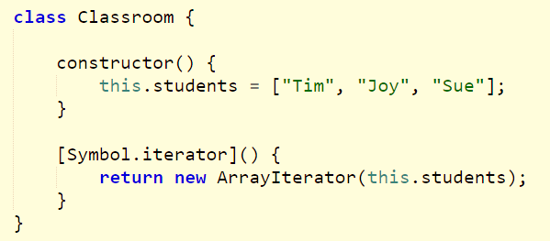
Make Your Own Iterable

Slide 24
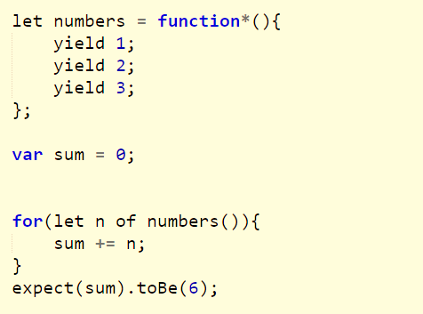
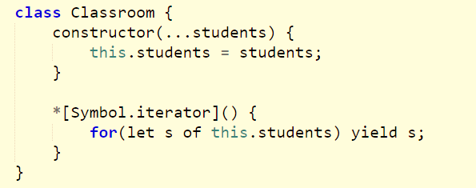
Generators

Slide 25
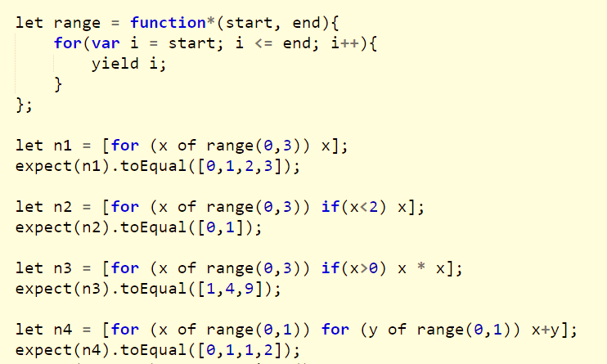
Array Comprehensions

Slide 26
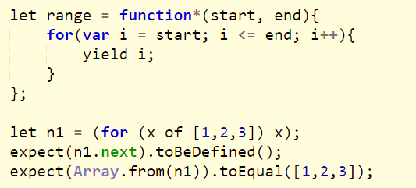
Generator Comprehensions

Slide 27
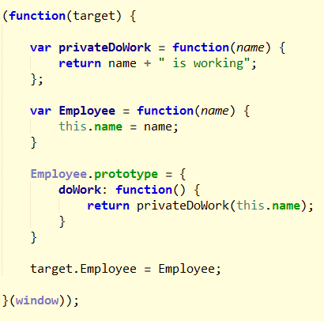
An IIFE Module
Organize
Control
visibility

Slide 28
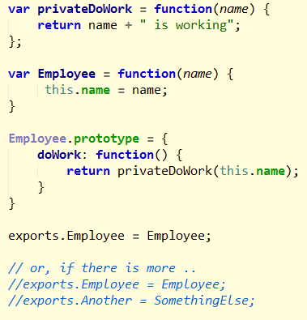

CommonJS

Slide 29
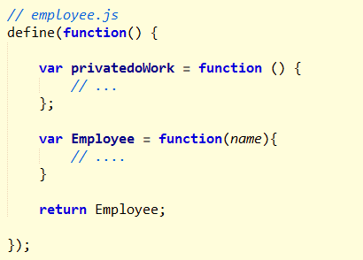

AMD

Slide 30
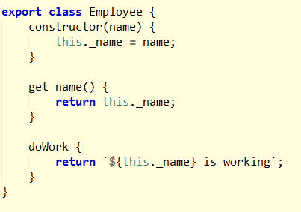

ES6 Modules

Slide 31
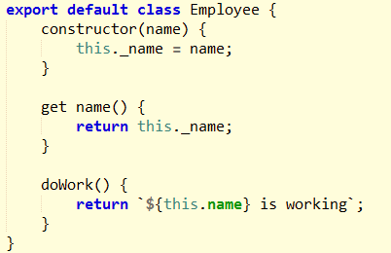


module and default

Slide 32
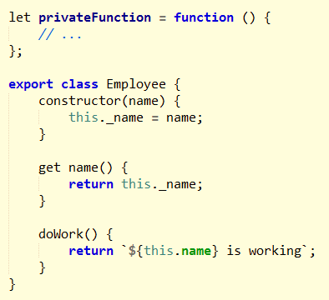
Hiding The Details

Slide 33
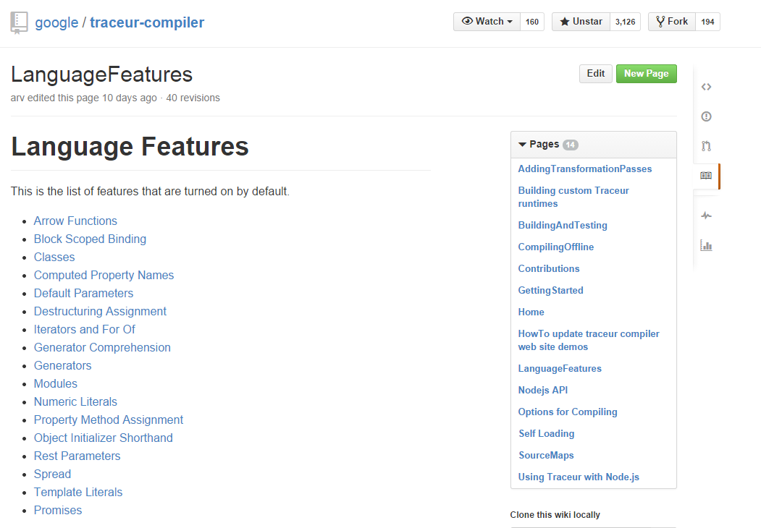
Writing ES6 Today With Tracuer

Slide 34

Summary
ES6 is the future!
scott@OdeToCode.com

