Slide 1
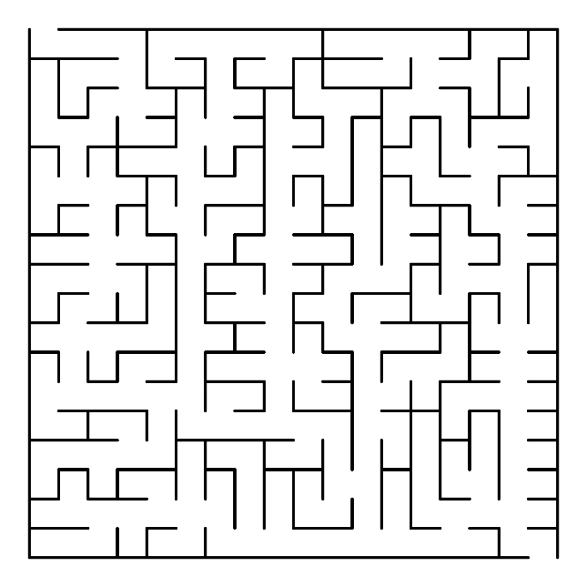
JavaScript Patterns for 2017
K. Scott Allen
@OdeToCode

Slide 2
Modules
Tools
Language Features
Builds

Slide 3
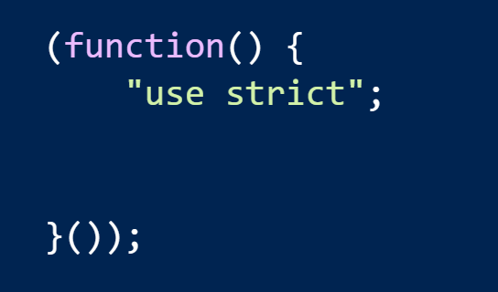
ES Modules
No more strict IFFEs!
Forget old patterns

Slide 4
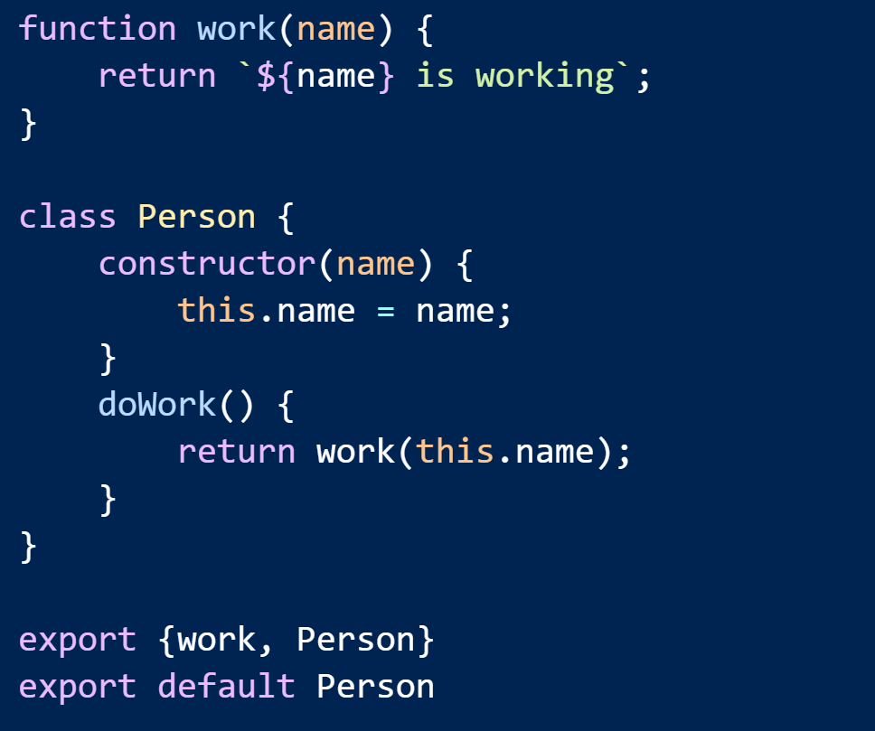
Exports

Slide 5
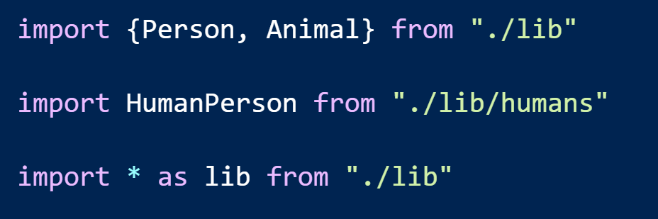
Imports

Slide 6
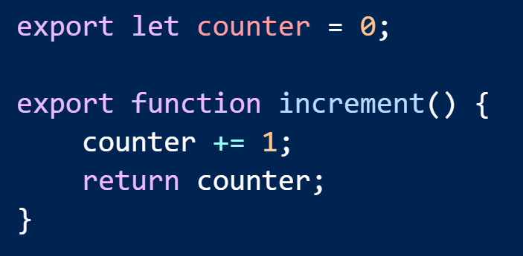
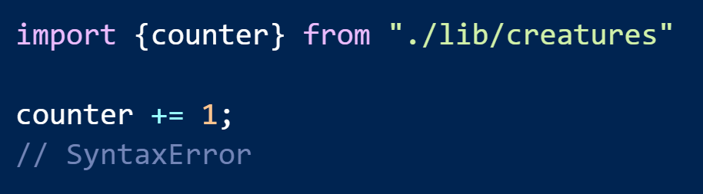
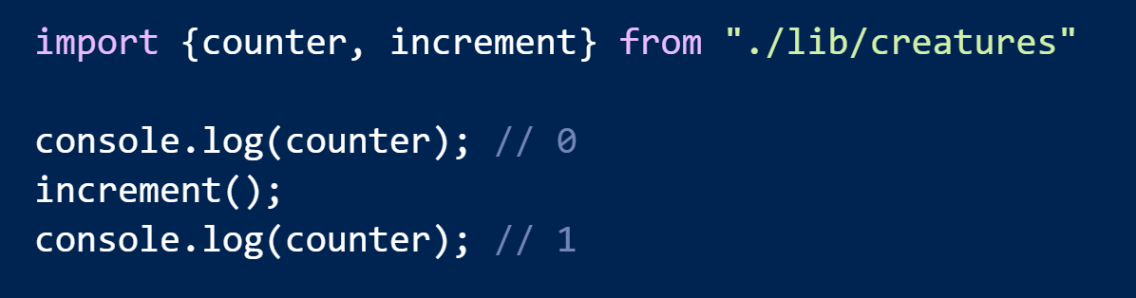
Import Creates Immutable Bindings

Slide 7
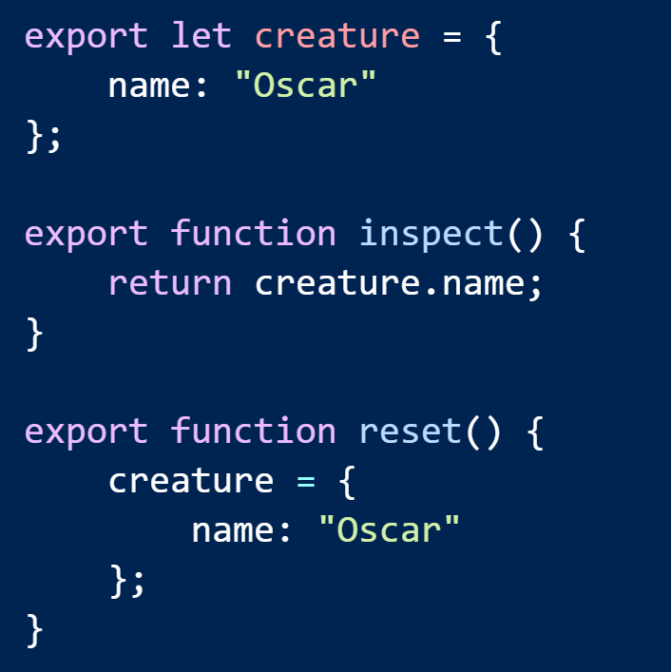
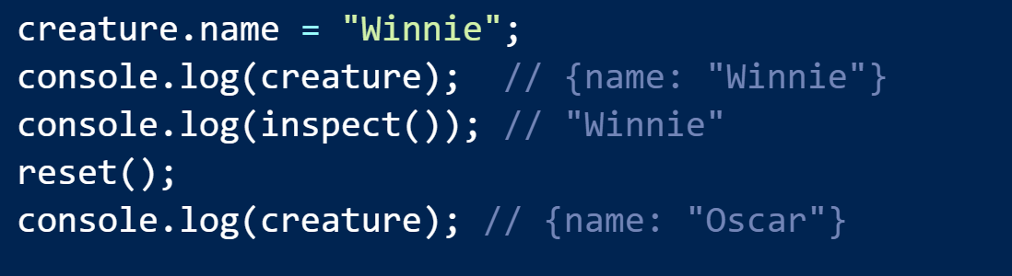
It’s Alive!

Slide 8


Building Boundaries with Modules
routing
routes
headers
logging
shell
rating
xhr
http
components
userlist
fetch
dashboard
httpmessage

Slide 9
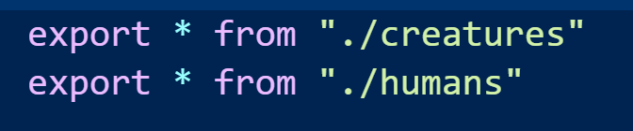
Public APIs with index.js

Slide 10




Building Modules
Closure
Rollup

Slide 11
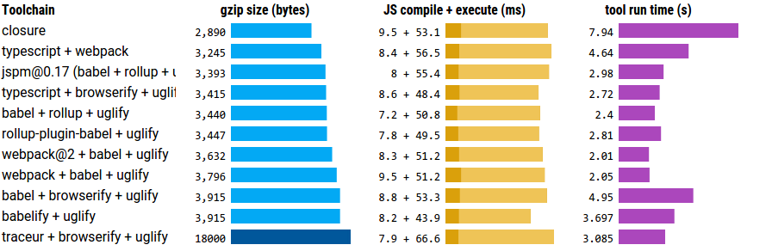
Toolchain can impact performance

Slide 12
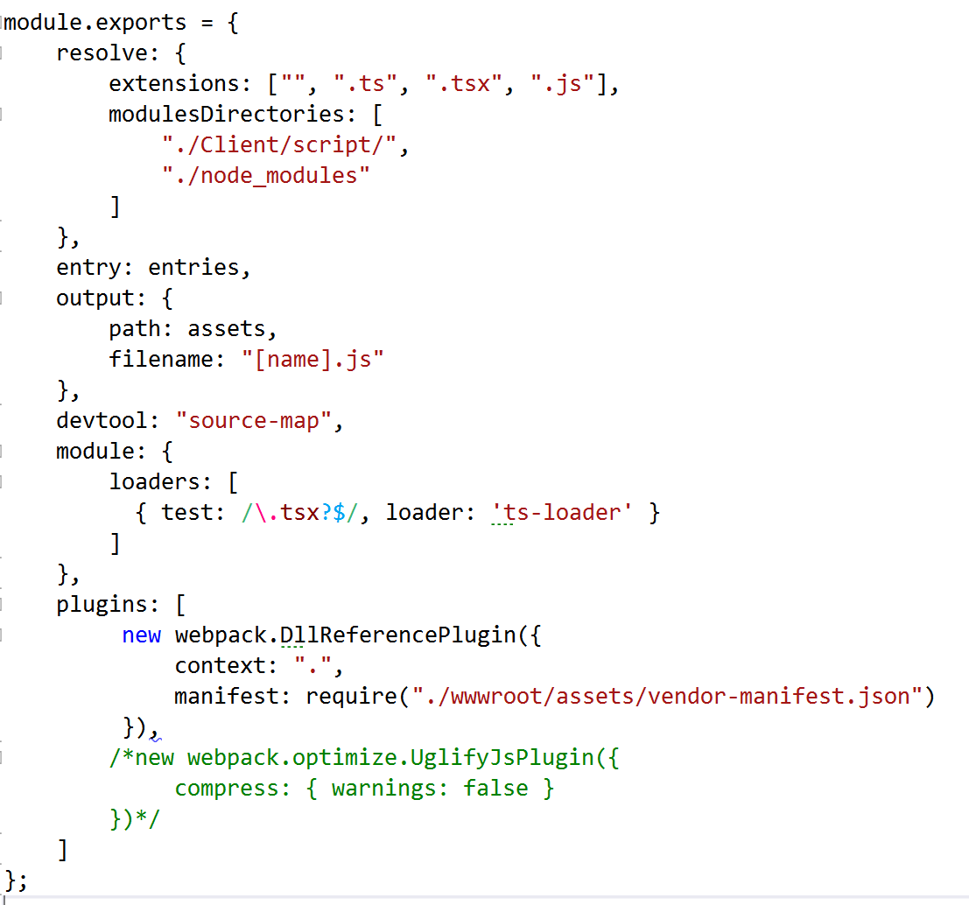
Using WebPack

Slide 13
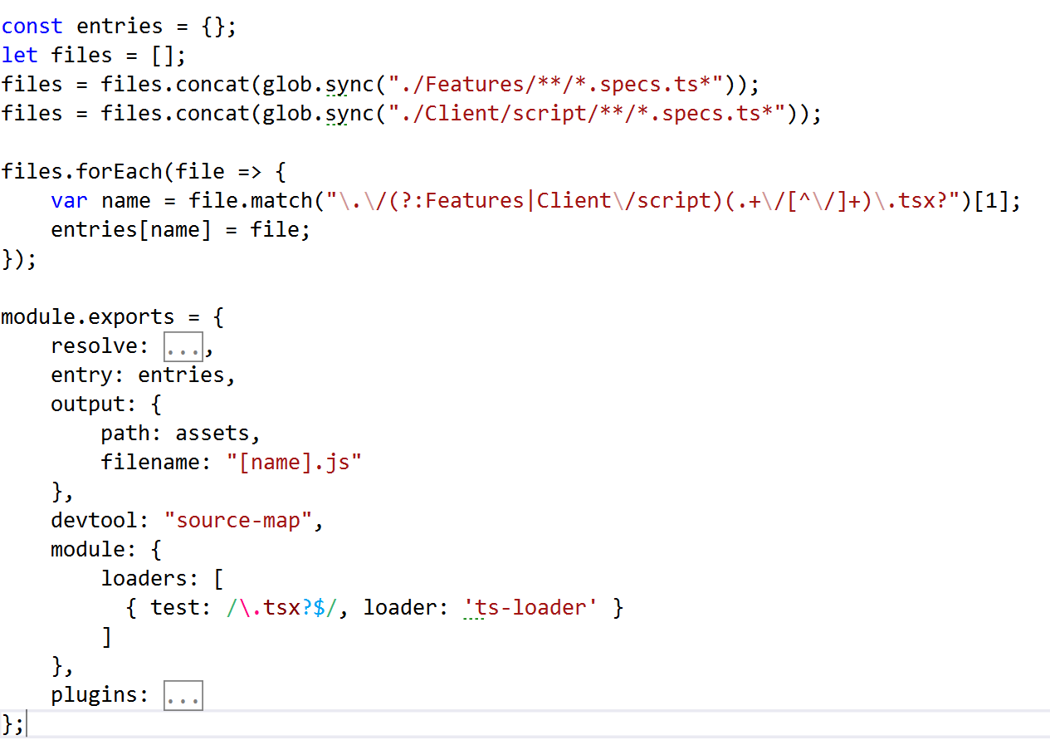
WebPack Config Per Purpose

Slide 14
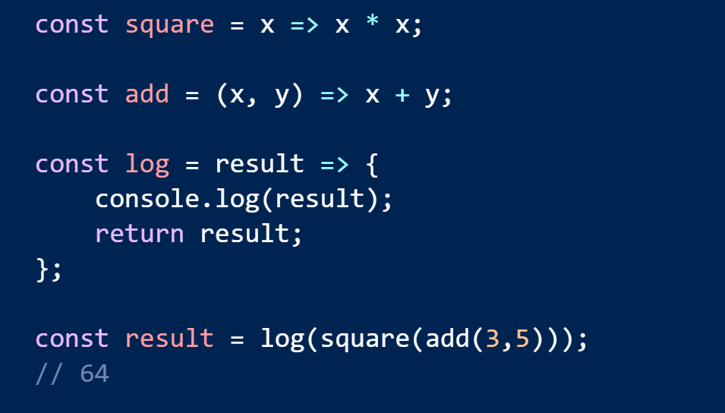
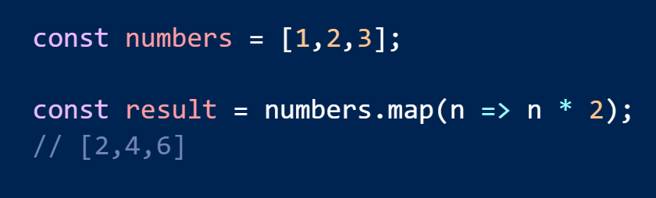
Arrow Syntax

Slide 15
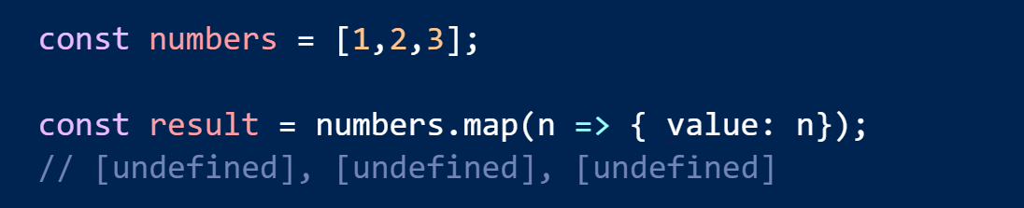
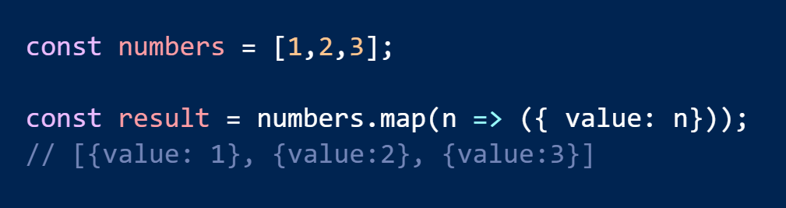
Return An Object Literal

Slide 16
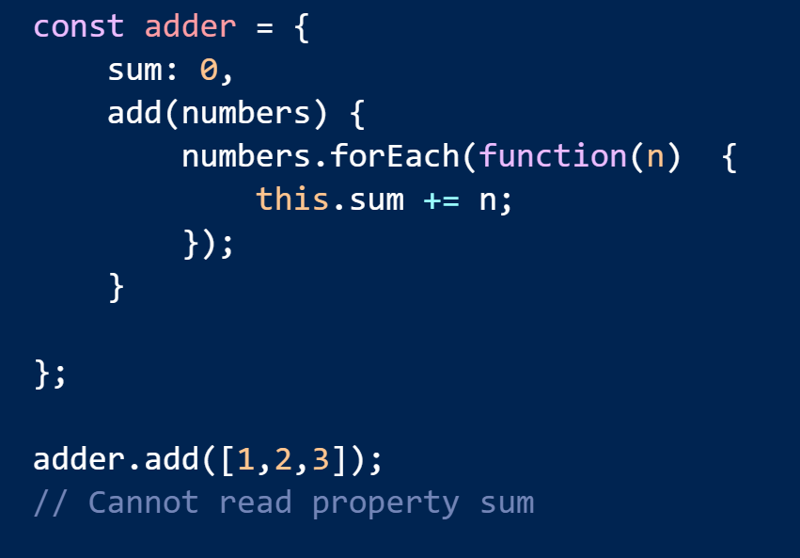
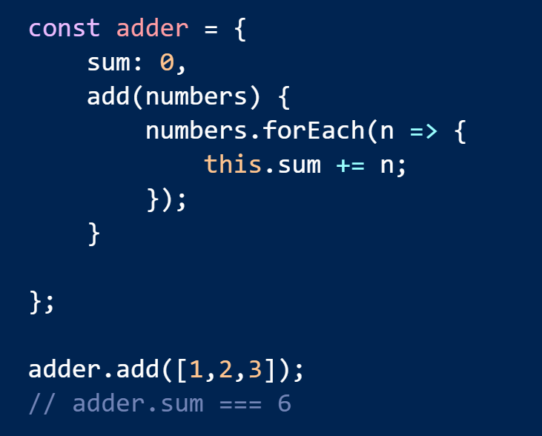
Lexical this Reference

Slide 17
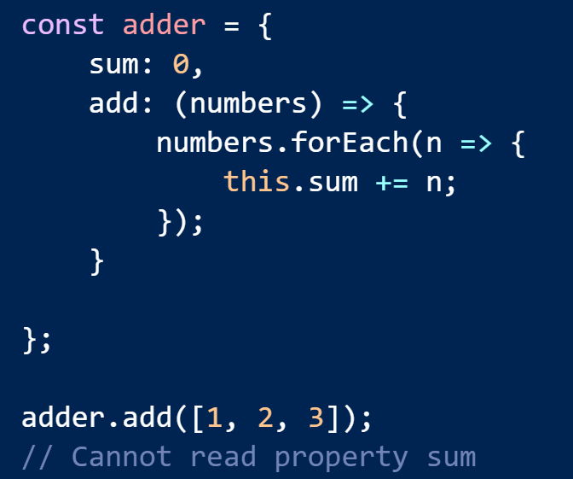
Too Many Arrows

Slide 18
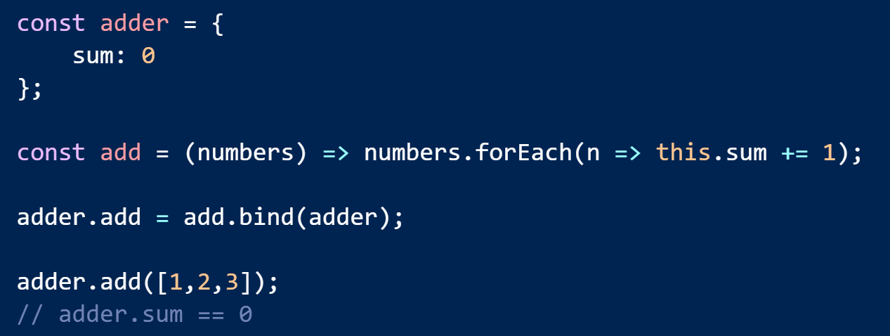
Cannot re-bind with bind, apply, or call

Slide 19
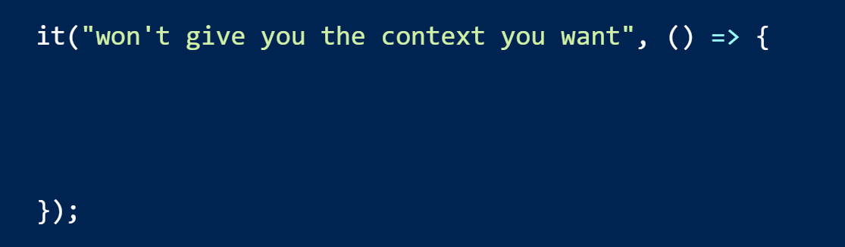
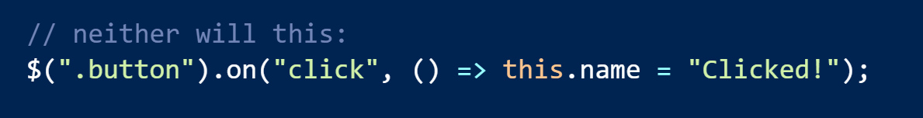
Careful with Legacy Libraries

Slide 20
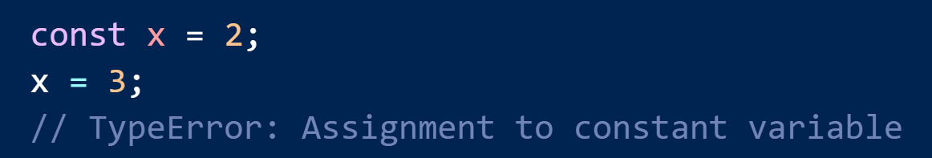
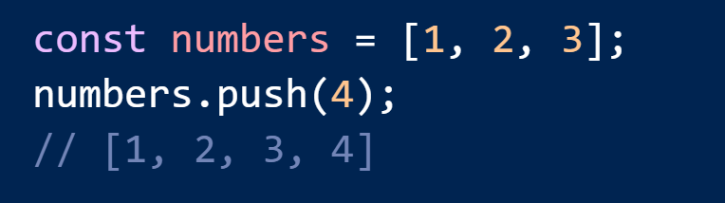
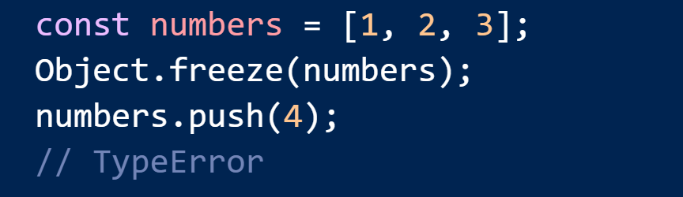
const means no more assignments

Slide 21
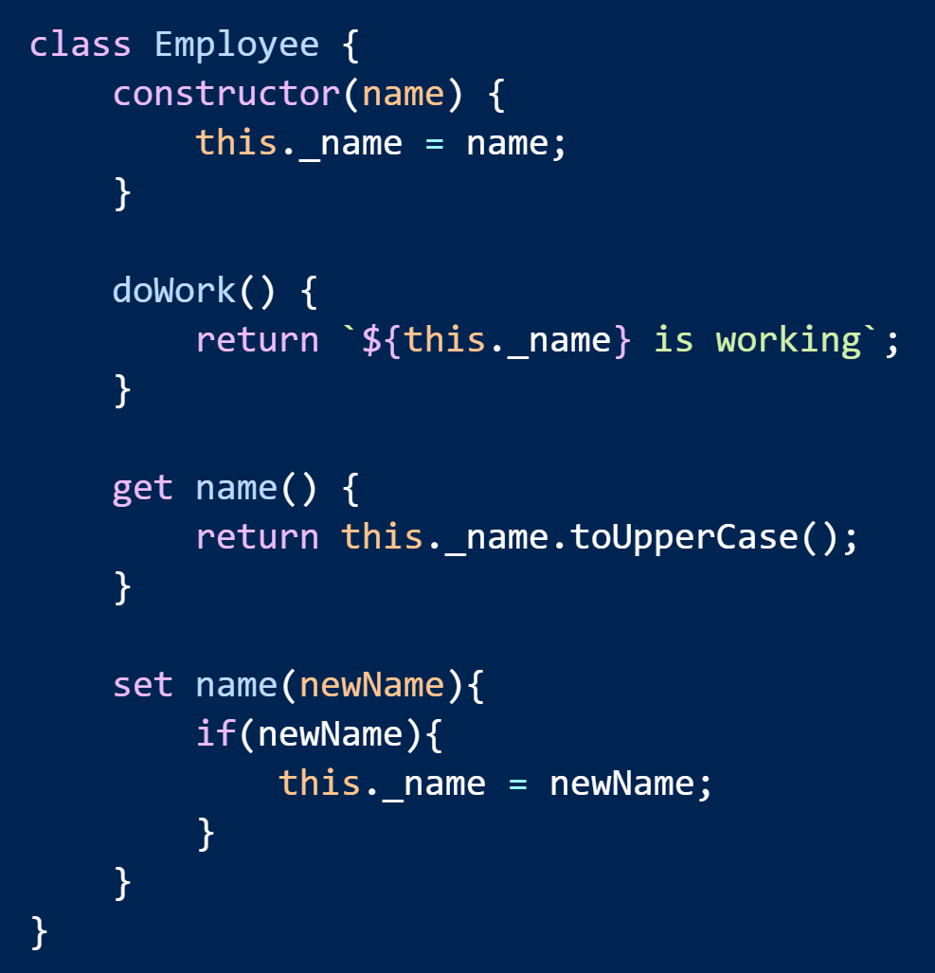
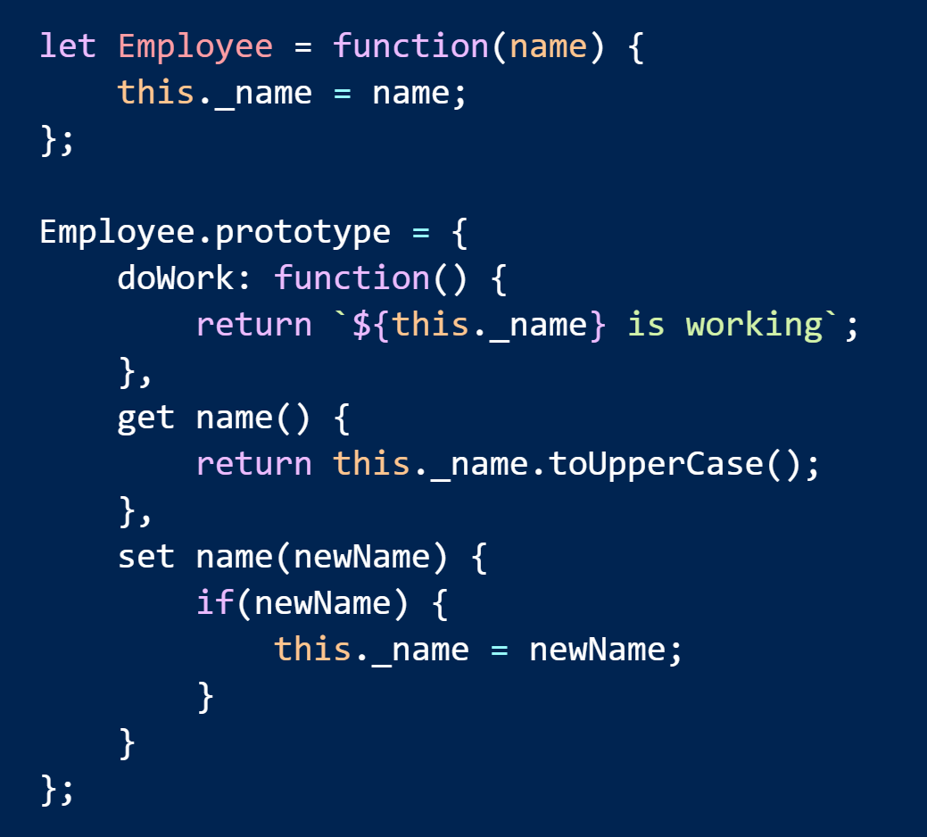
Classes are Mostly Sugar

Slide 22
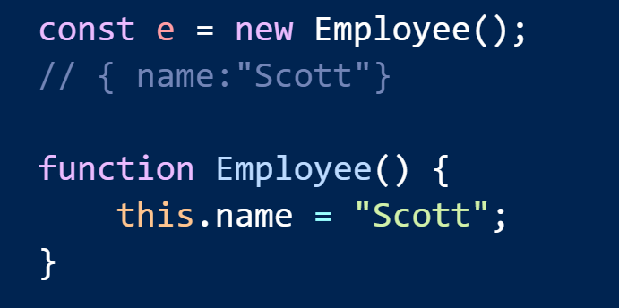
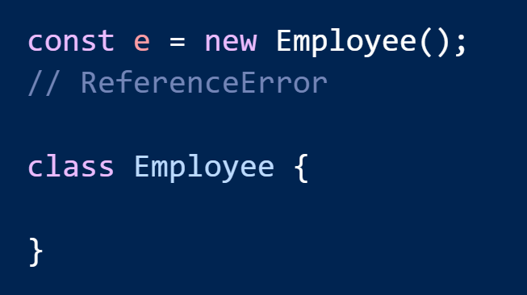
Hoisting

Slide 23
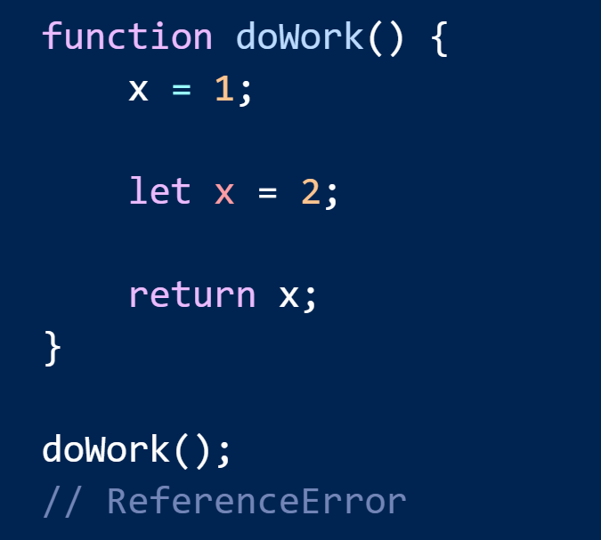
The TDZ

Slide 24
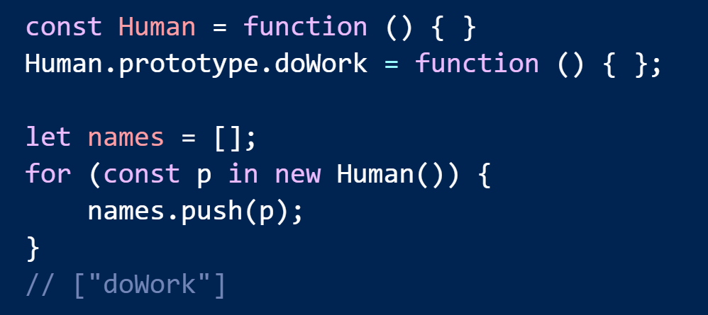
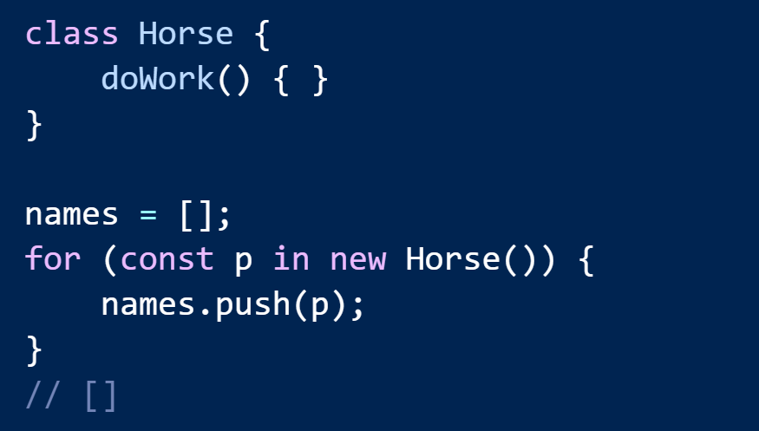
Reflective Introspection

Slide 25
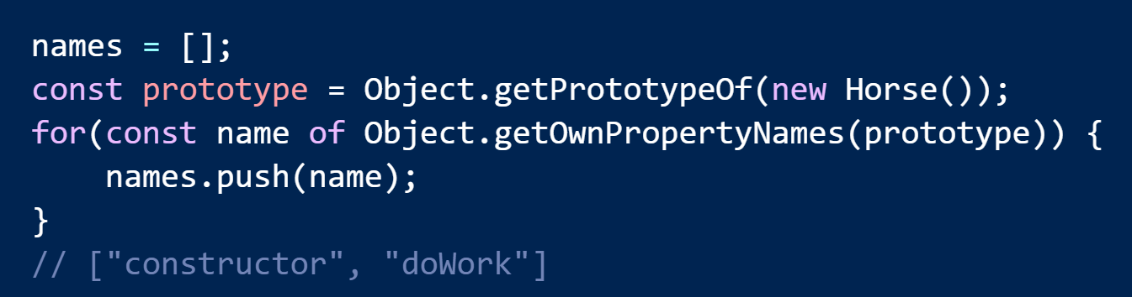
Introspection Part II

Slide 26
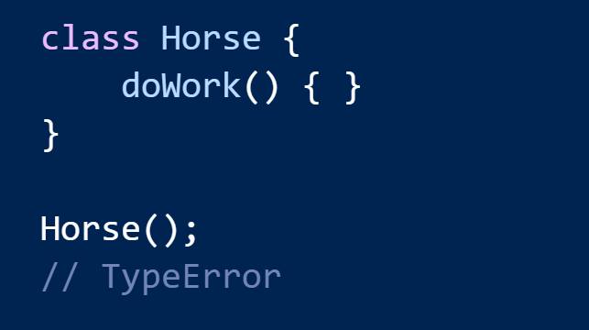
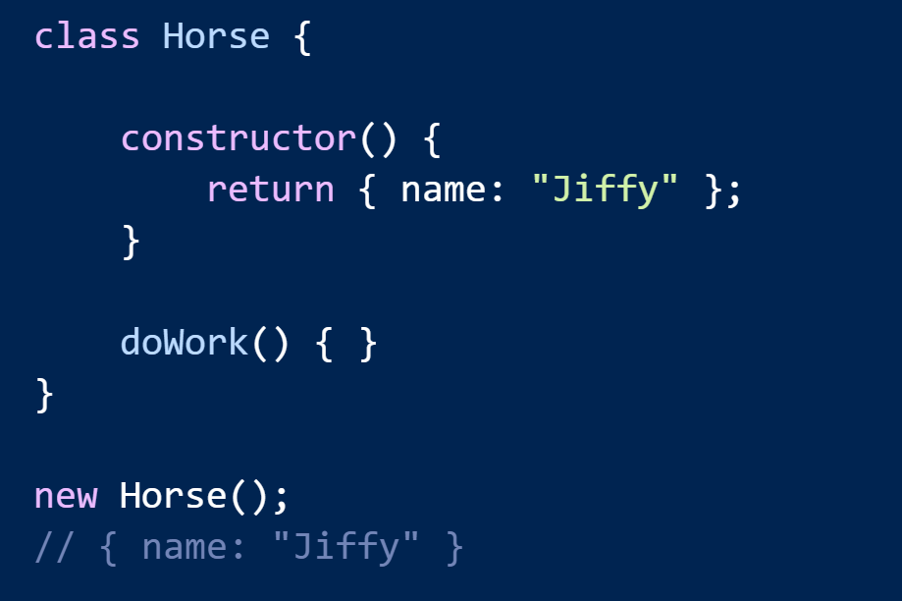
No Need to Enforce new

Slide 27
Using New Features
Babel
latest
react
es2017
es2016
es2015
stage-0
stage-1
stage-2
stage-3

Slide 28
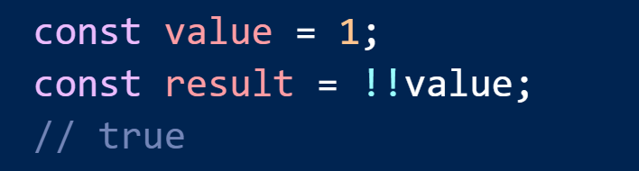
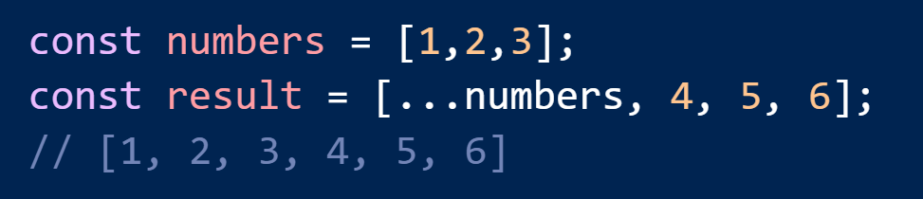
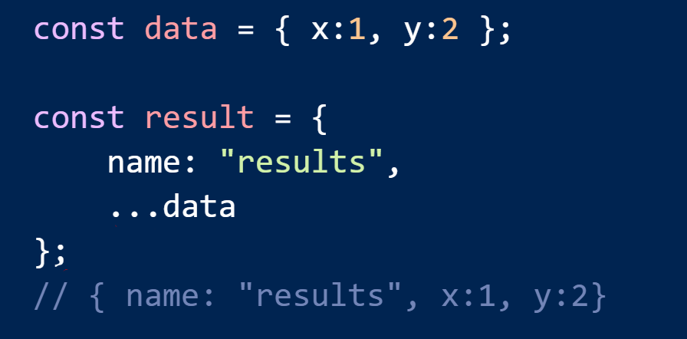
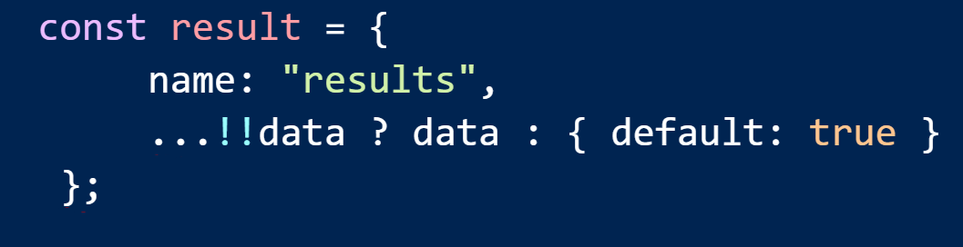
Crazy Operators

Slide 29
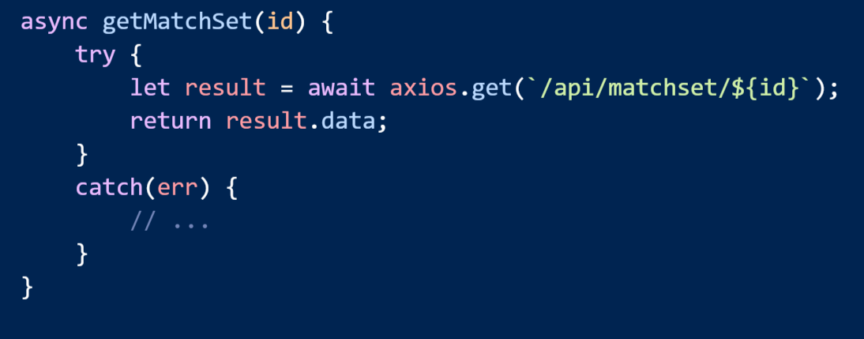
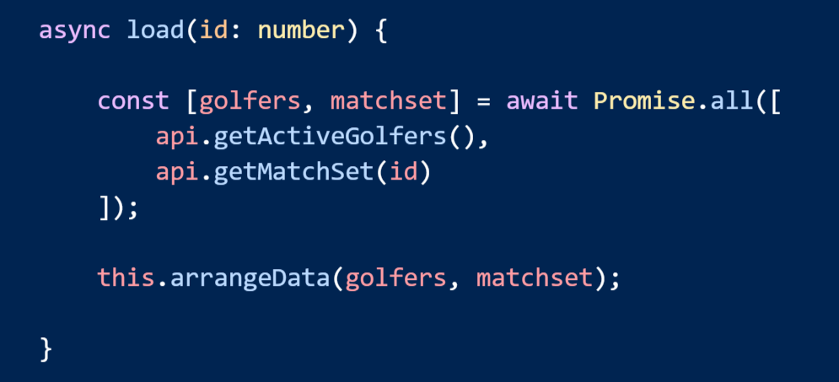
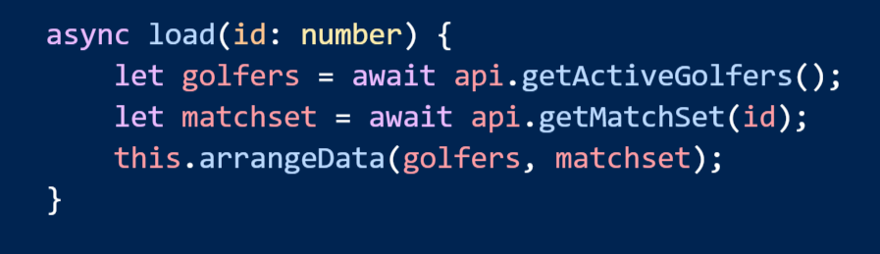
async await

Slide 30
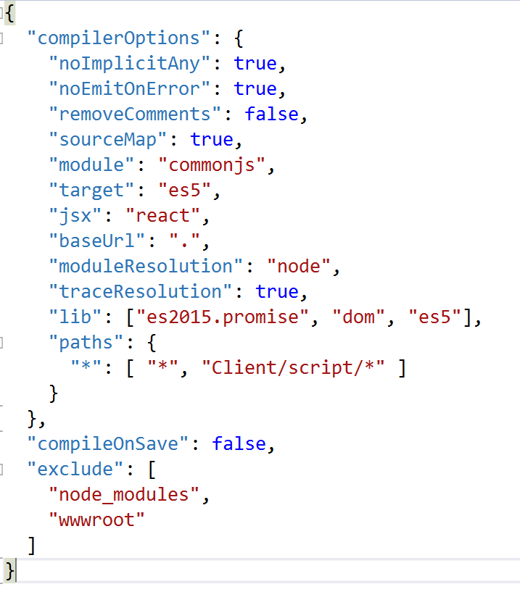
TypeScript 2.x – Better All the Time
Optional types
Not just for Google
No more references or tsd
Understands my environment
Understands my layout

Slide 31
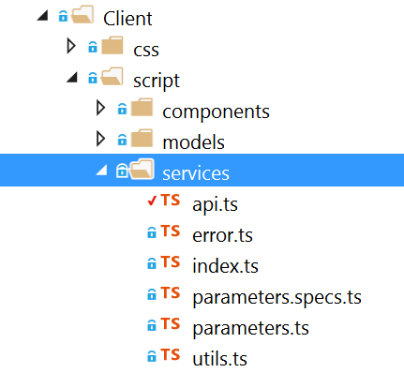
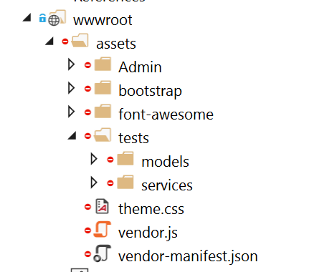
A Place to Call Home

Slide 32
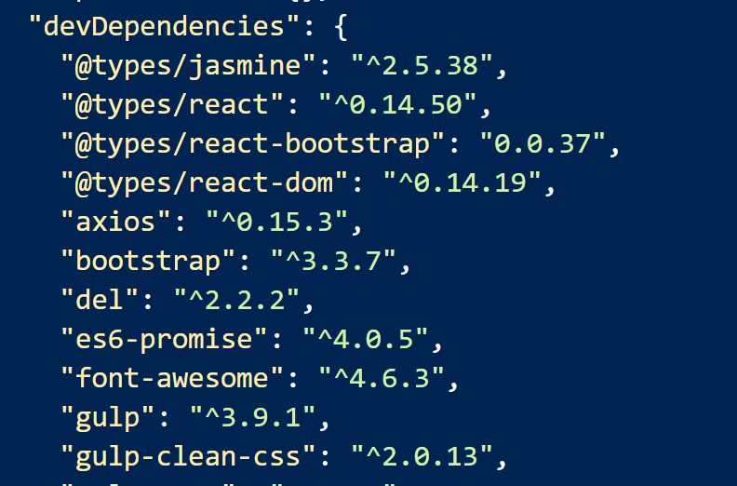
Use @types

Slide 33
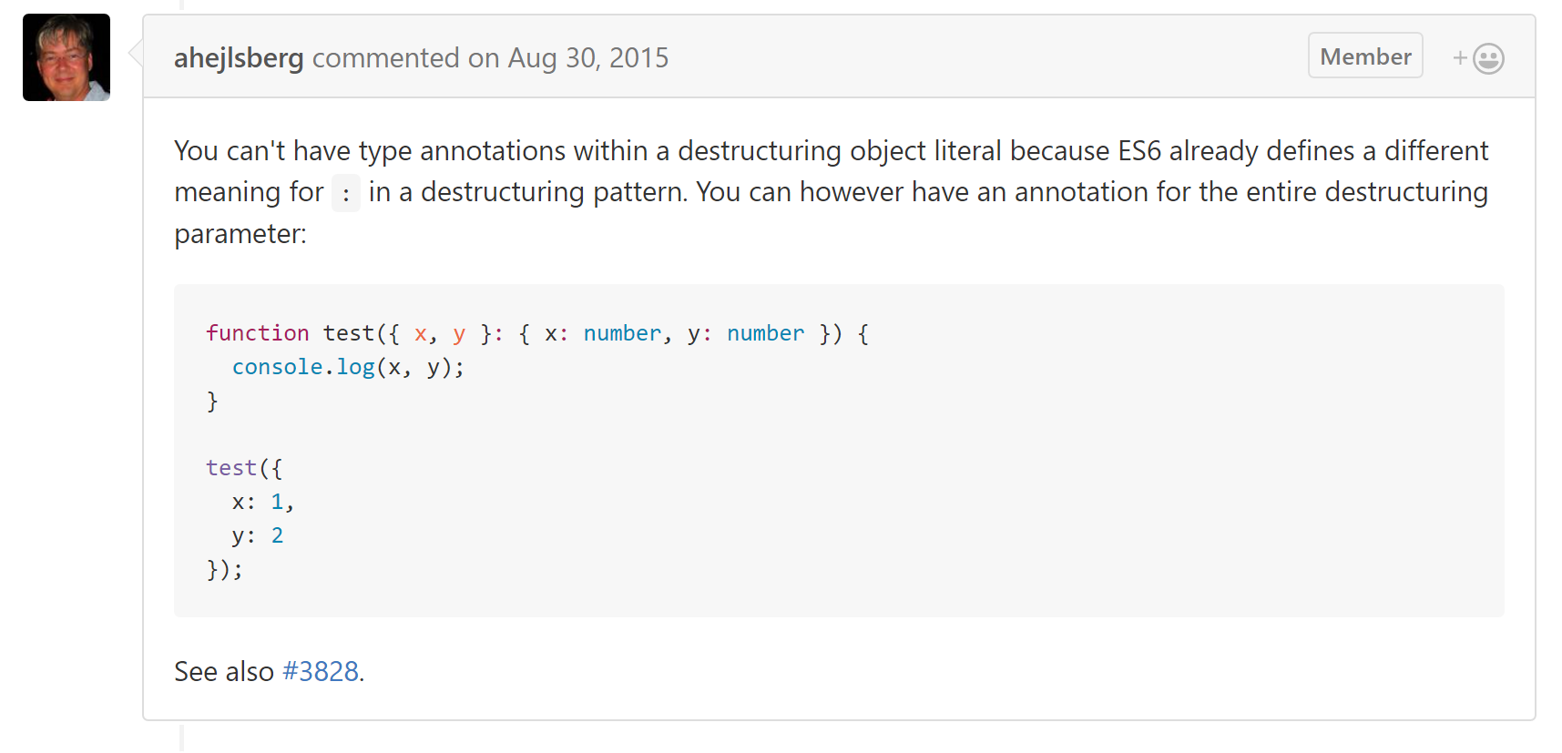
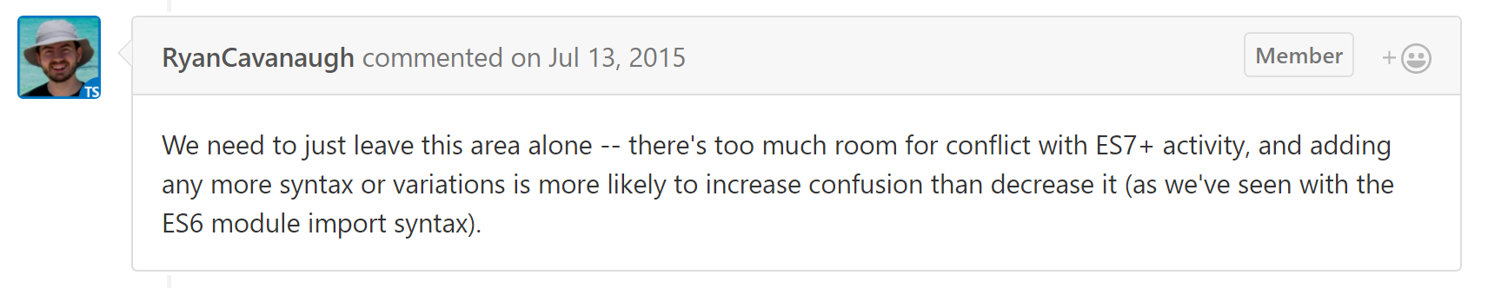
Reasons for Concern

Slide 34
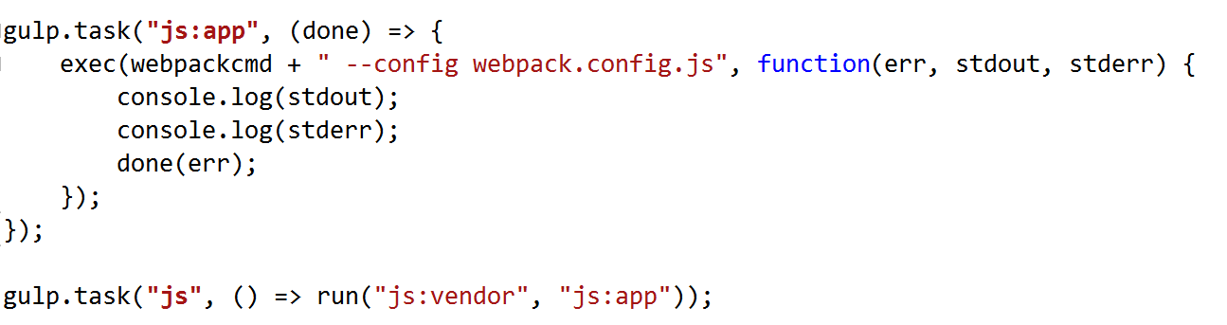
The Build

Slide 35

No Global Tools!

Slide 36

Tests – Karma + Jasmine

Slide 37

Tests Live in Folder with Module

Slide 38

More Integration, Fewer Units

Slide 39

The End
scott@OdeToCode.com
@OdeToCode

