Slide 1
Razor Pages
Pages are for HTML

Slide 2
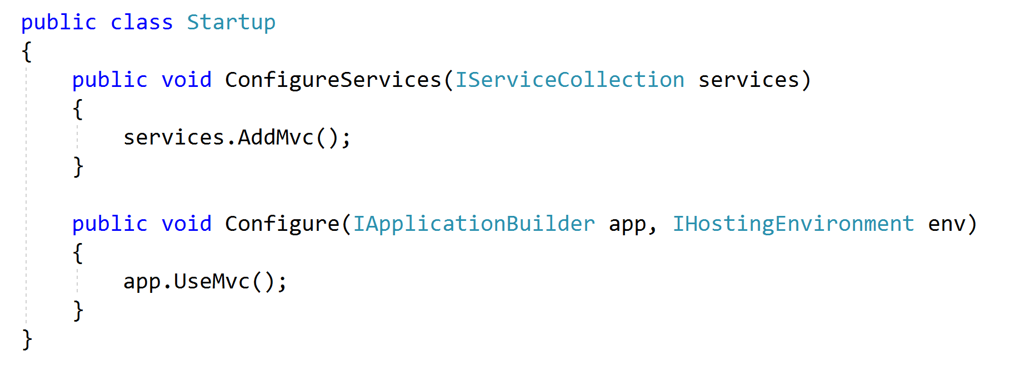
Razor Pages are part of MVC

Slide 3
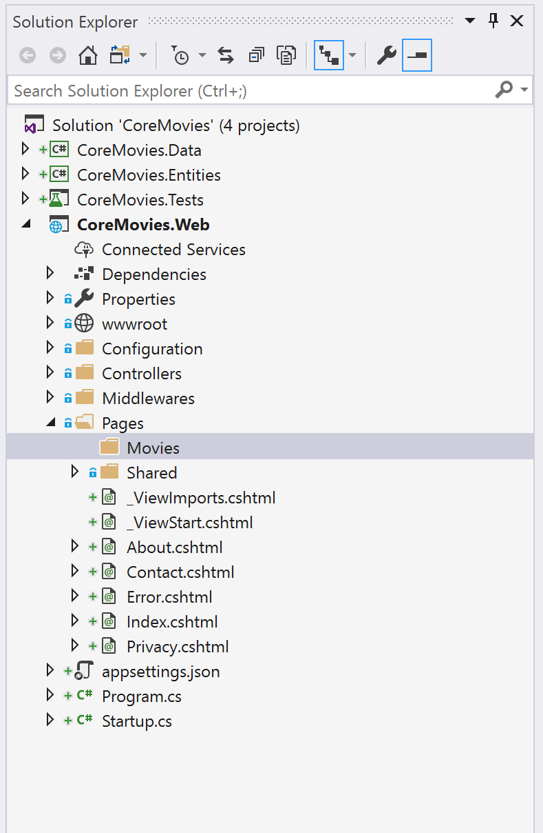
Page Conventions
Pages is the default folder
Index.cshtml is the default page
File | URL
/Pages/Index.cshtml | / or /Index
/Pages/Contact.cshtml | /Contact
/Pages/Movies/List.cshtml | /Movies/List
/Pages/Movies/Index.cshtml | /Movies or /Movies/Index

Slide 4
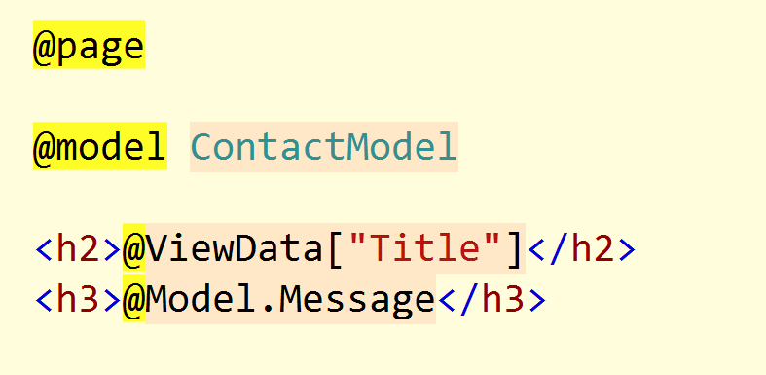
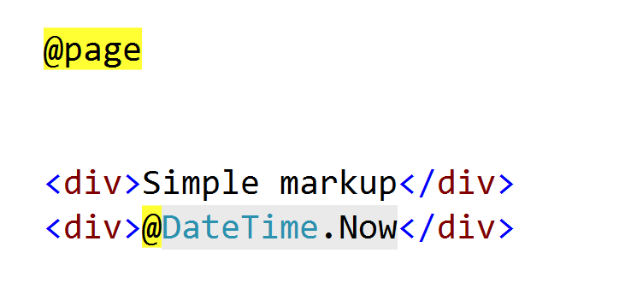
@page Directive
@page differentiates Page from View
@model sets the type of Model property
Inherits from PageModel derived class

Slide 5
Razor Templates
Template
Data
Generated
Output
+
=

Slide 6
Intermingling C# and HTML
<ul> @foreach (var movie in Model) { <li> <a href="/home/details/@movie.ID">@movie.Title</a> </li> } </ul>
Email: scott-allen@pluralsight.com Twitter: @@OdeToCode

Slide 7
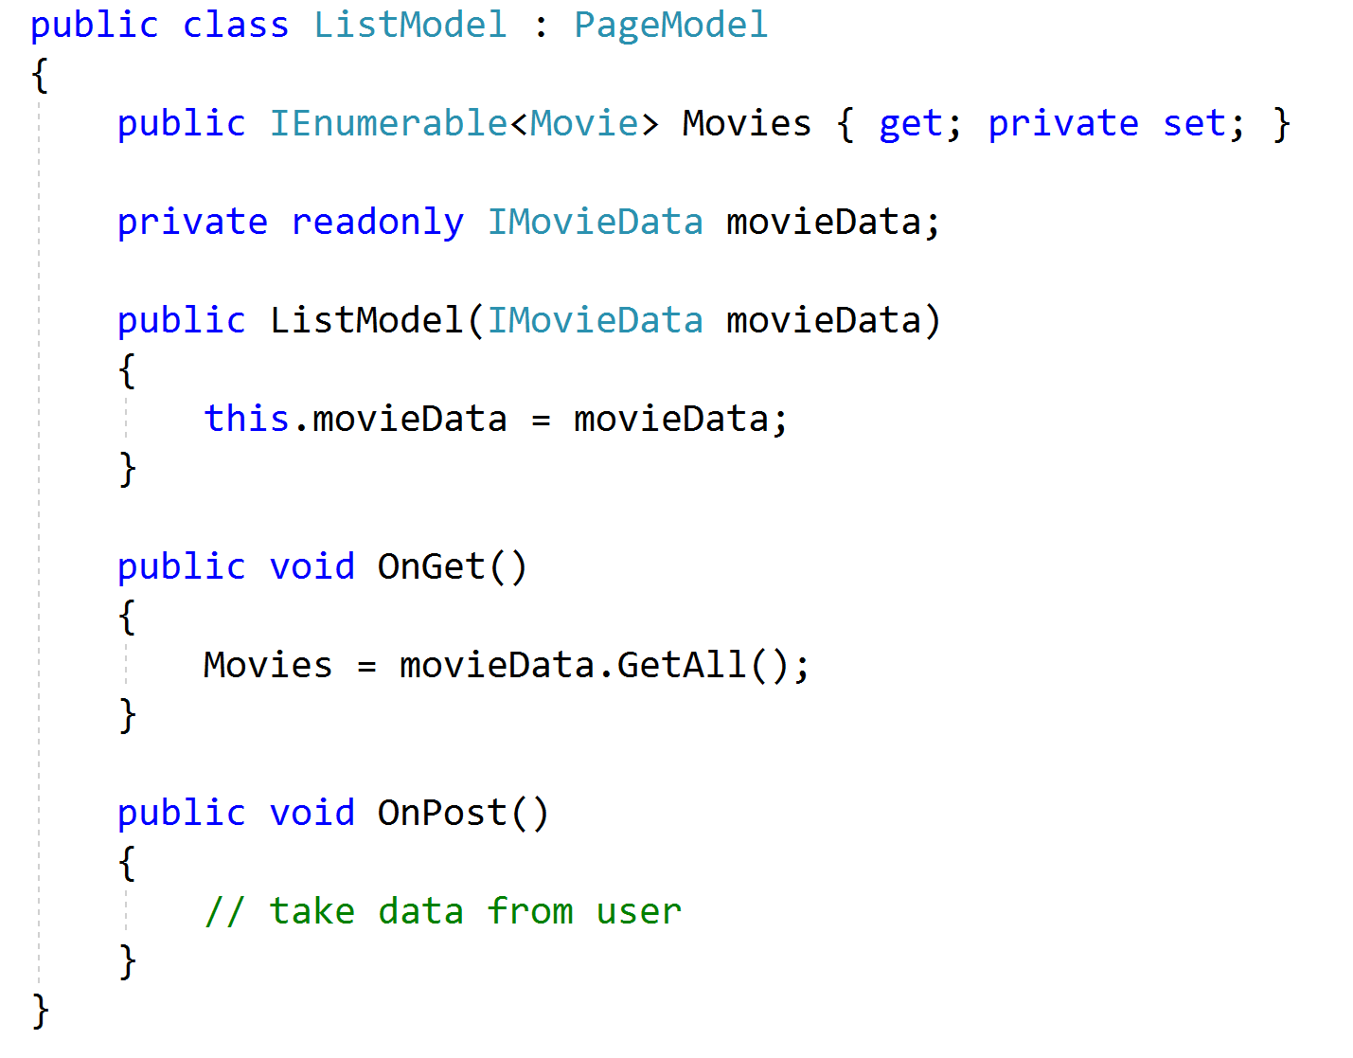
Handlers
OnGet and OnPost
OnGetAsync and OnPostAsync
Can also have custom handlers

Slide 8
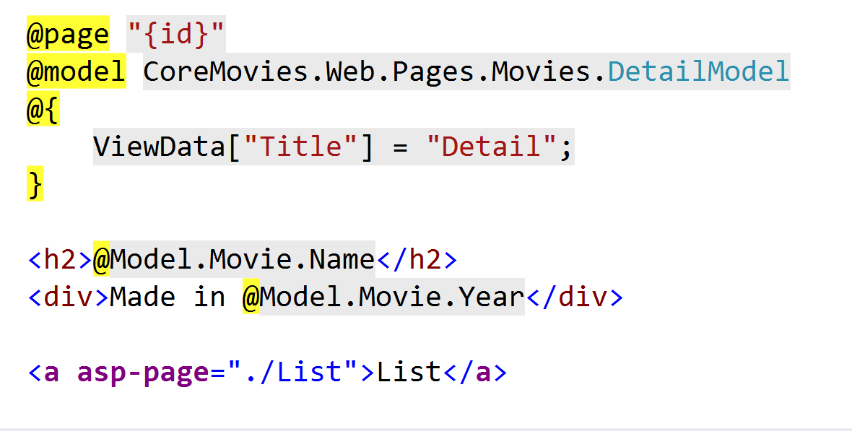
Route Templates
Specify in the @page directive
Can change route, add parameters

Slide 9
Layout
Layout views allow for pluggable content areas
RenderBody
RenderSection
<!DOCTYPE html> <html> <head> <title>@ViewBag.Title</title> <script src="@Url.Content("~/Scripts/jquery-1.4.4.min.js")"
type="text/javascript"></script> </head> <body> @RenderBody() </body> </html>

Slide 10
_ViewStart
Code inside _ViewStart.cshtml executes before every view renders
Hierarchical (subfolders override parent)
@{ Layout = "~/Views/Shared/_Layout.cshtml"; }

Slide 11

_ViewImports
Add namespaces and tag helpers

Slide 12
HTML Helpers
Html is a property of the ViewPage base class
Many HTML helpers replaced with tag helpers
@using (Html.BeginForm()) { @Html.ValidationSummary(true) <div class="editor-label"> @Html.LabelFor(model => model.FirstName) </div> <div class="editor-field"> @Html.EditorFor(model => model.FirstName) @Html.ValidationMessageFor(model => model.FirstName) </div>

Slide 13
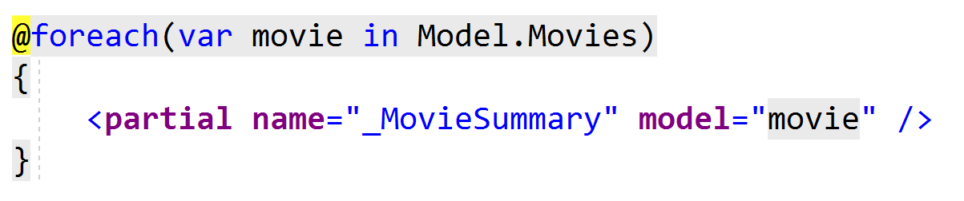
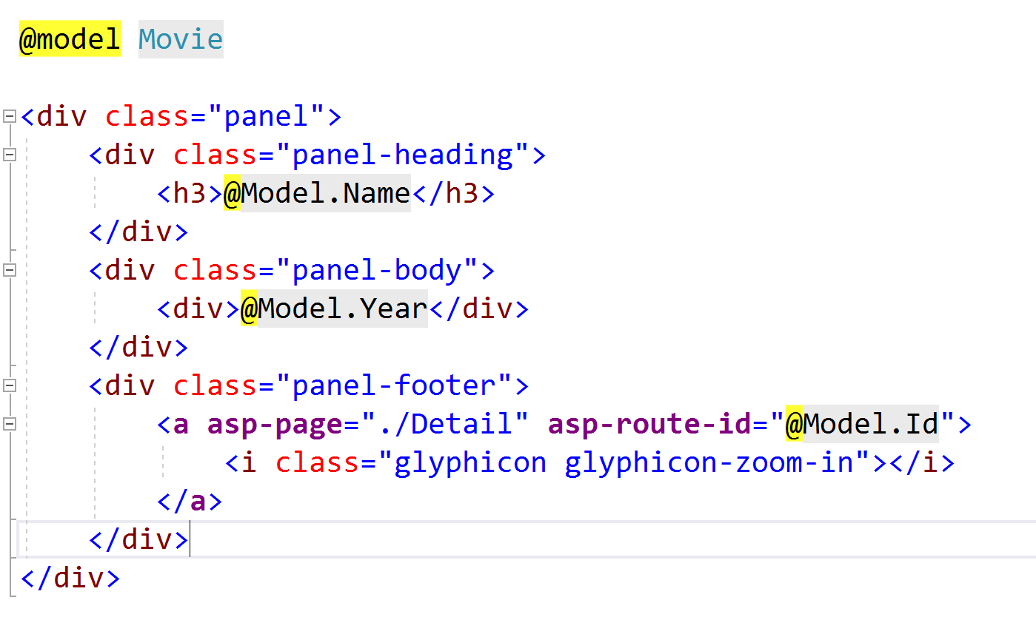
Partials
Partial views render portions of a page
Reuse pieces of a view

Slide 14
TagHelpers
A better HTML helper
Opt-in (required @addTagHelper support)
Forms, links, inputs
Caching, environment, and more

Slide 15
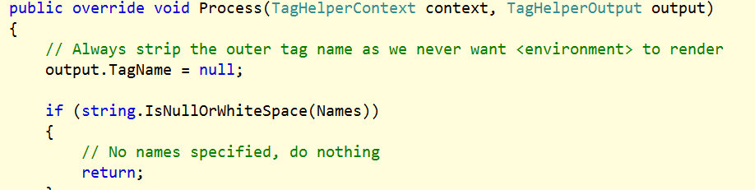
Custom Tag Helper

Slide 16
Summary
Controller or
Page
Model
View

