Slide 1
Configuration and Services
JSON and Injection

Slide 2
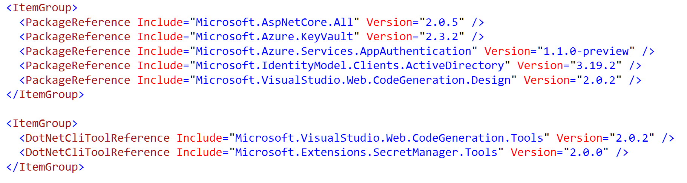
Dependencies
Live in csproj
Only top level dependencies required

Slide 3
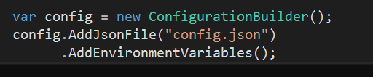
Runtime Configuration
Instantiate Configuration class in Startup
Add sources via extension methods
JSON
INI
Environment variables
XML
Command line

Slide 4

Configuration Is Key => Value
Drill into hierarchy using :

Slide 5
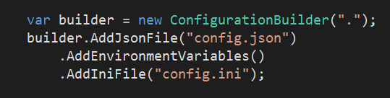
Configuration Override
Last entry wins

Slide 6
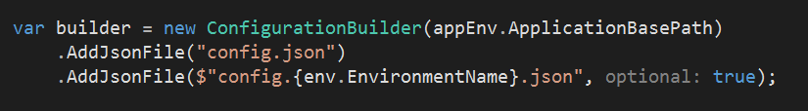
Using the Environment
Add files with names corresponding to environment

Slide 7
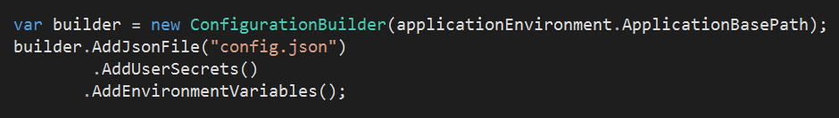
User Secrets
Secrets stored in user home directory
Manage from Visual Studio or user-secrets CLI
Allows protected configuration outside of source control

Slide 8
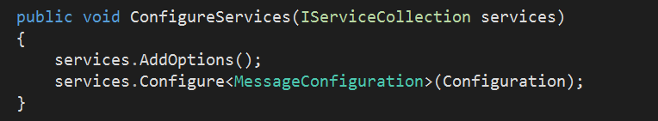
Configuration In The Application
Inject IOption<T> instances

Slide 9
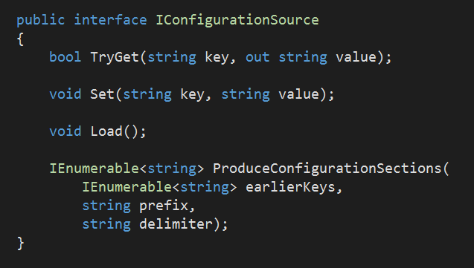
Custom Configuration Providers
Implement IConfigurationSource
Load, Set, TryGet
Or, inherit from ConfigurationSource

Slide 10
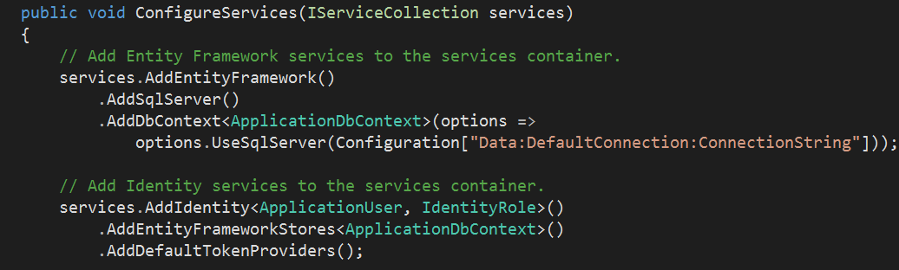
Dependency Injection
Single, simple container out of the box
DI all the way down

Slide 11
IServiceProvider
Abstraction for systemwide container
Implementation supports lifestyles:
Instance
Transient
Singleton
Scoped

Slide 12
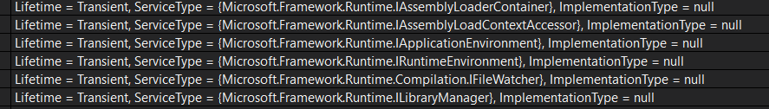
Summary
Configuration and DI work together
Many options for flexibility and extensibility

