Slide 1

Templates
{{ binding }}

Slide 2
The Role of Templates
<template>
Components
No direct DOM manipulation
Templates
No serious model manipulation
properties
events
@Component

Slide 3


Interpolation
Expression evaluated against parent component
No access to global scope
Somewhat forgiving (errors logged to console)

Slide 4
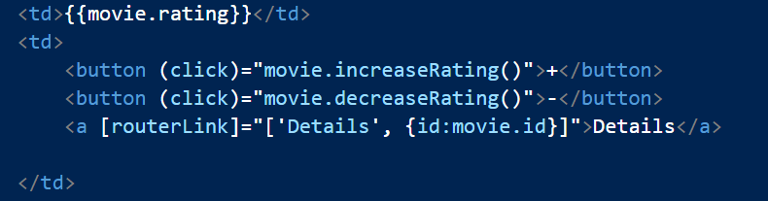
Template Expressions
Object literals and array literals are allowed
Statements only allowed for events
No keywords (new, if, class, function)
Angular uses a parser to understand expressions

Slide 5
Binding Overview
Event Binding
Property Binding
Event Binding
Attribute Binding
Two Way Binding

Slide 6
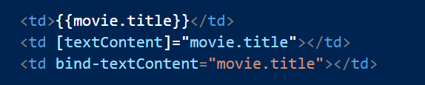
Property Binding
[ ] or bind are property bindings
Binding to properties not attributes
Also works with custom components and directives

Slide 7
Attribute Binding
Not all attributes are backed by a property
aria-* attributes, for example

Slide 8
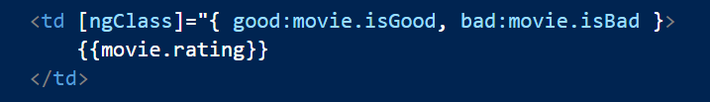
Class and Style Binding
Use ngClass and ngStyle
Special directives for special cases

Slide 9
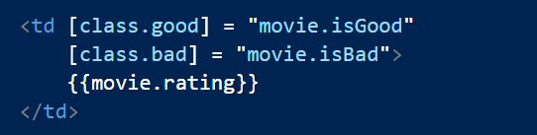
Class Binding versus NgClass
Two approaches for binding classes and styles

Slide 10
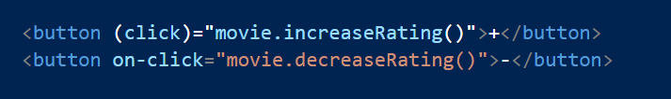
Event Binding
Use ( ) or on with any DOM event
No special directives needed for new events

Slide 11

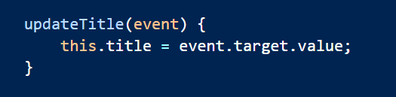
$event
Send DOM event information to event handler
Directives can also emit events (more later)

Slide 12
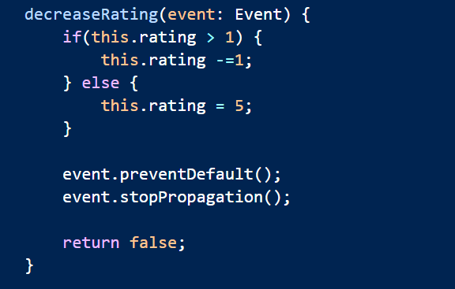
Event Bubbling
Many DOM events bubble upwards
Return false or use event API to stop bubbling
Event delegation more efficient

Slide 13

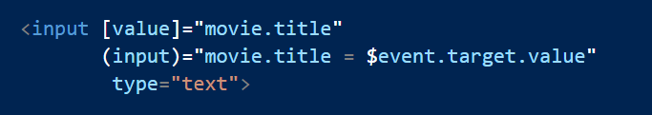
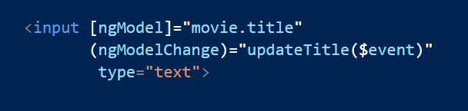
Two Way Binding
Use [( )] with ngModel to synchronize an input with a model

Slide 14
Using Built-in Directives
New binding syntax doesn’t require as many low level directives
No need for ngMouseOver and ngClick, for example
Ng2 directives are helpers
NgClass, for example

Slide 15
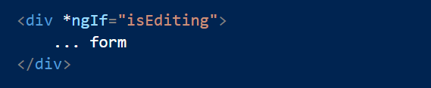
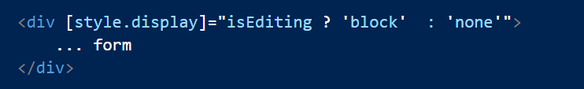
NgIf
Add or remove element from DOM

Slide 16
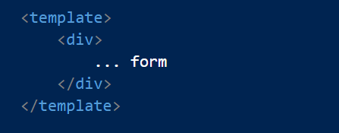
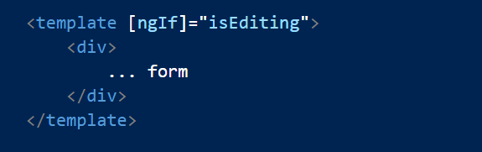
How Things Work - <template>
Defined in HTML5 specification
Holds HTML fragments
Browser will not render fragments
Fragments are managed by scripts

Slide 17
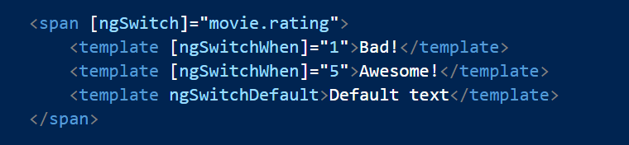
NgSwitch
Like a switch statement for DOM manipulation

Slide 18
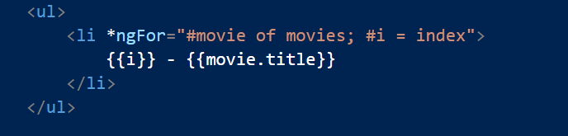
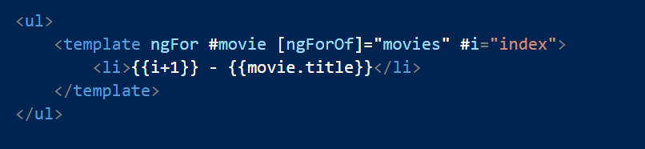
NgFor
Loop over a collection to clone a template once for each item
Provides index, last, even, odd for aliasing

Slide 19
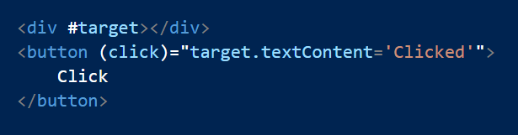
Template Variables
# creates a local template variable
Usable from siblings and children
Directive sets the variable
Or, variable refers to the element

Slide 20
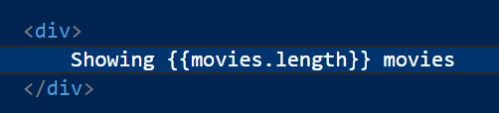

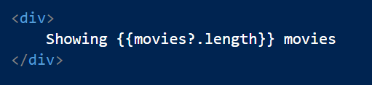
Null Conditional (Elvis) Operators
Avoid dereferencing null and undefined values

Slide 21
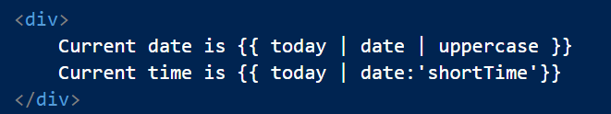
Pipes
Typically format a model value for display

Slide 22
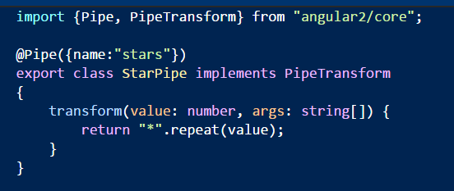
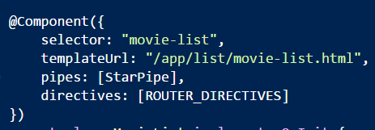
Custom Pipes
Extend PipeTransform and use @Pipe decorator
Register pipe at component level

Slide 23
Summary
Templates present the component model
Data flows to the template
Events flow to the component
Directives are the underlying building block
<template>
properties
events
@Component

