Slide 1

An Introduction To Angular 2

Slide 2

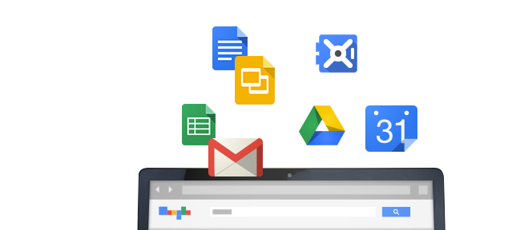
History
Started in 2009 @ Google
Built from experience with large web applications

Slide 3
Concepts and Goals
Separate
Concerns
Testability
Extensibility
Forward
Looking

Slide 4


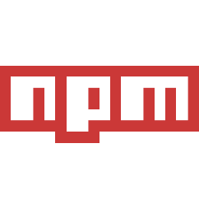
Tools & Languages

Slide 5
Getting Started : Packages
angular 2 – the framework
typescript – the language
systemjs - the module loader
npm init –y
npm install angular2 typescript systemjs --save

Slide 6
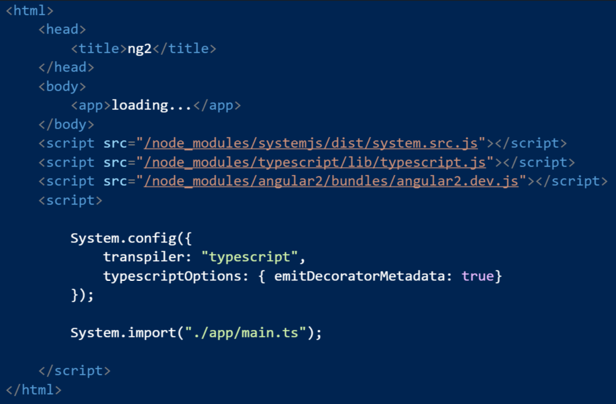
Getting Started: Shell Page

Slide 7
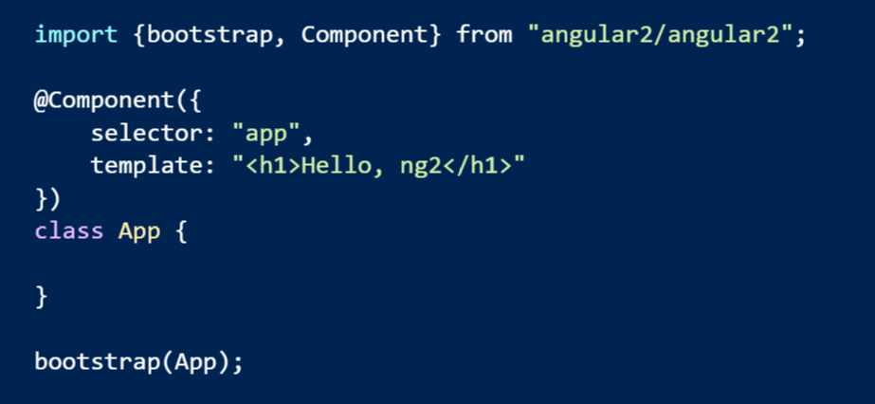
Getting Started: First Script

