Slide 1
Resolving Dependencies
Dependency Injection and IOC in MVC 3

Slide 2
Resolving Dependencies
What is dependency resolution (and why do I care)?
Service location for MVC features
Controllers
Filters
Model validation and metadata
Model binders
Activators

Slide 3
What is Dependency Resolution?
I’m A Component
A Service
Who Needs
(like a controller)
(like a repository)
Dependency
public ActionResult Index() { var repository = new EmployeeRepository(); var model = repository.GetSalariedEmployees(); return View(model); }

Slide 4
Dependency Resolution
Component
Dependency
Resolver
I need a <T>
Here is a <T>
Service Locator
Design Pattern
public ActionResult Index() { var repository = DependencyResolver.Current .GetService<IEmployeeRepository>(); var model = repository.GetSalariedEmployees(); return View(model); }

Slide 5
Dependency Resolution Benefits
Flexibility, testability, extensibility
MVC Framework is extensible
Controller
Builder
ModelBinders
Model Metadata
Providers
Controller
Factory
Model
Binders
Model
Metadata
Dependency Resolver

Slide 6
Dependency Resolver and You
You can write a dependency resolver and plug into anything
Usually thunks to an IoC container
class MyResolver : IDependencyResolver { public object GetService(Type serviceType) { // ... } public IEnumerable<object> GetServices(Type serviceType) { // ... } }
DependencyResolver.SetResolver(new MyResolver());

Slide 7
Controller Injection
Controller pieces pass through dependency resolver
Controller factory
Controller activator
Controller itself
public class HomeController : Controller { private readonly ILogger _logger; public HomeController(ILogger logger) { _logger = logger; } public ActionResult Index() { _logger.WriteMessage("Index"); return View(); } }
IKernel kernel = new StandardKernel(); kernel.Bind<ILogger>().To<SqlLogger>(); DependencyResolver.SetResolver(new NinjectDependencyResolver(kernel));

Slide 8
View Injection
View related components set through dependency resolver
View engine
Views themselves
public abstract class MessagingWebViewPage<T> : WebViewPage<T> { [Inject] public IMessenger Messenger { get; set; } }
@inherits MessagingWebViewPage<dynamic> @{ ViewBag.Title = "Index"; } <h2>Index</h2> @{ Messenger.SendMessage("Questionable"); }

Slide 9
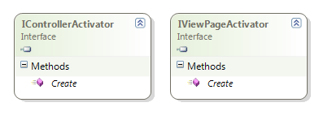
Activators
IControllerActivator
Fine grained control over bringing a controller to life
IViewPageActivator
Fine grained control over bringing a view to life
public class CustomControllerActivator : IControllerActivator { public IController Create(RequestContext requestContext, Type controllerType) { return Activator.CreateInstance(controllerType) as IController; } }

Slide 10
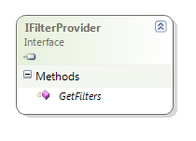
Action Filter Extensibility
Action filters in MVC 3 don’t need to be attributes
IActionFilter, IResultFilter, IExceptionFilter, IAuthorizationFilter
Filters gathered from IFilterProviders
Three filtered providers configured by default
Global filter provider
Attribute filter provider
Controller instance provider
public IEnumerable<Filter> GetFilters( ControllerContext controllerContext, ActionDescriptor actionDescriptor) { yield return new Filter( _kernel.Get<MessageFilter>(), FilterScope.Global, order: null ); }

Slide 11
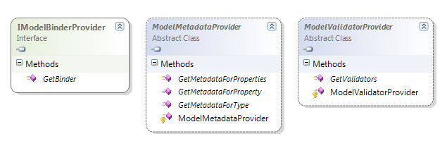
Model Extensibility
IModelBinderProvider
Multiple services to locate model binders
ModelMetadataProvider
A single service to locate model metadata
ModelValidatorProvider
Multiple services to provide validators

Slide 12
Summary
The DependencyResolver
Allows a single extensilbility point
Custom resolvers can leverage an IoC
Dependency injection everywhere!
Providers for filters, model binding, model metadata, and model validation
You have complete control over the services consumed by the runtime

