Slide 1
MVC 4 – Async Actions
Asyncing and Awaiting
Scott Allen

Slide 2
Scalability
Web App
Slow Service
T1
HTTP Request
Service Request
T2
Request
Service Request
T3
Request
Service Request

Slide 3
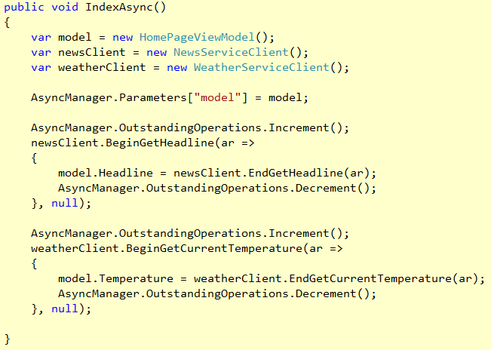
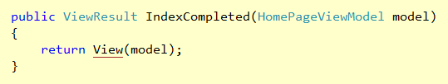
AsyncController in MVC 3

Slide 4
Scalability
Web App
Slow Service
Service Request
HTTP Request
T1
HTTP Request
Service Request
HTTP Request
Service Request

Slide 5
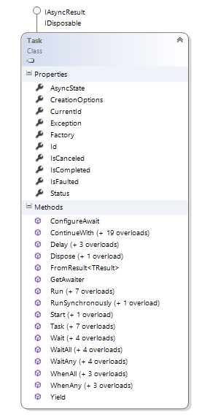

The Task Parallel Library
Parallel processing
Asynchronous processing
A better abstraction for threads

Slide 6
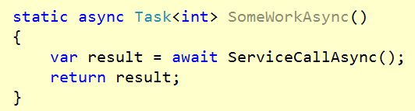
async & await
Method with async keyword can use an await
await can suspend an async method
await can free the calling thread
Execution can resume where it left off

Slide 7
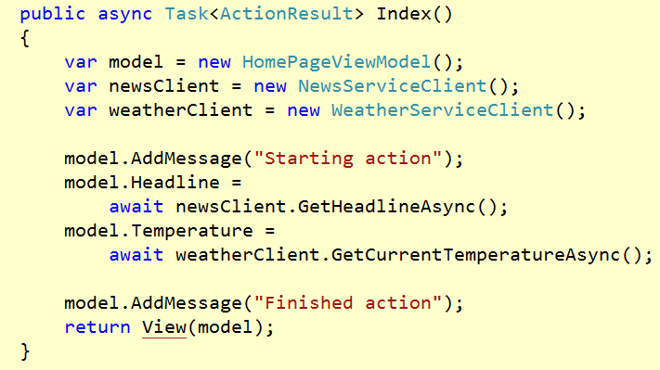
async actions

Slide 8
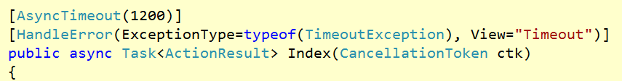
Timeouts
Use AsyncTimeout attribute
Requires CancellationToken parameter
Pass token to other async operations

Slide 9
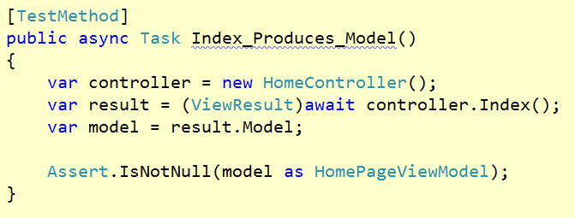
async Testing
Use a test runner that supports async test methods
MSTest
XUnit

Slide 10
Summary
async await make for easy asynchrony
Structure awaits to suit the processing model
Test async methods with a async capable test runner

