Slide 1
ASP.NET 5 Security
The Return of Middleware

Slide 2
It’s All About Claims
Identities are based on claims throughout .NET framework
Claims are simple key-value pairs
Scott is an admin
Scott’s email is scott@OdeToCode.com
ClaimsIdentity is a collection of claims

Slide 3
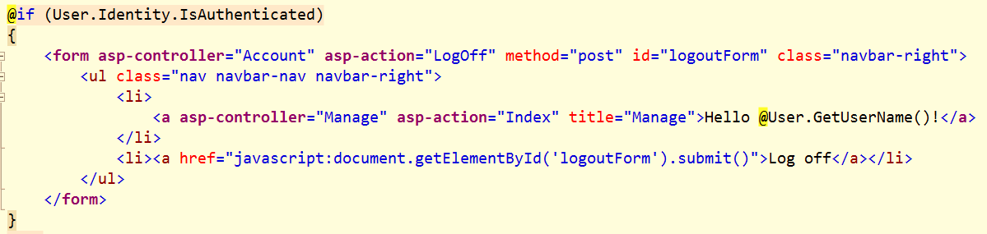
ClaimsPrincipal
A collection of ClaimsIdentity
User property available in controllers and views

Slide 4
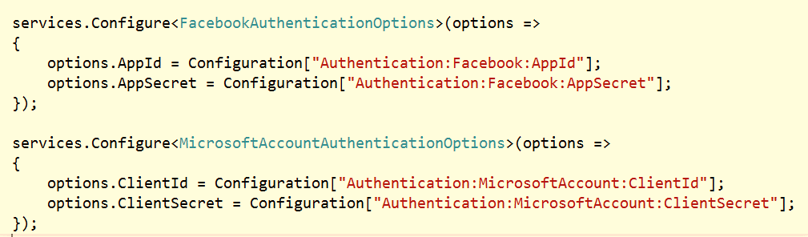

OAuth
Microsoft, Google, Facebook, Twitter, LinkedIn
All supported via middleware

Slide 5
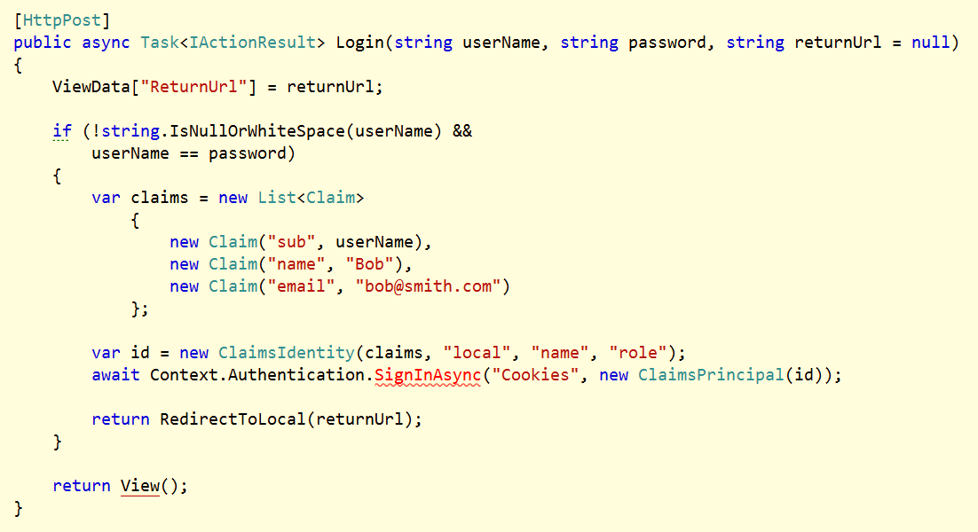
Authentication Manager
SignIn / SignOut
Sets cookie
Challenge
Authenticate
GetAuthenticationSchemes

Slide 6
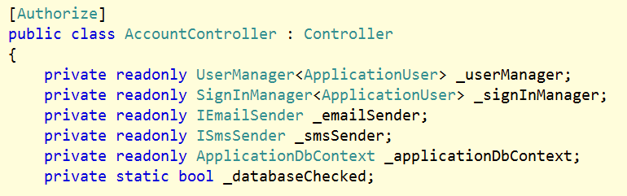
Authorize Attribute
Use to protect controllers, actions
Use [AllowAnonymous] to be explicit

Slide 7
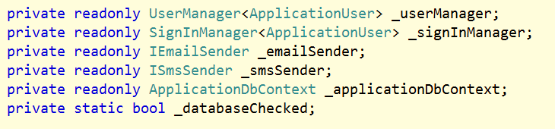
ASP.NET Identity
Builds on top of cookie middleware

Slide 8
CORS
Support in Microsoft.AspNet.Cors
Use CORS middleware for global settings
[EnableCors] attribute works on controllers and actions

Slide 9
Summary
Three key abstractions
Middleware
ClaimsPrincipal
AuthenticationManager

