Slide 1



Node Tools For Front End Developers

Slide 2
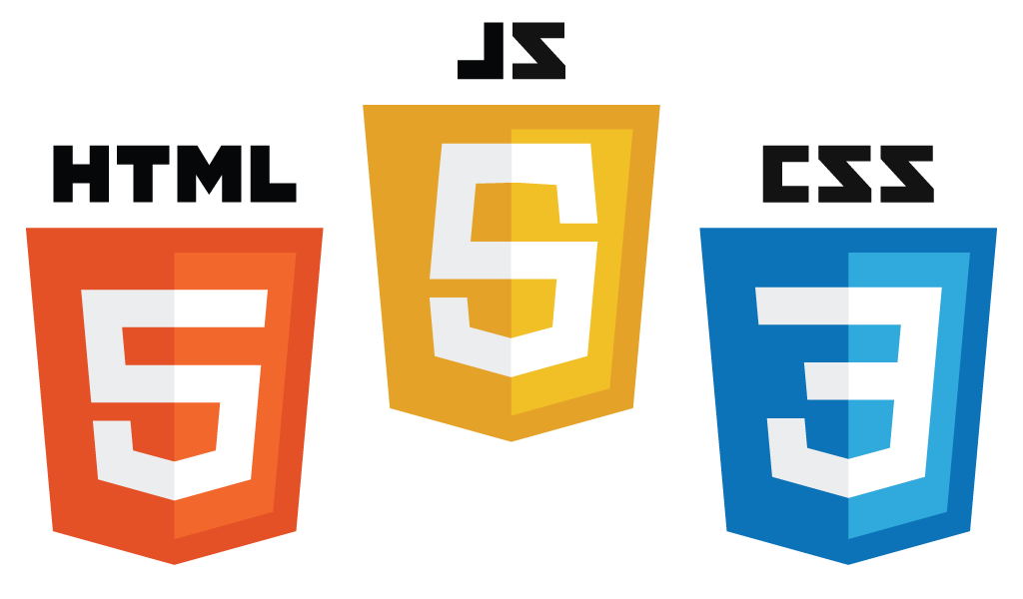
Why?

Slide 3
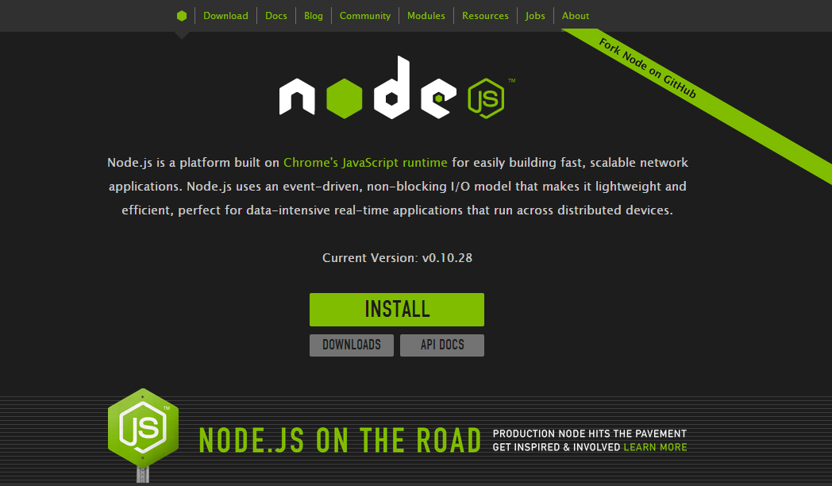

Slide 4
Topics
Package Managers
Task Runners
Generators

Slide 5
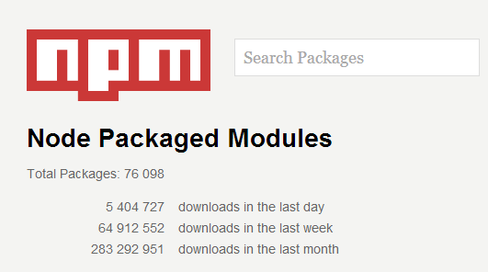
Package Management: npm
npm is the gateway to other tools

Slide 6
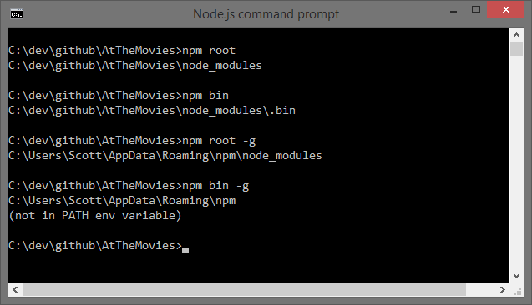
npm – where?

Slide 7
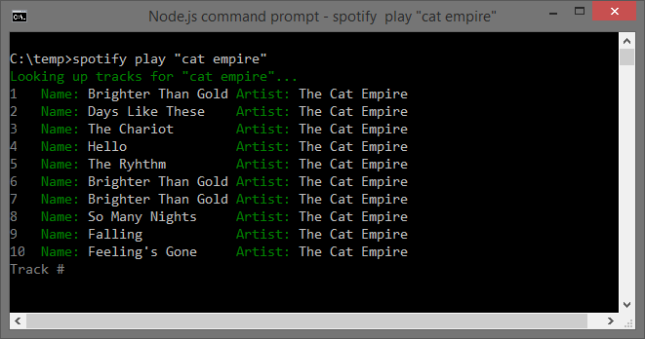
npm – cli

Slide 8
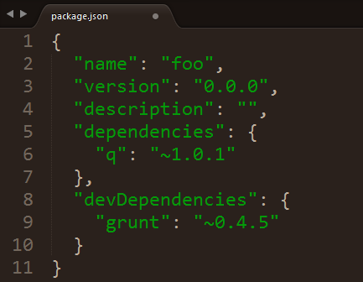
npm help
npm init
npm install <package> --save
npm install <packge> --save-dev
npm install
npm update

Slide 9

Package Manager: Bower

Slide 10
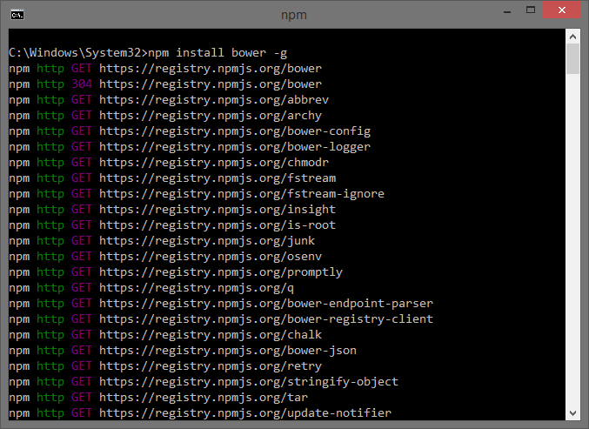
Installation via npm

Slide 11
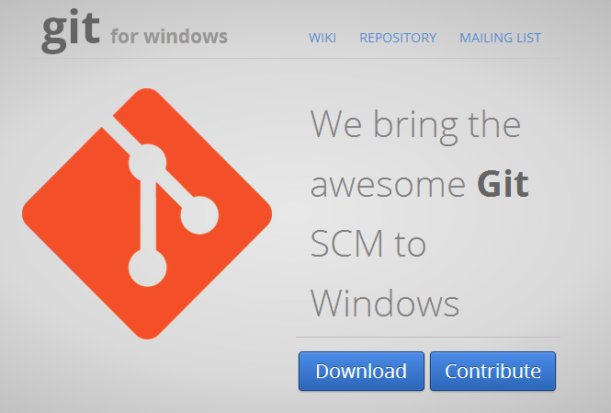
Bower Requires Git Client

Slide 12
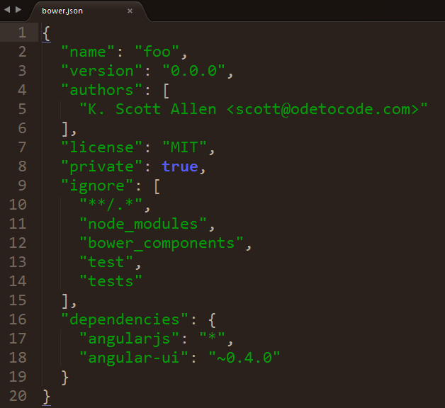
bower help
bower init
bower install <package> --save (or --save-dev)
bower install
bower update

Slide 13

Task Runner - Grunt
Automation, automation, automation
Installed in two pieces
npm install grunt-cli –g
npm install grunt –save-dev

Slide 14

Gruntfile.js
Configure tasks to execute
Execute grunt

Slide 15







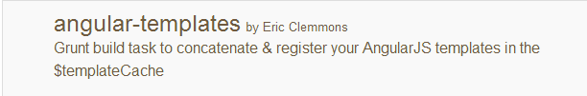


Other Grunt Tasks

Slide 16
Task Runner - Gulp
Grunt is declarative
Gulp is imperative
Installation
npm install –g gulp
npm install gulp –save-dev

Slide 17
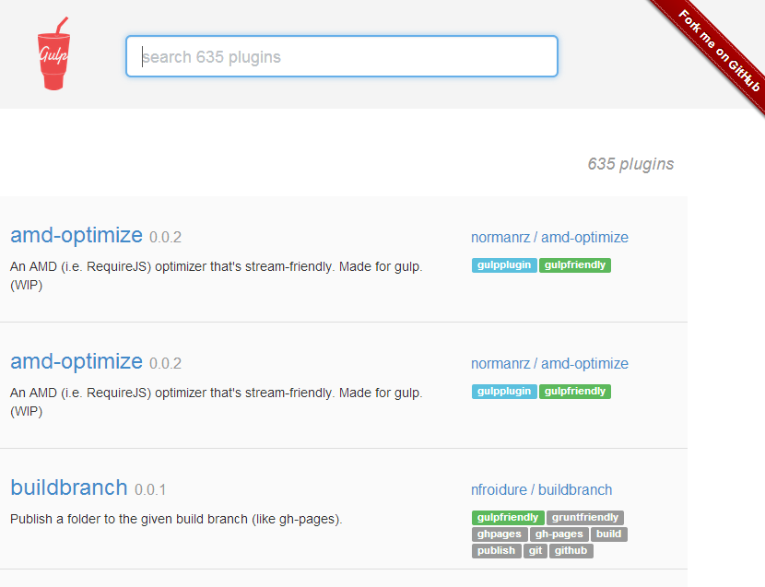

Slide 18

Yeoman

Slide 19
Yeoman Generators
gruntfile
jasmine
karma
angular
:controller
:filter
:factory
:directive

Slide 20
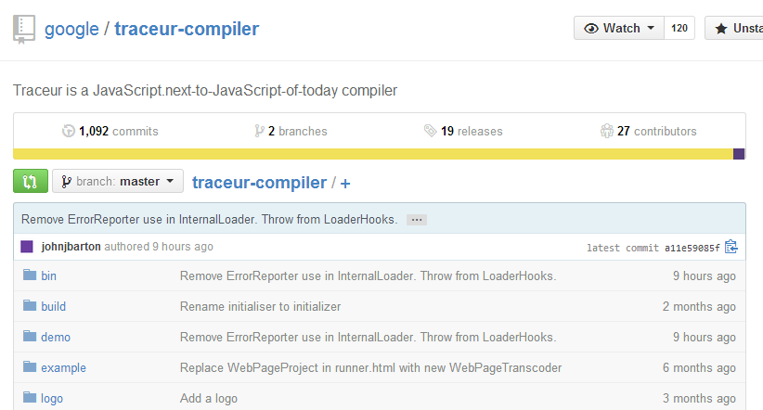
Traceur

Slide 21
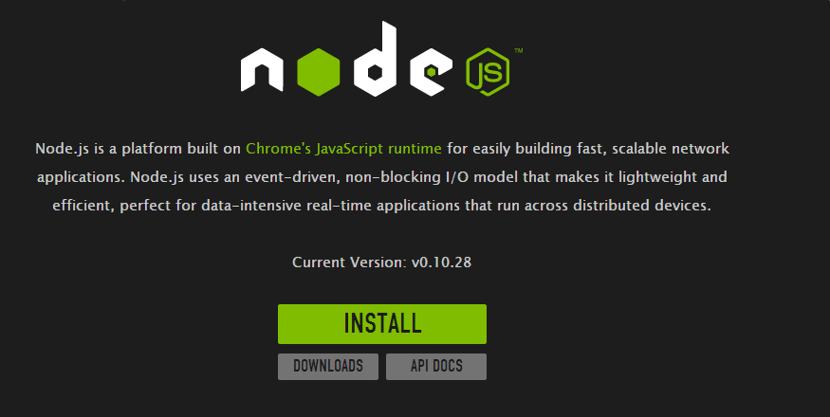
Summary

