Slide 1
ASP.NET 5 Deployment
dnu.exe

Slide 2
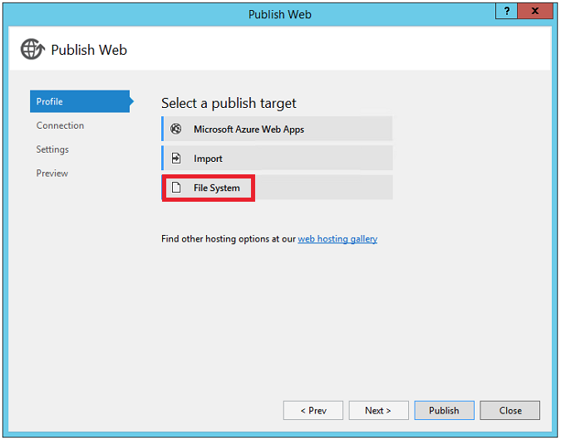
Deployment Options
Visual Studio
xcopy
dnu

Slide 3
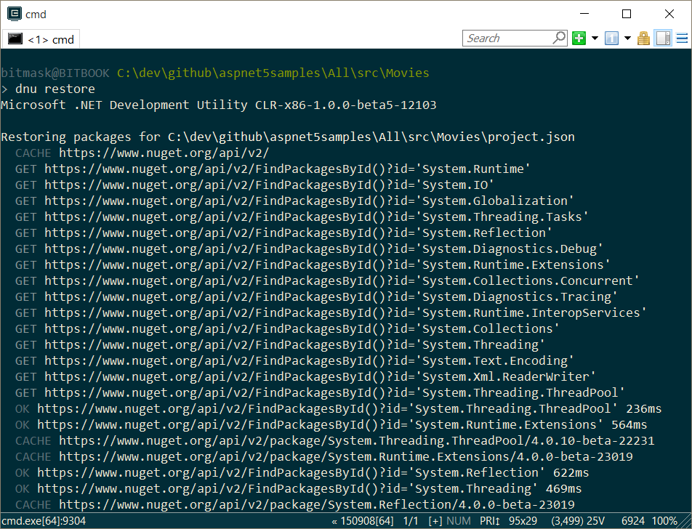
dnu restore
Download all dependencies for an application

Slide 4
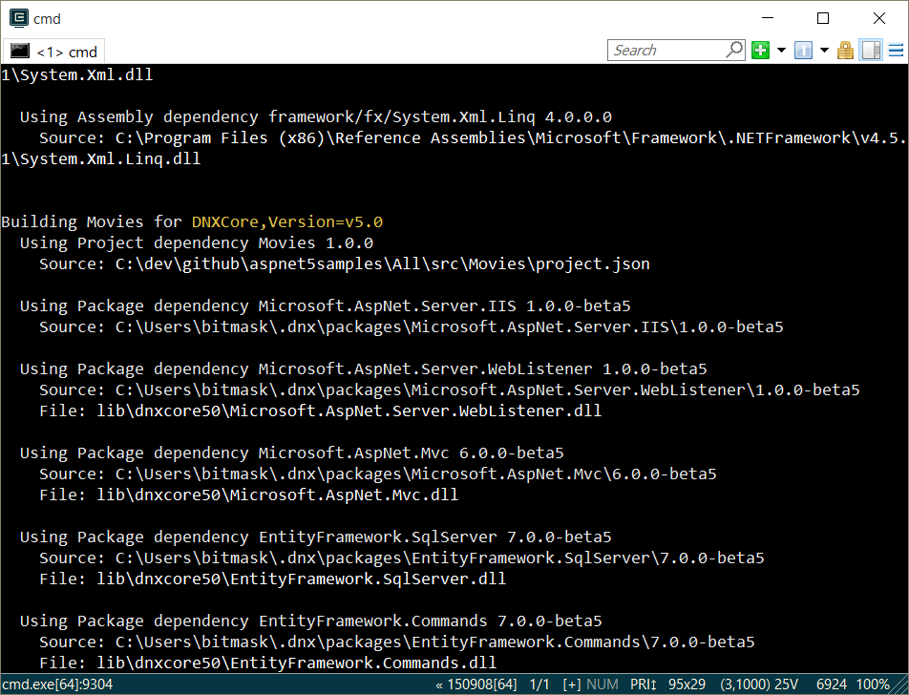
dnu pack
Build project into NuGet package

Slide 5
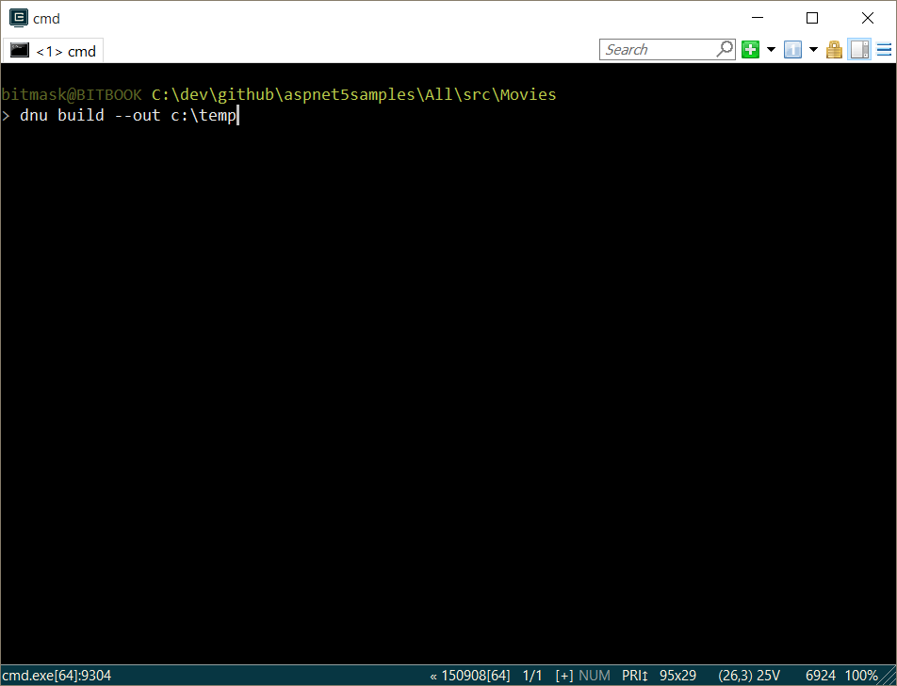
dnu build
Build assembly to disk

Slide 6

dnu publish
Publish with commands to deployable directory

Slide 7
Summary
Cloud optimized deployments

