Slide 1

Services
Factories & Providers

Slide 2
What’s A Service?
Service
Carry out a specific task
Server communication
Environment interaction
Algorithms and logic
Managed by injector
Substitutable
Controller
Directive
Module
Filter

Slide 3
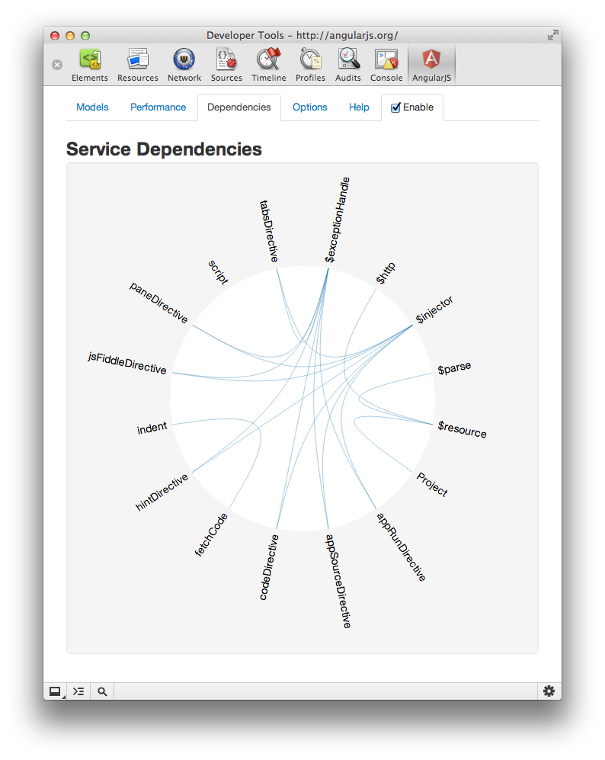
Services versus Controllers
Controllers manipulate $scope
Services can make HTTP requests
Services are singletons
Services can hold state
Services can have logic

Slide 4
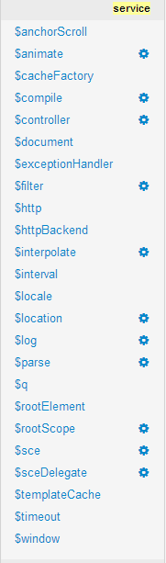
Built-in Services
ng services
Deferred objects
Logging
Window and browser interaction
ngRoute services
ngAnimate services
ngResource
ngCookies
ngTouch
ngSanitize
ngMock

Slide 5
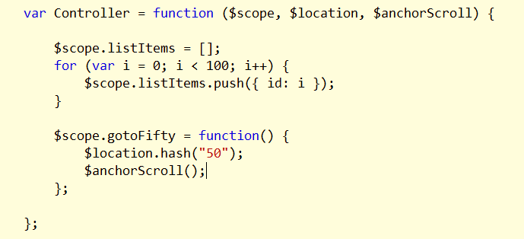
$anchorScroll

Slide 6
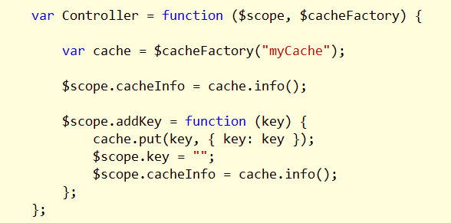
$cacheFactory
Create and manage named caches
Use capacity parameter to create an LRU cache

Slide 7
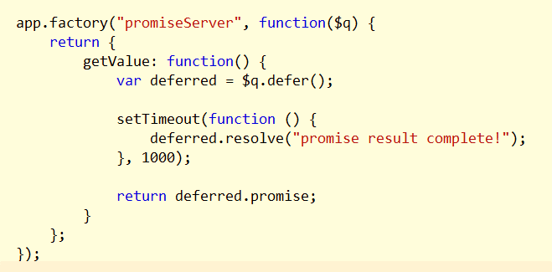
Promises and $q
Follows CommonJS promise specification
$q can build a deferred object
Use resolve, reject, notify
Deferred object can return a promise
Use then, catch, finally*

Slide 8
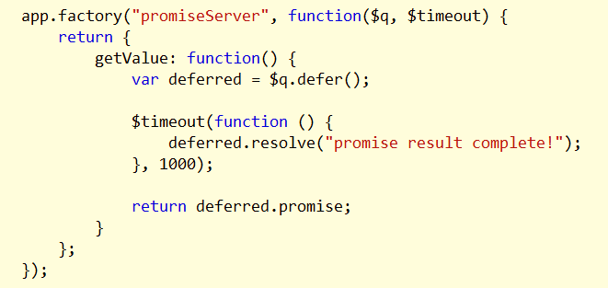
$timeout
Use instead of setTimeout
Works with the digest cycle
Testable

Slide 9
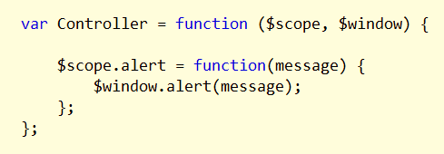
$window and $document
Use instead of window and document globals
Testable

Slide 10
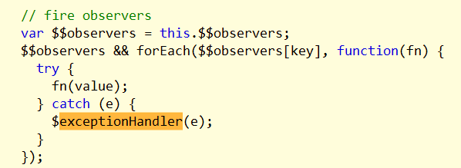
$exceptionHandler and $log
Uncaught exceptions sent to this service
Uses $log by default

Slide 11
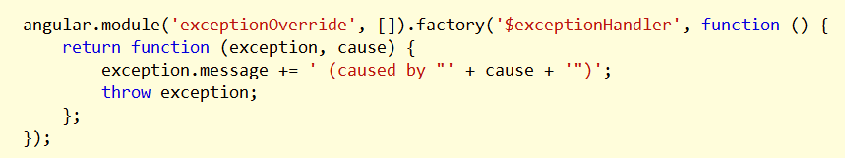
Overriding Services
Last registration wins…

Slide 12
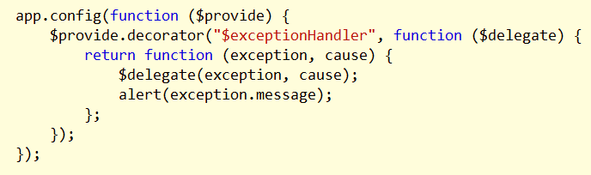
Decorating Services
Provide pre or post processing logic around an existing service

Slide 13
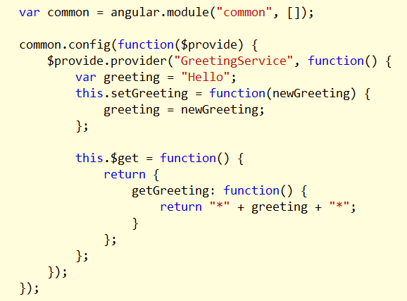
Service Providers
Uses $provide to register a service factory
Service provider can configure a service during config phase
Useful when writing services for others

Slide 14
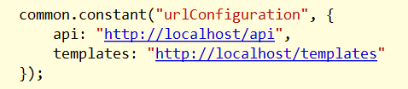
Creating services - constant
Injectable primitives
Can inject into config functions

Slide 15

Creating Services - value
Injectable primitives
Cannot inject into config functions

Slide 16
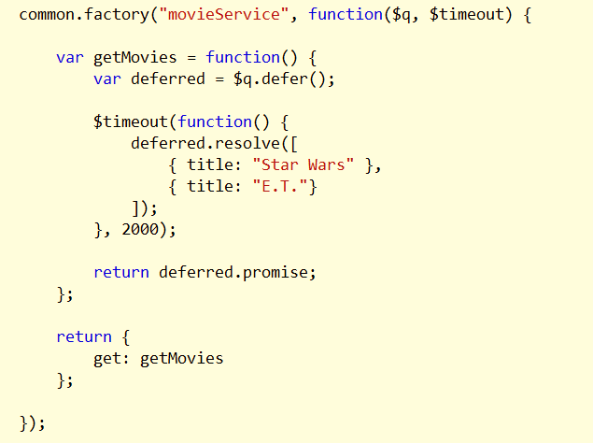
Creating services- factory
Shortcut method to create a service and provider
Returns service object

Slide 17
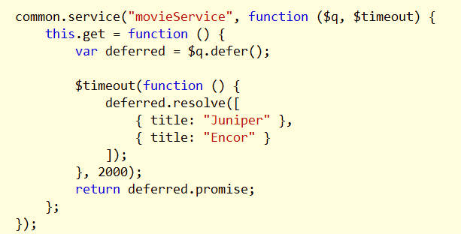
Creating services - service
Shortcut method to create a service and provider
Returns service constructor

Slide 18
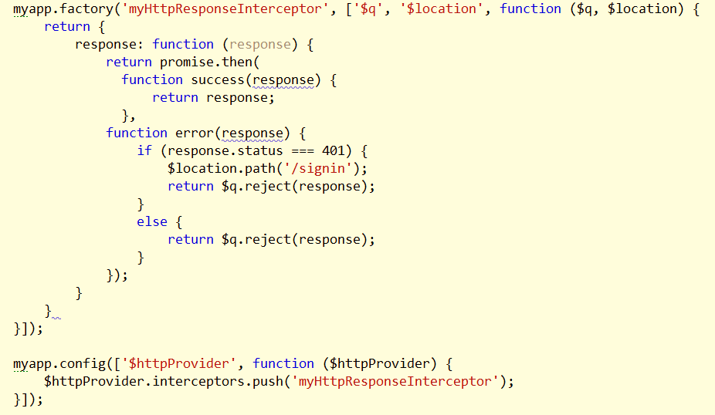
HTTP Interceptors
Request interceptors can modify the request config object
Response interceptors can change or modify behavior

Slide 19
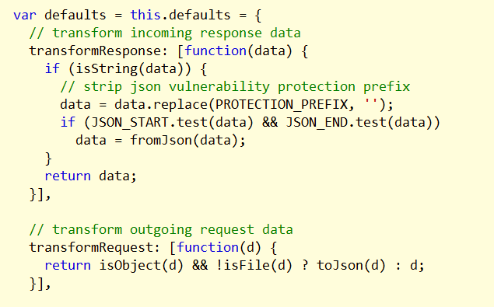
HTTP Transforms
Request and response transforms

Slide 20
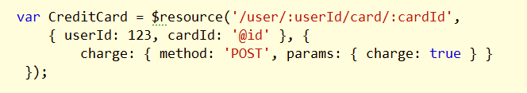
Resources
ngResource module
Uses GET, PUT, POST, DELETE to interact with a service

Slide 21
Summary
Services are
Injectable
Replaceable
Decoratable
Create services and service providers
$provider
factory
service
value
contanst

