Slide 1
ngLessons
K. Scott Allen
@OdeToCode

Slide 2
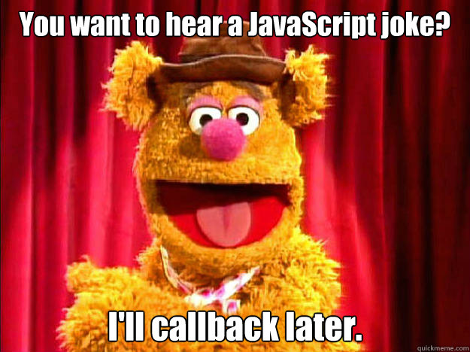

Slide 3
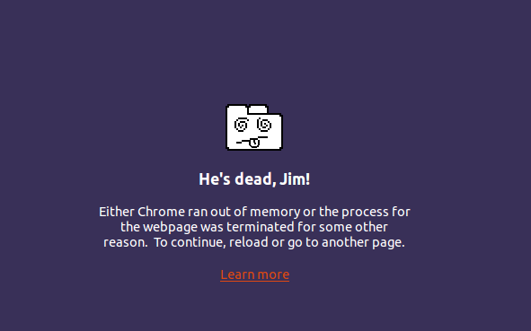

Slide 4
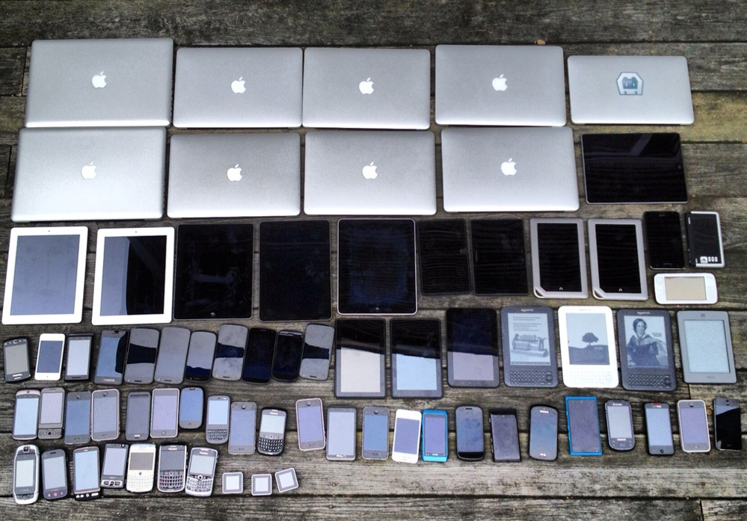

Slide 5
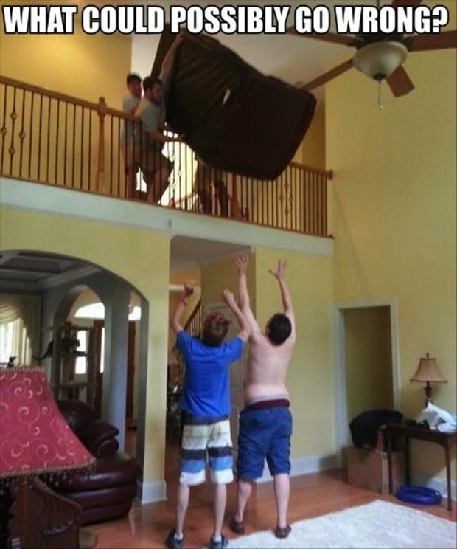

Slide 6
Three Things
Needs
Cautions
Plans

Slide 7

Needs

Slide 8
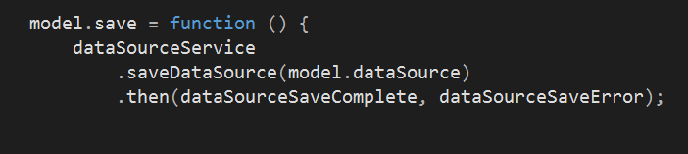
Need: Robust Error Handling

Slide 9
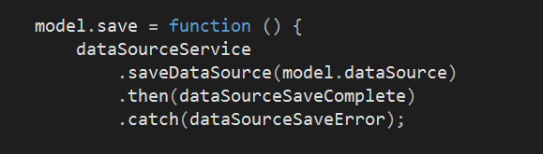
Catch At The Top Of The Chain

Slide 10
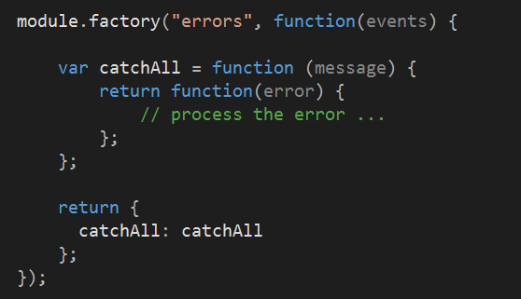
Need: Consistent Error Handling

Slide 11
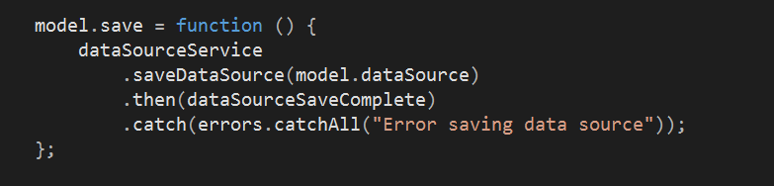
Error Service Usage

Slide 12
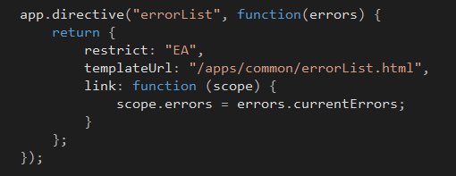
Consistent Display

Slide 13
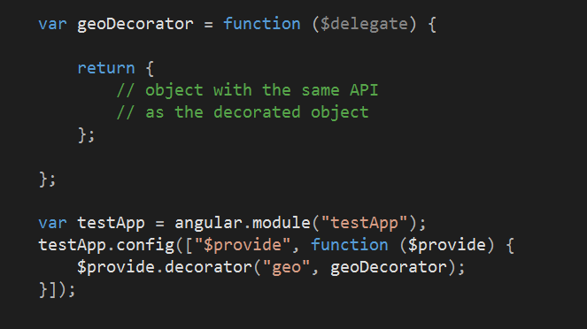
Need: Decorators

Slide 14
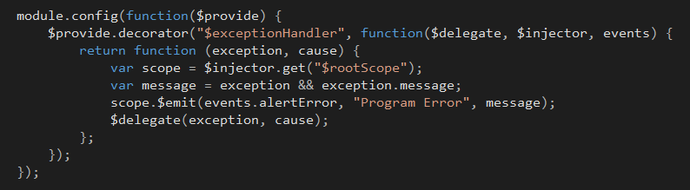
See All The Errors

Slide 15
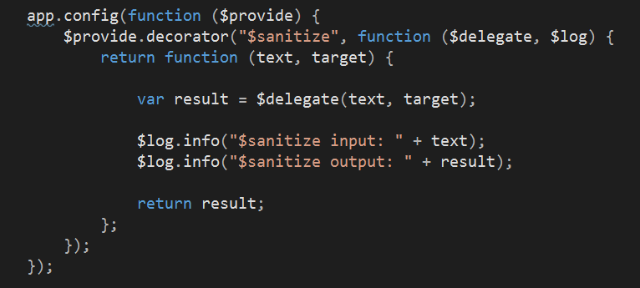
Decorators For Instrumentation

Slide 16
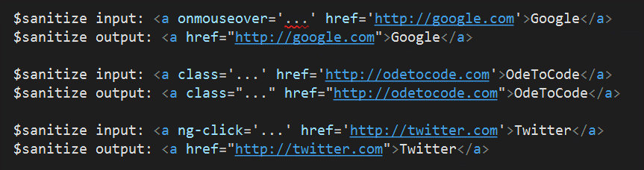
Sanitize Decorator Output

Slide 17
Decorators For Debugging

Slide 18
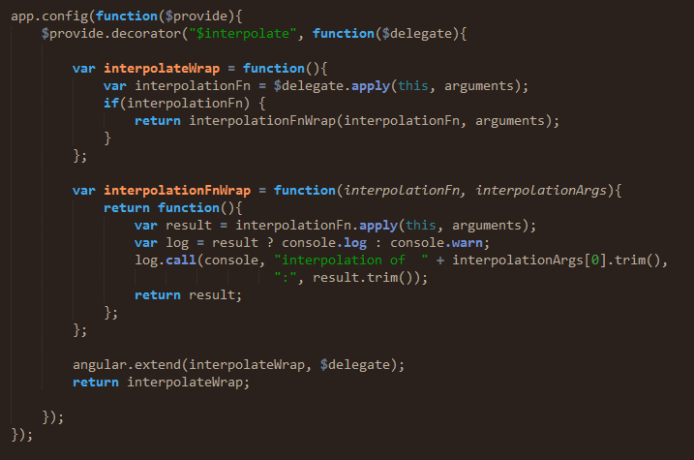
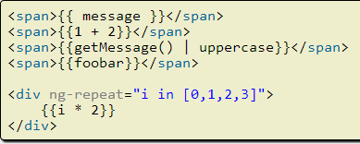
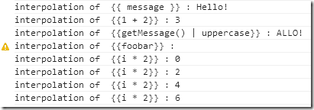

Slide 19
Need: $http Interceptors

Slide 20
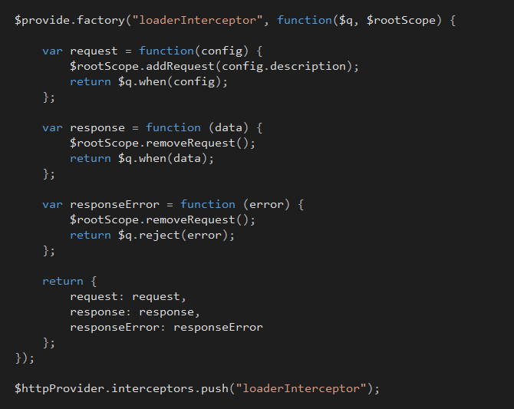

Slide 21
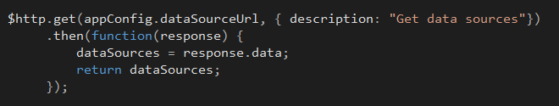
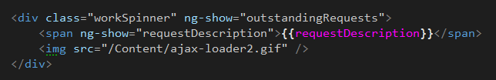

Slide 22
Need: Custom Directives

Slide 23
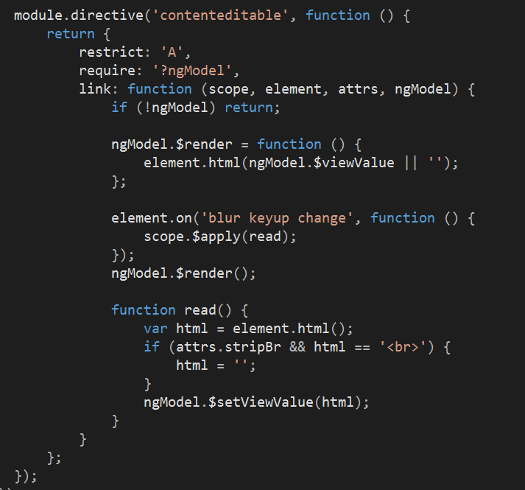

Slide 24
Need: Unit Tests

Slide 25
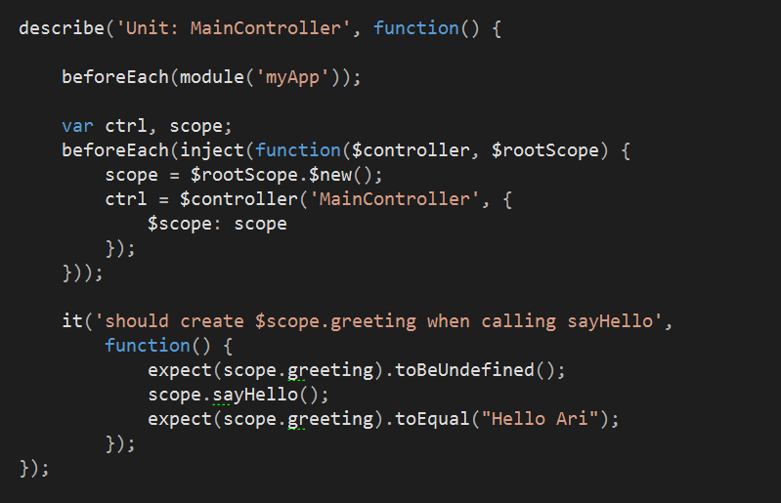

Slide 26
Inject All The Things

Slide 27
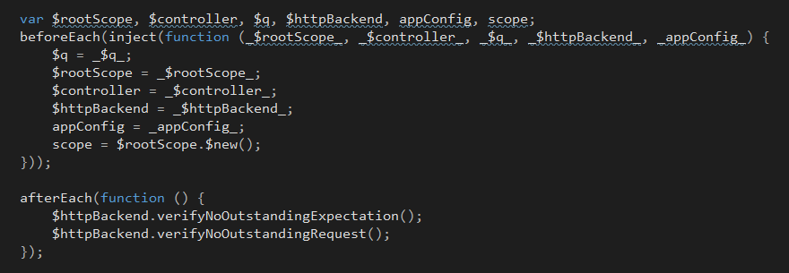

Slide 28
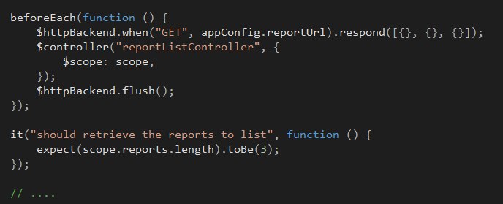

Slide 29
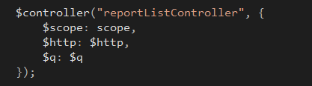

Use $controller With What You Need

Slide 30
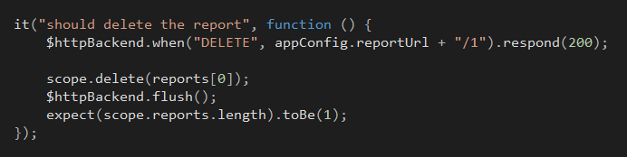
Possibly Redefine The SUT

Slide 31
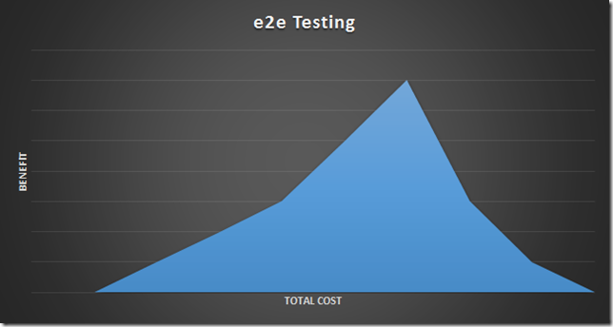
Protractor

Slide 32
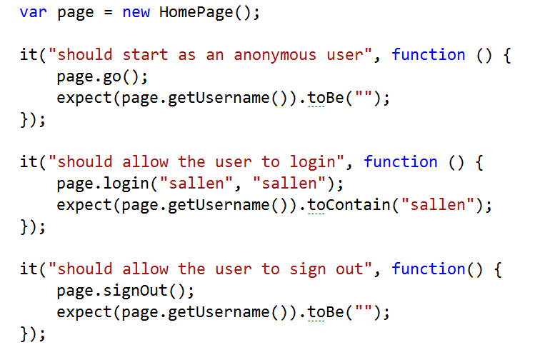
Use Page Objects

Slide 33
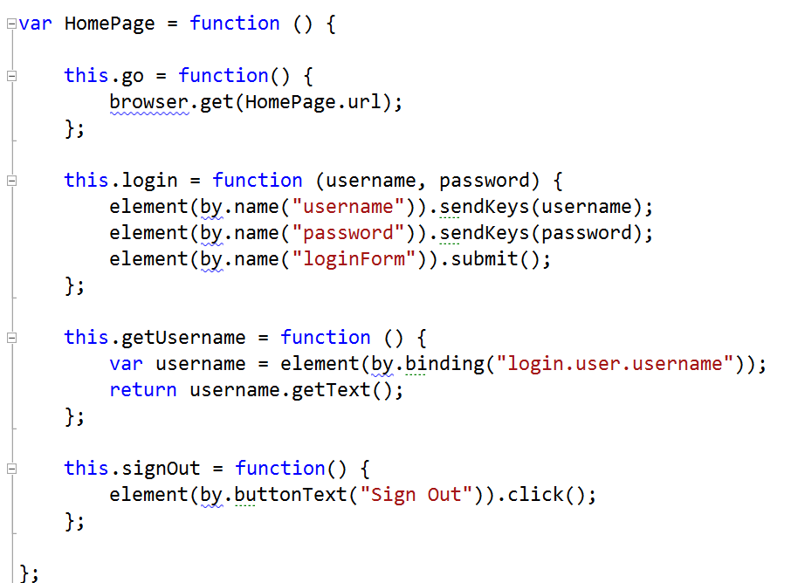

Slide 34
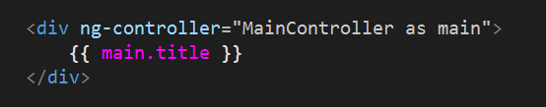
Use Controller As
Explicit in the view
Simplifies tests

Slide 35

Cautions

Slide 36
Avoid: $rootScope Abuse
Let’s store errors
Let’s store loading messages
Let’s store user profile
Let’s store configuration constants

Slide 38
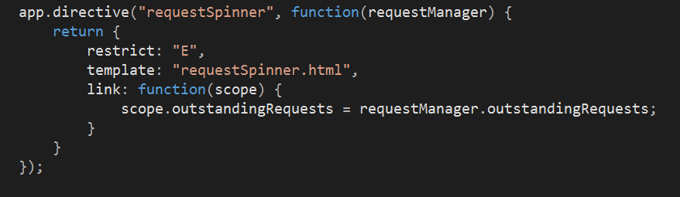

Slide 39
Avoid: Promise Abuse

Slide 40
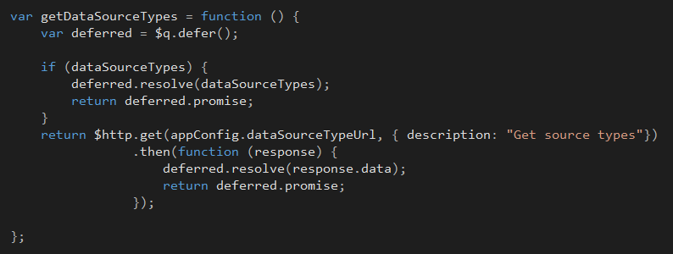
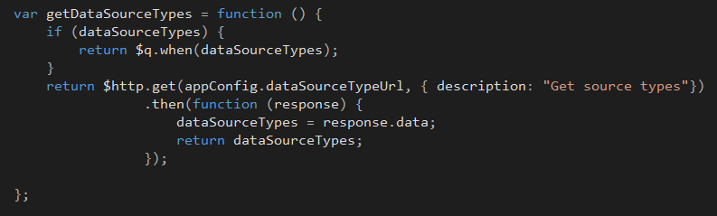

Slide 41
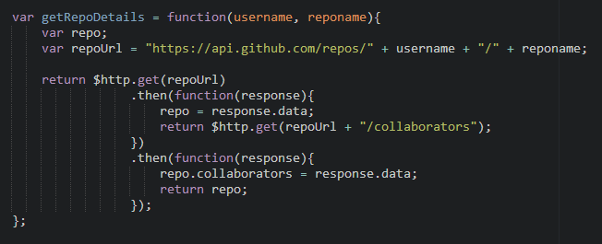
Promises Chain!

Slide 42

Planning

Slide 43
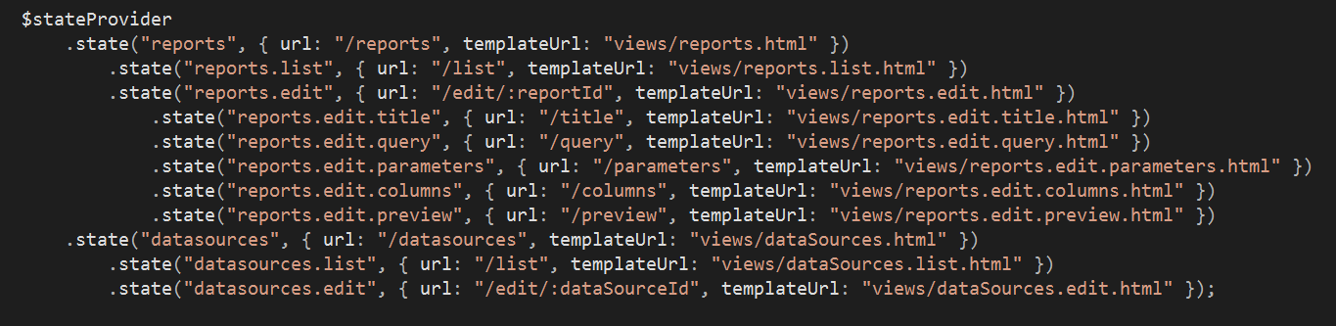
Think About: Your Router
Look at UI-Router

Slide 44
Think About: A Better $http
BreezeJS
Restangular
Caching, configuration, offline…

Slide 45
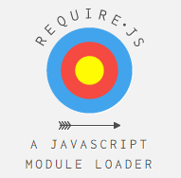
Think About: AMD

Slide 46
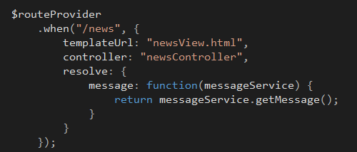

Think About: Resolve

Slide 47
Resolve Pros
View appears with data ready
Easier to stay somewhere is there is an error
Easier to test controllers

Slide 48
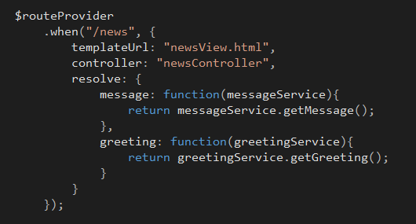
Resolve Everything

Slide 49
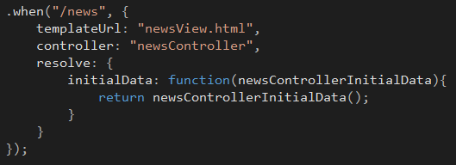
Move Resolve To A Service

Slide 50
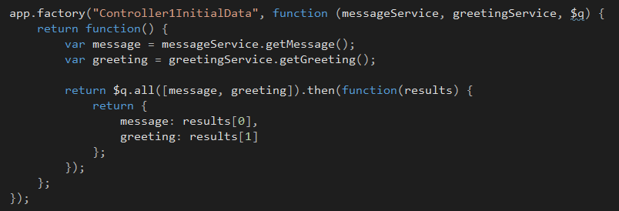

Slide 51
Think About: Authentication and Authorization

Slide 52
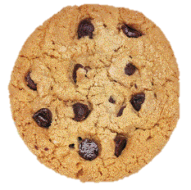

Cookies or Tokens?
Cookies
Tokens
Sent with every request
Susceptible to CSRF
Difficult to use across domains
Offer more control, no forgeries
Work across domains
Require more code

Slide 53

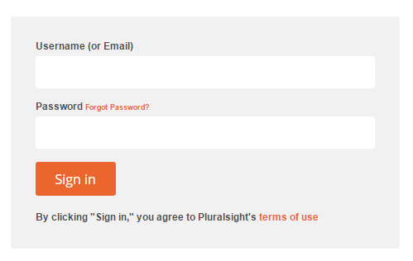

Logins and Redirects
GET /secret
redirect
GET /secret
redirect

Slide 54
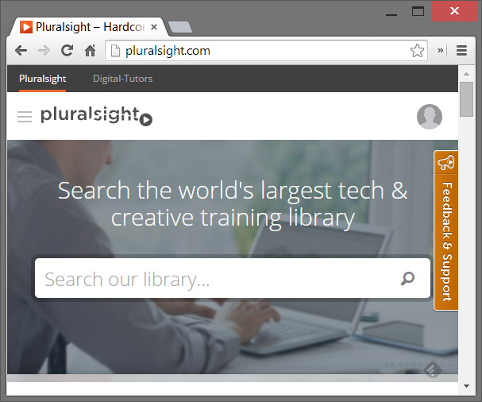

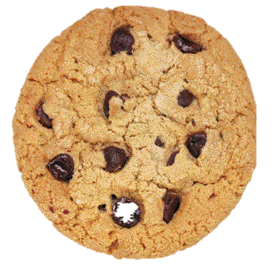
Managing Tokens

Slide 55
Think About: Basic Abstractions
Controller
Model
Service
Directive
Filter

Slide 56
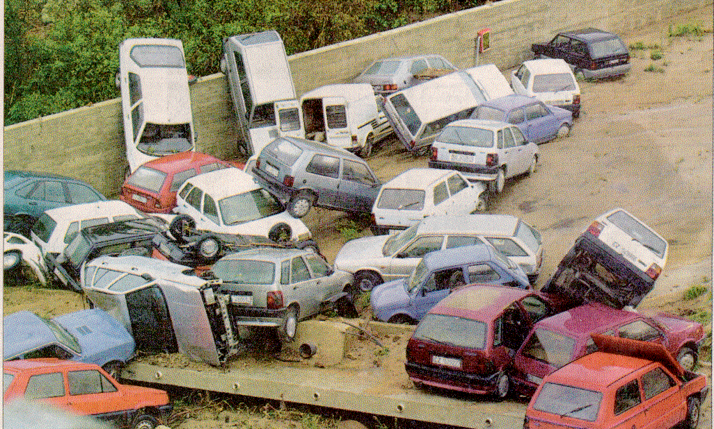
Think About: Code Standards

Slide 57
Think About: Directory Structure
I like feature based

Slide 58
apps
movieApp
module.js
templates
dashboard
common
specs
js

Slide 59
Summary
Error handling
Decorators, interceptors
Custom directives
Code style and structure

