Slide 1
Middleware
The HTTP Pipeline in ASP.NET Core

Slide 2
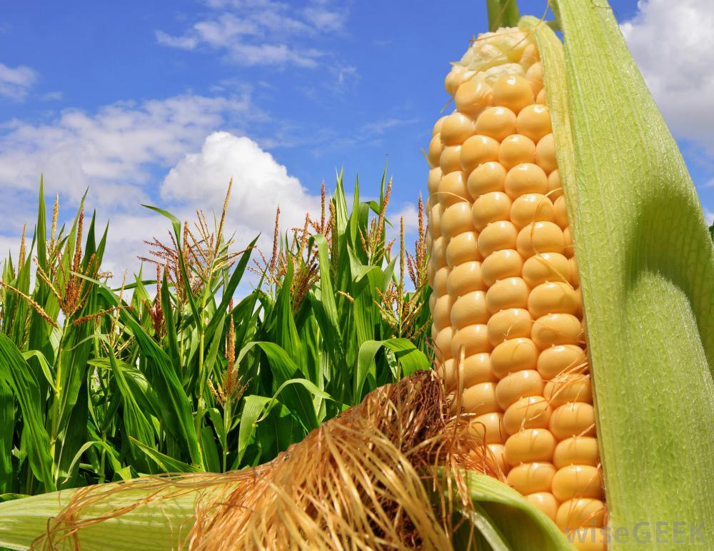

Slide 3
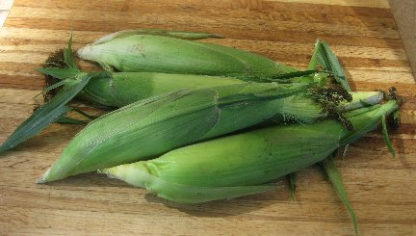
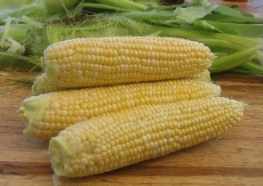
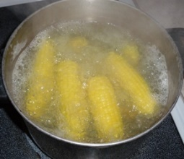
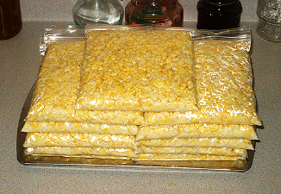
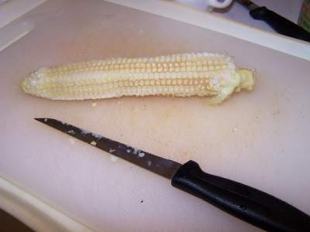
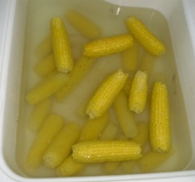
Allen Family Food Processing
Me
next
Mom
next
Dad
return
return

Slide 4
Middleware
POST /corn
POST /corn
POST /corn
Me
next
Mom
next
Dad
return
return
HTTP/1.0 200 OK
<html>
….
</html>
HTTP/1.0 200 OK
<html>
….
</html>
HTTP/1.0 200 OK
<html>
….
</html>

Slide 5
Middleware
Incoming
Request
POST /addmovie
POST /addmovie
POST /addmovie
Logger
next
Authorizer
next
Router
return
return
Response
Created
Outgoing
Response
HTTP/1.0 200 OK
<html>
….
</html>
HTTP/1.0 200 OK
<html>
….
</html>
HTTP/1.0 200 OK
<html>
….
</html>

Slide 6
Previously in ASP.NET …
…
BeginRequest
Authenticate
Request
Acquire
Request
State
PreRequest
Handler
Execute
HTTP Pipeline
HTTP
Hander
…
EndRequest
PostRequest
Handler
Execute

Slide 7
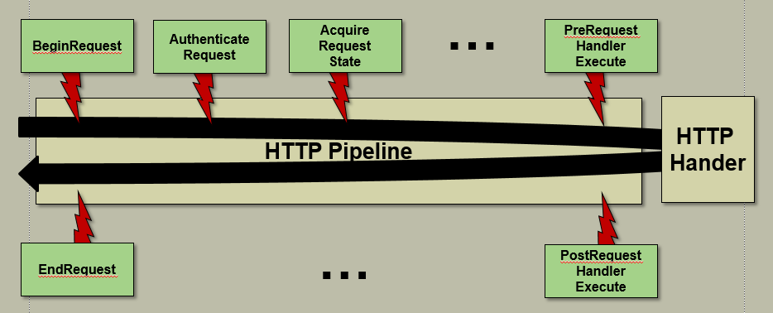
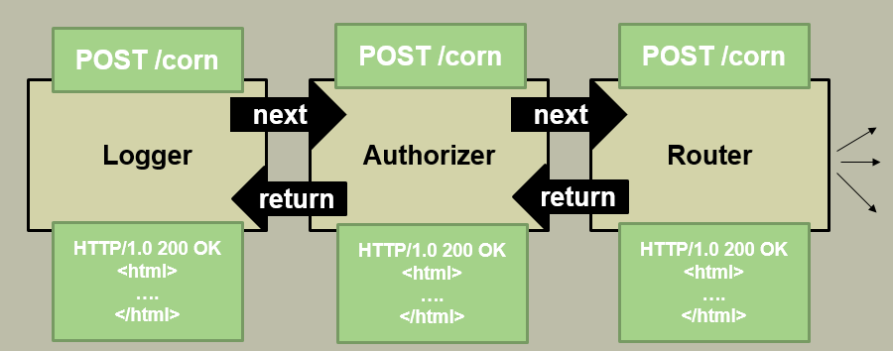
Why Middleware?
Flexibility
Performance
Hello World Performance Tests
Stack | Requests / s
ASP.NET 4.6 | 57,843
NodeJS | 127,017
ASP.NET Core | 168,005 228, 062
https://github.com/aspnet/benchmarks

Slide 8
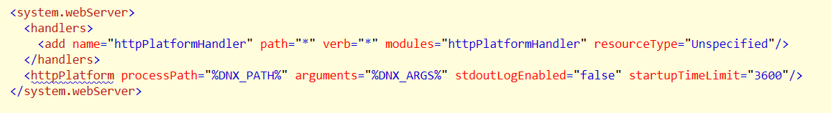
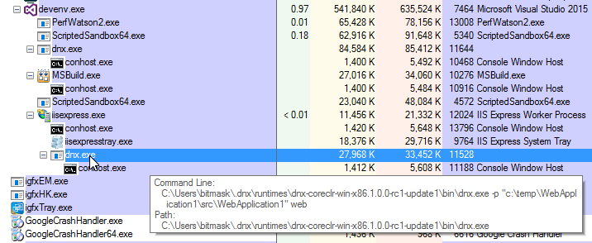
How Does Middleware Fit In?
First, let’s understand the hosting model

Slide 9
What Does That Mean?
IIS
Proxy
Process
Management
Your App
Request
& Response
Processing

Slide 10
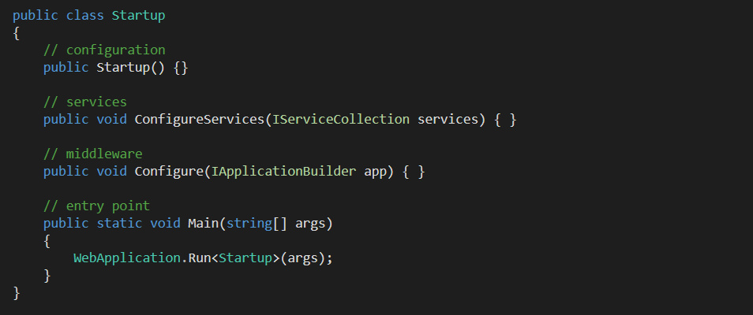
Startup Class
ASP.NET searches for Startup
Defines configuration, middleware, services, and entry point

Slide 11
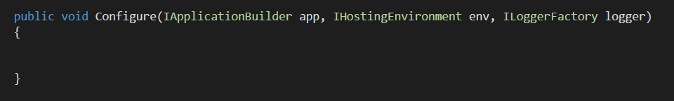
Configure
Provides IApplicationBuilder parameter
Use this API to build the pipeline
Injectable parameters
IHostingEnvironment
ILoggerFactory
Can also ask for configured services

Slide 12
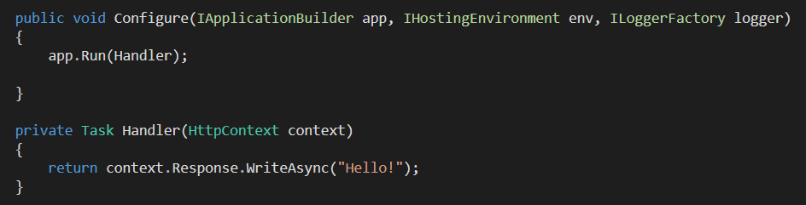
IApplicationBuilder
Use middleware
Run middleware

Slide 13
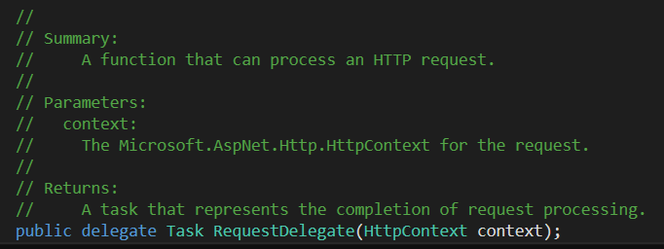
Middleware Relies on RequestDelegate
RequestDelegate is a method that:
Take an HttpContext parameter
Returns Task

Slide 14
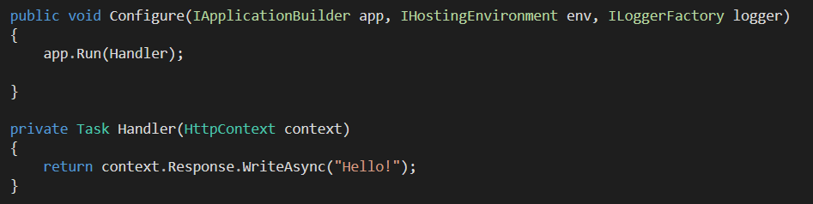
Run
Pass a RequestDelegate to Run
No access to other middleware
Run is terminal

Slide 15
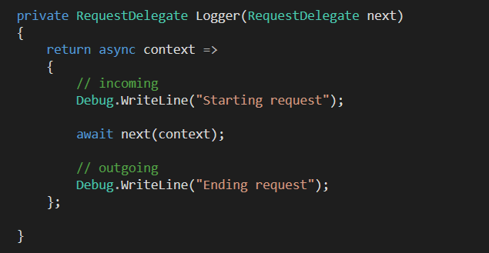
app.Use
Take a RequestDelegate
Return a RequestDelegate

Slide 16
Three Categories of Middleware
Cares About
The
Request
Cares About
The
Response

Slide 17
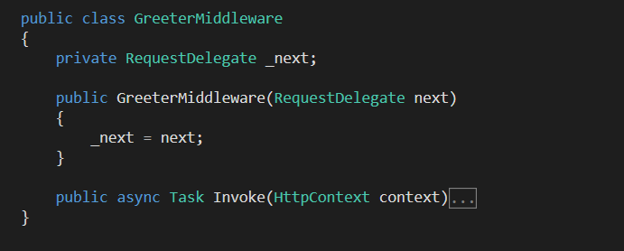
UseMiddleware
Encapsulate middleware in a class
Requires constructor and Invoke method
Both are injectable

Slide 18
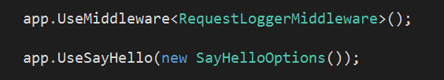
Custom Middleware
Convention is to create custom options object and Use method.

Slide 19
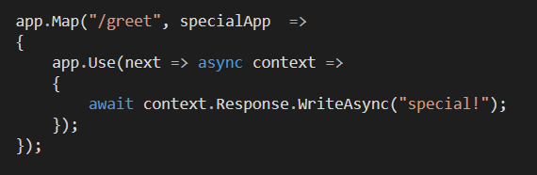
Forking Middleware
Map and MapWhen

Slide 20
Middleware Pipelines
POST /corn
POST /corn
POST /corn
Me
next
Mom
next
Dad
return
return
HTTP/1.0 200 OK
<html>
….
</html>
HTTP/1.0 200 OK
<html>
….
</html>
HTTP/1.0 200 OK
<html>
….
</html>

Slide 21

UsePlatformHandler
Required for Windows authentication
IIS
App
Process
Auth ticket
X-IIS-WindowsAuthToken
IIS Platform Handler
forwardWindowsAuthToken
WindowsPrincipal

Slide 22
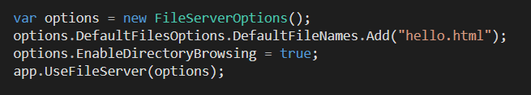
Serving Static Files
Microsoft.AspNet.Static files package
Serve static files
Directory browsing
Default files

Slide 23
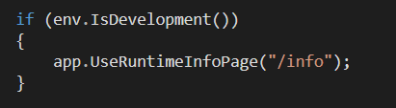
Errors and Diagnostics
Microsoft.AspNet.Diagnostics package
Developer exception page
Production error page
Runtime info page
Welcome page
Status code mapping

Slide 24

CORS
Microsoft.AspNet.Cors
Add services and middleware

Slide 25


Session
Microsoft.AspNet.Session
Add services and middleware
Also requires a cache service
Microsoft.Extensions.Caching.Memory
Implements an in-memory cache service

Slide 26
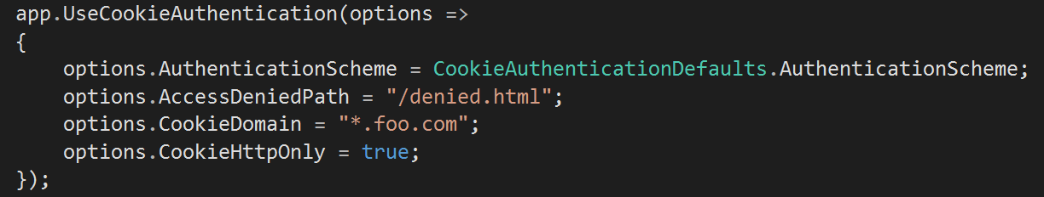
Authentication
Microsoft.Authentication.*
Cookies, JWT Bearer
OAuth and OpenID
Google, Twitter, Facebook, Microsoft, OAuth*
Middleware works with Authentication property of HttpContext

Slide 27
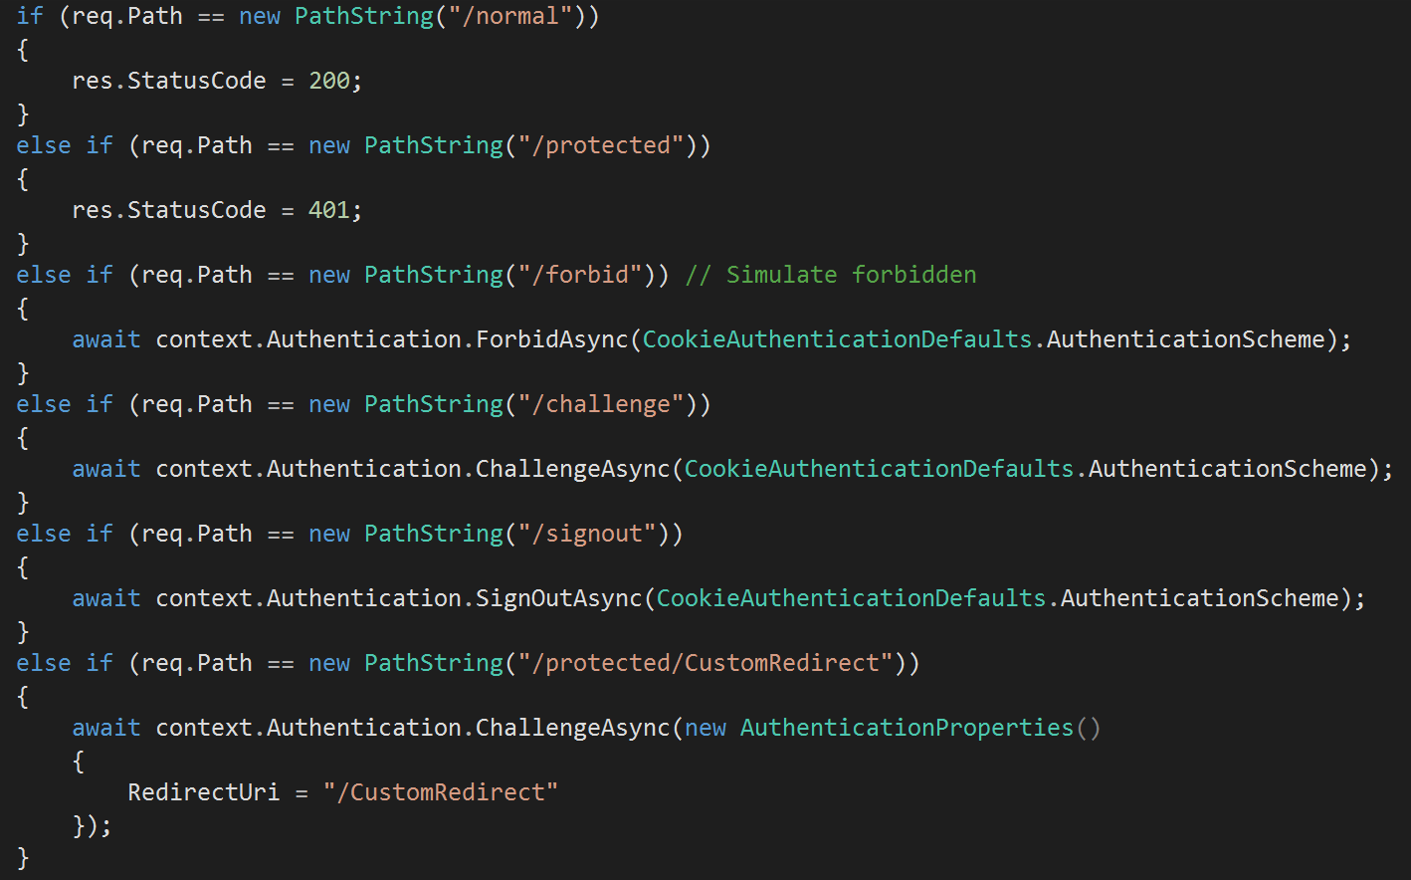
Using HttpContext.Authentication

Slide 28
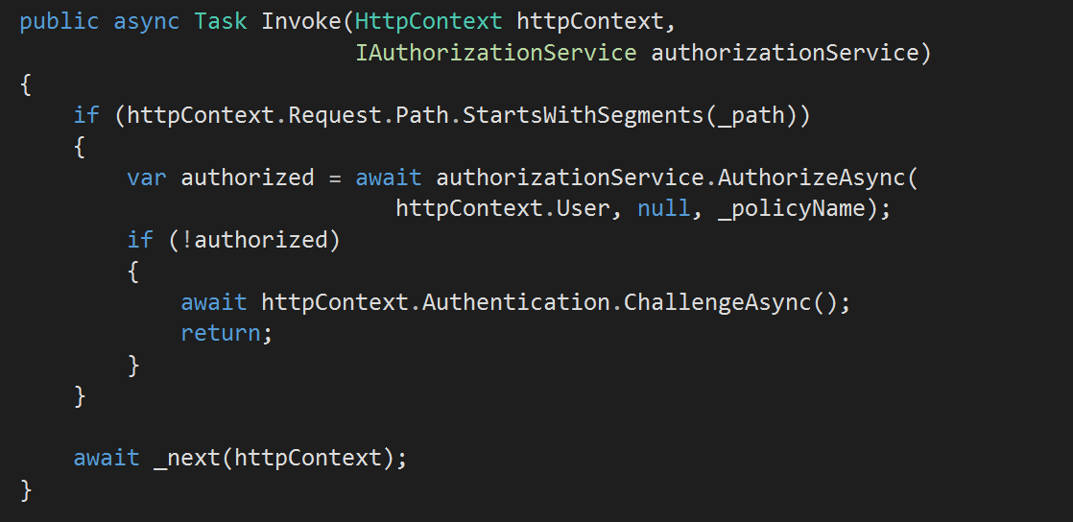
Example: Protecting a Folder

Slide 29
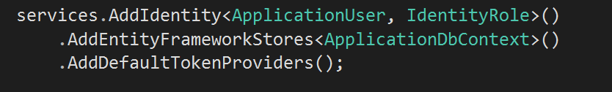

Identity
Identity adds a layer of abstraction over authentication mechanisms
Middleware uses various cookie auth middleware

Slide 30
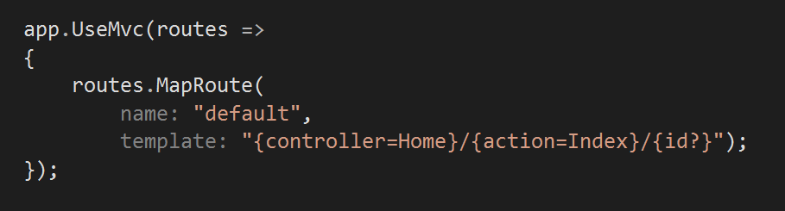
MVC
MVC middleware enables controller routing

Slide 31
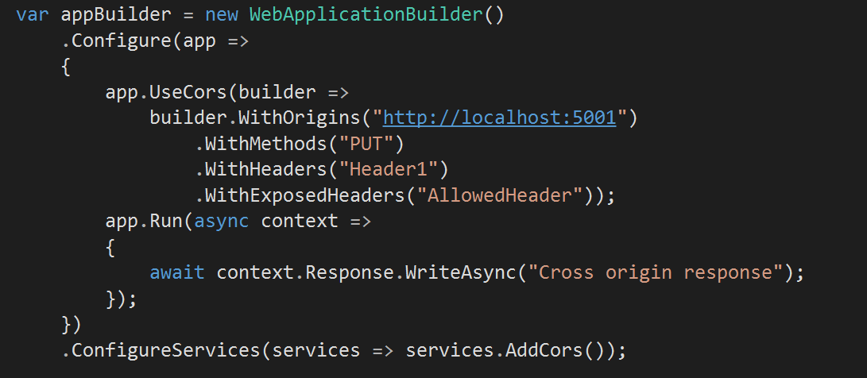
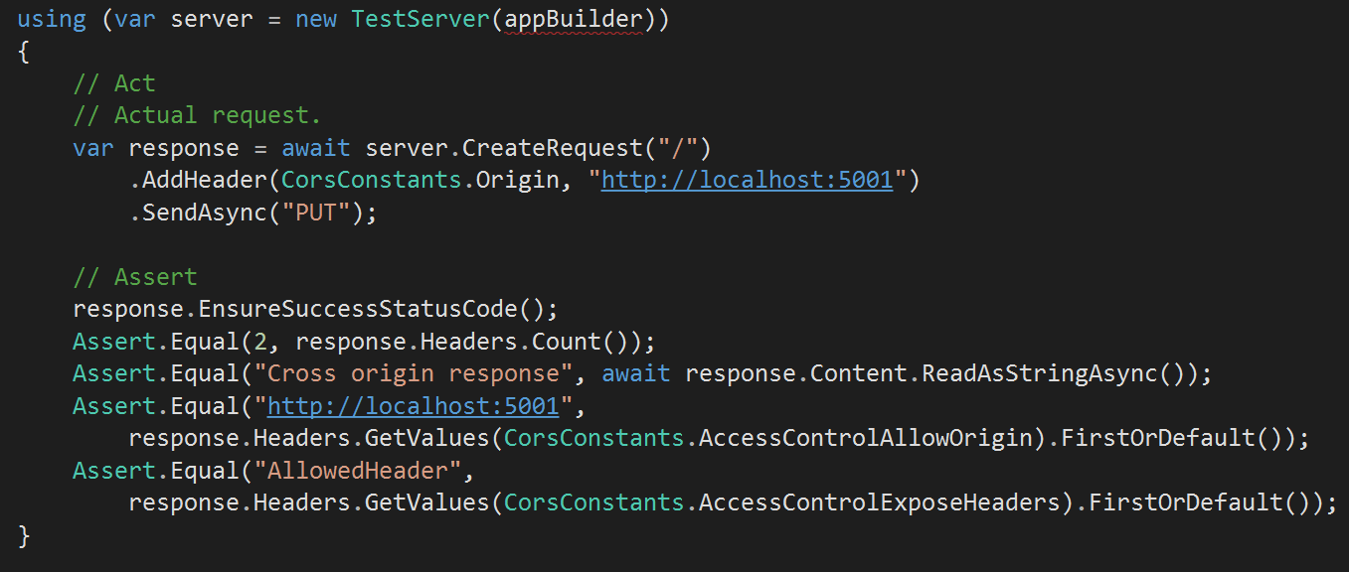
Testing Middleware
Use package Microsoft.AspNet.TestHost

Slide 32
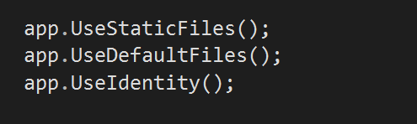
Tip: Order is Important

Slide 33
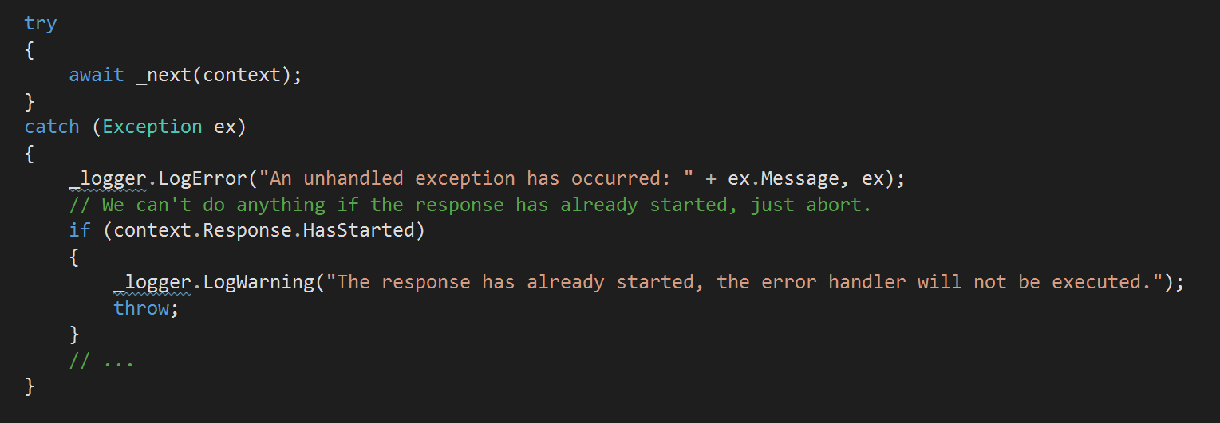
Tip: Check Response.HasStarted

Slide 34
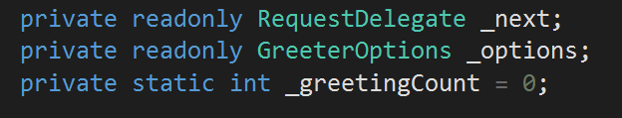
Tip: Middleware Are Singletons
Be careful with data shared across requests

Slide 35
context.Items is Useful
Items are scoped to a single HTTP transaction

Slide 36
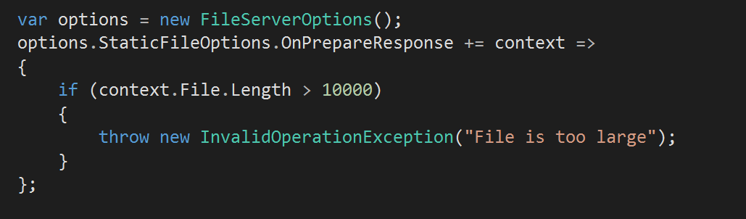
Tip: Action Options For Extensibility
Some options classes expose “events”

Slide 37
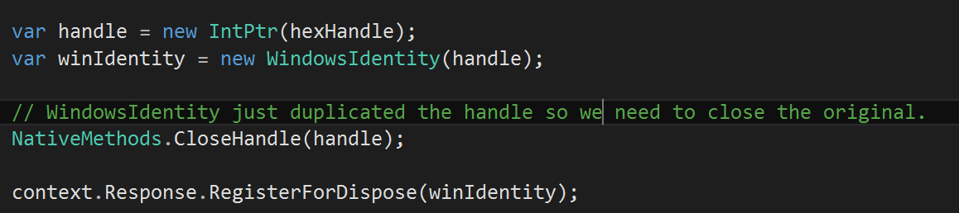
Tip: Response.Dispose Is Useful
Make sure to clean up resources

Slide 38
Summary
Middleware provides logic for HTTP processing
POST /corn
POST /corn
POST /corn
Logger
next
Authorizer
next
Router
return
return
HTTP/1.0 200 OK
<html>
….
</html>
HTTP/1.0 200 OK
<html>
….
</html>
HTTP/1.0 200 OK
<html>
….
</html>

