Slide 1
.NET Core
New framework - familiar platform

Slide 2
.NET Today
.NET
FRAMEWORK
.NET
CORE
XAMARIN
WINDOWS
APPS
X-PLAT
APPS & SERVICES
MOBILE
APPS

Slide 3






.NET Core
Fast
Cross-platform
Lightweight
Open Source
Compatible
Tools

Slide 4
.NET Runtime
CoreCLR
GC
CoreFX
System.IO
System.XML
CLI
Build
Run Tests
String
Collections
System.NET
Crypto
Threading
CodeDOM
Reflection
Run
Create
JIT

Slide 5
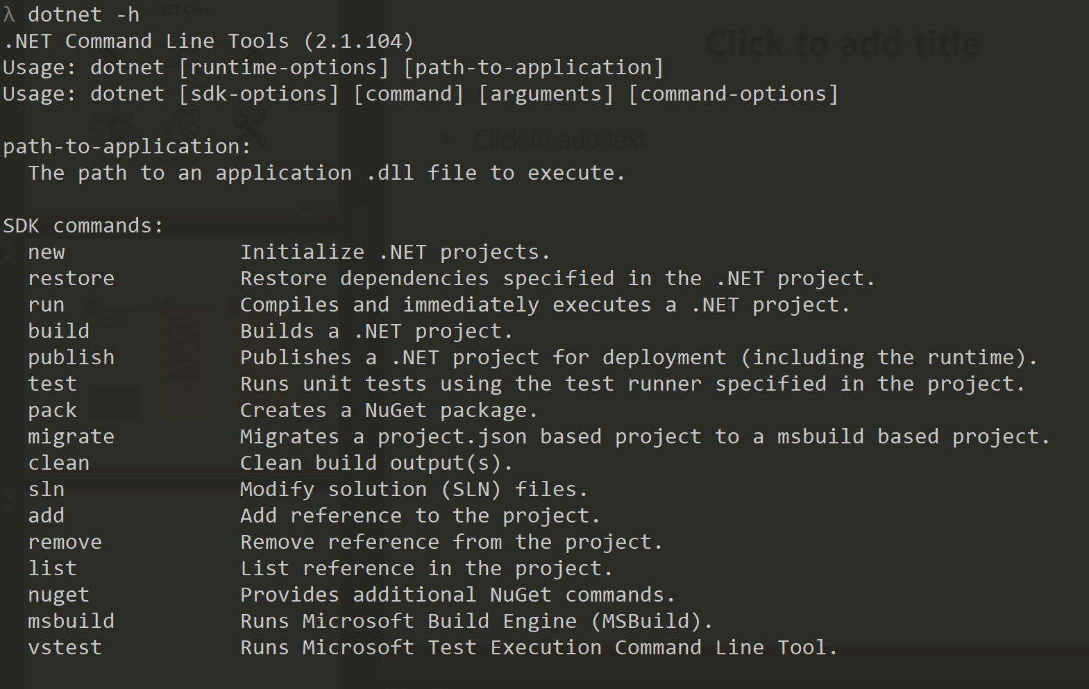
dotnet CLI

Slide 6
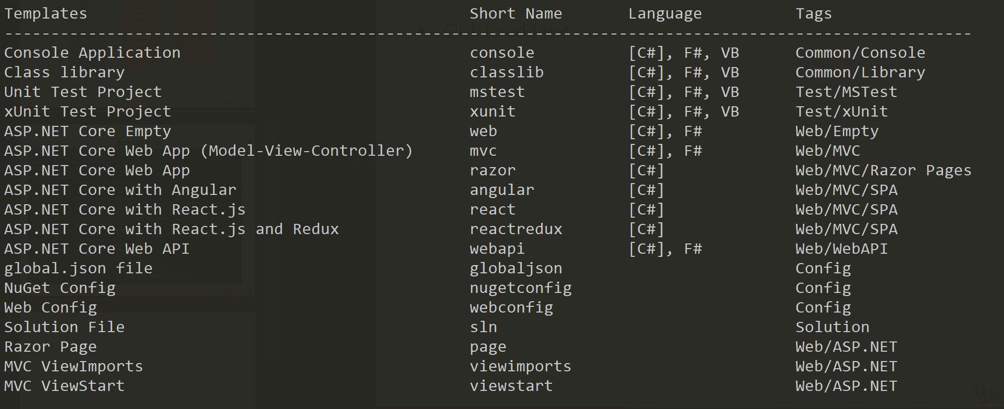
dotnet new

Slide 7
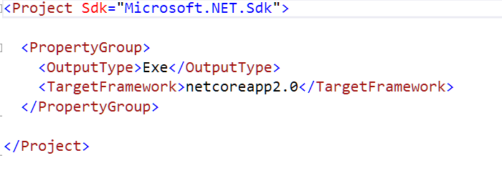

Slide 8
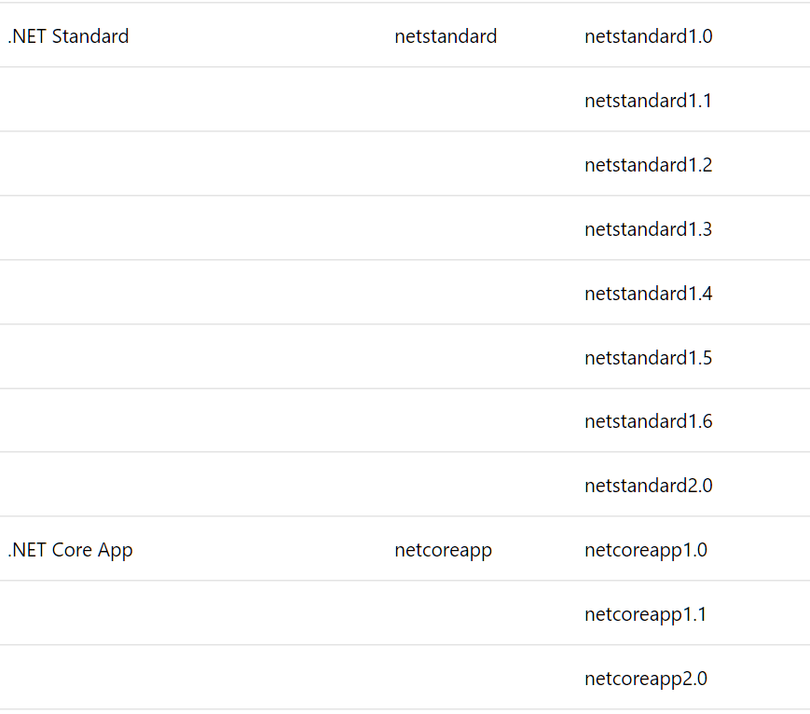
Target Framework Monikers

Slide 9
Compatibility with .NET Standard
.NET
FRAMEWORK
.NET
CORE
XAMARIN
WINDOWS
APPS
X-PLAT
APPS & SERVICES
MOBILE
APPS
.NET STANDARD

Slide 10
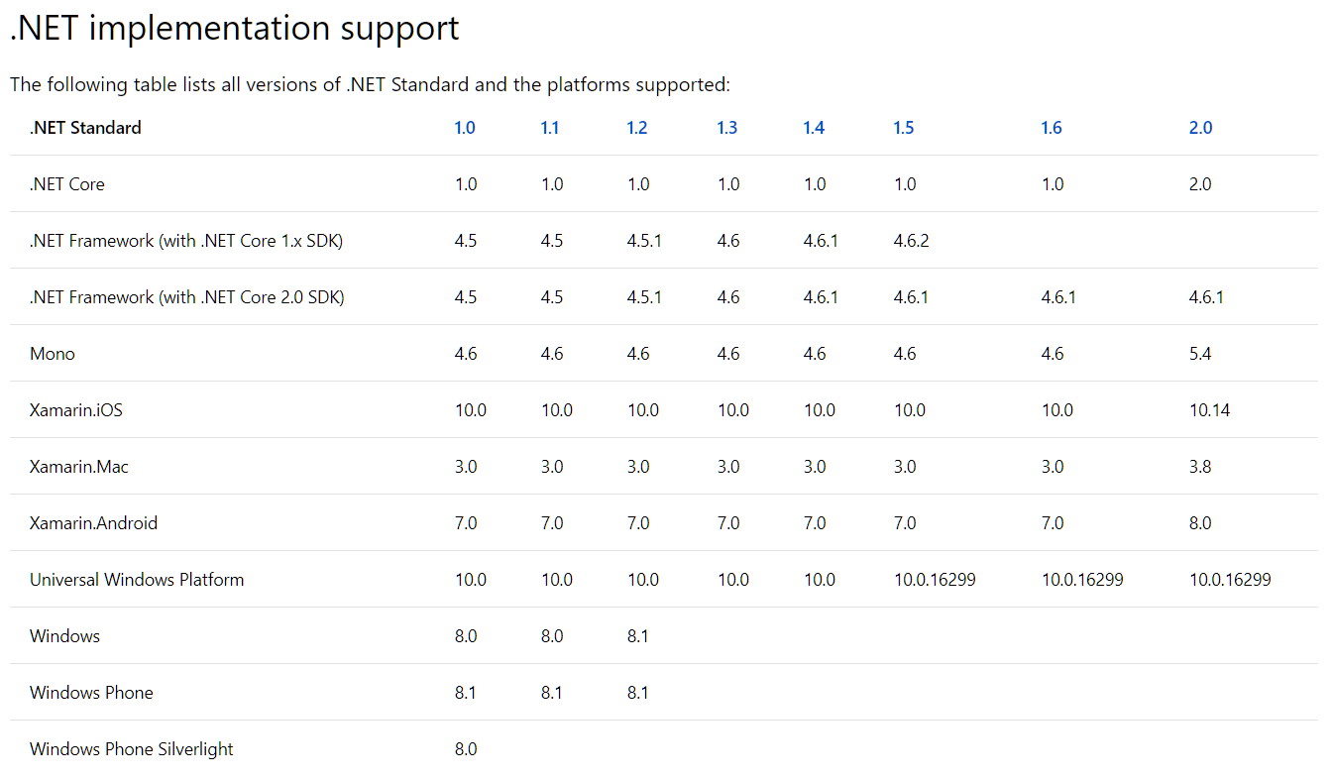
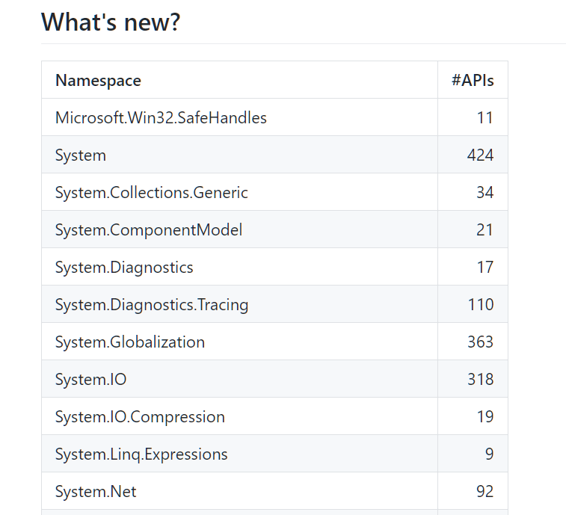

Slide 11
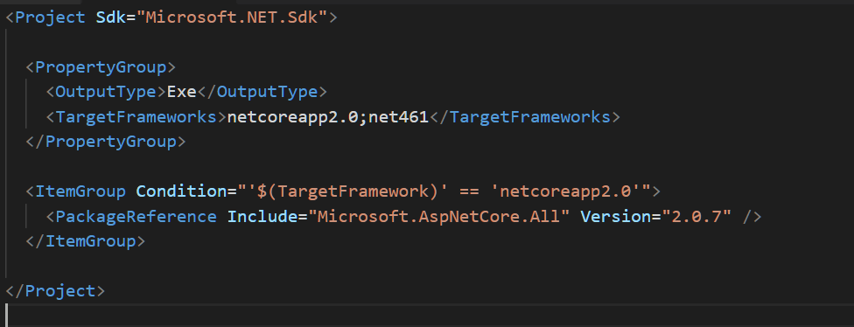
Packages & Metapackages

Slide 12
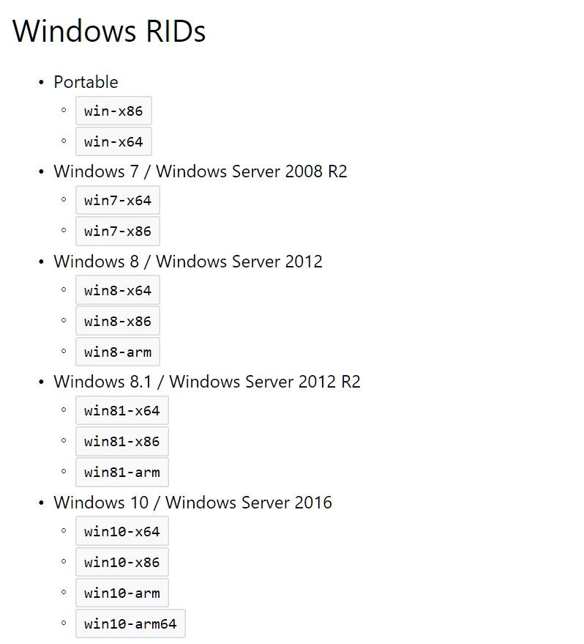
dotnet publish
Can create self-contained app

Slide 13
Summary

