Slide 1
ASP.NET MVC
C is for Controller

Slide 2
MVC – The Pattern
Controller
Model
View
Notes:
Routing has other uses outside of ASP.NET MVC

Slide 3
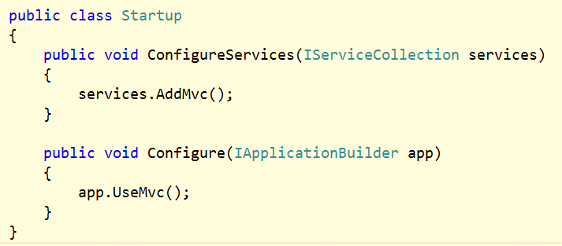
Setup
Package Microsoft.AspNetCore.Mvc
Add the MVC services
Use the MVC middleware

Slide 4
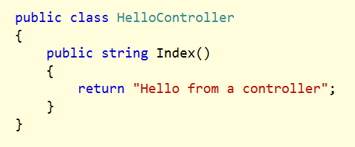
Controllers
Can be POCOs with a Controller name suffix
Or, derive from Controller base class
Public methods are actions

Slide 5
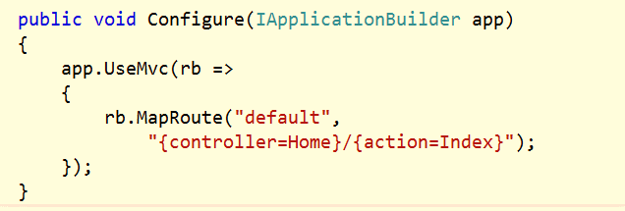
Routing with MapRoute
Supports defaults and catch-all parameters

Slide 6
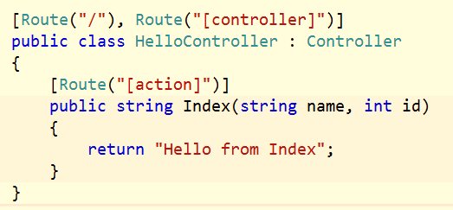
Routing with Attributes
Sets routing rules inline with a controller
Use [controller] and [action] tokens

Slide 7
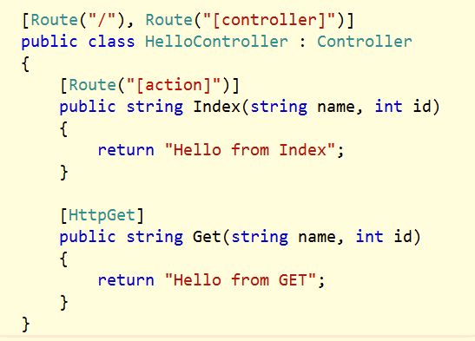
Verb Routing versus Named Actions
Routing works with actions and API style routing

Slide 8
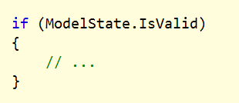
Controller Base Class
Provides access to HTTP context, current user, request, response
Provides IActionResult helpers

Slide 9
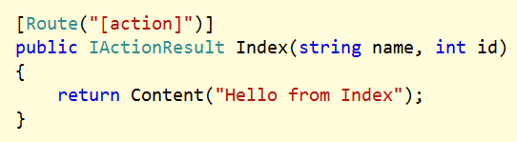
Action Results
IHttpActionResult encapsulates controller decision
Execution of result is later in the MVC pipeline

Slide 10
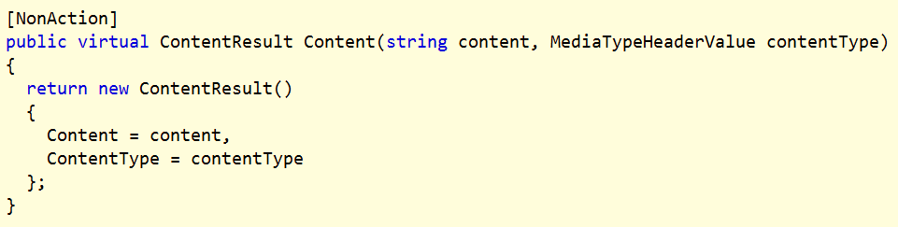
Action Result Helpers
Controller base class provides convenience methods
Created, HttpNotFound, Redirect, and more

Slide 11
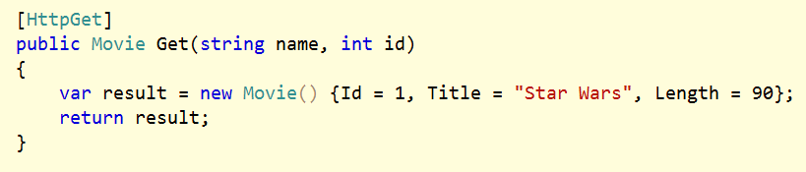
Content Negotiation
Default format is JSON
XML formatter not included by default

Slide 12
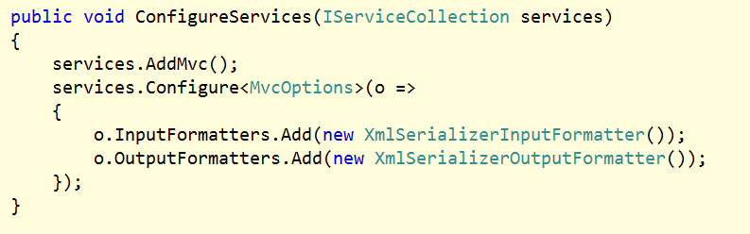
MVC Options
Configure in ConfigureServices

Slide 13
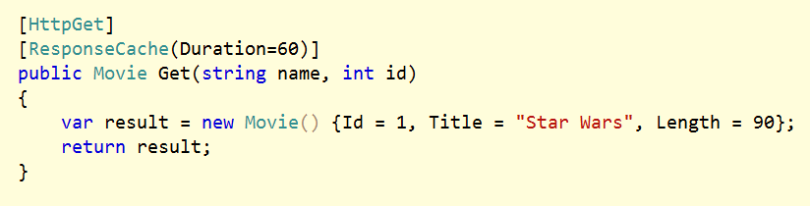
Action Filters
Filters work on actions, controllers, and globally

Slide 14
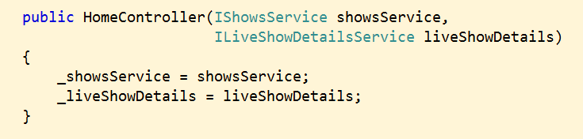
Dependency Injection
Controller and filters can all use constructor injection

Slide 15
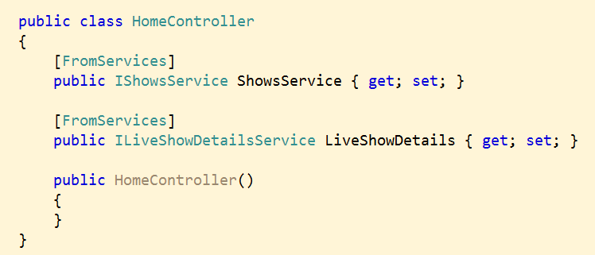
[FromServices]
Attribute allows binding on properties
Even works with model objects

Slide 16
Opinion
MVC Controllers work best for building APIs
For HTML, consider Razor Pages

Slide 17
Summary
Controller
Model
View

