Slide 1
ASP.NET MVC 6
Working with MVC 6
More Specifically, Using What’s New & Different

Slide 2
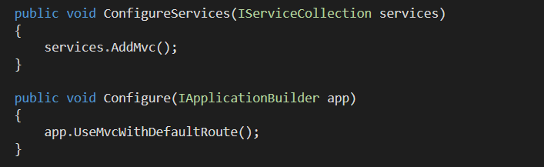
The Setup
Package : Microsoft.AspNet.Mvc
Configure services
Configure middleware

Slide 3
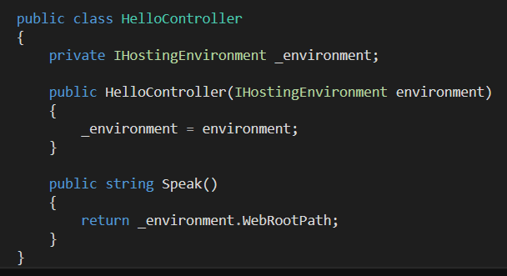
Controller Requirements
Any class with public methods will do
No base class or interface requirements
No return type restrictions

Slide 4
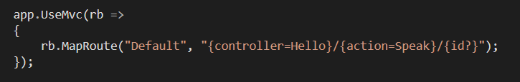
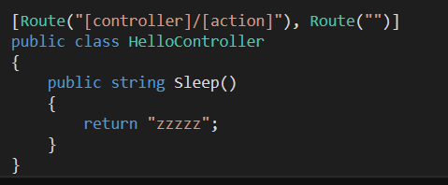
Getting To The Controller
Map routes with template or attributes (or both)

Slide 5
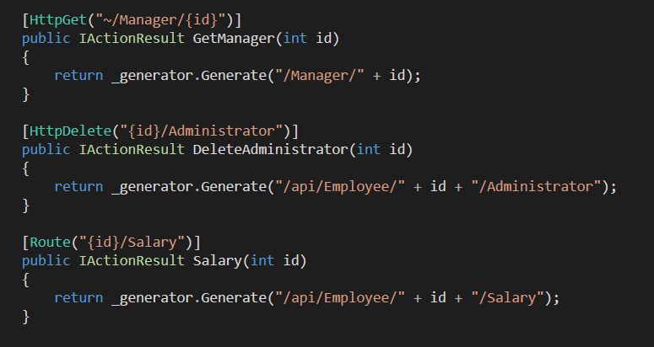
The Routing Merge
Framework considers Route and HttpMethod attributes

Slide 6
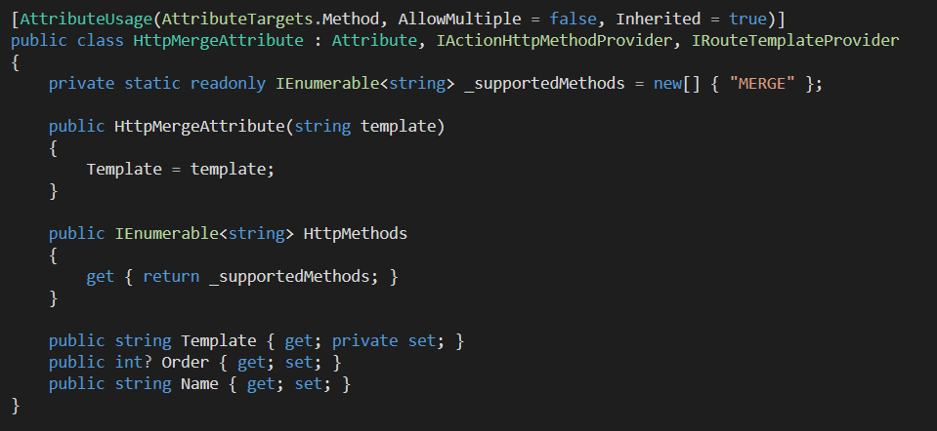
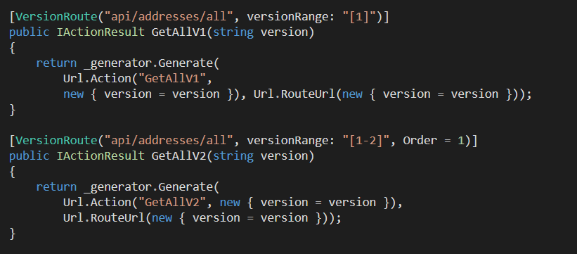
Custom Route Attributes
Key interfaces
IRouteTemplateProvider
IActionHttpMethodProvider
IActionConstraintFactory

Slide 7
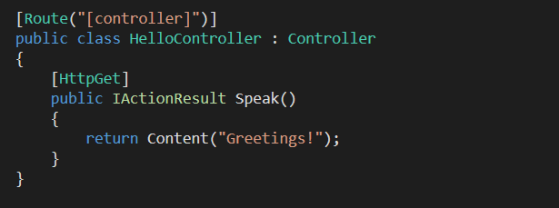
One Controller
No MVC Controller versus ApiController
New: IActionResult
All the usual result helper methods

Slide 8
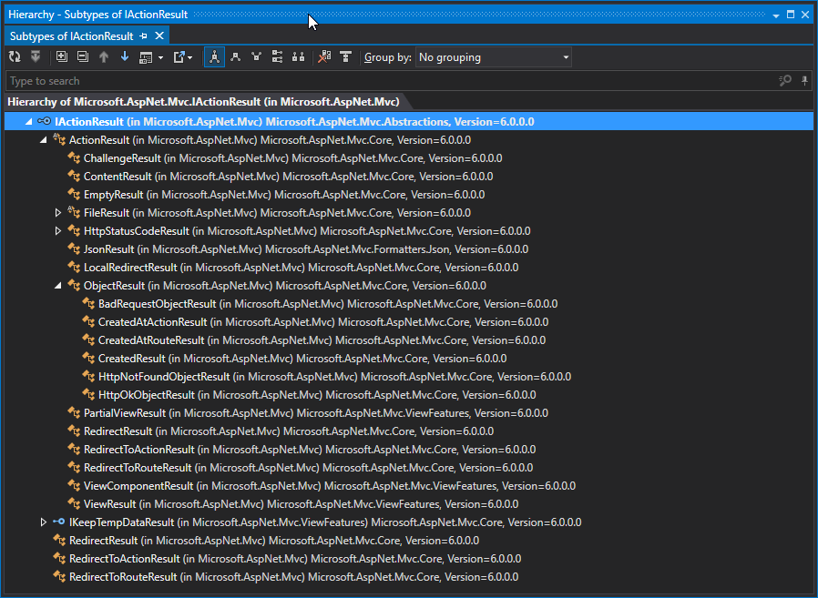
IActionResult

Slide 9
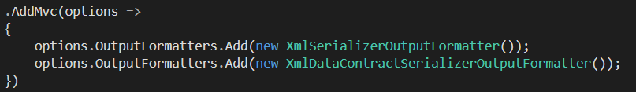
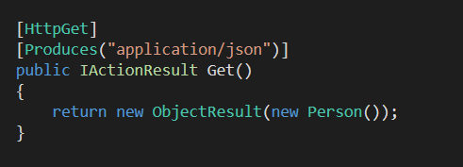
Content Negotiation
ObjectResult negotiates content
No XML installed by default
Can always override negotiation with [Produces]

Slide 10
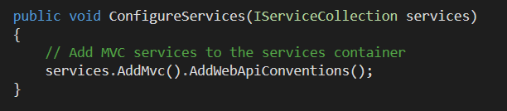
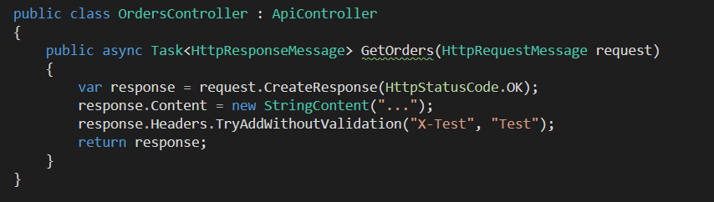
WebAPI Compatibility
Use Microsoft.AspNet.Mvc.WebApiCompatShim

Slide 11
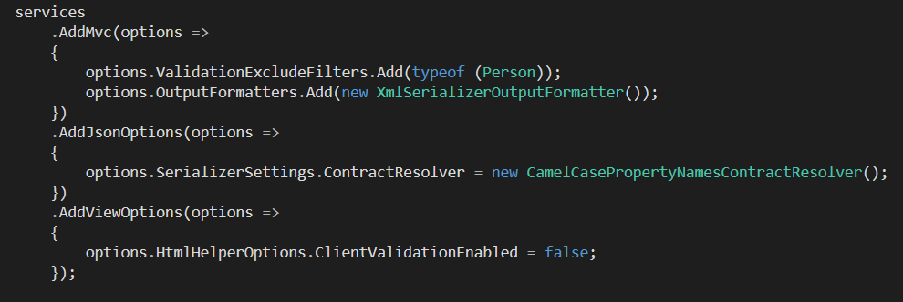
Options
Everything is in code
Razor, filters, validators, serializers

Slide 12
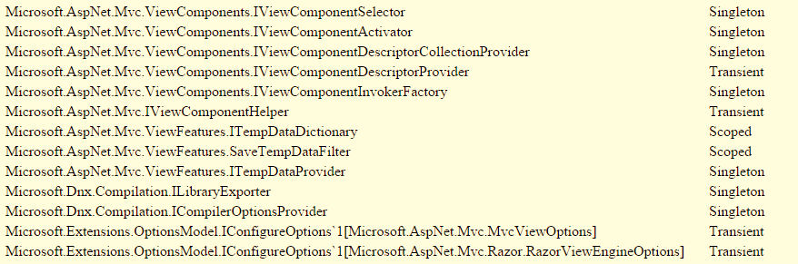
Dependency Injection
Nothing is new, everything is injected

Slide 13
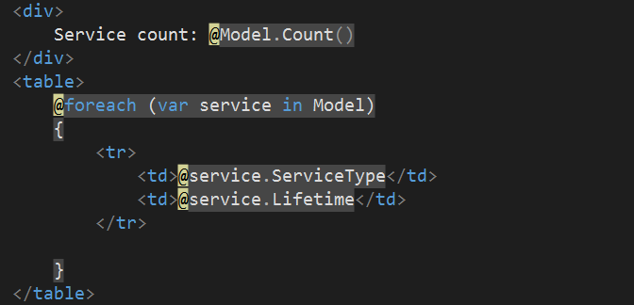
Razor Views
Same syntax, structure and conventions

Slide 14
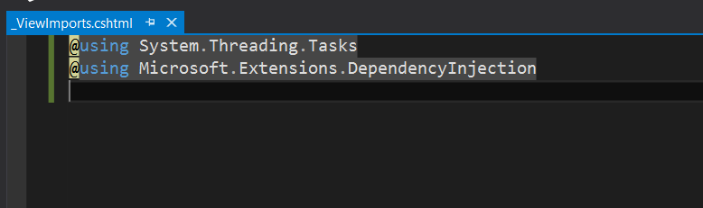
_ViewImports
Bring in namespaces for view compilation
Bring in tag helpers

Slide 15
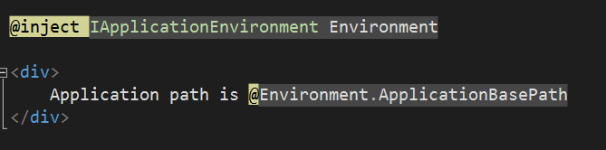
@inject
Creates a property
Property populated by container

Slide 16
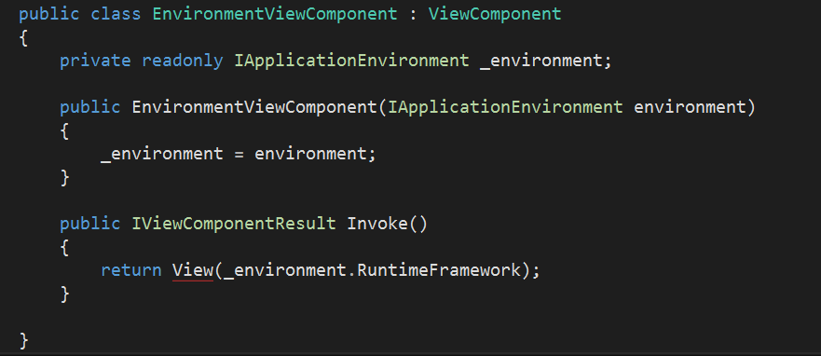
View Components
An upgrade to partial views
Particularly child actions and custom HTML helpers

Slide 17
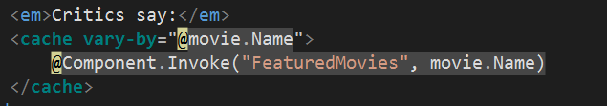


Tag Helpers
An upgrade to HTML helpers

Slide 18
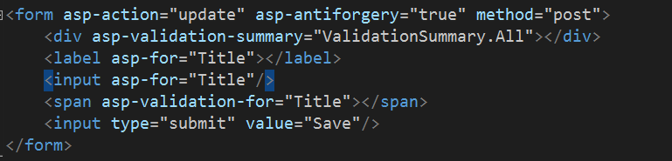
Form Helpers
asp-for works with
Labels
Inputs
Text areas

Slide 19
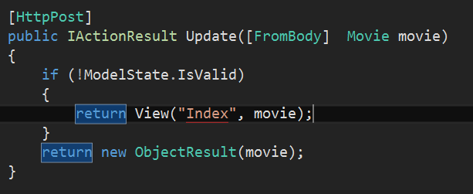
Model Binding
Mostly the same as MVC 5 / WebAPI 2, but
Query string wins in many scenarios
[FromBody] required to get a formatter involved
Other binding attributes include:
FromForm
FromQuery
FromRoute
FromHeader
FromServices

Slide 20
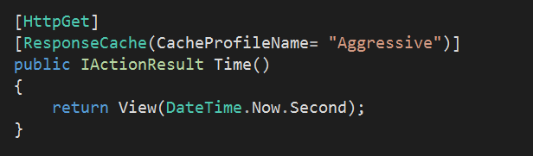
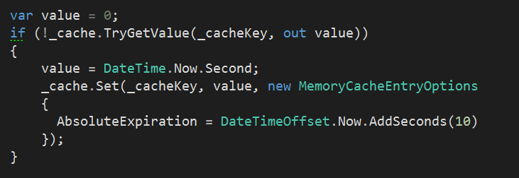
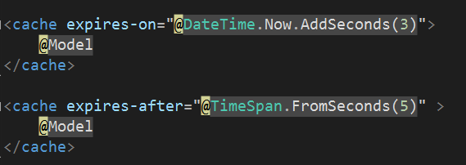
Caching
Many options
In-memory
Redis
SQL Server
Client

Slide 21
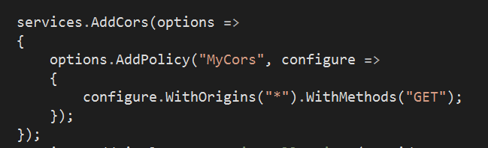


CORS
CORS policies
CORS middleware

Slide 22
Summary

