Slide 1

Routing
<router-outlet>

Slide 2
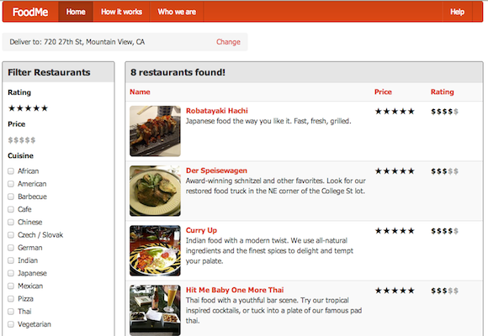
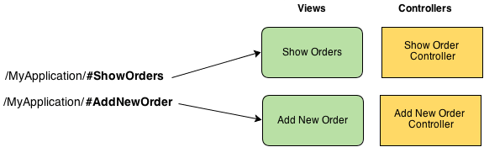
Why Routing?
Break large application into small components
Provide more features
Deep linking
Bookmarks
History

Slide 3
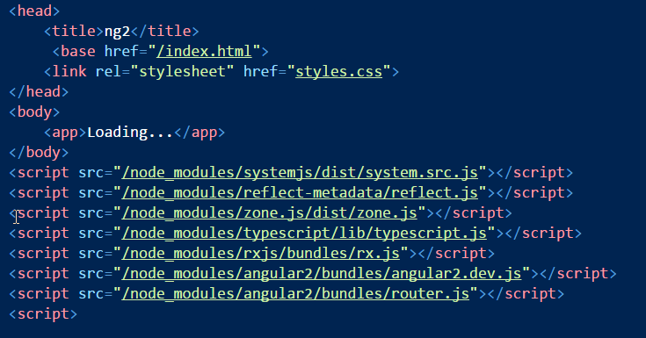
Prepare for Routing
Router features are in angular2/router
Set a base href if using HTML5 routing (no #)

Slide 4
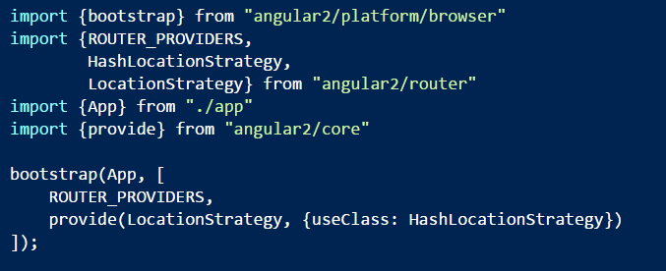
Bootstrap for Routing
Add the router providers
Optionally use the HashLocationStrategy

Slide 5
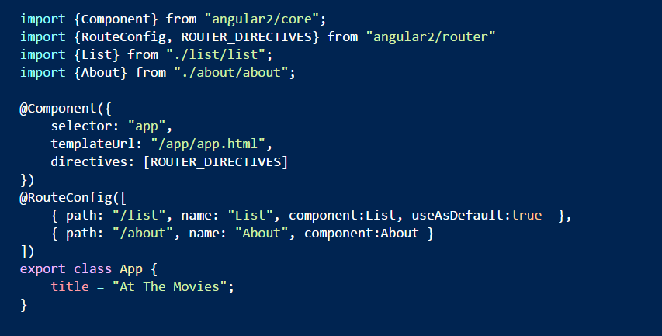
The App Component
Use the @RouteConfig decorator

Slide 6
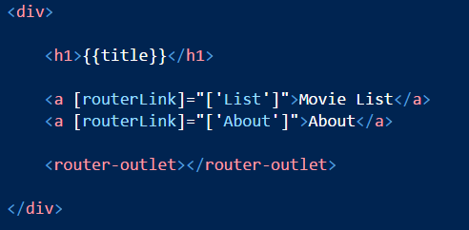
The “Shell Page”
Top level component typically becomes a shell
Use router-outlet directive to plugin routed components
Use routerLink to build anchor tags based on route config

Slide 7
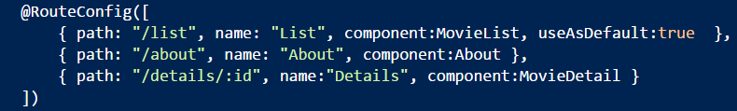
Working with Parameters
:tokens are placeholders
Can use multiple tokens

Slide 8
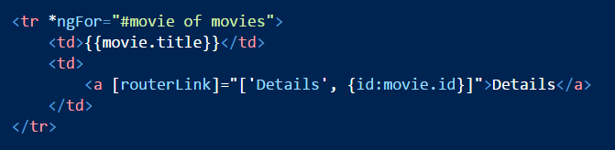
Passing Parameters
Pass an object for parameters in routerLink array

Slide 9

Receive Parameters
Use RouteParams

Slide 10


Programmatically Route
Inject a Router and use navigate

Slide 11
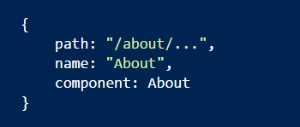
Child Routers
Sub components can also expose a route configuration
Useful for composite UIs (example: tabbed interface)
Expose a non-terminal (…) route on a parent components

Slide 12
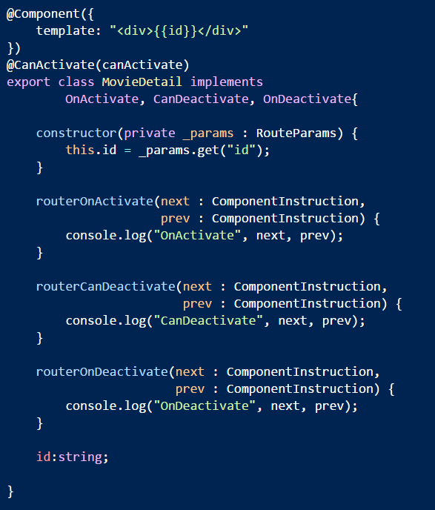
Router Lifecycle Hooks
CanActivate / OnActivate
CanDeactivate / OnDeactivate

Slide 13
Summary
Routing builds big applications from small pieces
App
Orders
Customers
Reports
CustomerEdit
CustomerDetail

