Slide 1
Modern JavaScript
Modules & Prototypes

Slide 2
JavaScript
It’s dynamic
It’s functional
It has some great features
Has a dark side, too ...

Slide 3
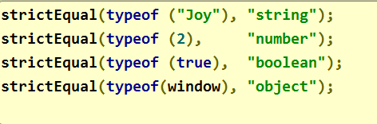
Weakly Typed
Only a few built-in types
Variables can point to anything - anytime

Slide 4

Object Orientation
Objects have state and behavior
No type or class definitions

Slide 5
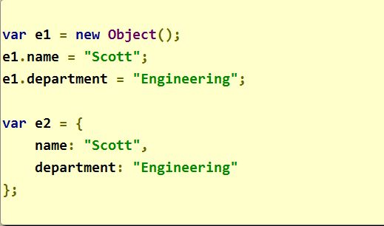
Creating Objects
Use a new operator
Or an object literal

Slide 6
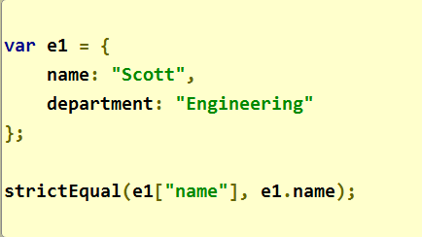
Objects are Hashtables
Use . or []

Slide 7
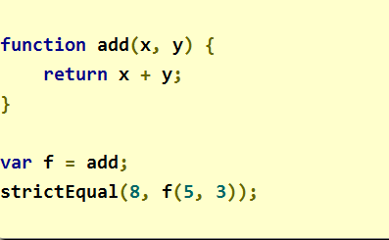
Functions are Objects, Too
Pass them as parameters
Assign them to variables
Return them from other functions

Slide 8
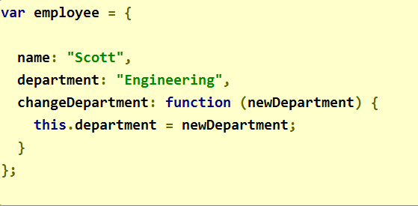
Functions as Methods
Invoke a function via object
this keyword is not optional

Slide 9
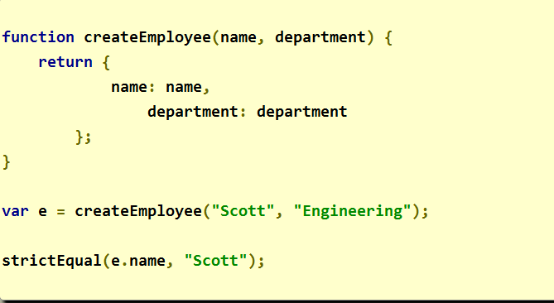
Consistency
How to make consistent objects?

Slide 10
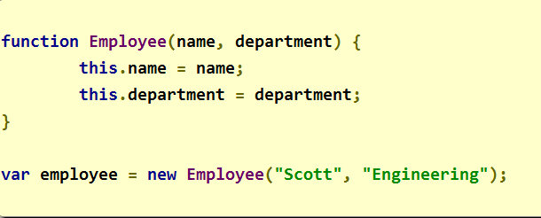
Constructor Functions
Used with the new operator
Capital first letter by convention

Slide 11
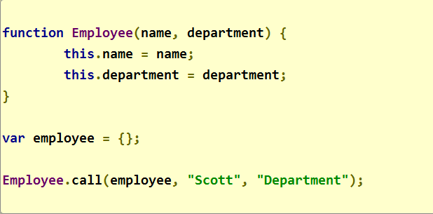
What new Will Do
Create a new, empty object
Invoke constructor passing object as “this”
And assign the prototype

Slide 12
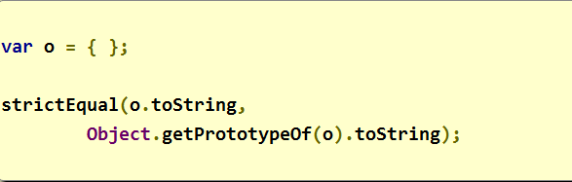
Prototypes and Inheritance
Every object has a prototype
Runtime looks into prototype to resolve members
Called prototypal inheritance

Slide 13
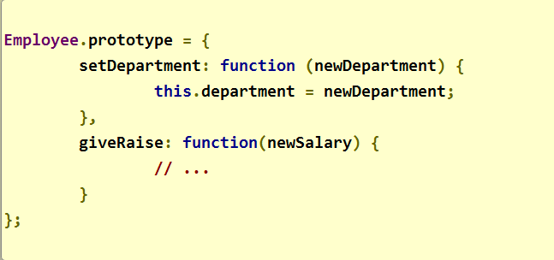
Using Prototypes
Share method definitions among objects

Slide 14
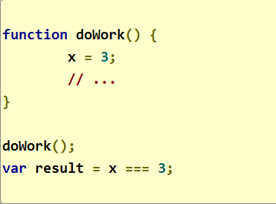
Scope
Function scope
Global scope
No block scope

Slide 15
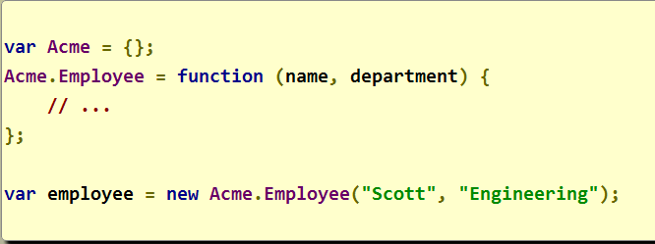
Namespaces
There are none
But, we can fake them …

Slide 16
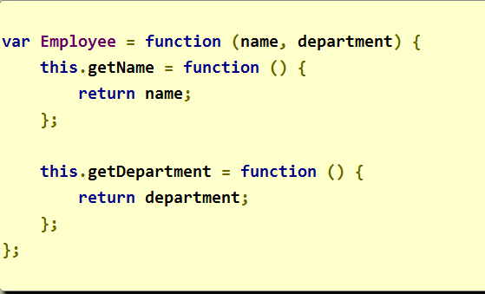
Encapsulation
Fields aren’t protected
Can hide state with closures

Slide 17
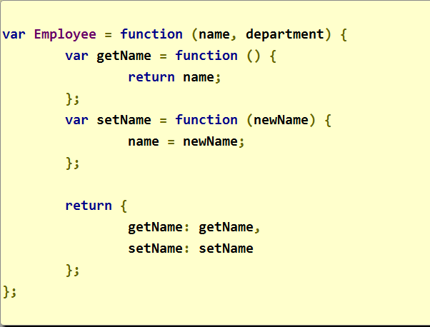
Module Pattern
Closures on a large scale

Slide 18

Strict Mode
Part of ECMAScript 5
Backward compatible

Slide 19
Summary
JavaScript is different
Prototypes and modules are building blocks
Be careful with scope

