Slide 1

ASP.NET 5 First Look
New Projects and Runtimes
K. Scott Allen
@OdeToCode

Slide 2
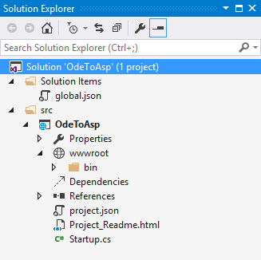
New Project System
File based project system
Dynamic compilation
New default folder structure

Slide 3

Cloud Optimized Core CLR
Fast and lean runtime for the server
CLR wrapped in a NuGet package
Runs outside of Windows

Slide 4

Unification
MVC 6 == ASP.NET MVC + WebAPI
Less overhead, less duplication
No System.Web

Slide 5

Summary

