Slide 1
Introduction To AngularJS
Hello World!

Slide 2

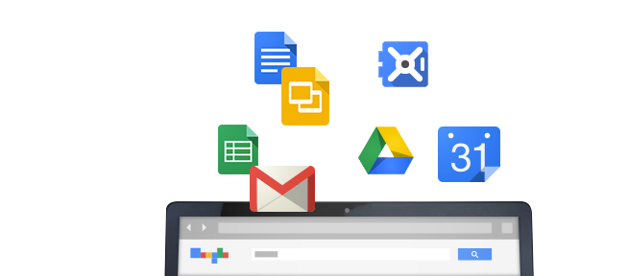
History
Started in 2009 @ Google
Miško Hevery, Adam Abrons, Igor Minár, Vojta Jína
Built from experience with large web applications

Slide 3
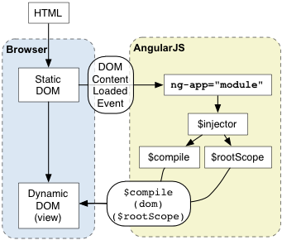
Concepts & Goals
Separation of Concerns
Models and Views
Testability
Dependency Inversion Principle
Extensibility
Loose coupling
Forward Looking
What HTML + JS Will Look Like …

Slide 4
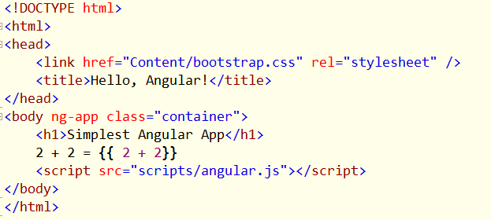
Getting Started
Download Angular.js
AngularJS.org
Tell Angular to manage the DOM

Slide 5


Other Starting Points
Angular Seed Project
https://github.com/angular/angular-seed/
Bower
http://bower.io/
Yeoman
http://yeoman.io/

Slide 6
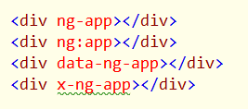
ng Directives
Extend HTML
Angular compiles the DOM
Can build your own directives

Slide 7
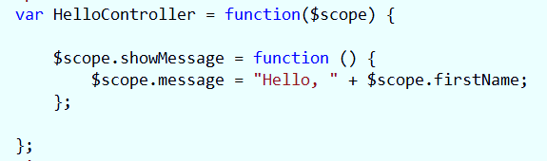
Controllers
Manage the relationship between the model and the view

Slide 8
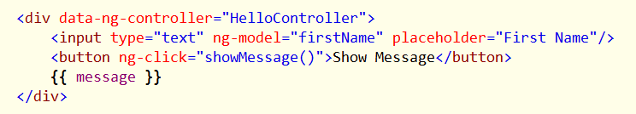
Templates and Views
Responsible for presenting the model
Uses directives
Uses {{ interpolation }}

Slide 9
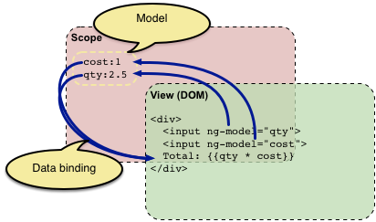
Models
POJOs!
Data and behavior for the application
Assigned to $scope inside a controller

Slide 10
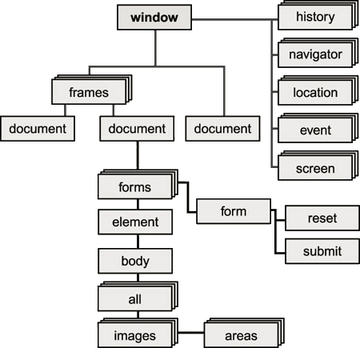
Anatomy
Controllers
Expose the model through $scope
No direct DOM manipulation
Models
Provide data for the view
No direct DOM manipulation

Slide 11

Display Text
Use ngBind directive
Or use double curly characters {{ }}
Use ngCloak to hide templates

Slide 12

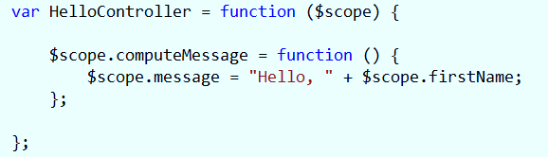
Inputs
Two way data binding with ngModel
Change notifications with ngChange

Slide 13
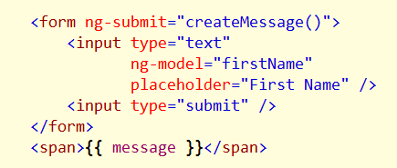
Forms
Capture form submit with ngSubmit

Slide 14
Ng Events versus Unobtrusive JavaScript
Everyone is using JavaScript
Angular behaves the same across browsers
Expressions not evaluated in global scope

Slide 15

Expressions
Can use subset of JavaScript in {{ }}
Don’t allow logic leaks
Math (+ - / *)
Comparisons (== != > < >= <=)
Boolean logic (&& || !)
Function calls
Arrays and object literals

Slide 16
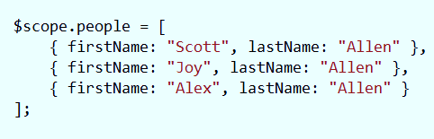
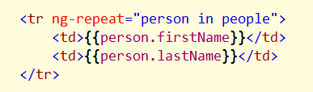
Lists and Tables
Use ngRepeat
Will detect changes to collection

Slide 17

Hiding and Showing
Use ngShow and ngHide
We’ll look at animations later
ngShow, ngHide, ngCloak all toggle a style of display:none

Slide 18

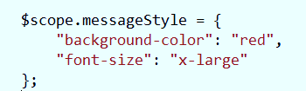
Styles
ngStyle and ngClass
Properties mapped to style and class attributes

Slide 19

Sources and Hrefs
ngSrc and ngHref avoid problems
Browser won’t preload

Slide 20
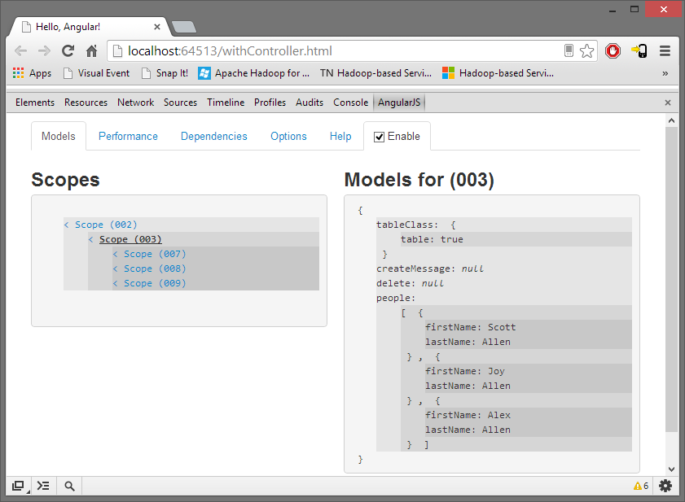
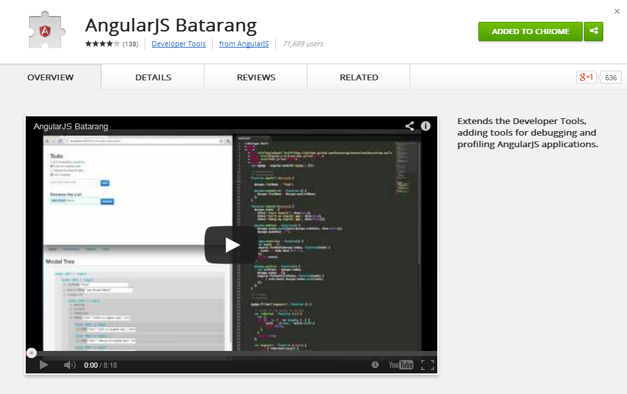
Batarang
Debug Angular applications with Chrome

Slide 21
Summary
AngularJS is an application framework
Model - view - *
Data binding
Extensible, modular, testable
More on modularity coming up next …

