Slide 1

Modules, Services, Controllers
Abstractions For Applications

Slide 2
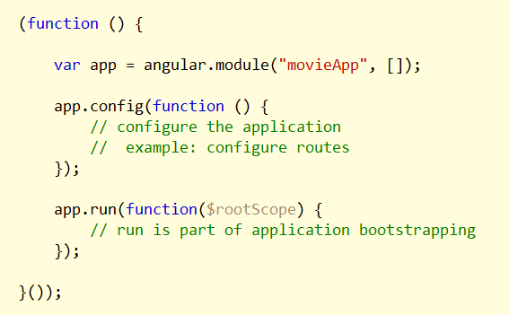
Modules
Separate code by vertical feature or responsibility
Start with an application module
Modules have dependencies
Must describe dependencies to AngularJS

Slide 3
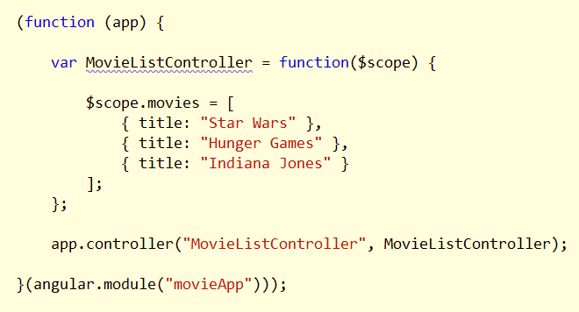
Controllers
One component type you can add to a module

Slide 4
Services

Slide 5
Promises and $q

Slide 6
Web APIs and $http

Slide 7
HTTP Headers

Slide 8
Http Caching

Slide 9
HTTP Transforms

Slide 10
DI and the $injector

Slide 11
Bootstrapping

Slide 12
DI and Minification

Slide 13
Module Run

Slide 14
Module Config

Slide 15
Code Organization

Slide 16
Core Angular API
equals
copy
forEach
extend
is*
version
jqLite

Slide 17
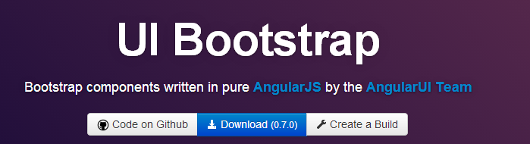
Other Modules
ngMock
ngAnimate
ngCookies
ngRoute
ngResource
uiBootstrap, and more …

Slide 18
Summary
AngularJS is an application framework
Model - view - *
Data binding
Extensible, modular, testable
More on modularity coming up next …

