Slide 1
ASP.NET MVC 6
Working with MVC 6
With
A Focus On What’s New & Different

Slide 2
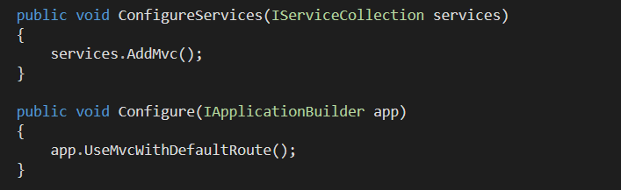
The Setup
Package : Microsoft.AspNet.Mvc
Configure services
Configure middleware

Slide 3
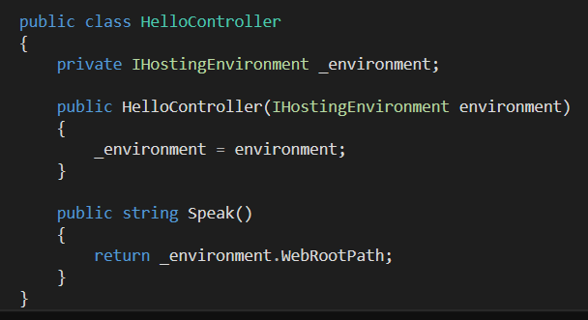
Controller Requirements
Any class with public methods will do
No base class or interface requirements
No return type restrictions

Slide 4
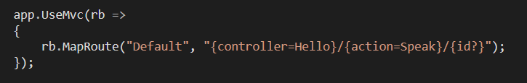
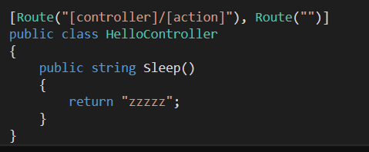
Getting To The Controller
Map routes with template or attributes (or both)

Slide 5
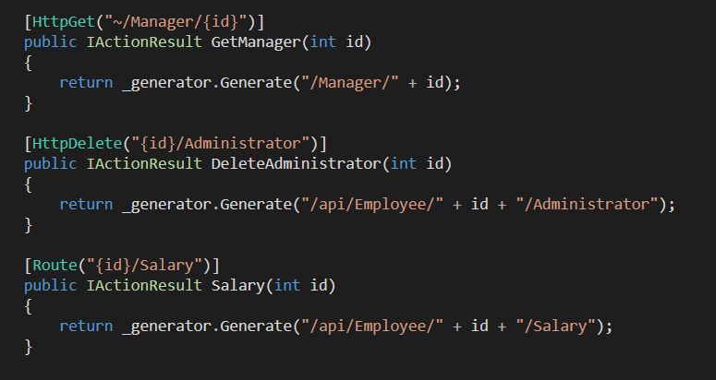
The Routing Merge
Framework considers Route and HttpMethod attributes

Slide 6
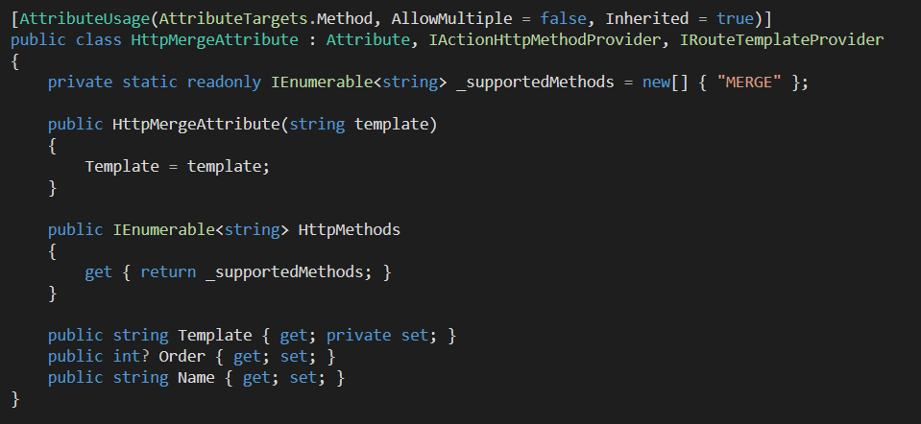
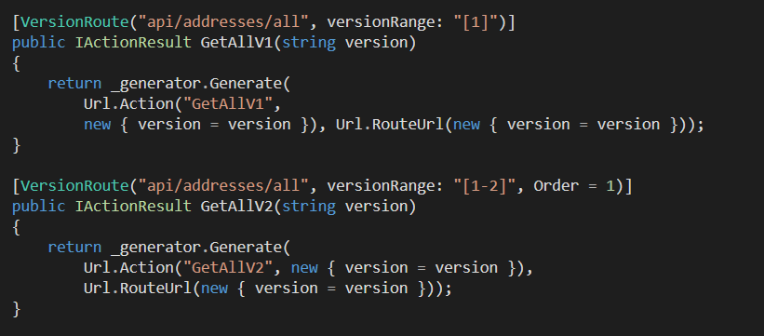
Custom Route Attributes
Key interfaces
IRouteTemplateProvider
IActionHttpMethodProvider
IActionConstraintFactory

Slide 7
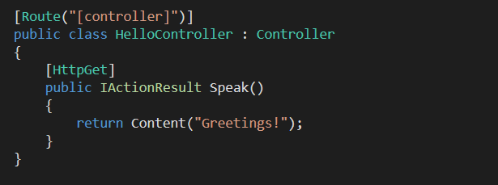
One Controller
No MVC Controller versus ApiController
New: IActionResult
All the usual result helper methods

Slide 8
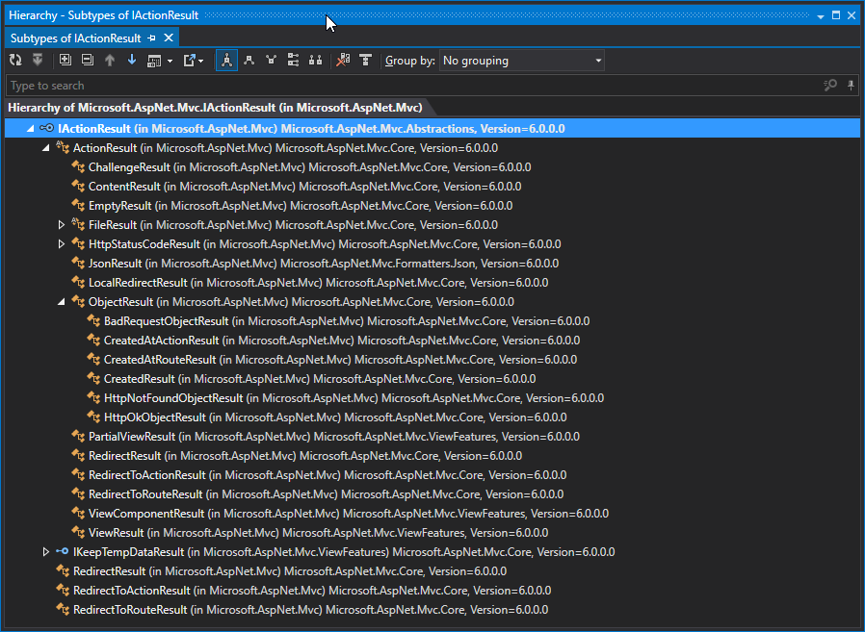
IActionResult

Slide 9
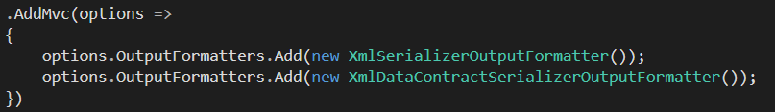
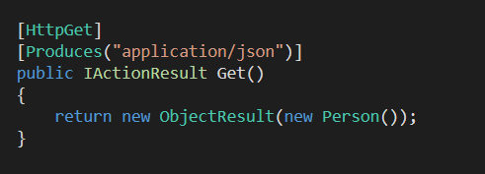
Content Negotiation
ObjectResult negotiates content
No XML installed by default
Can always override negotiation with [Produces]

Slide 10
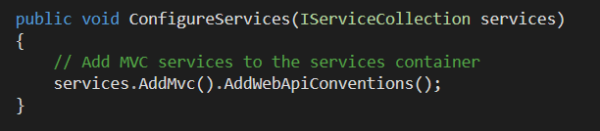
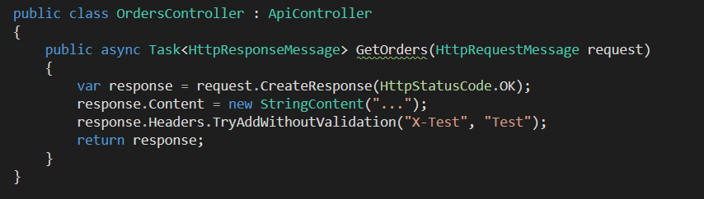
WebAPI Compatibility
Use Microsoft.AspNet.Mvc.WebApiCompatShim

Slide 11
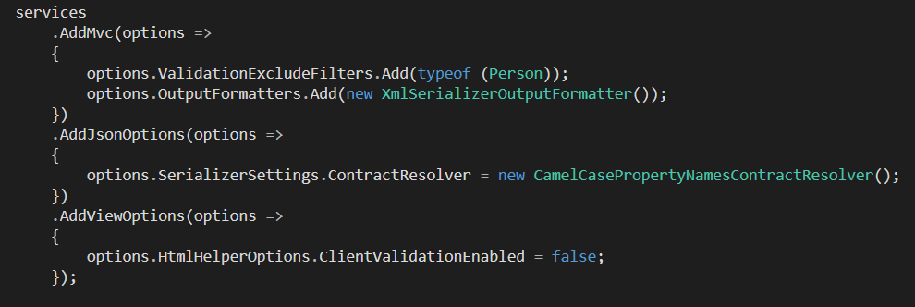
Options
Everything is in code
Razor, filters, validators, serializers

Slide 12
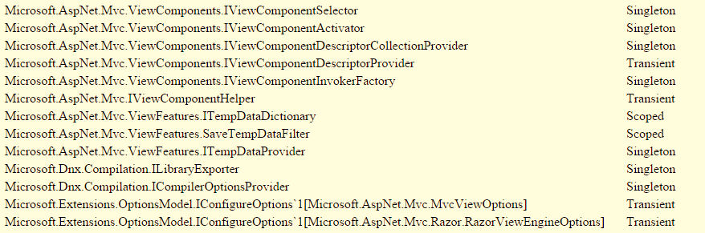
Dependency Injection
Nothing is real, everything is injected

Slide 14
Topics
Tag helpers
View components
_viewimports
@inject
Model binding and model binding attributes
Caching
Sessions and response features
CORS
Compilation & precompilation
Auth

